Slide 1


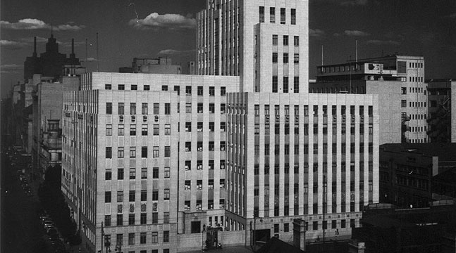

MOSH NOISE Team - CSIR Interaction
Noise Team
CHAMBER OF MINES OF SOUTH AFRICA
Working together for a sustainable future since 1889

Slide 2

Table of Contents
Introduction to MOSH
MOSH Noise Team initiatives
  Industry Workshop
  Expert Model
  Buy Quiet Initiatives
CSIR - Involvement
Leading the change to zero harm

Slide 3
How the System works
It emphasises the behavioural aspects that should accompany adoption for sustainability
It is a process that identifies OHS leading practices throughout industry (pockets of excellence) and facilitates their industry wide adoption
It has adoption teams focusing on falls of ground, transport and machinery, dust and noise respectively
It is done by people within industry with the assistance and guidance by the MOSH learning Hub (a department of the Chamber )
Leading the change to zero harm

Slide 4
The MOSH Adoption Process
MOSH Leading Practice Adoption System - identifies Leading Practices in health and safety and then helps with their widespread adoption across industry
Identification Phase – Identifying leading practices with greatest potential to address major risks
Documentation Phase – Documenting the leading practice at the source mine where it already applied
Demonstration Phase – Demonstrating the leading practice at another operating mine
Facilitation Phase – Facilitating the widespread adoption of the practice
Leading the change to zero harm

Slide 5
Key Industry Players
Sponsors
    Typically CEO level person for each team who sits on Chamber Council
    Provide strategic guidance as required
MOSH Task Force members
    Preferably the most senior OHS office bearer of each Chamber member
    Provide strategic oversight of MOSH processes; communication link between Hub and own executives
Adoption coordinators
    One per Chamber member, preferably reporting to the MOSH Task Force Member
    Facilitate contact between the Learning Hub and member companies
Adoption Team Members
    Senior technical and Occupational Hygienists experts in their field
People at the operations
    The adopters: Manages, supervisors, team members
Leading the change to zero harm

Slide 6
MOSH Task Force
Member
Member
Member
Member
Member
Member
Adoption coordinator
National/Regional
Industry MOSH Adoption Team Members
Mine Adoption Team Manager
Mine Adoption Team Manager
Mine Adoption Team Manager
Operational
Adopters: Supervisors and team members
Leading the change to zero harm

Slide 7
Table of Contents
Introduction to MOSH
MOSH Noise Team initiatives
  Industry Workshop
  Expert Model
  Buy Quiet Initiatives
CSIR - Involvement
Leading the change to zero harm

Slide 8
Achievements in Combating NIHL
Very good progress in combating NIHL
  Over 50 % improvement in NIHL claims early 2000s to 2011
  Positive Response from the State
  Compensation for Occupational Injuries and Diseases Act 130/1993 (COID Act)
  Instruction - 168, 171 - Simplification & fairness the compensation mechanism
  Positive Response from the Industry
  1988 - Establishment of HCP User Guide No. 11
    Voluntary
Leading the change to zero harm

Slide 9
Achievements in Combating NIHL
  Positive Response from the Industry (cont.)
  Mining Occupational Health Advisory Committee (MOHAC) - Tripartite advisory body
  Adopted the 2003 Industry milestones
    Implemented the DMR/DME ‘s HCP Guidelines
  Establishing the MOSH Noise Team etc
  Mining Charter reporting
  “Acknowledging’ that Noise is the biggest occupational health risk in the mining industry
  Overwhelming Literature and Research
  Data : Scarce , unreliable not standardized (different criteria for different countries etc)
  General absence of a ‘ helicopter view’
Leading the change to zero harm

Slide 10
The Problem
Nature of the Hazard
  Prolonged exposure to high levels of noise can result in permanent & irreversible damage to hearing
Elimination
– Substitution -
-Isolation-
Engineering Controls
– Silencers-
- Noise filters-
Administrative Controls
– Removal of persons from the hazard –
- Reducing exposure times –
Personal Protective Equipment
– PPE - Last resort
Leading the change to zero harm

Slide 11
Table of Contents
Introduction to MOSH
MOSH Noise Team initiatives
  Industry Workshop
  Expert Model
  Buy Quiet Initiatives
CSIR - Involvement
Leading the change to zero harm

Slide 12
MOSH Noise Team Initiatives
1st Leading Practice - Noise Elimination (2008)
  Electric Drilling Machine
    World-wide accepted approach
    Not successful
      Various reasons
      Summary - Right answer in a wrong paradigm – Galileo
    Is concept worth revisiting? YES
2nd Leading Practice - PPE and Administrative Control (2010 -2011)
  Hearing Protection Device , Training ,Awareness and Selection Tool (HPD _ TAS)
    Only segments of the Leading Practice implemented
    Is it worth revisiting? - YES
    Prof. Cas Badenhorst ‘s MMPA presentation – “It is wrong to protect with PPE and then use medical surveillance to measure our success or failure . Occupational medicine and hygiene as disciplines are not the “silver bullet”
Leading the change to zero harm

Slide 13
MOSH Noise Team Initiatives (cont.)
Engineering Controls
  Suite of Leading Practices
    Need based approach
    Collaboration with suppliers
    Should they be the primary focus?
HCP | Leading Practice
Elimination ,Isolation etc | 1st Leading Practice - (Electric Drilling machines)
Engineering Controls | Ongoing - (Suite of Simple Leading Practices)
Administrative Controls | 2nd Leading Practice - (HPD_TAS Tool)
Personal Protective Equip. (PPE)
Leading the change to zero harm

Slide 14
The Direction of the Solution
Source: None but can be inferred
Mosh Noise Team ‘s First Leading Practice
Duty of Care & ALARP Zone
HCP | Current
Elimination ,Isolation etc | ????%
Engineering Controls | ????%
Administrative Controls | ????%
Personal Protective Equip. (PPE) | MOST emphasis is still here – Maybe 70% of effort
Leading the change to zero harm

Slide 15
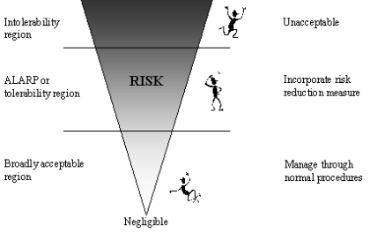
The Direction of the Solution - ALARP
Leading the change to zero harm

Slide 16
Shared Vision
Source: None but can be inferred
Duty of Care & ALARP Zone
HCP | Current | Future
Elimination ,Isolation etc | 10%? | 60%
Engineering Controls | 10%? | 20 %
Administrative Controls | 10%? | 10%
Personal Protective Equip. (PPE) | 70%? | 10%
Leading the change to zero harm

Slide 17
The Direction of the Solution
Consensus with the Industry on the need for paradigm shift
  Consensus on future management of the Noise Problem i.e. need a Paradigm shift (Strategy, ALARP , buy Quiet Policy etc)
    Aligning HCPs and Noise Improvement programs to the suggested approach
    Challenges of an employee profile of a Developed Country viz Developing Country – Understanding of quality of life
    Effectiveness: Is there a NEED for MOSH Noise Team to function like other MOSH Teams
    Implications?
    Leading Practice Approach?
Leading the change to zero harm

Slide 18
Conclusion
Noise challenge is at a different phase (importance, maturity, tipping point, development, etc) than other MOSH teams and other OH challenges (e.g. MMPA conference)
  Need for a different approach
  Maybe leading practices need conducive paradigm
Focus on Source Elimination - revisit the source elimination concepts such as electric, hydraulic drills etc
  In-depth review of source elimination concepts – long term view
  Not as a leading practice but part of Mining System
    Longer timelines (>10 yrs)
    Report on the new mines, expansion projects etc that are now designed/ compatible for electric, hydraulic drills etc
    Not as compliance to the Mining Charter
  Standardized Buy quiet policies etc
  Reach a consensus on NHIL targets for next two & five years
Leading the change to zero harm

Slide 19
Conclusion (cont.)
Continue with Engineering controls but not as a primary focus for the MOSH Noise Team
  Guide the Team on how to effectively manage and promote these Simple Leading Practices
  More of an Engineering challenge than a people challenge
‘Closure’ strategy on the HPD _TAS Tool Leading Practice - (remember the Hilti)
  Do we still have a challenge of employees not wearing HPDs?
  Do we need a customised MOSH Process for this?
Leading the change to zero harm

Slide 20
Industry Workshop Program
CHAMBER OF MINES OF SOUTH AFRICA
Working together for a sustainable future since 1889

Slide 21
Noise Team Expert Model
CHAMBER OF MINES OF SOUTH AFRICA
Working together for a sustainable future since 1889

Slide 22
Buy Quiet Initiative
CHAMBER OF MINES OF SOUTH AFRICA
Working together for a sustainable future since 1889

Slide 23
CSIR Involvement
CHAMBER OF MINES OF SOUTH AFRICA
Working together for a sustainable future since 1889

Slide 24
Questions
Questions
Leading the change to zero harm

