Slide 1


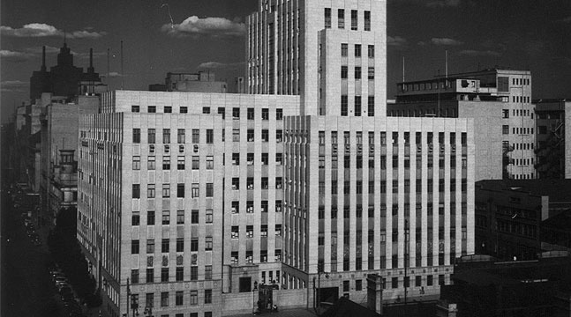

NOISE Team Alignment
Noise Team
CHAMBER OF MINES OF SOUTH AFRICA
Working together for a sustainable future since 1889

Slide 2

Table of Contents
Introduction
The Problem
MOSH Noise Team initiatives
Conclusion
Leading the change to zero harm

Slide 3
Achievements
Very good progress in combating NIHL
  Over 50 % improvement in NIHL claims early 2000s to 2011
  Positive Response from the State
  Compensation for Occupational Injuries and Diseases Act 130/1993 (COID Act)
  Instruction - 168, 171 - Simplification & fairness the compensation mechanism
  Positive Response from the Industry
  1988 - Establishment of HCP User Guide No. 11
    Voluntary
Leading the change to zero harm

Slide 4
Achievements
  Positive Response from the Industry (cont.)
  Mining Occupational Health Advisory Committee (MOHAC) - Tripartite advisory body
  Adopted the 2003 Industry milestones
    Implemented the DMR/DME ‘s HCP Guidelines
  Establishing the MOSH Noise Team etc
  “Acknowledging’ that Noise is the biggest occupational health risk in the mining industry
  Overwhelming Literature and Research
Leading the change to zero harm

Slide 5
Context
…do we have OH challenge? YES
…do we have a Noise problem relative to other OHS challenges?
Is the Noise Team effectively contributing towards Zero Harm? NO
Do we have a successfully Adopted Noise Leading Practice? Not REALLY
Use of Trends viz Numbers to inform direction
Money used as a common base for comparison
Leading the change to zero harm

Slide 6
Table of Contents
Introduction
The Problem
MOSH Noise Team initiatives
Conclusion
Leading the change to zero harm

Slide 7
The Problem
Nature of the Hazard
  Prolonged exposure to high levels of noise can result in permanent & irreversible damage to hearing
Elimination
– Substitution -
-Isolation-
Engineering Controls
– Silencers-
- Noise filters-
Administrative Controls
– Removal of persons from the hazard –
- Reducing exposure times –
Personal Protective Equipment
– PPE - Last resort
Leading the change to zero harm

Slide 8
The Problem
Global profile of NIHL
  NIHL has been recognized by World Health Organisation (WHO)
    Program for Prevention of Deafness and Hearing Impairment (PDH)
  NIHL prevalence of 120 Million
    Member states to setup National Programs on Noise
  WHO-PDH rates NIHL as the most prevalent irreversible industrial disease and most compensable occupational disease
Leading the change to zero harm

Slide 9
The Problem
State Intervention
  Compensation for Occupational Injuries and Diseases Act 130/1993 (COID Act)
    Instruction - 168, 171
    Simplification & fairness the compensation mechanism
    Punishes employers who allow the hearing ability of employees to deteriorate due to noise exposure at work places – Part of the National Program
    Baseline Audiogram test
  DMR’s Hearing Conservation Guidelines
    Hearing Conservation Programs in Mines
    Medical surveillance Programs
Leading the change to zero harm

Slide 10
The Problem
Industry Response
  1988 - Concern through the establishment of HCP User Guide No. 11
    Voluntary
  Mining Occupational Health Advisory Committee (MOHAC) - Tripartite advisory body
    Adopted the 2003 Industry milestones
    Implemented the DMR/DME ‘s HCP Guidelines
      Elimination,
      Engineering Noise Control
      Administrative Control measures
      Personal Protection
      Medical surveillance
Leading the change to zero harm

Slide 11
The Problem
Industry Response (cont.)
    HPD to be used as an interim protective measure while permanent engineering solutions are being investigated and developed – world wide applicable standard
      DMR approach
      World wide applicable standard/approach
Leading the change to zero harm

Slide 12
The Problem
Prevalence of NIHL are derived primarily from compensation data
  Only once workers are compensable (10% PLH shift from the baseline assessment) are they documented as having NIHL
  Any degree of hearing loss that is not compensable is not reported in public data
  70% of South African miners are exposed to noise levels exceeding the legislated Occupational Exposure Level (OEL) of 85 dBA
Leading the change to zero harm

Slide 13
The Problem
Source: Rand Mutual Assurance
Impact of the Hazard
  NIHL has cost the Industry R890 M – 1997 to 2007
    R370 M – 2005 to 2009
  Single biggest occupational disease in workforce
  Total NIHL claims in 2011 – R 44M
    Direct Cost – R37M
    Subsequent cost – R5M
    Days off - R 175K
  Very good progress
  Overwhelming Literature
    Data : Scarce , unreliable not standardized (different criteria for different countries etc)
    General absence of a ‘ helicopter view’
Leading the change to zero harm

Slide 14
The Problem
Source: Rand Mutual Assurance
Leading the change to zero harm

Slide 15
The Problem Relative to OHS Challenges
NB: Numbers are used to inform direction (frequencies viz. sound)
  Safety Challenges
    123 lost lives
    Estimated total cost to the Industry = R 1.5 Bn (R 12M x 123)
  OHS Challenges
    Estimated total cost to the Industry =approx. 5 X 1.5Bn = R7.5bn
    Total NIHL claims = R 44M
  The Noise Problem viz Safety Challenges
    Noise induced hearing loss was recognised as a major problem in the mining industry in 1994 by the Leo Commission
    Safety Problem : Noise Problem = 33: 1
    OH Problems : Noise Problem = 170: 1
    Approx. 2 Orders of Magnitude
Source: Mining Weekly (3/11/2010) and Dr Frankel – Falling Ground
Source: Mine Health & Safety Council – 2012 MMPA Presentation
Leading the change to zero harm

Slide 16
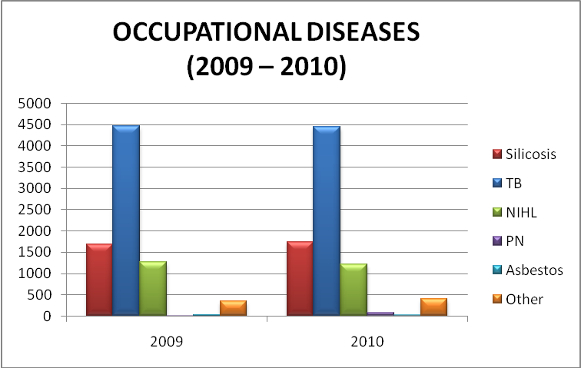
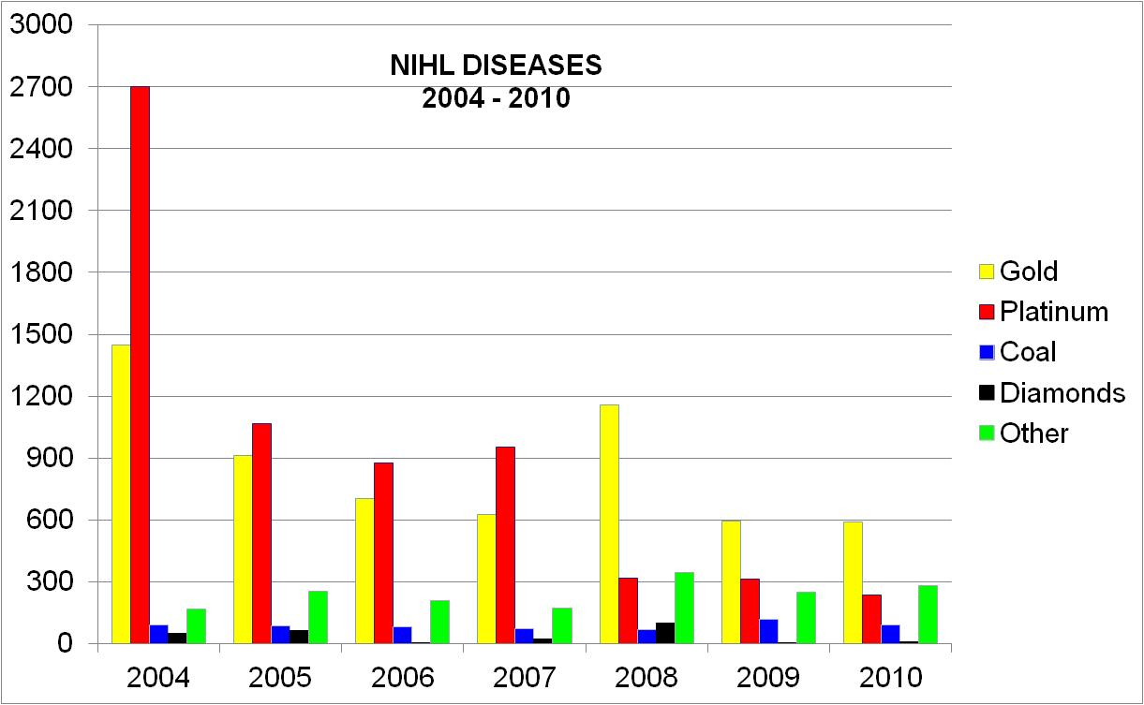
Health - Occupational Diseases
Source: Mine Health & Safety Council – 2012 MMPA Presentation
Same areas in the last few years
SILICOSIS
TB
NIHL
Leading the change to zero harm

Slide 17
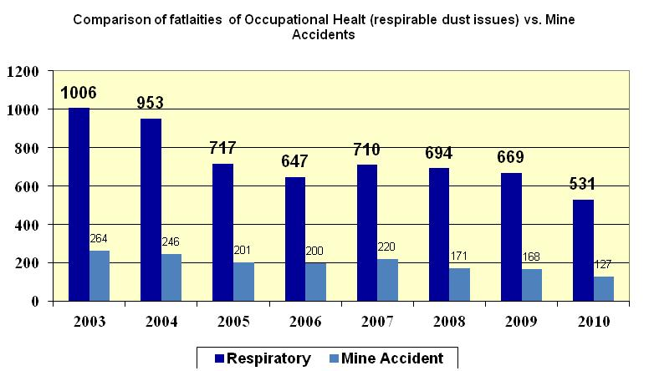
Safety vs. Health
Prior to 2003 milestones, focus was on safety
Respirable related deaths approx 80%
Source: Mine Health & Safety Council – 2012 MMPA Presentation
Leading the change to zero harm

Slide 18
CLINICAL CAUSES OF DEATH
2003 - 2010
Source: Mine Health & Safety Inspectorate – 2012 Presentation

Slide 19
Most prevalent diagnosis amongst the overall workforce
Source: Tia- Mari Hoffman (RFA – AGA & ANGLO Platinum) – MMPA 2012 Presentation
(Group representation expressed as a percentage of the total number of clients with pathology, not of the gross overall number of clients)
Leading the change to zero harm

Slide 20
Implications
Do we have a Noise Problem?? YES
  Zero Harm Commitment
Do we have a Nose Problem RELATIVE to other OHS Challenges (Dust, TB, Fatigue and Safety)?
  Dust : US 100 Bn potential from the Mankaye case
  Safety : ‘good progress’ but 70% off international standards
  Noise = ??
  Should the Noise Problem compete for space and time with other OHS challenges (Dust, TB and Safety)??
  Should we have the have the same approach ??
  Is there a need for a Paradigm shift in our approach? YES;
    Hearing Conservation Programs in Mines: where do currently focus? & where should we focus?
Leading the change to zero harm

Slide 21
Table of Contents
Introduction
The Problem
MOSH Noise Team initiatives
Conclusion
Leading the change to zero harm

Slide 22
MOSH Noise Team Initiatives
1st Leading Practice - Noise Elimination (2008)
  Electric Drilling Machine
    World-wide accepted approach
    Not successful
      Various reasons
      Summary - Right answer in a wrong paradigm – Galileo
    Is concept worth revisiting? YES
2nd Leading Practice - PPE and Administrative Control (2010 -2011)
  Hearing Protection Device , Training ,Awareness and Selection Tool (HPD _ TAS)
    Only segments of the Leading Practice implemented
    Is it worth revisiting? - YES
    Prof. Cas Badenhorst ‘s MMPA presentation – “It is wrong to protect with PPE and then use medical surveillance to measure our success or failure . Occupational medicine and hygiene as disciplines are not the “silver bullet”
Leading the change to zero harm

Slide 23
MOSH Noise Team Initiatives (cont.)
Engineering Controls
  Suite of Leading Practices
    Need based approach
    Collaboration with suppliers
    Should they be the primary focus?
HCP | Leading Practice
Elimination ,Isolation etc | 1st Leading Practice - (Electric Drilling machines)
Engineering Controls | Ongoing - (Suite of Simple Leading Practices)
Administrative Controls | 2nd Leading Practice - (HPD_TAS Tool)
Personal Protective Equip. (PPE)
Leading the change to zero harm

Slide 24
Table of Contents
Introduction
The Problem
MOSH Noise Team initiatives
Conclusion
Leading the change to zero harm

Slide 25
The Direction of the Solution
Source: (Franz, et al., 1997; Dekker et al.,2007).
Comparison of reported average noise exposure in gold mines
Occupation (Gold Mines) | 1997 | 2007 | % Improvement
Driller | 111.4 | 105.5 | 200%
Winch Operator | 98.3 | 92.1 | 200%
Loco Driver | 95 | 95.3
Shiftboss | 104.9 | 89.7 | 500%
Miner | 103.2 | 90.4 | 400%
Stoper | 102.3 | 91.2 | 400%
Team Leader | 104.9 | 93.2 | 400%
Leading the change to zero harm
Notes:
Driller = 200% improvement
Winch Operator = 200% improvement
Shiftboss = 500% improvement
Miner = 400% improvement
Stoper = 400% improvement
Team Leader = 400% improvement

Slide 26
The Direction of the Solution
Source: None but can be inferred
Mosh Noise Team ‘s First Leading Practice
Duty of Care & ALARP Zone
HCP | Current
Elimination ,Isolation etc | ????%
Engineering Controls | ????%
Administrative Controls | ????%
Personal Protective Equip. (PPE) | MOST emphasis is still here – Maybe 70% of effort
Leading the change to zero harm

Slide 27
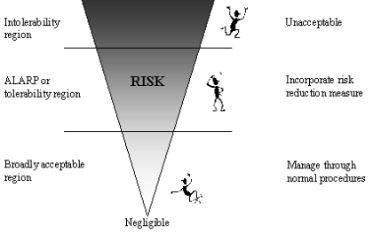
The Direction of the Solution - ALARP
Leading the change to zero harm

Slide 28
Shared Vision
Source: None but can be inferred
Duty of Care & ALARP Zone
HCP | Current | Future
Elimination ,Isolation etc | 10%? | 60%
Engineering Controls | 10%? | 20 %
Administrative Controls | 10%? | 10%
Personal Protective Equip. (PPE) | 70%? | 10%
Leading the change to zero harm

Slide 29
The Direction of the Solution
Consensus with the Industry on the need for paradigm shift
  Consensus on future management of the Noise Problem i.e. need a Paradigm shift (Strategy, ALARP , buy Quiet Policy etc)
    Aligning HCPs and Noise Improvement programs to the suggested approach
    Challenges of an employee profile of a Developed Country viz Developing Country – Understanding of quality of life
    Effectiveness: Is there a NEED for MOSH Noise Team to function like other MOSH Teams
    Implications?
    Leading Practice Approach?
Leading the change to zero harm

Slide 30
Conclusion
Noise challenge is at a different phase (importance, maturity, tipping point, development, etc) than other MOSH teams and other OH challenges (e.g. MMPA conference)
  Need for a different approach
  Maybe leading practices need conducive paradigm
Focus on Source Elimination - revisit the source elimination concepts such as electric, hydraulic drills etc
  In-depth review of source elimination concepts – long term view
  Not as a leading practice but part of Mining System
    Longer timelines (>10 yrs)
    Report on the new mines, expansion projects etc that are now designed/ compatible for electric, hydraulic drills etc
    Not as compliance to the Mining Charter
  Standardized Buy quiet policies etc
  Reach a consensus on NHIL targets for next two & five years
Leading the change to zero harm

Slide 31
Conclusion (cont.)
Continue with Engineering controls but not as a primary focus for the MOSH Noise Team
  Guide the Team on how to effectively manage and promote these Simple Leading Practices
  More of an Engineering challenge than a people challenge
‘Closure’ strategy on the HPD _TAS Tool Leading Practice - (remember the Hilti)
  Do we still have a challenge of employees not wearing HPDs?
  Do we need a customised MOSH Process for this?
Leadership and guidance from the MOSH Taskforce
Leading the change to zero harm

Slide 32
Questions
Questions
Leading the change to zero harm

Slide 33
End
THANK YOU

