Slide 1

Mine Health and Safety Council
Presentation to MMPA
Annual Conference
18 May 2012
Valley Lodge – Magaliesburg
Navin Singh

Slide 2
Contents
  MHSC Mandate
  The Road to Zero Harm
  MHSC Overview
  MHSC Objectives
  MHSC Initiatives
  Attaining ZERO HARM
  Conclusions

Slide 3
Health and Safety Yardstick
Occupational Safety – Fatalities and Injuries – Milestones
Industry Target: Zero rate of fatalities and injuries | In the Gold Sector: By 2013, achieve safety performance levels equivalent to at least current international benchmarks for underground metalliferous mines
 | In the Platinum, Coal and Other Sectors: By 2013, achieve constant and continuous improvement equivalent to at least current international benchmarks
Occupational Health – Milestones
Industry Target: Elimination of Silicosis | By December 2008, 95% of all exposure measurement results will be below the occupational exposure limit for respirable crystalline silica of 0.1mg/m3 (these results are individual readings and not average results)
 | After December 2013, using present diagnostic techniques, no new cases of silicosis will occur amongst previously unexposed individuals (Previously unexposed individuals = individuals unexposed prior to 2008, i.e. equivalent to a new person entering the industry in 2008)
Industry target: Elimination of Noise Induced Hearing Loss (NIHL) | After December 2008, the hearing conservation programme implemented by the industry must ensure that there is no deterioration in hearing greater that 10% amongst occupationally exposed individuals
 | By December 2013, the total noise emitted by all equipment installed in any workplace must not exceed a sound pressure level of 110dB(A) at any location in that workplace (includes individual pieces of equipment)

Slide 4
Health and Safety Yardstick
Occupational Safety – Fatalities and Injuries – Milestones
Industry Target: Zero rate of fatalities and injuries | Benchmark less than 1 fatality per 33 million hours worked by 2013
Occupational Health – Milestones
Industry Target: Elimination of Silicosis | No new cases of silicosis for new employees from 2008
Industry target: Elimination of Noise Induced Hearing Loss (NIHL) | Deterioration < 10% Noise from any & all equipment < 110 dB(A)

Slide 5
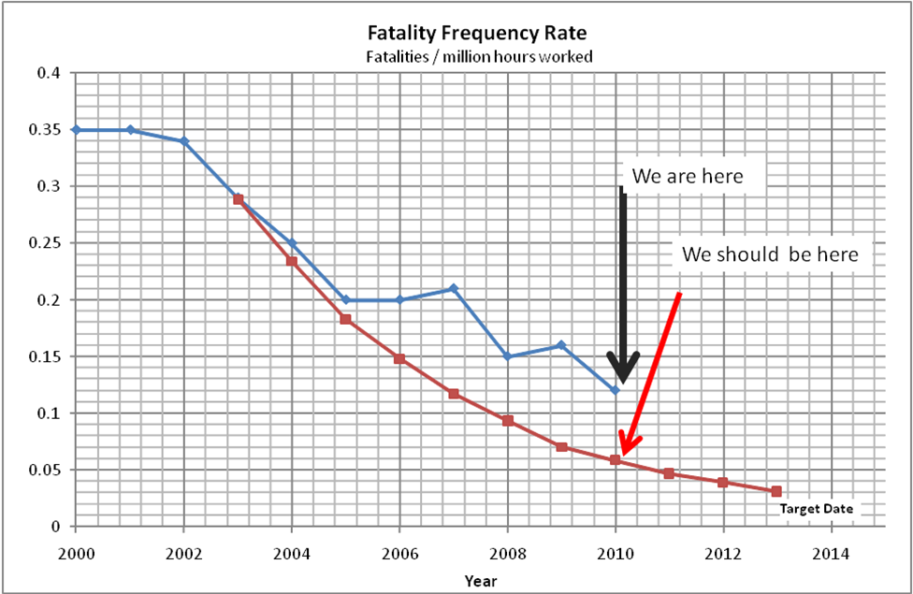
Our track record - Safety
Notes:
5

Slide 6
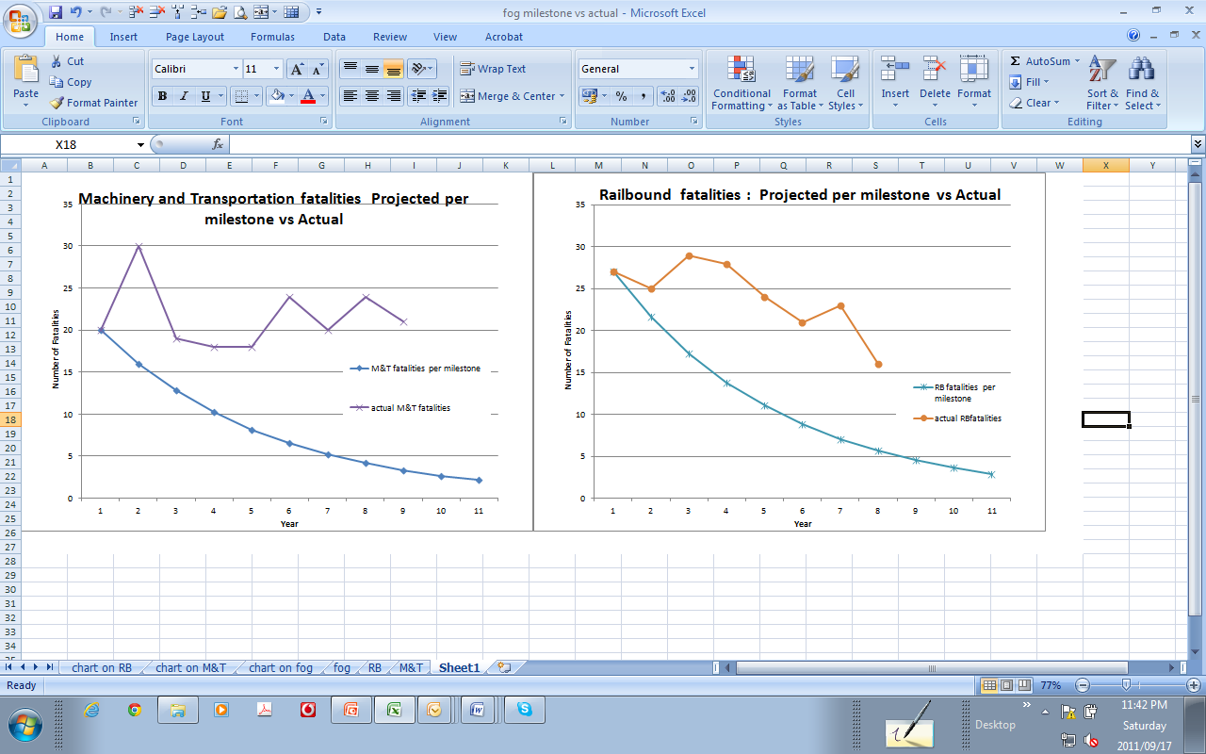
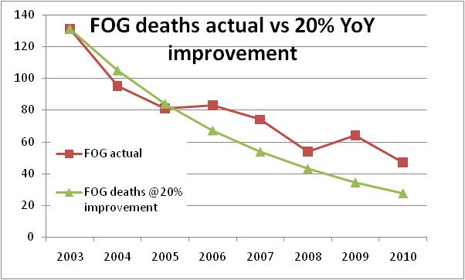
Our track record - Safety
THE
CHALLENGE
REMAINS
Notes:
6

Slide 7
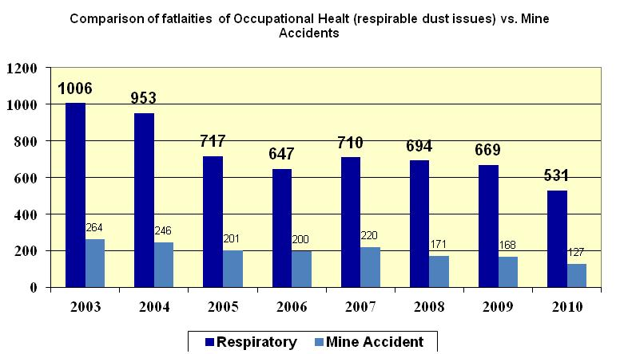
Safety vs. Health
Prior to 2003 milestones, focus was on safety
Respirable related deaths approx 80%

Slide 8
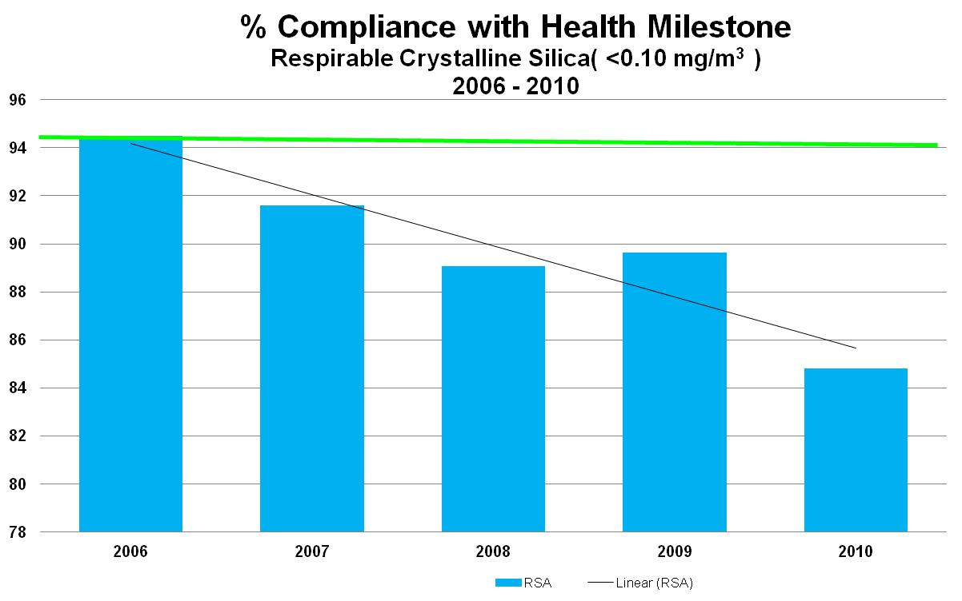
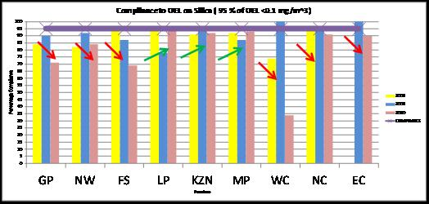
Health – Silicosis
Silicosis
OEL of 0.1 mg.m⁻³
Country as a whole has steadily regressed.
Only 3/9 provinces showing upward trend
GP, NW, FS combined have largest workforce – 70%, 85% 70% compliance only
Notes:
8

Slide 9
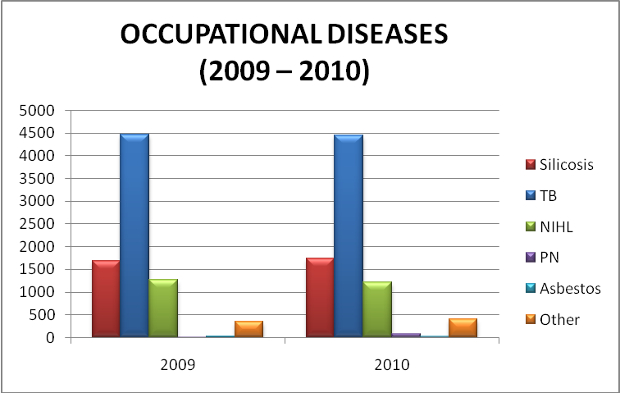
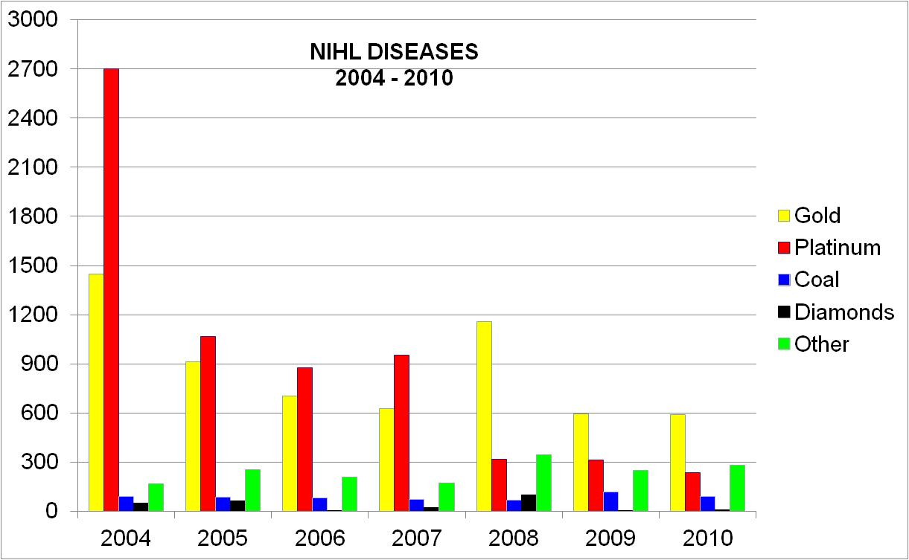
Health - Occupational Diseases
Same areas in the last few years
SILICOSIS
TB
NIHL
Notes:
9

Slide 10
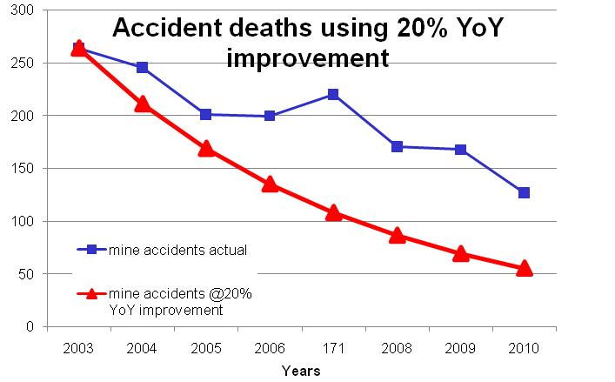
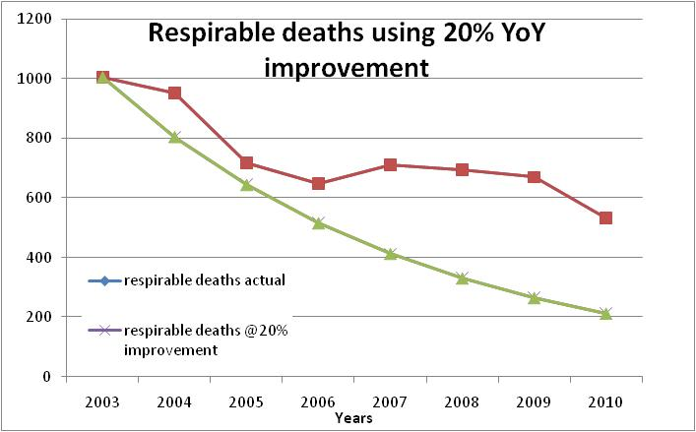
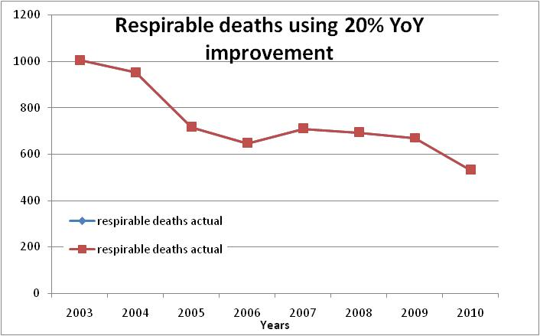
Our track record - Safety
Prior to 2003 milestones, focus was on safety
Respirable related deaths approx 80%
Notes:
10

Slide 11
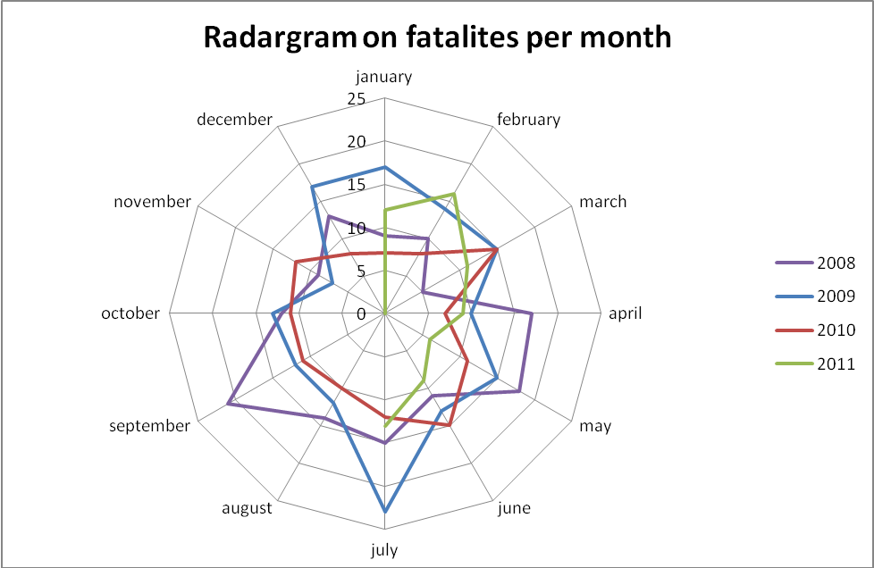
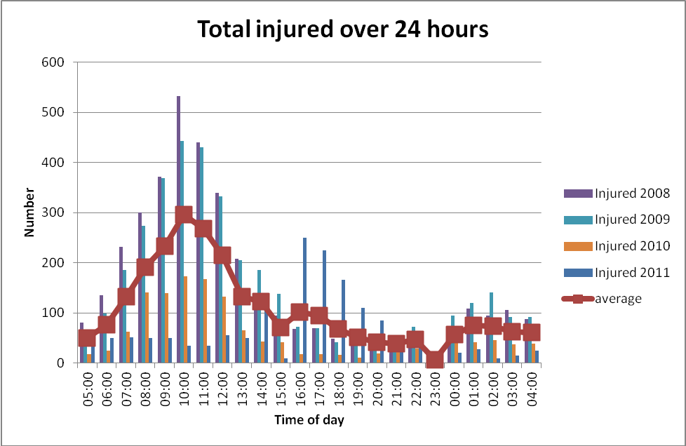
Fatigue – A factor?
It was first postulated that accidents occur on either side of shut-down periods.
Close inspection shows accidents peak around 10H00

Slide 12
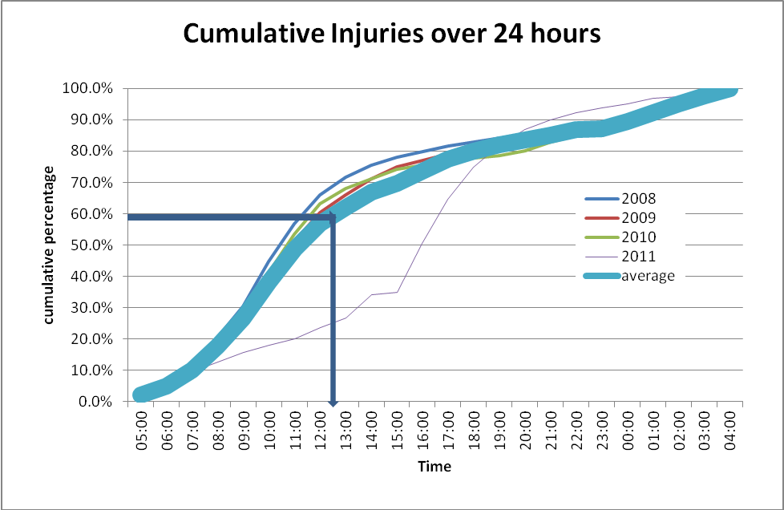
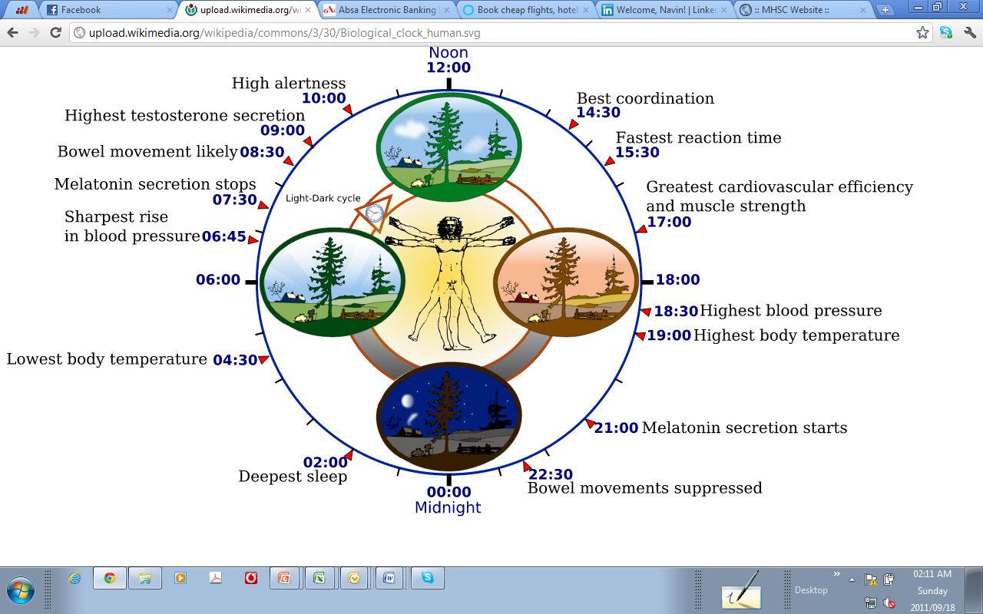
If one assumes that a shift starts at 05H00 in the morning and would end at 13H00
approximately 26% of accidents occur within the first three hours of the start shift
Approximately 60% of accidents occur within by 12H30.
Shifts may be 8 hours but what is the true start times and end times?
Influenced by nutrition, fluid intake, health and medication

Slide 13

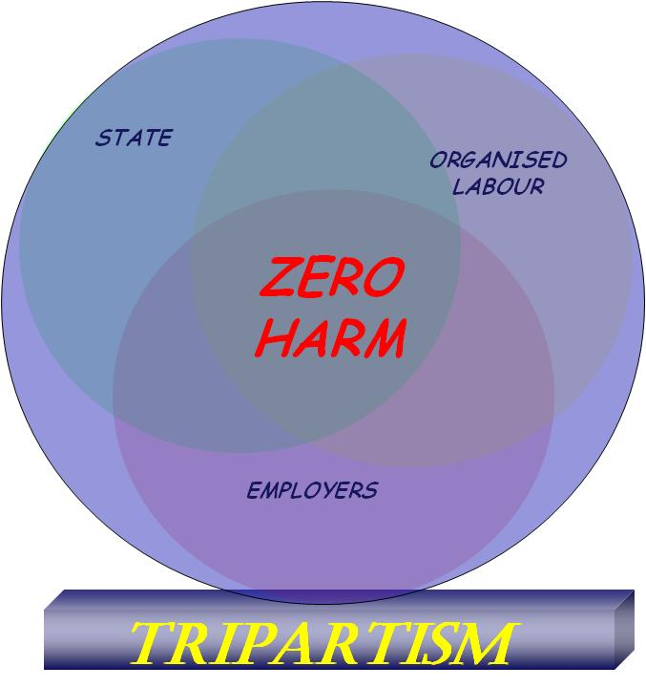
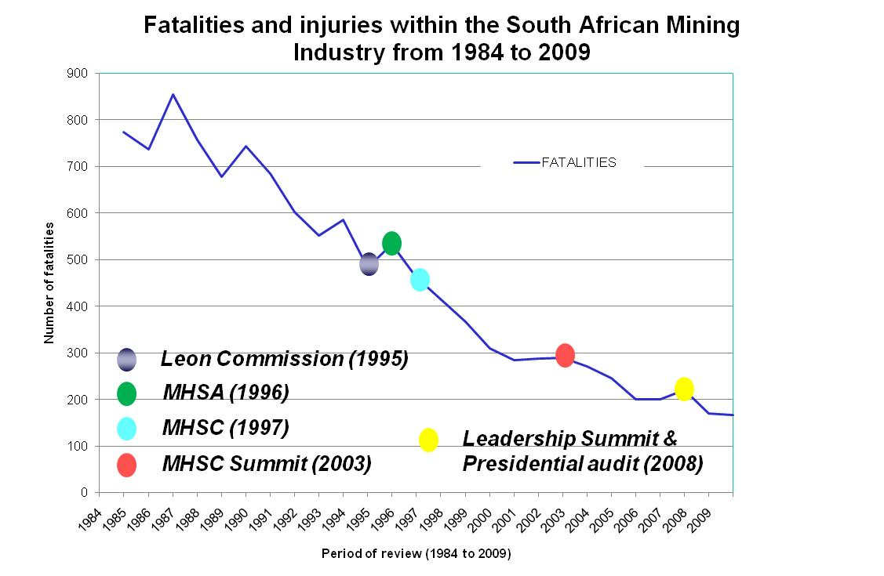
The road to ZERO HARM
Attaining ZERO HARM is a journey
  Long
  Windy
  Very bumpy
SAMI has achieved major successes but the challenge is ever-constant.

Slide 14
MHSC Mandate
Advise the Minister on all occupational health and safety issues in the mining industry relating to legislation, research and promotion
Review and develop legislation for recommendation to the Minister
Promote health and safety in the mining industry
Oversee research in relation to health and safety in the mining industry
Liaise with other bodies concerned with health and safety issues
Advise the Minister on all occupational health and safety issues in the mining industry relating to legislation, research and promotion
Review and develop legislation for recommendation to the Minister
Promote health and safety in the mining industry
Oversee research in relation to health and safety in the mining industry
Liaise with other bodies concerned with health and safety issues
Notes:
14

Slide 15
MHSC Overview
Mine Health and Safety Council
Audit and Risk Committee (ARC)
Mining Regulations Advisory Committee (MRAC)
Mining Occupational Health Advisory Committee (MOHAC)
Safety in Mines Research Advisory Committee (SIMRAC)
Mining Industry HIV/AIDS and TB Advisory Committee (MITHAC)
State
Labour
Employers
Legislation
Regulations
Guidelines
Standards
Health Policy
Health information
Health regulations
Research input
Research needs
Research programmes
HIV/AIDS and TB programmes
Operational Execution and Implementation
15

Slide 16
The Plan – summarised

Slide 17
MHSC Initiatives- OHS Summit
Health and Safety Culture
Implement culture transformation framework
Improve tripartite relations
Ensure implementation of summit commitments
Learning industry
Establish Centre of Excellence for research, research implementation and capacity-building focusing on:
Improve OHS capacity
Reduce illiteracy in the mining sector
Increase scarce skills that are critical to OHS
Improve monitoring of occupation diseases
Healthy and Safe Workplaces
Eliminate Silicosis Eliminate NIHL Eliminate falls of Ground Eliminate transport and machinery accidents
Improve lifestyle of mine workers
Integrate and simplify compensation system
17
Notes:
17

Slide 18
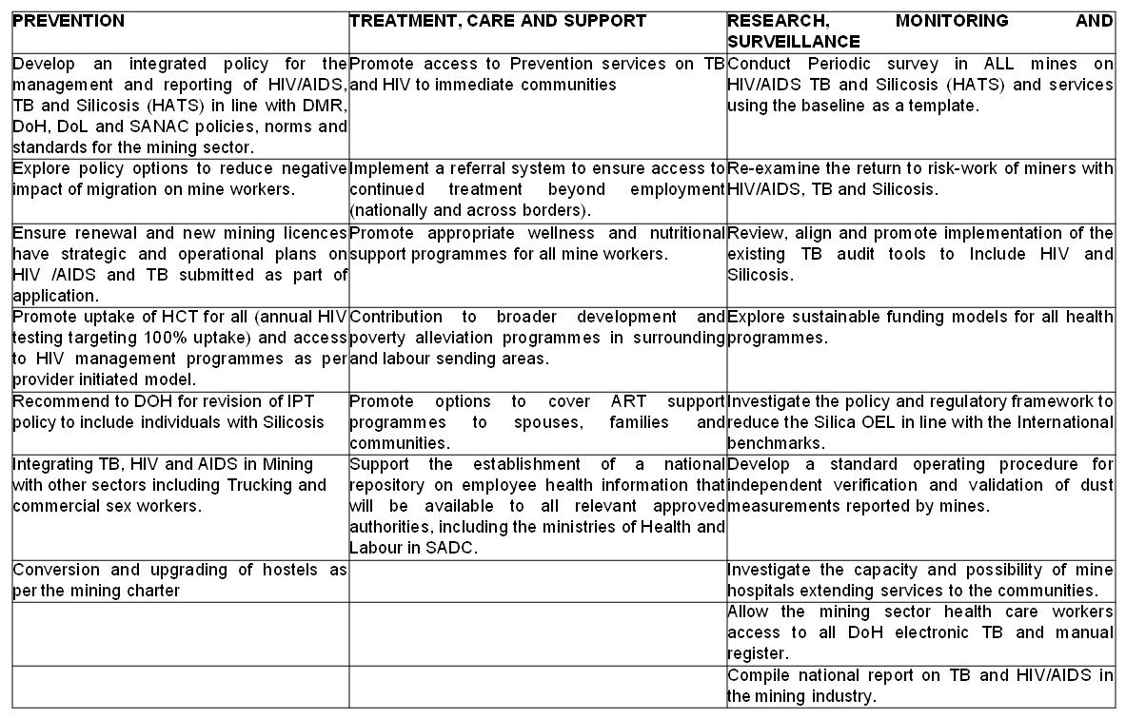
MHSC Initiatives- HIV/AIDS & TB Summit
At the Summit in November 2011, the principals agreed to work to the three pillars on HIV/AIDS, TB and Silicosis in the mining sector
PREVENTION
TREATMENT, CARE AND
SUPPORT
RESEARCH, MONITORING
& SURVEILLANCE
In total there are 22 areas
focus.
18
Notes:
18

Slide 19
MHSC Initiatives- Culture Transformation
PILLAR
1 | Integrated mining activities
2 | Risk management*
3 | Technology
4 | LEaDING practice*
5 | Elimination of DISCRIMINATION*
6 | Bonuses and Performance Incentives*
7 | Tripartism
8 | Regulatory framework
9 | Inspectorate
10 | Data
11 | Leadership*
At the Summit in November 2011, the principals launched the Culture Transformation Framework
11 pillars were identified
Each focussing on various aspects that would improve the attitude and approach to OHS in the sector.
Stakeholder prioritised 5 of the pillars.
Focus is on promotion and implementation of the CTF
PILLAR
1 | Integrated mining activities
2 | Risk management*
3 | Technology
4 | LEaDING practice*
5 | Elimination of DISCRIMINATION*
6 | Bonuses and Performance Incentives*
7 | Tripartism
8 | Regulatory framework
9 | Inspectorate
10 | Data
11 | Leadership*
19
Notes:
19

Slide 20
MHSC Initiatives- Centre of Excellence
The MHSC will fund the Centre of Excellence in line with an approved Business Plan for the Centre.
The MHSC will ensure that leadership of the Centre implement a strategic plan in a coordinated and comprehensive manner in line with the mandate of the MHSC and purpose of the Centre.
The MHSC will consider the Centre of Excellence as a provider of choice for research and capacity building as the Centre develops its own capacity to deliver.
20
Notes:
20

Slide 21
MHSC Initiatives- research programme
Project name | Objectives
Investigation into surface activity of airborne particles in the gold, platinum and coal mining environment’ | Draft best practice manuals for sector with regards physicochemical properties of respirable dust samples
Adverse Health Impacts from Dust Tailings Facilities | Year 2 will consolidate the preliminary studies associated with the dust from Tailings Facilities.
Characterising the Risk of Human Exposure and Health Impacts from AMD in SA | To understand the risks from exposure to AMD
Fluid Induced Seismicity (FIS) | To assess the Risk posed to Jhb and surrounding areas from FIS from abandoned mined
Integration of national seismic network and the mine networks | To integrate the mine network with the national network
Noise Control for Fans and Other Sources | To finalise the testing of equipment for sound levels and to negate sources of sound prior to sending the underground
Technology Transfer | Technology Transfer Opportunities

Slide 22
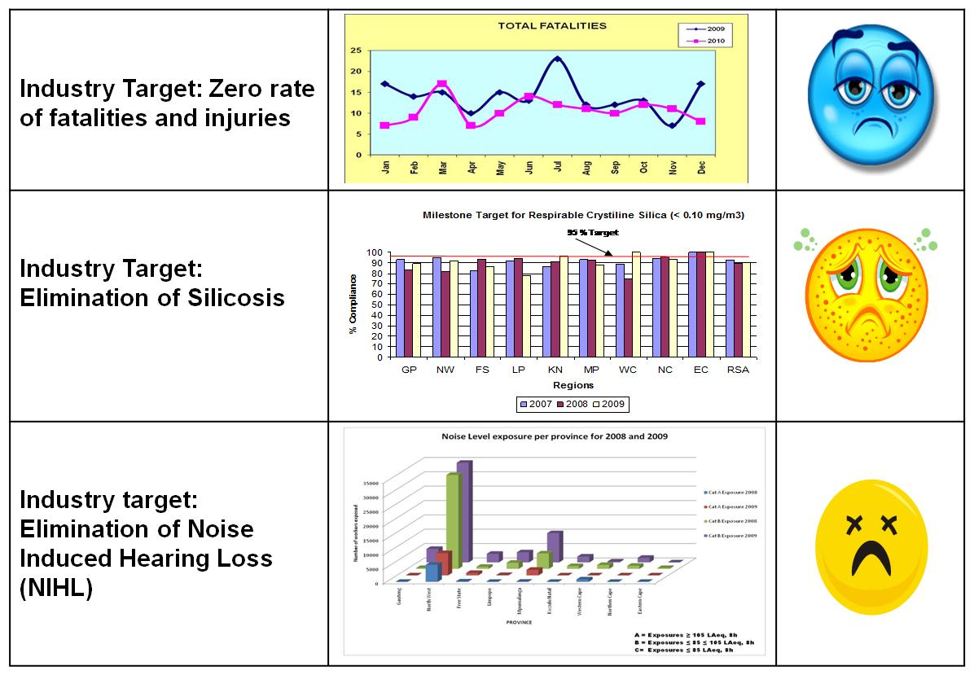
Paradigm Shift Required
22

Slide 23
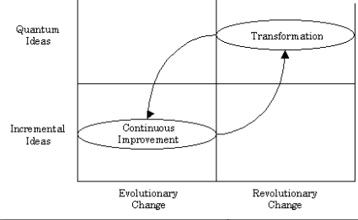
Paradigm Shift Required
Notes:
Help me understand these M&E slides, pls.

Slide 24
Attaining ZERO HARM
Zero Harm
Skills, capacity and training
Relevant knowledge and information
Health and Safety Culture
Each set is critically important to the reach the target…
The right mind set….
Doing the right things….
With the right support….
Notes:
24

Slide 25
OHS initiatives sector perspective
Poor track record on dissemination
Poor track record on implementation
Mining Charter forces employers to focus on research
How does the MHSC initiatives reach the target audience?
How do issues on the ground reach the MHSC?
Notes:
Help me understand these M&E slides, pls.

Slide 26
Promotion of the MHSC
Regional Tripartite Forums provide ideal opportunity for shared
MHSC will support such initiatives
Currently dominated by safety issues
If 80% of mine deaths are HEALTH related why are health issues not brought to the fore?
Notes:
Help me understand these M&E slides, pls.

Slide 27

Attaining ZERO HARM
The MHSC continues to work tirelessly to make a meaningful contribution towards the realisation of ZERO HARM at South African mines.
Reaching the industry’s 2013 milestones is indeed a mammoth task that calls for dedication and co-operation from all

Slide 28
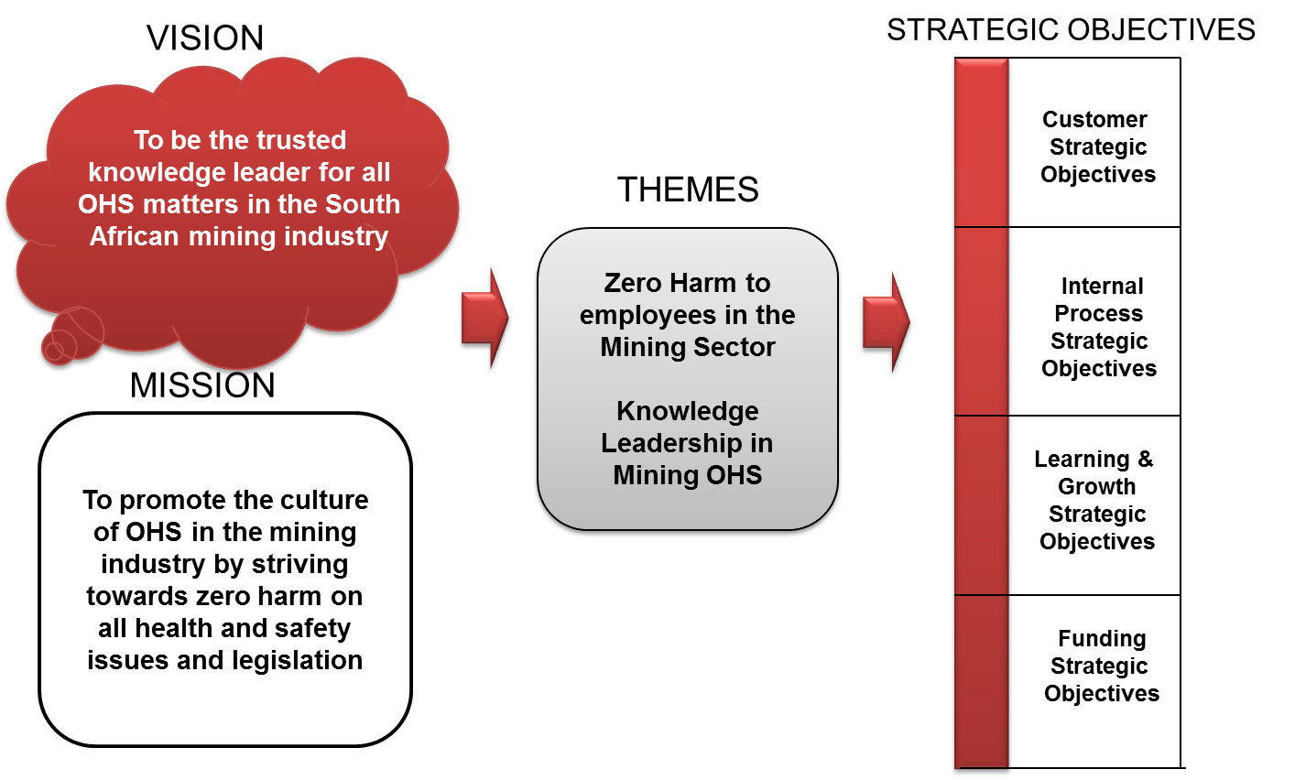
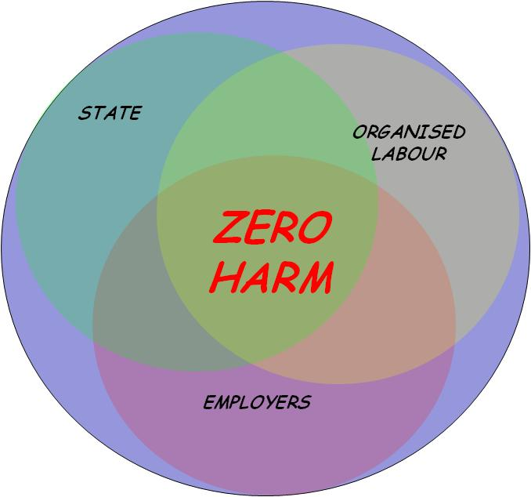

Conclusion
Supported by
Driven by
Towards

Slide 29
ZERO HARM
ZERO HARM is not just about SAFETY but HEALTH as well
What is needed to elevate the issues of health?
“who is going to drive the bus?”
the time for talking is over
ZERO HARM THROUGH ACTION

Slide 30
Thank you
Mine Health and Safety Council
MHSC Disclaimer:
All views expressed herein are the views of the author and do not reflect the views of the Mine Health and Safety Council unless specifically stated otherwise. The information is intended only for the person or entity to which it is addressed and may contain confidential and/or privileged material. Any review, retransmission, dissemination or other use of, this information by persons or entities other than those intended recipient/s is prohibited. The replication of this material in any form will require approval from the author and Mine Health and Safety Council.

