Slide 1


THE MOSH
LEADING PRACTICE
ADOPTION SYSTEM
Key Elements of the
Adoption System
and Its Operation
By
Stanford Malatji
Head: Learning Hub
20 April 2015
CHAMBER OF MINES OF SOUTH AFRICA
Putting South Africa First

Slide 2



Roadmap of Key Events and Decisions
2008
Piloted the MOSH adoption system successfully
2007
Developed the MOSH leading practice adoption system
2005
Committed to share best practices
2003
Mining Industry Tripartite Partners agreed OHS Targets and Milestones agreed upon
Leading the change to zero harm

Slide 3
Roadmap of Key Events and Decisions
2014
2011
Mining Industry Tripartite Partners agreed New OHS Milestones. Centre of Excellence was officially launched
Members made important commitments to implement the Culture Transformation Framework as per the Mining Charter
2010
2009
Learning Hub is integrated into the Chamber’s core business.
Adoption of leading practices forms an integral part of the Mining Charter.
Established the Learning Hub to promote learning by encouraging mining companies to learn from the pockets of excellence that exist in the mining industry
Leading the change to zero harm

Slide 4
MOSH Intent
The MOSH Leading Practice Adoption System
  A systematic approach for identifying leading practices in health and safety and helps with their widespread adoption across the industry.
  Focuses on the “People” issues that help to overcome resistance to adoption.
The MOSH Learning Hub
  Promotes learning by encouraging mining companies to learn from the pockets of excellence that exist in the mining industry.
  Facilitates the adoption of leading practices through a people oriented process that involves leadership behaviour and behaviour communication aspects.
Leading the change to zero harm

Slide 5
Simple logic of the MOSH process
The Basic MOSH Process
Step 3
Facilitate widespread adoption of the leading practice
Step 2
Document the leading practice, including behavioral plans
Step 1
Identify the leading practice with the greatest OHS benefit
Leading the change to zero harm

Slide 6
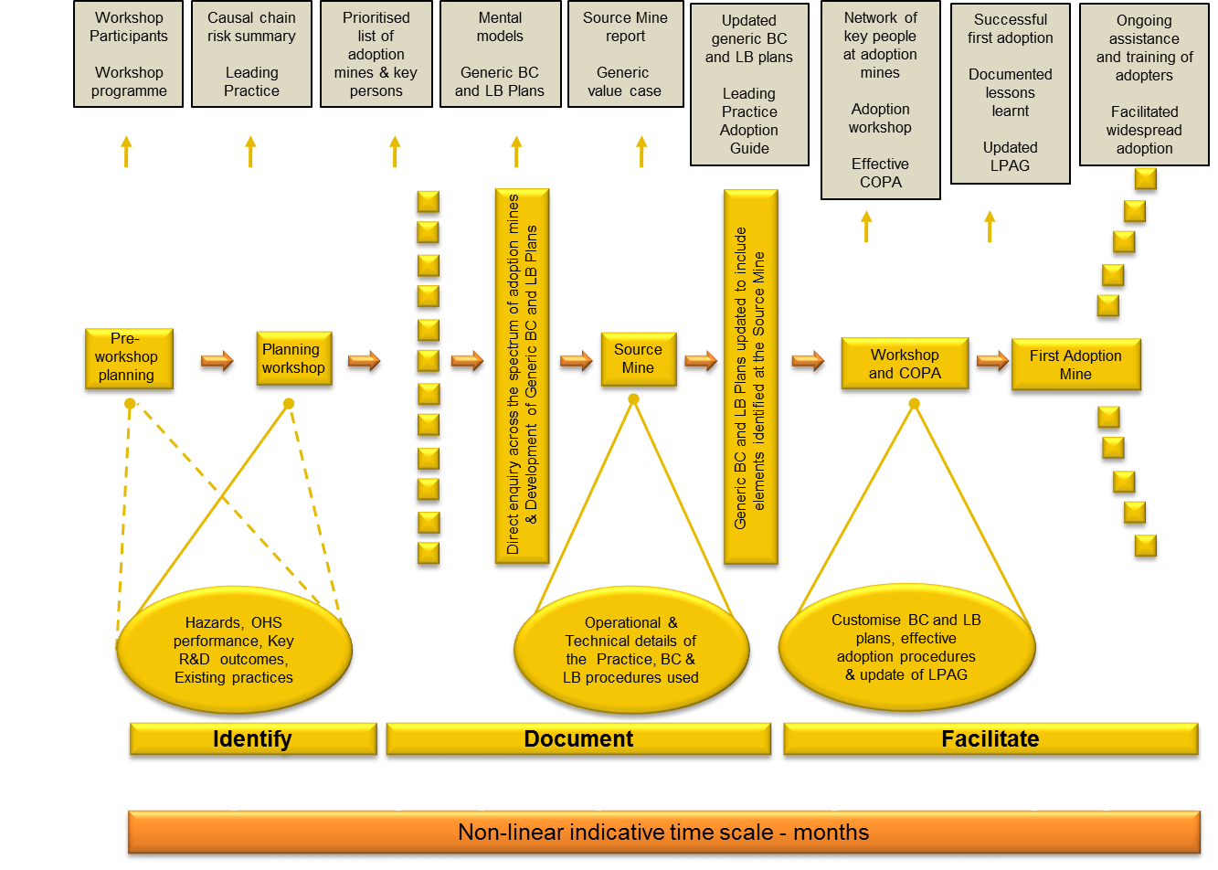
Systematic process steps of the adoption system
Leading the change to zero harm

Slide 7
Key features of the adoption system - Industry ownership
Schematic showing the core MOSH Structures
Adoption Team Sponsor
(one per team)
Chamber Council
MOSH Task Force
Chamber Executive
Advisory Body (Tripartite)
Head of Learning Hub and MOSH Secretariat
Specialist support for MOSH adoption teams
Learning
Hub
MOSH
Adoption Team
Dust
MOSH
Adoption Team
Noise
MOSH
Adoption Team
Falls of Ground
MOSH
Adoption Team
Transport and Machinery
Adoption Team Manager,
Adoption Specialist,
Industry Members
Facilitation of widespread adoption of leading and simple leading practices
Leading the change to zero harm

Slide 8
Schematic of the Behaviour Change Process
Best Available Knowledge
Expert model of risk situation
Established behaviour science
Existing Mental Model
Leadership behaviour plan
Analysis to establish Mental Model
New Mental Model
Comparison to identify communication and leadership requirements
Behavioural communication plan
Direct enquiry process
Misperceptions, Poor understanding,
Knowledge gaps, Disbelief
↓
Misplaced Resistance
It makes sense to me
It will improve my safety
Safe production is important
We must make it work
↓
Well-founded Acceptance
Leading the change to zero harm

Slide 9
Identification of mental models and behavioural plans
Identify key adopters and other stakeholders
Develop direct enquiry protocol (procedures / questions)
Select persons to be interviewed
Train interviewers and conduct enquiries
Analyse responses and establish mental model
Review mental model against expert model and behaviour science
Develop behavioural communication and leadership behaviour plans
Leading the change to zero harm

Slide 10
Documenting the leading practice at it’s Source Mine
Leadership detail
  Investigate and document
Communications
  Investigate and document
Detailed Source Mine Report
Technical details
  Investigate and document
Example materials
  Training
  Communications
  Signage
Leading the change to zero harm

Slide 11
Identifying and documenting the full value case
Financial Impacts
Strategic Impacts
Initial cost
Operational cost
Financial benefits
Production
etc.
The Generic Value Case
Health and Safety
Relationships
Image
Investor support
etc.
Leading the change to zero harm

Slide 12
The 16 steps for adoption of a leading practice
Facilitate the adoption decision
Plan and conduct direct enquiries
Customise generic behavioural plans
Finalise and implement mine-wide roll-out plan
1
8
9
16
Secure support for adoption
Update key stakeholders on progress
Customise generic behavioural plans
Monitor, evaluate and report on performance
2
7
10
15
Establish an effective mine adoption team
Establish effective relationship with the COPA
Assess risk and develop final adoption plan for approval
Implement pilot adoption of practice
3
6
11
14
Prepare initial plan for adoption
Initiate baseline monitoring programme
Develop training and communication materials
Brief and train key persons
4
5
12
13
Leading the change to zero harm

Slide 13

Closing comments
Much achieved since 2003
Improvements are due to action by operational management
Reluctant compliance is unlikely to be sustainable
The key is eager adoption, not reluctant compliance
Adoption requires people to voluntarily change what they do
The MOSH System addresses this challenge in a special way
Leading the change to zero harm

Slide 14
For more information
contact the Chamber of Mines
LEARNING HUB
at
011 498 7100
www.mosh.co.za
Dust Team
Dr Audrey Banyini
ABanyini@chamberofmines.org.za
Noise Team
Hlangabeza Gumede
HGumede@chamberofmines.org.za
FOG Team
Chris Legodi
CLegodi@chamberofmines.org.z
T&M Team
Kobus Blomerus
KBlomerus@chamberofmines.org.za
M&E
Lettie Masilo
LMasilo@chamberofmines.org.za
Head of the Learning Hub
Stanford Malatji
SMalatji@chamberofmines.org.za
Leading the change to zero harm

Slide 15

Outline of the leading practice
By Gerrie
Leading the change to zero harm

Slide 16


Long walk to our Sediba
COPA
2012
Industry workshop
(Emperors Palace)
2012-2014
Piloting and refining
2008
MOSH – Dust
5-Year Plan
2009 - 2011
Introduction into Gold
and Coal sectors
2003
SIMRAC: 03-06-03
Track B
Leading the change to zero harm

Slide 17

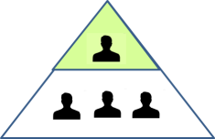



What makes up a MOSH leading practice?
A MOSH Leading Practice comprises of three legs of
equal importance.
Sustainable adoption of the practice requires adoption of all
three legs:
Leading Practice
Leading Practice
TECHNICAL DETAILS
BEHAVIOUR COMMUNICATION
TECHNICAL DETAILS
LEADERSHIP BEHAVIOUR
Technical details
LEADERSHIP BEHAVIOUR
Leadership behaviour
Behaviour communication
Leading the change to zero harm

Slide 18
Our Source
Kopanang Gold Mine
AngloGold Ashanti
New Vaal Colliery
Anglo Coal
Mine Health and Safety Council (MHSC)’ Safety in Mining Research Advisory Committee (SIMRAC) Project ‘03 06 03 Track B: Environmental and Engineering Controls’
Leading the change to zero harm

Slide 19
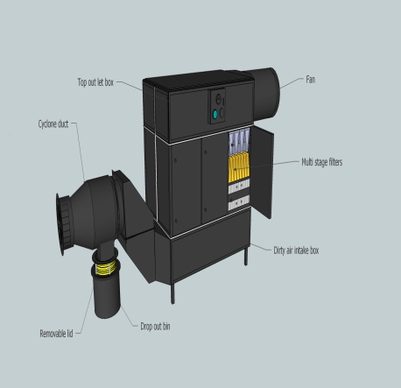
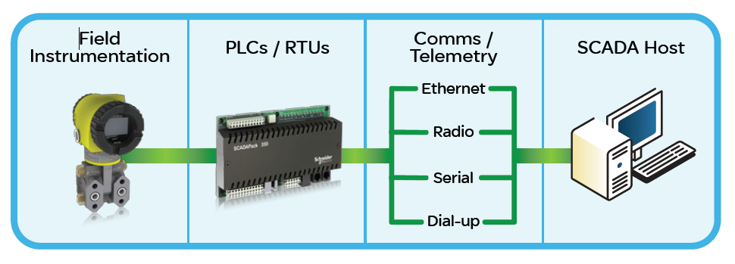
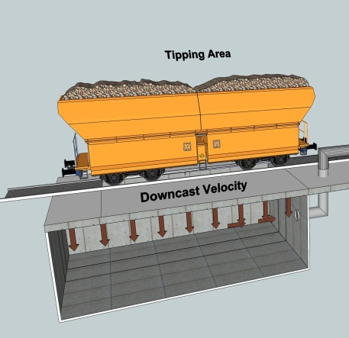
Principle
2
3
Engineering Control
Continuous Monitor
1
The Leading Practice that will make a
DIFFERENCE
4
Activity
PLC/RTU’s
Includes:
Communication drivers
Real-time data monitoring
Real-time database
Alarm and event journal
Historic archive
Configuration database
6
5
Communication/
Telemetry
Host/Control Room

Slide 20

Features of Practice
1
Move from re-active to pro-active mode
2
It is predictive and preventative maintenance management
3
It broadens the conventional approach of personal sampling
4
Allows for immediate intervention
Continuous monitors are placed strategically to monitor engineering controls.
The ambient air condition is then monitored continuously in real-time.
A “dust alarm” initiates immediate intervention.
Leading the change to zero harm

Slide 21
Rationale
There is a real need from industry for a practice that provides consistent procedures and measurements for reliably identifying, implementing and CONTINUOUSLY MONITORS appropriate airborne pollutant engineering controls. This practice, which serves that purpose, allows for:
Pro-actively detecting working places or processes with unsatisfactory airborne pollutant conditions
Determining sources or causes of such conditions
Indicating necessary control measures
Determining the effectiveness of airborne pollutant suppression methods or equipment
Confirmation that satisfactory conditions have been achieved following remedial measures
Confirmation that satisfactory conditions are being maintained
On-going continuous real-time monitoring of the effectiveness of control measures
Providing records of airborne pollutant conditions so that trends can be determined
Improve design of ventilation systems
Determining risk levels ( through appropriate risk assessments)
etc
Mine Health and Safety Council (MHSC)’ Safety in Mining Research Advisory Committee (SIMRAC)
Project ‘03 06 03 Track B: Environmental and Engineering Controls’ where applicable.
Leading the change to zero harm

Slide 22
Methodology
Identification of areas (ventilation districts) where the monitoring will occur
List activities and potential dust sources in these areas
Risk rank the activities and prioritise
Determine which activities will be monitored for the purpose of continuous real-time monitoring
Real time monitors to be placed at each identified source/activity.
Action levels to be determined for intervention.
Leading the change to zero harm

Slide 23
Value case
Progress towards zero harm
OHS benefit
Improved working relationships
Generic
Buy-in and support
Reduced compensation
Legal compliance
SASOL
Extract from Mine Health and Safety Act: section 5. (1)
As far as is reasonably practicable, every employer must provide and maintain a working environment that is safe and without risk to the health of employees.
Leading the change to zero harm

Slide 24
Concluding Comment (key lessons learnt)
1
People need to understand the reason for the change
2
Anxiety and fear are powerful emotions that by themselves create resistance to change
3
Individuals in the stakeholder map need to make personal values, skills and attitudinal changes.
4
5
Adoption can only be realized if the individuals collectively change
In the absence of a good technical project plan, the engagement process will cause resistance
A platform for managing the change enables the change towards realization of the benefit of the practice.
6
Leading the change to zero harm

Slide 25
Behavioural Communication and Leadership Behaviour plan
By Johan
Leading the change to zero harm

Slide 26

MOSH – 3 legs of sustainable adoption
The Leading Practice
Continuous monitoring of airborne pollutants
Behavioural Communication
Generic BC plans for initial strategic decision, operational adoption
Leadership Behaviour
Key generic leadership behavioural framework (A,B,C)
Enables real-time assessment of engineering controls
Makes (immediate) intervention(s) possible
Create the Mental Model, review BC plans
Direct inquiry – analyse data
Direct inquiry – analyse data
Create the Mental Model, review LC plans
WHAT
WHY, HOW
Leading the change to zero harm

Slide 27
MOSH – quest for sustainable adoption
Understand the mental models
Perceptions, experience, beliefs, values , biases.
Generic BC & LB plans
Address perceptions, issues
Eager adoption
Sustainable
Zero harm
Interview adopters, deciders, stakeholders
Analyse data to find supports, barriers.
Leading Practice Adoption
Leading the change to zero harm

Slide 28

Framework of Behavioural Communication
Belief / Issue
Essence of required communication
1
  No personal benefit
The LP results in significant reduction in dust risk that has direct health benefits.
2
  Negative impact on production
Adoption of the continuous real-time monitoring of airborne pollutant engineering controls LP has no impact on production.
3
  Extra work effort
Maintenance staff and control room operators must add LP’s maintenance and monitoring to their defined work.
4
  Shortcuts taken to meet production targets
Explain that a safe mine is a productive mine.
5
  Trust and buy-in needed
Explain that early and regular dialogue with staff is needed to identify
and address concerns.
6
  Leaders must lead by example
Leaders must regularly check that the equipment is
in proper working order and proper actions are taken when required to do so – problems are addressed – give feedback.
7
  Workers disregard health and safety
Managers and supervisors must communicate their high regard
for health and safety through their actions, and ensure workers
don’t sacrifice health and safety for production performance.
8
  Workers don’t implement training
Workers who don’t do what they have been trained to do
must be constructively coached or re-trained.

Slide 29
Framework of Leadership Behaviour
A
Antecedents
B
Behaviour
Operational adopters (Control Room Operators , Instrument Technician), workers in surrounding area of monitors)
Require: | Responsibilities:
Operational and maintenance training on new LP | Install system as instructed – no short cuts
Briefing before it’s implemented | Report any problems with LP
Regular performance enquiries by supervisors | Request explanations to ensure full understanding
A
Antecedents
B
Behaviour
First-level Supervisors (Occupational Environmental Officers, Ventilation Shiftboss and Unions):
Require: | Responsibilities:
Briefing on operation, installation and required maintenance of new LP | Monitor equipment and maintenance crew’s performance
Briefing before it’s implemented | Ensure maintenance crew receive necessary training/instruction
Regular meetings with next level supervisor | Ensure no short cuts are taken
 | Prompt action on any reported problems
 | Provide immediate positive feedback on observing desired behaviour
 | Provide constructive coaching on observing sub-standard behaviour
Leading the change to zero harm

Slide 30

Framework of Leadership Behaviour
A
Antecedents
B
Behaviour
Second-level Supervisors (Shift Boss/Mine Overseer, Engineer, Hygienist):
Require: | Responsibilities:
Briefing before LP is implemented | Ensure no short cuts are taken
Regular meetings with next level supervisor | Ensure operators and supervisors receive necessary training/instruction
 | Enquire about SLP’s performance/problems at regular meetings with supervisors
 | Provide immediate positive feedback on observing desired behaviour
 | Provide constructive coaching on observing sub-standard behaviour
C
Consequence
Everyone’s responsibilities:
Responsibilities:
Provide immediate positive feedback on observing desired behaviour
Constructive coaching to address observed problems – no abuse
Special recognition for exceptional performance
R e c o g n i t i o n
Leading the change to zero harm

Slide 31
Key challenges
Proper implementation BC & LB plans
Resource requirements
Test generic BC & LB plans and customise
On-mine adoption team with appropriate skills, competency
Identify communication tools for conveying the message
COPA attendance
MOSH Video
Leading the change to zero harm

