Slide 1


LEADING PRACTICE
ADOPTION GUIDE
rev 0
By
Dr Audrey Banyini
20 April 2015
CHAMBER OF MINES OF SOUTH AFRICA
Putting South Africa First

Slide 2


Contents
Purpose of LPAG
Systematic approach
Adoption process
1
2
3
Leading the change to zero harm

Slide 3
Purpose of LPAG
Part 1
Part 2
Part 3
The Practice
Introduction
Adoption Guide
Detail of 16 step process
Behavioural Plan
Behavioural communication
Leadership behaviour
Summary description of the practice
The problem addressed
Summary of documented performance and impacts
The generic value case
Critical success factors
Supported with reference documentation and templates
Leading the change to zero harm

Slide 4
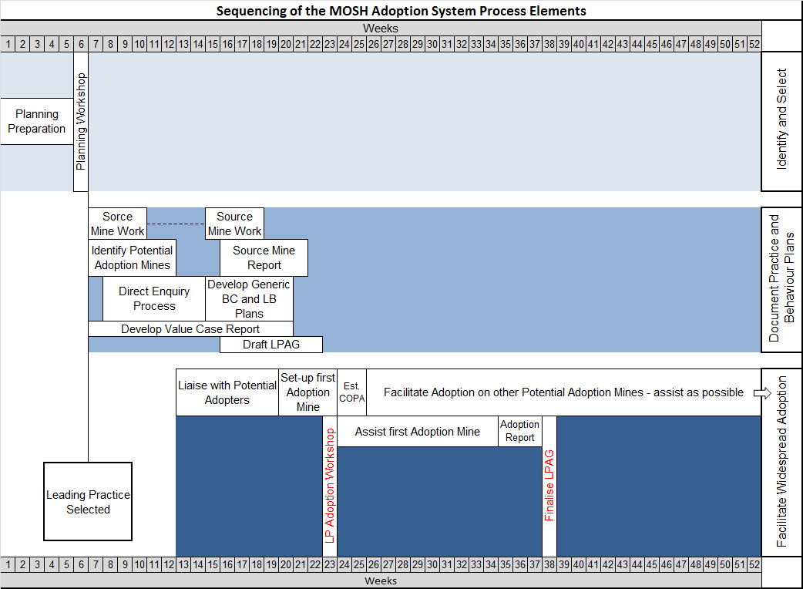
Systematic process steps of the adoption system
Leading the change to zero harm

Slide 5
Adoption process (step 1-8)
Step1
Step2
Step3
Step4
Facilitate the adoption decision
Secure support for adoption
Establish an effective mine adoption team
Prepare initial plan for adoption
The adoption process comprises of 16 interrelated steps involving various activities that need to be systematically and fully undertaken to achieve SUCCESSFUL ADOPTION
Step8
Step7
Step6
Step5
Plan and conduct direct enquiries
Update key stakeholders on progress
Establish effective relationship with the COPA
Initiate baseline monitoring programme
Leading the change to zero harm

Slide 6
Adoption process (step 9-16)
Step9
Step10
Step11
Step12
Customise generic behavioural plans
Customise generic behavioural plans
Assess risk and develop final adoption plan for approval
Develop training and communication materials
Step16
Step15
Step14
Step13
Finalise and implement mine-wide roll-out plan
Monitor, evaluate and report on performance
Implement pilot adoption of practice
Brief and train key persons
Leading the change to zero harm

Slide 7

Multi-disciplinary approach
Make or Break
Env. Engineering
(Hygiene)
Identify, evaluate, monitor,
recommend and follow up
Predictive and
preventative maintenance
Engineering & mining
Training and HR
Correct allocation of
labour and training
Finance
Secure capital and
working cost year on year
OMP
Medical surveillance link
Exec. Management &
Organised Labour
Honest commitment
and support
COMMUNICATION – COMMUNICATION - COMMUNICATION
Leading the change to zero harm

Slide 8

Outline of envisaged COPA operation
By Johan
Leading the change to zero harm

Slide 9
Community of Practice for Adoption
Mine Managers (initially)
Relevant specialists
Mine Adoption
Team Manager
Behavioural Overseer
LPAG
Training
Problem solving
Assistance
Share adoption experience
Continuous improvement
Mine visits
Who?
What?
COPA
Provides
on-going facilitation of the adoption process
How?
The COPA terminates its existence
when the members decide that it is
no longer needed.
Inaugural COPA:
28th May 2015
Regular meetings
Jointly implement LPAG
Work directly with lead adopter mine
Assist other adoption mines

Slide 10
For more information
contact the Chamber of Mines
LEARNING HUB
Dust Team
at
011 498 7100
Principal
Specialist
Dr Audrey Banyini
ABanyini@chamberofmines.org.za
ATM
Gerrie Pienaar
gerriepienaar69@gmail.com
ATM
Johan van Rensburg
johan.c.vanrensburg@angloamerican.com
Or visit our website:
www.mosh.co.za
Head of the Learning Hub
Stanford Malatji
SMalatji@chamberofmines.org.za
Leading the change to zero harm

