Slide 1
MOSH NOISE TEAM Activities
4October 2012

Slide 2

Discussion Points
Background
Noise Team Activities
Future Activities

Slide 3
Background
1st Leading Practice - Noise Elimination (2008)
  Electric Drilling Machine
    Potential to reduce noise by 6 dBA
    Source Mine : AngloGold Ashanti – Tau Tona
    Demo Mine : Moab Khotsong
    Adopters : None other than the Demo Mine
    Not successful for various reasons
      Readiness for adoption:
        Required substantial R&D: only available for stope drilling
      Cost constraints:
        Required substantial refinement that proved to be expensive
        Only Leasing Option available
      Other:
        “Climate” – “Energy crisis” paved the way for selection as leading practice.

Slide 4
Background
1st Leading Practice (cont.)
    Concept worth revisiting
      It is the ultimate Goal – part of zero harm
      Long term view
      Involving OEMs & Research institutions
    Current Noise at source - ± 108 dBA
      2013 Milestone : < 110 dBA & 2008 Milestone
      Legal Requirement : Noise Exposure: 85 dBLAeq,8h
      Shortfall: 25 dBA to be compensated for by HPDs

Slide 5
Background
2nd Leading Practice - PPE and Administrative Control (2010 -Current)
  Hearing Protection Device, Training, Awareness and Selection Tool (HPD _ TAS)
    Enables Occupational Hygienists to select the correct HPD per occupation based on noise exposures
    Training and awareness material – an explanation on the effects of noise, hearing protection devices and the usage, care and maintenance
    Only segments of the Leading Practice gets adopted & integrated into HCP programs
    Few Mines have fully adopted
    Communication flow challenges within organizations

Slide 6
Background
Fundamental Challenges
  Preventing Hearing loss versus Preventing Compensating for hearing loss
    Paradigm shift
    Improved but plateauing NHIL compensation figures (RMA)
  Noise has a lower priority compared to other Safety challenges (FoG, fatigue, T&M etc) and OH ( TB, HIV, Dust)
  Emphasis should be on Source Elimination

Slide 7
Discussion Points
Background
Noise Team Activities
Future Activities

Slide 8
MOSH Basics
  Fully functioning Industry Team
  Adopted Expert Model
  Shared understanding of the hazard and risk being addressed
  ‘Actual’ cost of noise (R14K/employee/year Vs. R60K/employee/year)
  Shared understanding of a comprehensive ‘Buy Quiet Policy’

Slide 9
HPD TAS Tool
Promotion of the Adoption of the Tool
  5 Adopters
  12 Partial Adopters
  27 Implementers
  Interest Group and future COPA
  Creation of Mine Adoptions Teams (Xstrata & Impala)
  Customization of Leadership Behaviour and Behavioural Communication Plans

Slide 10
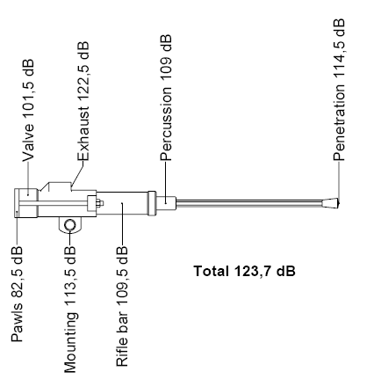
Source Elimination
  Current Machines - Drilling
  Noise sources are, Exhaust noise, Mechanical noise, Drill steel ringing, Steel on steel on rock, ambient noise, vibration and Echo
  Current focus is on exhaust muffling initiatives
  Five more noise sources that can be leveraged
  Interaction with Research institutions, T&M Team, OEMs

Slide 11
Source Elimination
Current Machines – other Equipment
  Assist the Industry with a source elimination Repository
  Some initiatives will be candidates for the new leading practice
  Source Elimination - Future mines and expansion projects
  Not explicitly catered for by MOSH process
  Forum where to influence the direction towards the usage of quieter rock breaking mechanisms such as hydraulic, electric drills
  The decision to use quieter rock breaking mechanisms is part of mine design and feasibility studies hence the benefits will be longer-term side
  Drilling Selection tool

Slide 12
Discussion Points
Background
Noise Team Activities
Future Activities

Slide 13
Future Activities
Source Elimination – Current Machines
  Collaborate with T& M Team and CM& CCs , MHSC, University of Pretoria & other research institutions – OCT 2012
  Regular progress reports at Industry Team Meetings
Source Elimination - Expansion projects and new mine
  Discussion with the MOSH Taskforce - 19 Oct 2012
  Obtain a list of design personnel from the MOSH Taskforce – 16 Nov 2012
  Drilling Selection Tool - Nov 2012
  Regular progress reports at Industry Team Meeting
HPD TAS Tool
  Daft Assessment Tool –Sept 2012
  Assist the adopter and Implementers – Jan 2013
  Facilitate Interest group activities – Nov 2012
  Regular progress reports at Industry Team Meetings

Slide 14
Future Activities
Source Elimination Repository
  Compile summary of the practices and contact personnel - 14 Nov 2012
  Source elimination repository on MOSH website - 14 Nov 2012
Industry Team Meetings & Workshops
  1st Industry Team Meeting - 26 Sept 2012
  2nd Industry Team Meeting Orientation - 14 Nov 2012
  Industry Team Workshop - 13 February 2013
  3rd Industry Team Meeting - 13 Mar 2013
  4th Industry Team – 15 May 2013
  5th Industry Team - 14 August 2013
  REFER TO THE WORK DOC.
MOSH Leading practice
  Identification Phase– 13 February 2013
  Documentation Phase – Feb to April 2013
  Demonstration Phase - April to Aug 2013
  Facilitation Phase – Aug to Jan 2014

Slide 15
Questions

