Slide 1
BEATRIX GOLD MINE
WINCH DUST COVER PROJECT
Presented to MOSH Dust
19 March 2014

Slide 2
Contents
Purpose and business need
Approach to the study
Exposured occupation
Initiative
Winch dust cover
Dust results
Project roll out
Lessons learnt

Slide 3
Purpose and business need
The pupose of the this case study is to determine the feasibility to use the winch dust cover as an effective and efficient dust cover to reduce the exposure to silica dust in the mining environment.
In terms of the need of Sibanye Gold to eliminate silica dust exposure to its employees, Mining Unit 3 sourced and tested an effective and cost efficient winch dust cover to reduce the exposure of silica dust to winch driver employees.

Slide 4
Exposed trends per Occupation (>0.05<0.1mg/m³)
Gravimetric sampling results indicated that winch drivers are most exposed
Intervention required to protect winch drivers

Slide 5
Approach to the study
The approach taken was to find a worst case scenario and explore ways in ensuring proper protection of winch drivers in their breathing zone whilst operating a winch without wasting any resources in getting the desired results.
An implementation plan starting at the training center and going down to the working faces.

Slide 6
Initiative to reduce exposure
Investigations done to determine the reasons for driver exposure
Exposure as result of coiling of ropes around winch drum
  In the breathing zone of the winch driver
Clinton Randall initiated the idea of the winch drum cover
  Fits over the winch drum guard
Tests done show reduction in exposure levels
The Randall cover is now being introduced throughout Beatrix

Slide 7
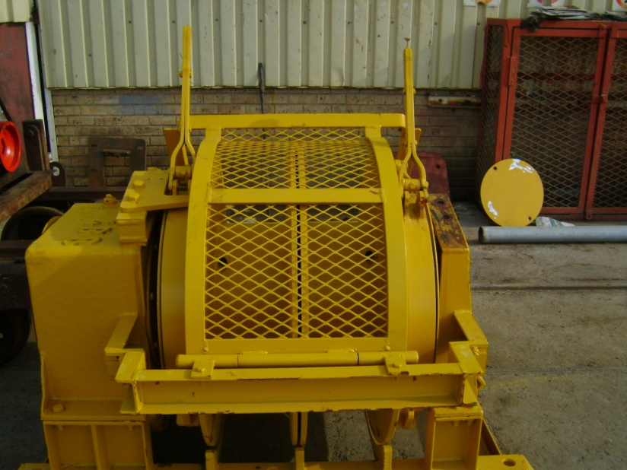
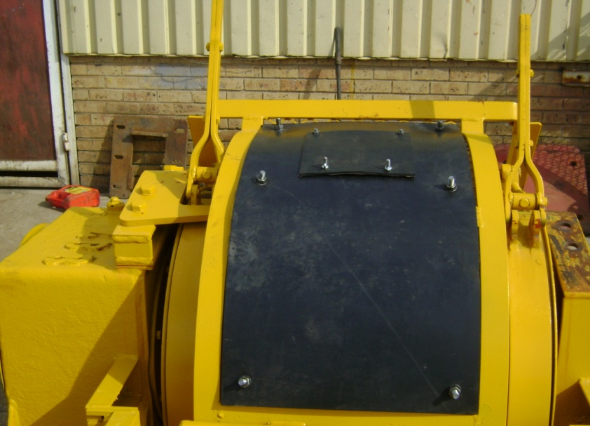
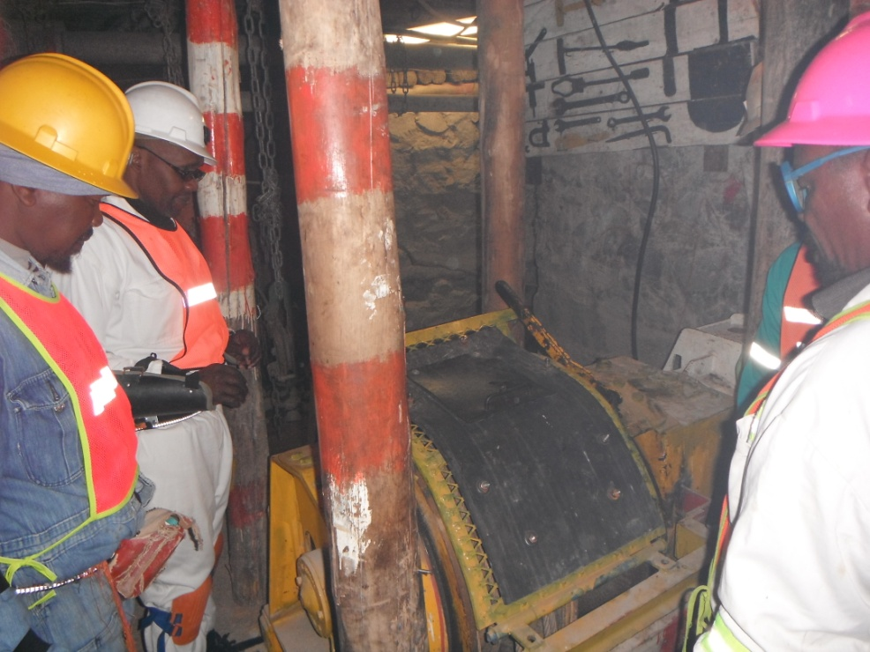
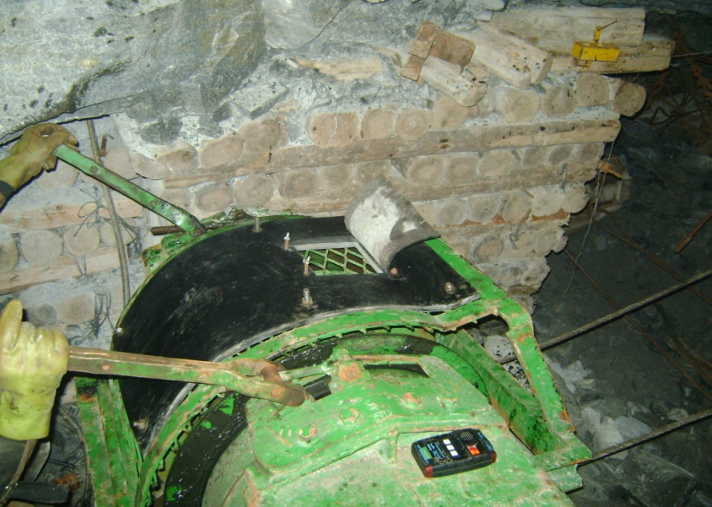
Winch cover

Slide 8
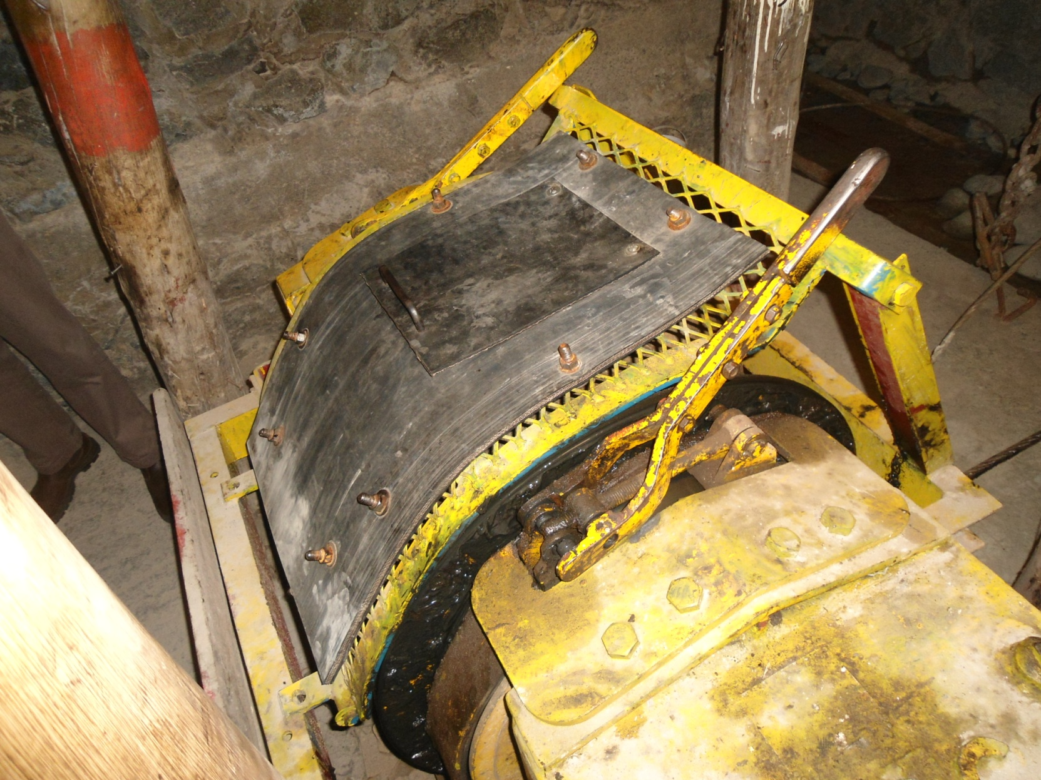
Randall Winch Dust cover

Slide 9
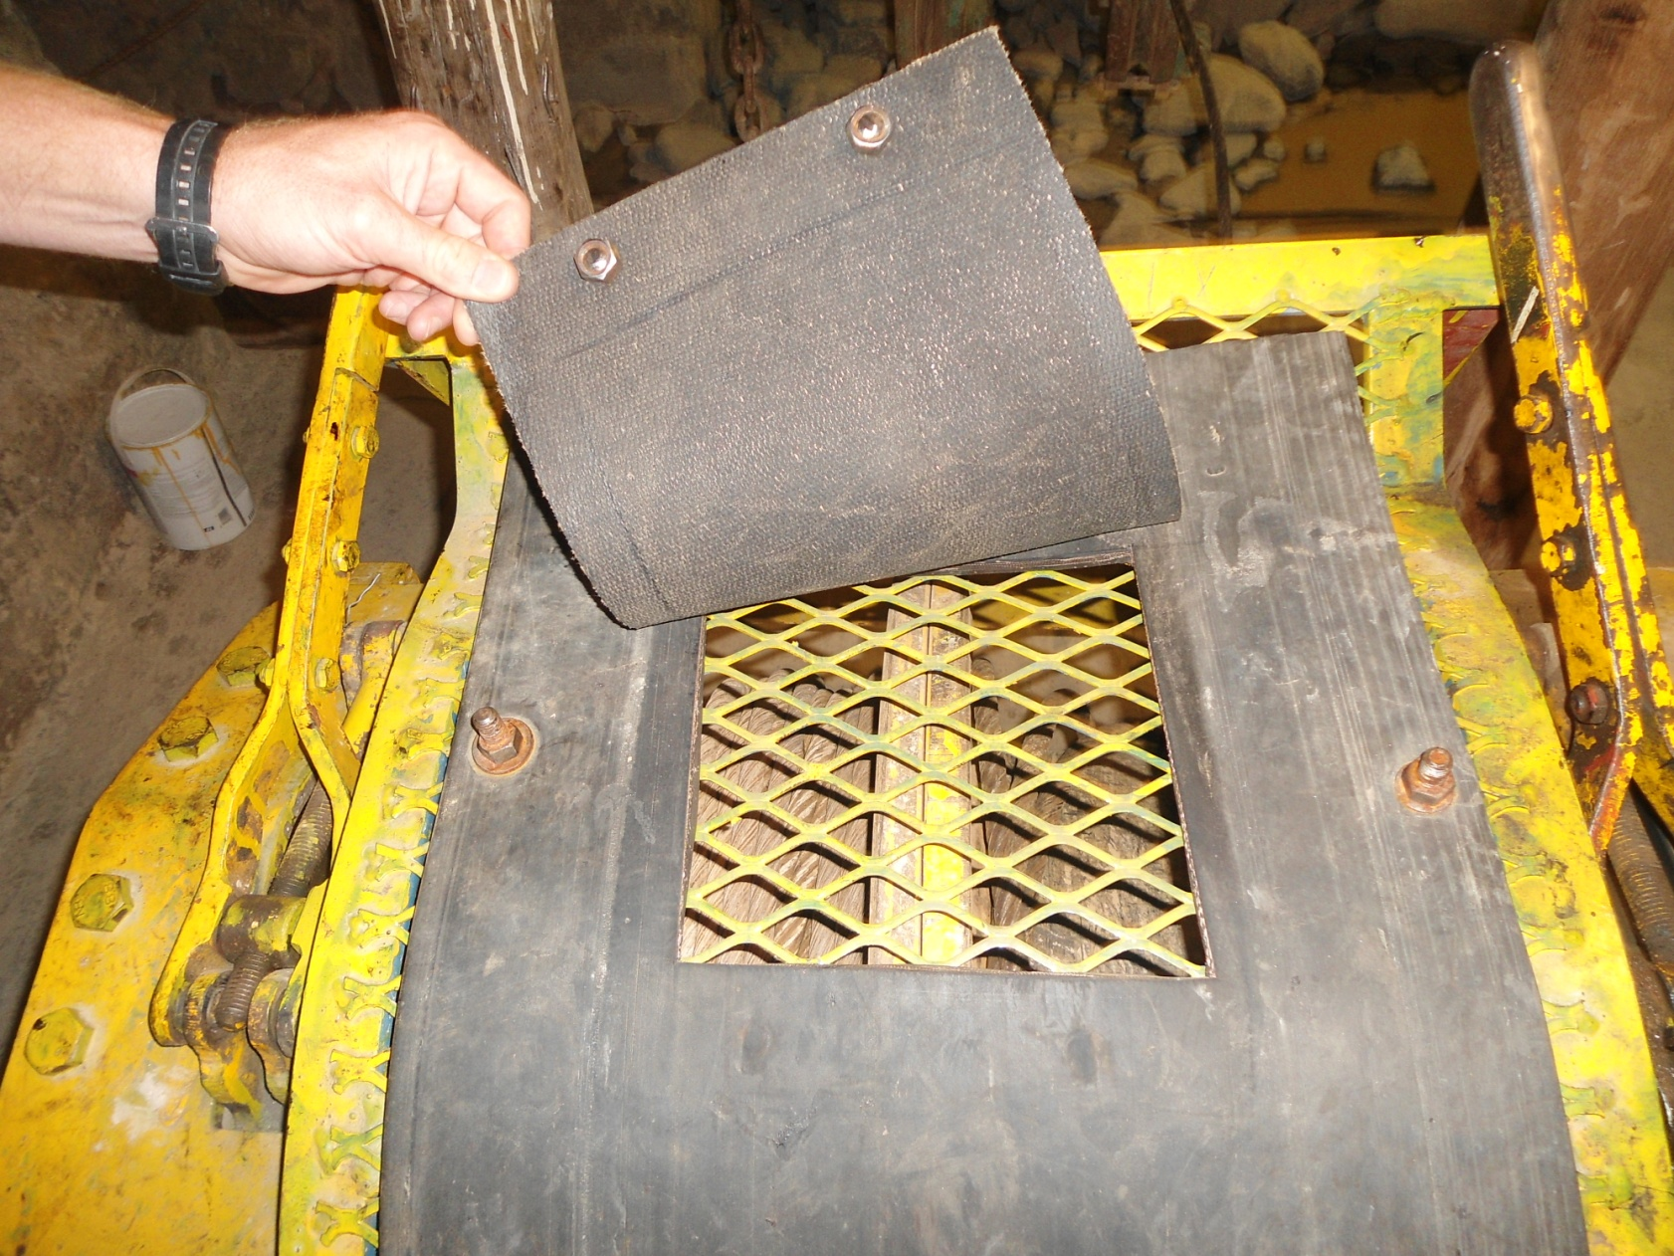
Randall winch dust cover

Slide 10
Initial test done on the Randall winch dust cover

Slide 11
Comparative dust readings

Slide 12
Comparative average dust readings (Before and After)

Slide 13
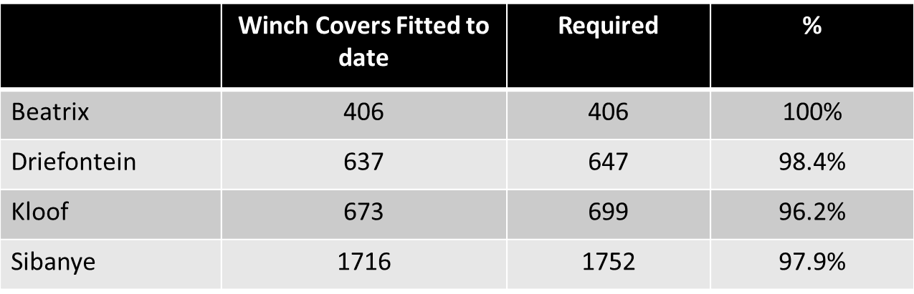
Project roll out
Project roll out commenced at Beatrix West Section
  Section where project was initiated

Slide 14
Lessons learnt
  Training of employees were a very important aspect of this project.
  Communication to employees.
  The project was not complicated and easy to implement.
  Winch drivers silica dust exposures at the winch areas were reduced by ±50%.

Slide 15

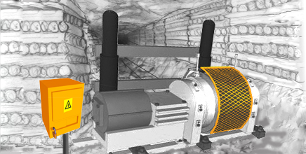
Weekly communication 10 Mar to 16 Mar 2014
WINCHES AND RIGGING SAFETY
Always be aware of the hazards and risks associated with all tasks that you perform and take the required steps to safeguard yourself and others.
Light installed and working.
Signaling devices installed with bell wires the full length of the scraper path on both sides.
Winch barricaded installed and safe.
Lockout in place when winch is not in use to prevent unauthorized operation.
Holding down bolts secured and checked daily.
Make sure your winches are fitted with a dust cover for protection of the winch operator against dust and fine stuff from entering his eyes!!!!!
1
2
2
3
4
5

Slide 16
Acknowledgement
CLINTON RANDALL
BEATRIX MANAGEMENT
???

