Slide 1



WINCH COVER
SLP BRIEF
L E A R N I N G H U B
by
Gerrie Pienaar
17 July 2013
CHAMBER OF MINES OF SOUTH AFRICA
Putting South Africa First

Slide 2

Contents
Documented benefits
Description of SLP
Value case
Key elements of brief
SLP
Behavioural aspects
SLP Technical Details
Steps for adoption
Leading the change to zero harm

Slide 3
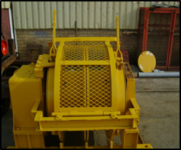
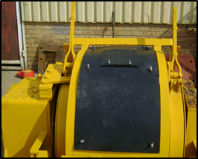
Principle of Winch Covers
This simple leading practice involves fitting a cover over the operating drums of a scraper winch to reduce the harmful dust exposure experienced by winch operators. Winch operators have been identified across industry as the occupation with the highest exposure to silica dust.
In principle, the winch cover simply involves fitting a cover to the winch drum guard of existing winches. The two pictures below illustrate a winch drum guard before and after fitting the winch cover
Before
After
Leading the change to zero harm

Slide 4
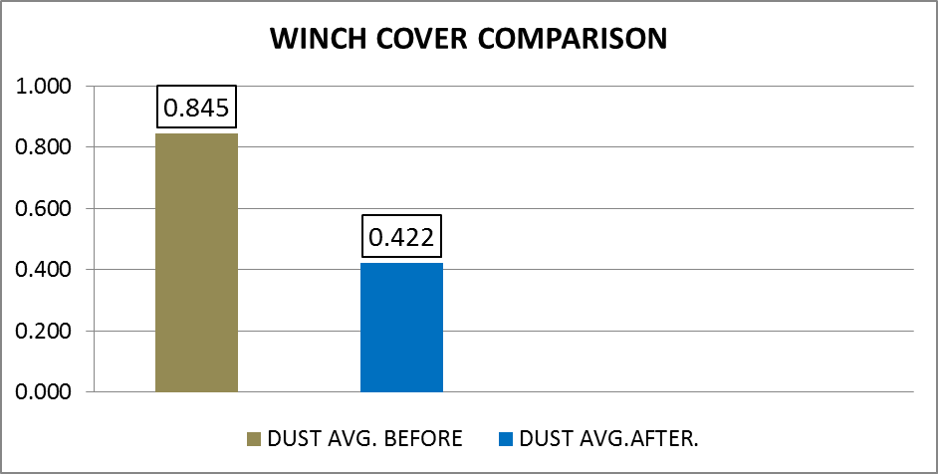
Documented Benefits
Average improvement of 50% reduction in aerosol particles
The installation of a winch cover has been found to result in a 50% reduction in aerosol particles in the breathing zone of winch operators.
The measurements were made over ten minute sampling periods using a spot sampling instrument (side pack).
Leading the change to zero harm

Slide 5
Value Case
Issue |  | Details
1 | Initial cost | If the cover is fitted by the winch supplier the estimated cost is R2500 per winch. If the covers are made and fitted using existing mine personnel and redundant conveyor belt, the real extra cost to the mine becomes negligible.
2 | Operational costs | No measurable increase in operational costs have been identified
3 | OHS benefit | The risk of silicosis to winch operators, the employees who are most at risk, will be very significantly reduced. This is of real value to both workers and management.
4 | Progress towards zero harm | Death from silicosis caused by excessive exposure to silica dust is the greatest cause of mortality in mine workers. Reducing this risk in the group most at risk will constitute a significant step towards achieving the ultimate goal of zero harm
5 | Improved working relationships | Implementation of the behavioural communication and leadership behaviour plans has the potential to significantly improve the operational working relationship between supervisors and their staff
6 | Buy-in and support | The mine-wide intervention in the interests of protecting the health of those most at risk will help engender buy-in and support for the intervention, and of employees for management
7 | Legal compliance | The installation of winch covers will assist in meeting regulated maximum dust exposure levels. It will also be a good case of management doing what is reasonably practicable to provide and maintain a working environment that is safe and without risk to the health of winch operators.
8 | Reduced compensation | In the longer term the mining industry, including the mine, will benefit from a reduction in compensation and other costs associated with silicosis.
Extract from Mine Health and Safety Act: section 5. (1)
As far as is reasonably practicable, every employer must provide and maintain a working environment that is safe and without risk to the health of employees.

Slide 6
Behavioural Communication
No. | Generic belief / issue | Essence of required communication
1 | There will be no personal benefit | The direct health benefits to winch operators from a 50% reduction of silica dust inhalation must be clearly identified and communicated to them. The indirect benefits derived from adopting the winch cover SLP must be identified and explained to the relevant supervisors and engineering maintenance staff
2 | It will have a negative impact on production | Experience illustrating that adoption of the winch cover SLP has no impact on production must be explained to all supervisors and winch operators..
3 | It will involve extra work effort | The extra maintenance work required of the winch operator and engineering maintenance staff must be made part of their defined work.
4 | Short cuts are taken to meet production targets | The reasons for a safe mine being a productive mine must be explained to the winch operators, engineering staff and their supervisors. The harm of ill-advised short cuts to health, safety and production should be brought out.
5 | Trust and buy-in are needed for adoption | The importance of regular dialogue with staff to identify and address any and all concerns about the SLP to be explained to all relevant supervisory levels.
6 | Leaders must lead by example | Leaders responsible for ensuring operation or maintenance of the equipment must regularly check and ensure that the equipment is in proper working order.
7 | Workers have a disregard for health and safety | Managers and supervisors must communicate their high regard for health and safety through their actions, and in particular by ensuring that workers do not sacrifice health and safety considerations in the interests of production.
8 | Workers fail to implement training provided | Explain to supervisors that they will get what they allow. Persons who do not do what they have been trained to do must be constructively coached or sent for re-training if necessary.
Communication materials
It is the responsibility of the mine to develop the required communication material to effectively (convincingly) convey the substance of the key messages set out in this generic behavioural communication plan which has been customized for the winch cover SLP.
It will also be important to identify and brief those responsible for delivering the various messages.

Slide 7
Leadership Behaviour
Antecedents (To enable the behaviour for successful adoption) | Behaviours (By the relevant person for successful adoption of the SLP) | Consequences (By next level supervisor in response to observed behaviour)
Operational adopters (Winch operator / Engineering Technician)
Operator training on operation and required regular maintenance Technician training on installation and maintenance of covers Briefing before implementation Regular performance enquiries by supervisors | Operator to operate and clean winches with covers as instructed Technician to install and maintain winch covers to specification as trained. No short cuts Report any problems with SLP Request explanations to ensure full understanding | Immediate positive feedback from supervisor on observing desired behaviour Constructive coaching to address any observed problems (no abuse) Special recognition for exceptional performance
First level supervisors (Miner / Foreman)
Briefing of miner on operation and required regular maintenance Briefing of foremen on installation and maintenance of winch covers Briefing prior to implementation Regular meetings with next level supervisor | Regular dialogue to check on equipment and operator performance Ensure operators / technicians receive any necessary training / instruction No short cuts allowed or taken Prompt action on any reported problems Provide immediate positive feedback on observing desired behaviour Provide constructive coaching on observing sub-standard behaviour | Immediate positive feedback from next level supervisor on observing desired behaviour Constructive coaching to address observed problems (no abuse) Special recognition for exceptional performance
Second level supervisors (Shift boss / Mine Overseer / Engineer)
Briefing before implementation Regular meetings with next level supervisor | No short cuts allowed or taken Ensure that operators and supervisors receive any necessary training / instruction Enquire about winch cover performance / problems at regular meetings with supervisors Provide immediate positive feedback on observing desired behaviour Provide constructive coaching on observing sub-standard behaviour | Immediate positive feedback from next level supervisor on observing desired behaviour Constructive coaching to address observed problems (no abuse) Special recognition for exceptional performance
Training
It is the responsibility of the mine to develop the training and briefing material required for implementation of the generic leadership behaviour plan that has been customised for the winch cover SLP.

Slide 8
Steps for Adoption
Facilitate adoption decision
Secure widespread support for adoption
Establish an effective adoption team
Develop mine-wide adoption plan
Implement a monitoring programme
Harmonise practice with mine standards
Develop training and communication materials
Brief and train mine persons
Pilot adoption of the practice
Finalise and implement mine-wide roll out plans
Critical success factors
Top management buy-in and support
A credible adoption champion with adequate time and support
Proper briefing and training of key people
A well designed and executed adoption roll-out plan
Leading the change to zero harm

Slide 9
Steps for Adoption
Steps for mine-wide adoption of multi-stage filtration system SLP (tipping points)
Step No. | Activity | Guidance notes / Comment
1 | Facilitate adoption decision Obtain top management decision to adopt | Environmental specialist to develop and present a mine-specific value case for mine-wide adoption Top management buy-in and support is essential for successful adoption
2 | Secure widespread support for adoption Issue mine wide briefing note about adoption Brief mine health and safety representatives | Advise all mine staff of the adoption decision; point out that this will benefit all underground staff and not only winch operators Brief health and safety representatives through dialogue
3 | Establish an effective adoption team Identify a person to lead / champion adoption process Ensure / enable provision of any needed support | Manager to ensure that the selected person has the stature and time needed to lead and champion the process. Manager to hold a meeting with relevant persons to brief / instruct about the needed support
4 | Develop mine-wide adoption plan Identify appropriate piloting arrangements Develop mine-wide roll out plan | Identify a suitable piloting section to enable checking and troubleshooting before mine-wide roll out Develop a mine-wide winch cover installation and maintenance programme
5 | Implement a monitoring programme Identify measurements to show impact of practice Design monitoring plan and initiate data collection | This should include appropriate dust measurements, as well as relevant measurements to show any impacts on winch performance and operator perceptions The monitoring plan must include analysis and reporting arrangements for the duration of the plan

Slide 10
Steps for Adoption – cont.
Steps for mine-wide adoption of winch cover SLP
Step No. | Activity | Guidance notes / Comment
6 | Harmonise practice with mine standards Review leading practice against mine circumstances Adjust non-core aspects of the practice as necessary | Engineering department to draw up specifications for the winch covers to suit the mine’s winches and operating conditions Adoption Leaders to ensure retention of core elements of the practice
7 | Develop training and communication materials Identify persons who need to be trained or briefed Develop required training and briefing materials | All persons involved in operating or overseeing adoption and successful operation and maintenance of the winch covers should be identified for briefing / training. The mine to develop the necessary materials to implement the behavioural communication and leadership behaviour plans provided in this brief Materials will be required, in particular, for use with winch operators, technicians, supervisors and foremen
8 | Brief and train mine persons Plan and implement briefing and training programme | Existing communication systems on the mine should be used, such as management briefs, posters, waiting place discussions, etc Responsibility for conducting the briefing sessions and providing the necessary training for successful adoption must be clearly identified. Appropriate elements of the behavioural communication material should be used to address the entire workforce and in awareness training during induction of new employees and returnees from leave.
9 | Pilot adoption of the practice Conduct pilot scale adoption of the practice Monitor, identify and test any needed improvements | The piloting arrangements should include a sufficient number of winch covers and be long enough to allow operational difficulties to emerge and be addressed

Slide 11
Steps for Adoption – cont.
Steps for mine-wide adoption of winch cover SLP
Step No. | Activity | Guidance notes / Comment
10 | Finalise and implement mine-wide roll out plans Review and finalise mine-wide roll out plans Implement mine-wide roll out | The roll out process should be carefully monitored by the mine’s adoption champion through to its completion.
Training and communication materials
Relatively simple training and communication materials are envisaged for the winch cover SLP.
Some of the identified behavioural communication messages may warrant being communicated to all employees. The development of more substantial material and presentation arrangements may thus be justified in those cases. This is a matter that should be seriously considered and decided by management.
Critical success factors
Top management buy-in and support
A credible adoption champion with adequate time and support
Proper briefing and training of key people
A well designed and executed adoption roll-out plan

Slide 12
SANS 971
Training
DMR
16/3/2/2-A8
SLP
Technical
Details
H2O
Cover specs.
Cleaning
Maint. schedule
Alignment
Leading the change to zero harm

Slide 13

Discussion
“together with the Mining Industry - we all need to get better at what we know is the right thing to do.”
G Briggs – Dust Sponsor - 2012
Thank you
Leading the change to zero harm

