Slide 1
WINCH COVER PROJECT AT BEATRIX GOLD MINE
Presented at the
MOSH WORKSHOP
17 July 2013

Slide 2
Exposure Trends
EXPOSURE TRENDS PER OCCUPATION (>0.05<0.1mg/m³)
Gravimetric sampling results indicated that winch drivers are most exposed
Intervention required to protect winch drivers

Slide 3
Initiatives to reduce exposure
Investigations done to determine the reasons for driver exposure
Exposure as result of coiling of ropes around winch drum
  In the breathing zone of the winch driver
Clinton Randall initiated the idea of the winch drum cover
  Fits over the winch drum guard
Tests done show reduction in exposure levels
The Randall cover is now being introduced throughout Beatrix

Slide 4
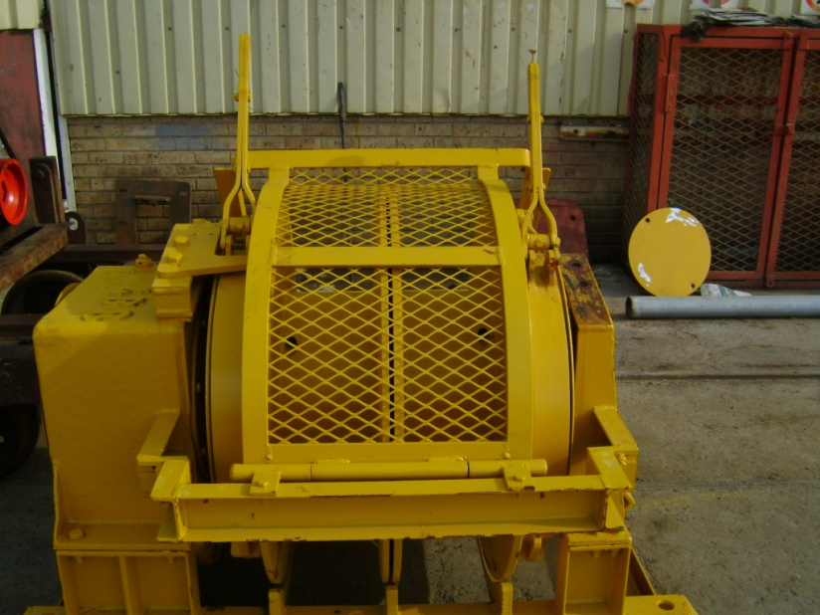
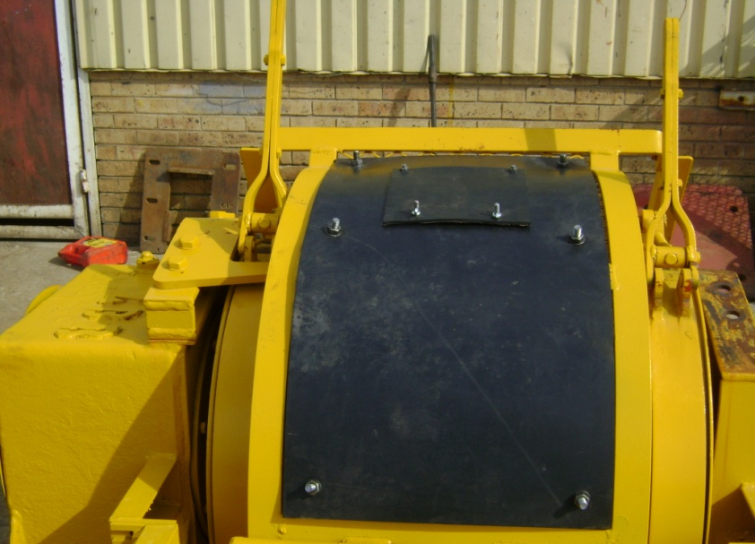
Winch cover fitment
Winch Cover – Randall Cover

Slide 5
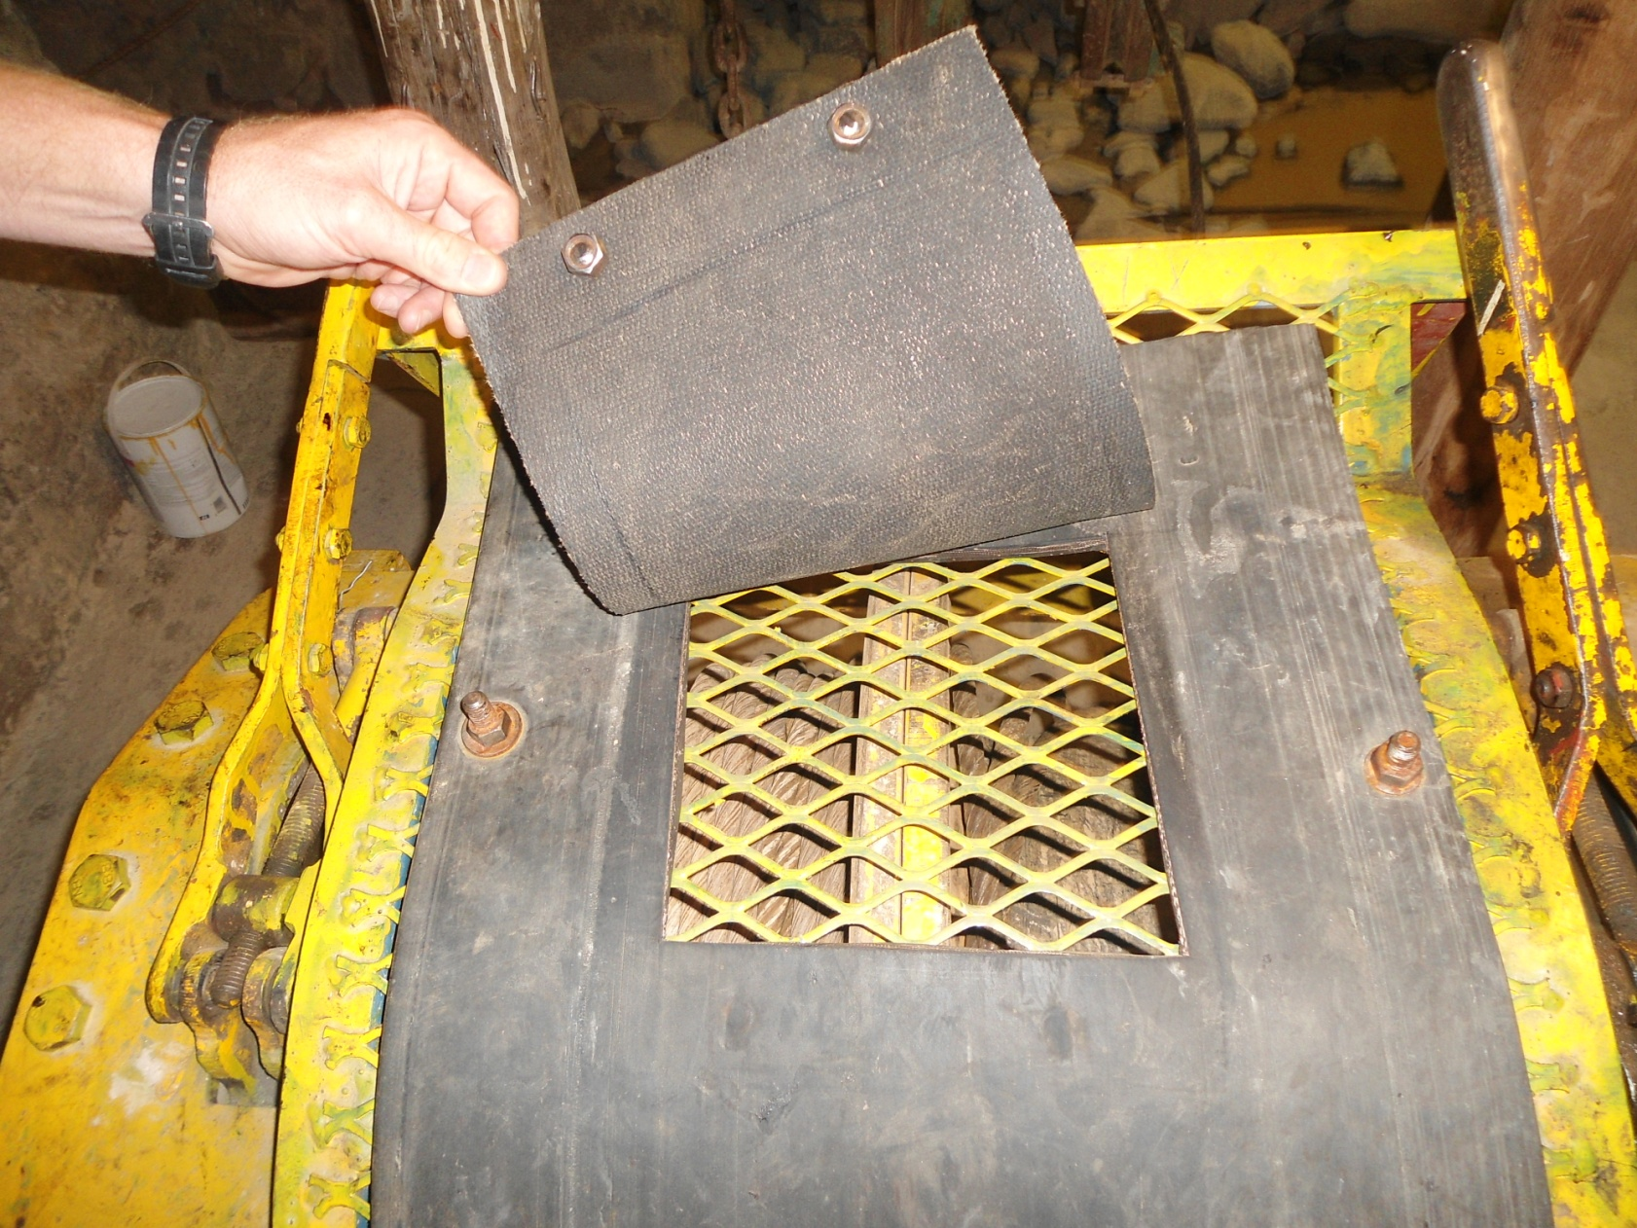
Winch cover inspection flap

Slide 6
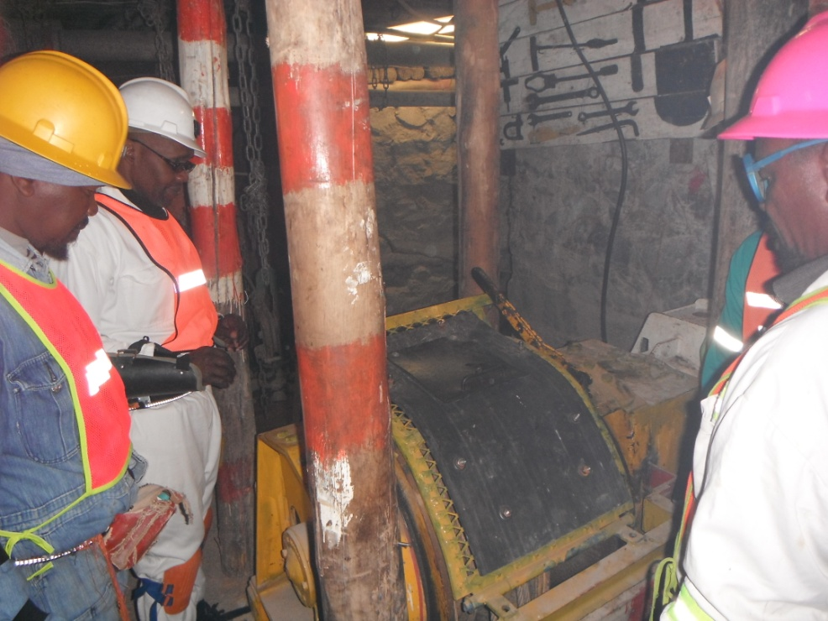
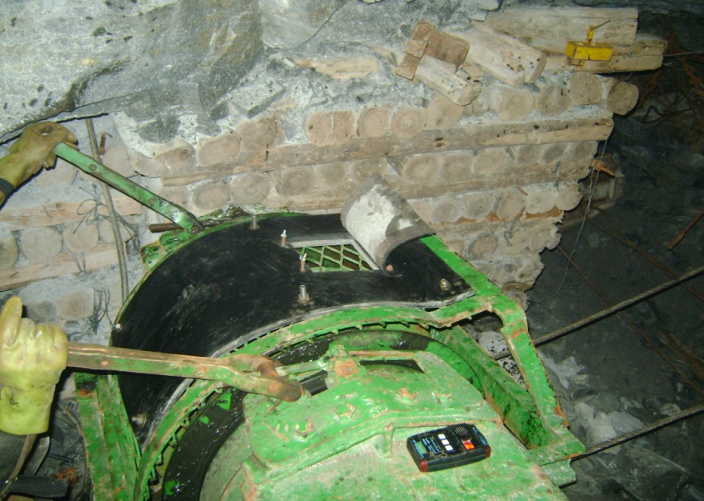
Winch cover in use

Slide 7
Results of initial tests
Winch cover initial tests done at start of project

Slide 8
Project roll out
Project roll out commenced at Beatrix West Section
  Section where project was initiated
113 Winches fitted with covers
Before and after readings:
  35 Before readings taken with an aerosol monitor
  21 After readings taken with aerosol monitor

Slide 9
Comparative dust readings

Slide 10
Average dust readings

Slide 11
Acknowledgement
Barry Nel
Clinton Randall
Beatrix Management

Slide 12
THANK YOU

