Slide 1

Tshepong Mine
Winch Covers
10 June 2014

Slide 2
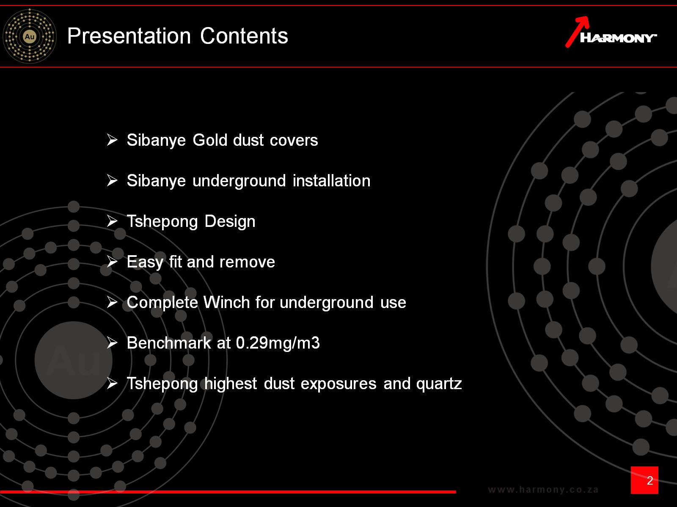
Presentation Contents

Slide 3
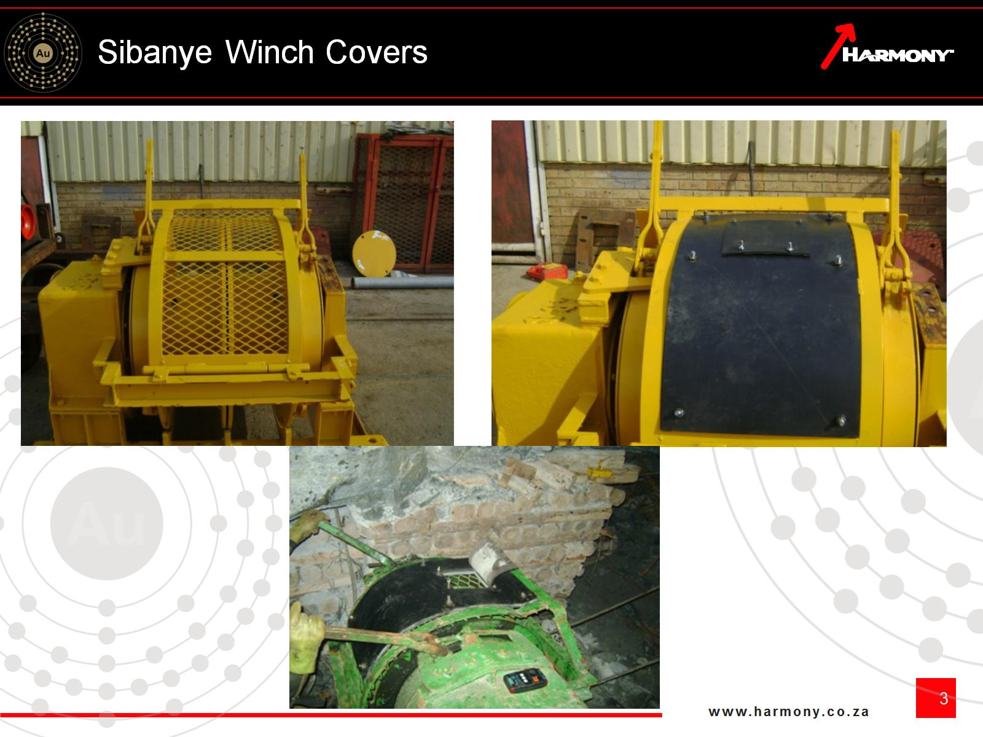
Sibanye Winch Covers

Slide 4
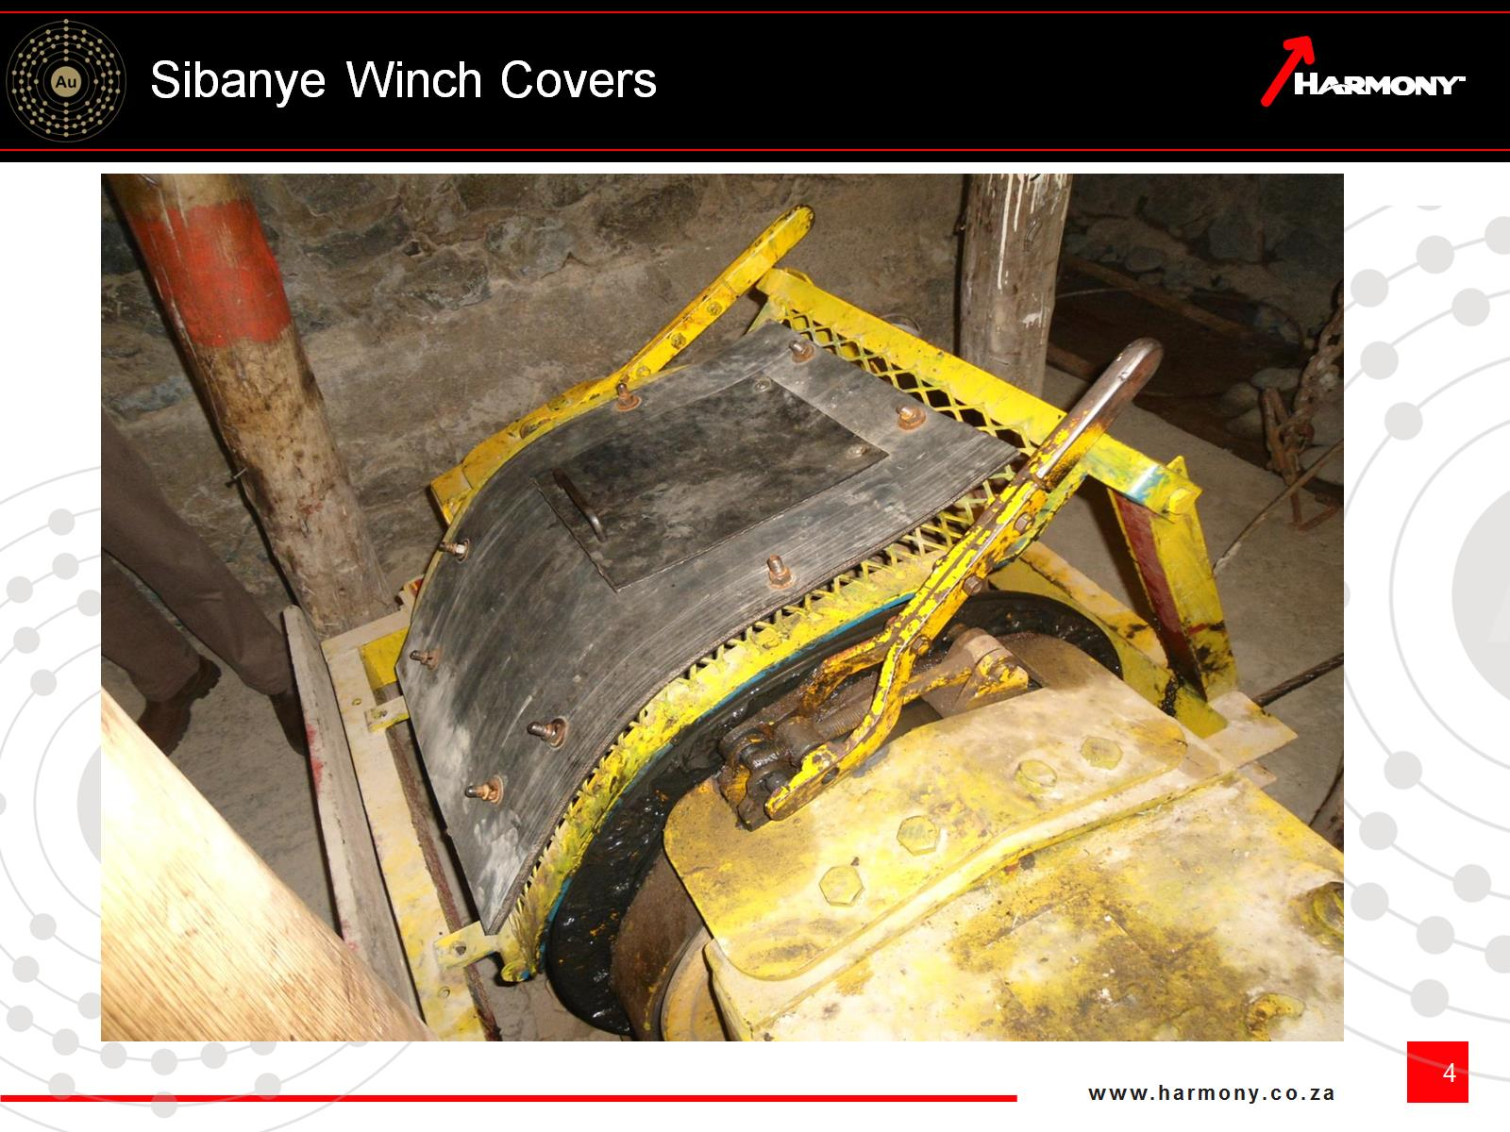
Sibanye Winch Covers

Slide 5
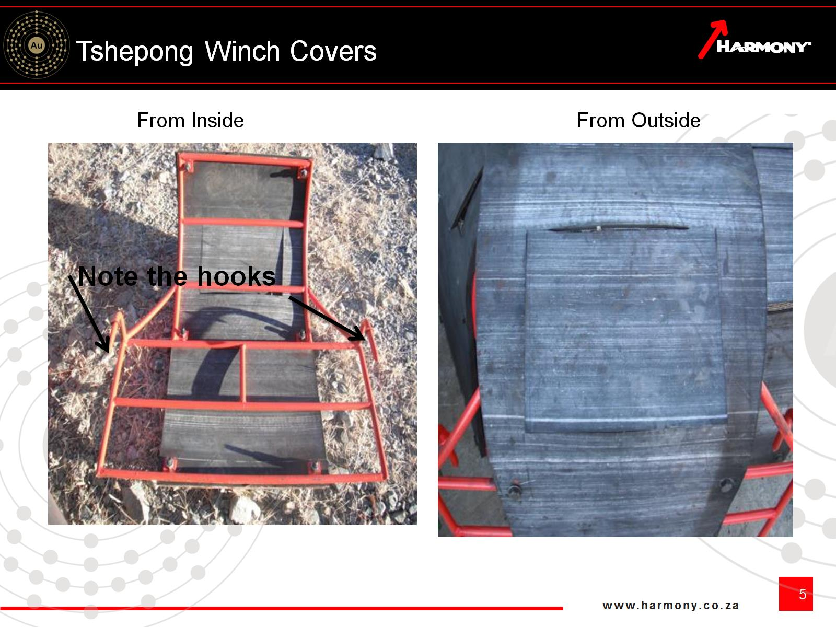
Tshepong Winch Covers

Slide 6
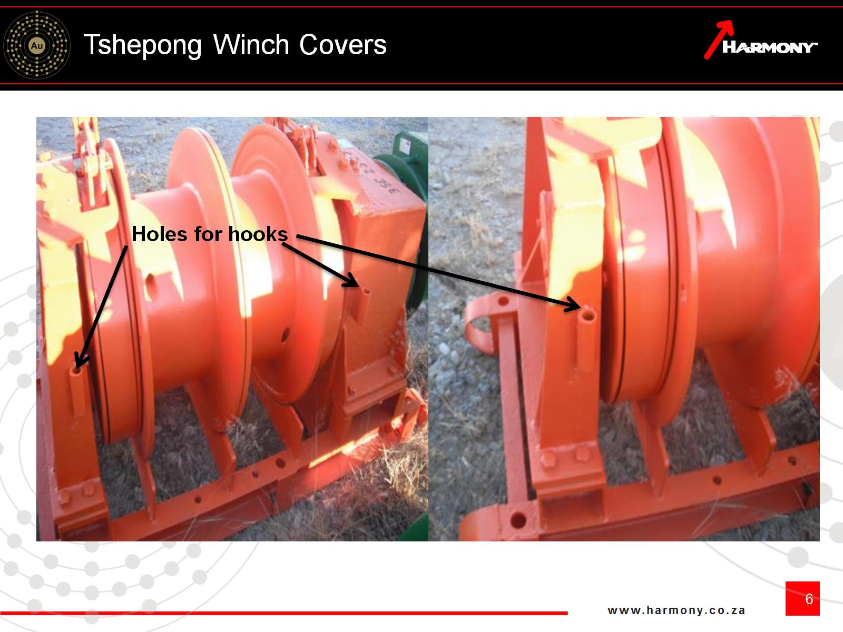
Tshepong Winch Covers

Slide 7
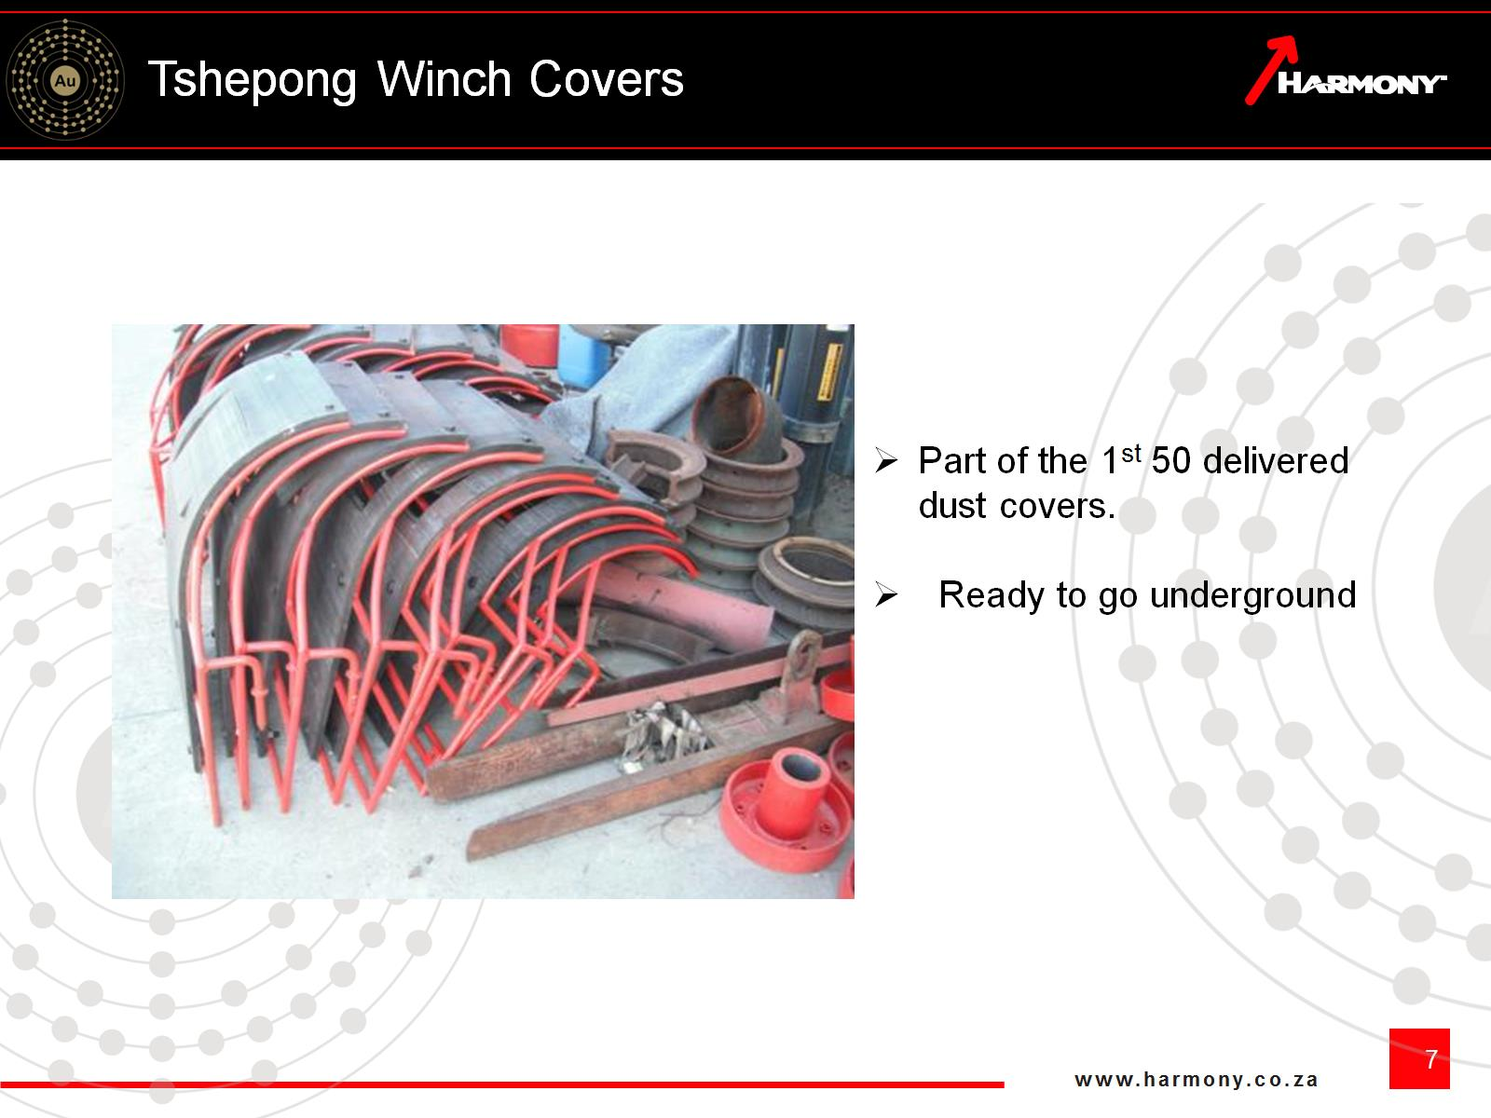
Tshepong Winch Covers

Slide 8
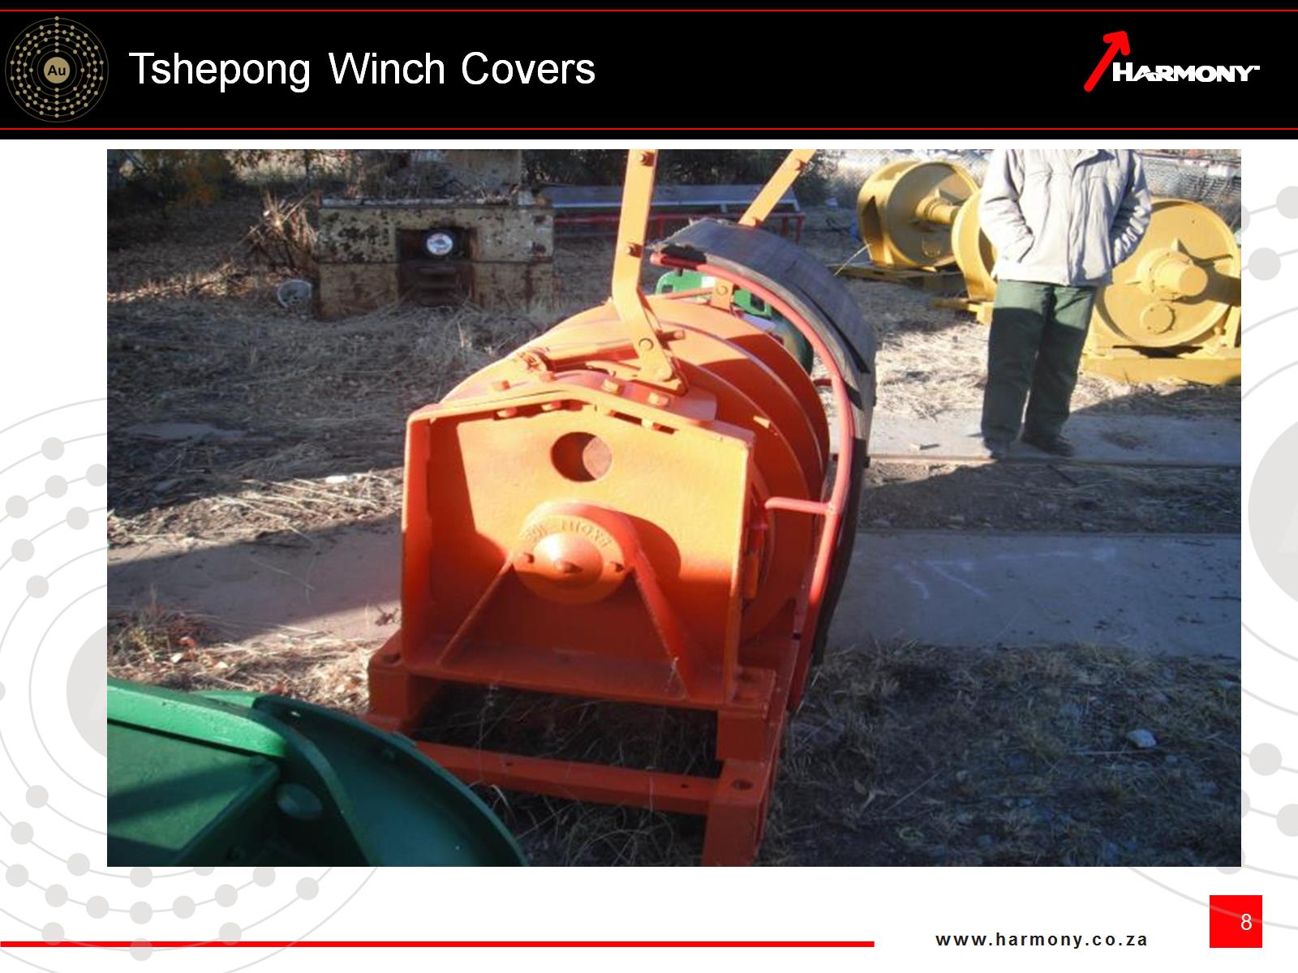
Tshepong Winch Covers

Slide 9
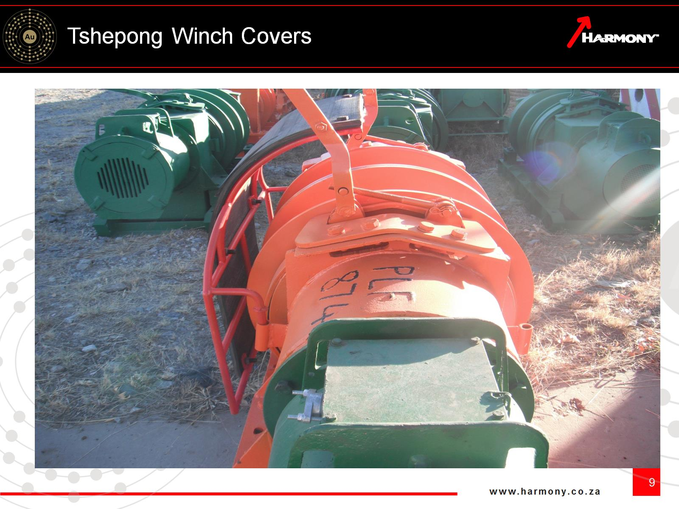
Tshepong Winch Covers

Slide 10
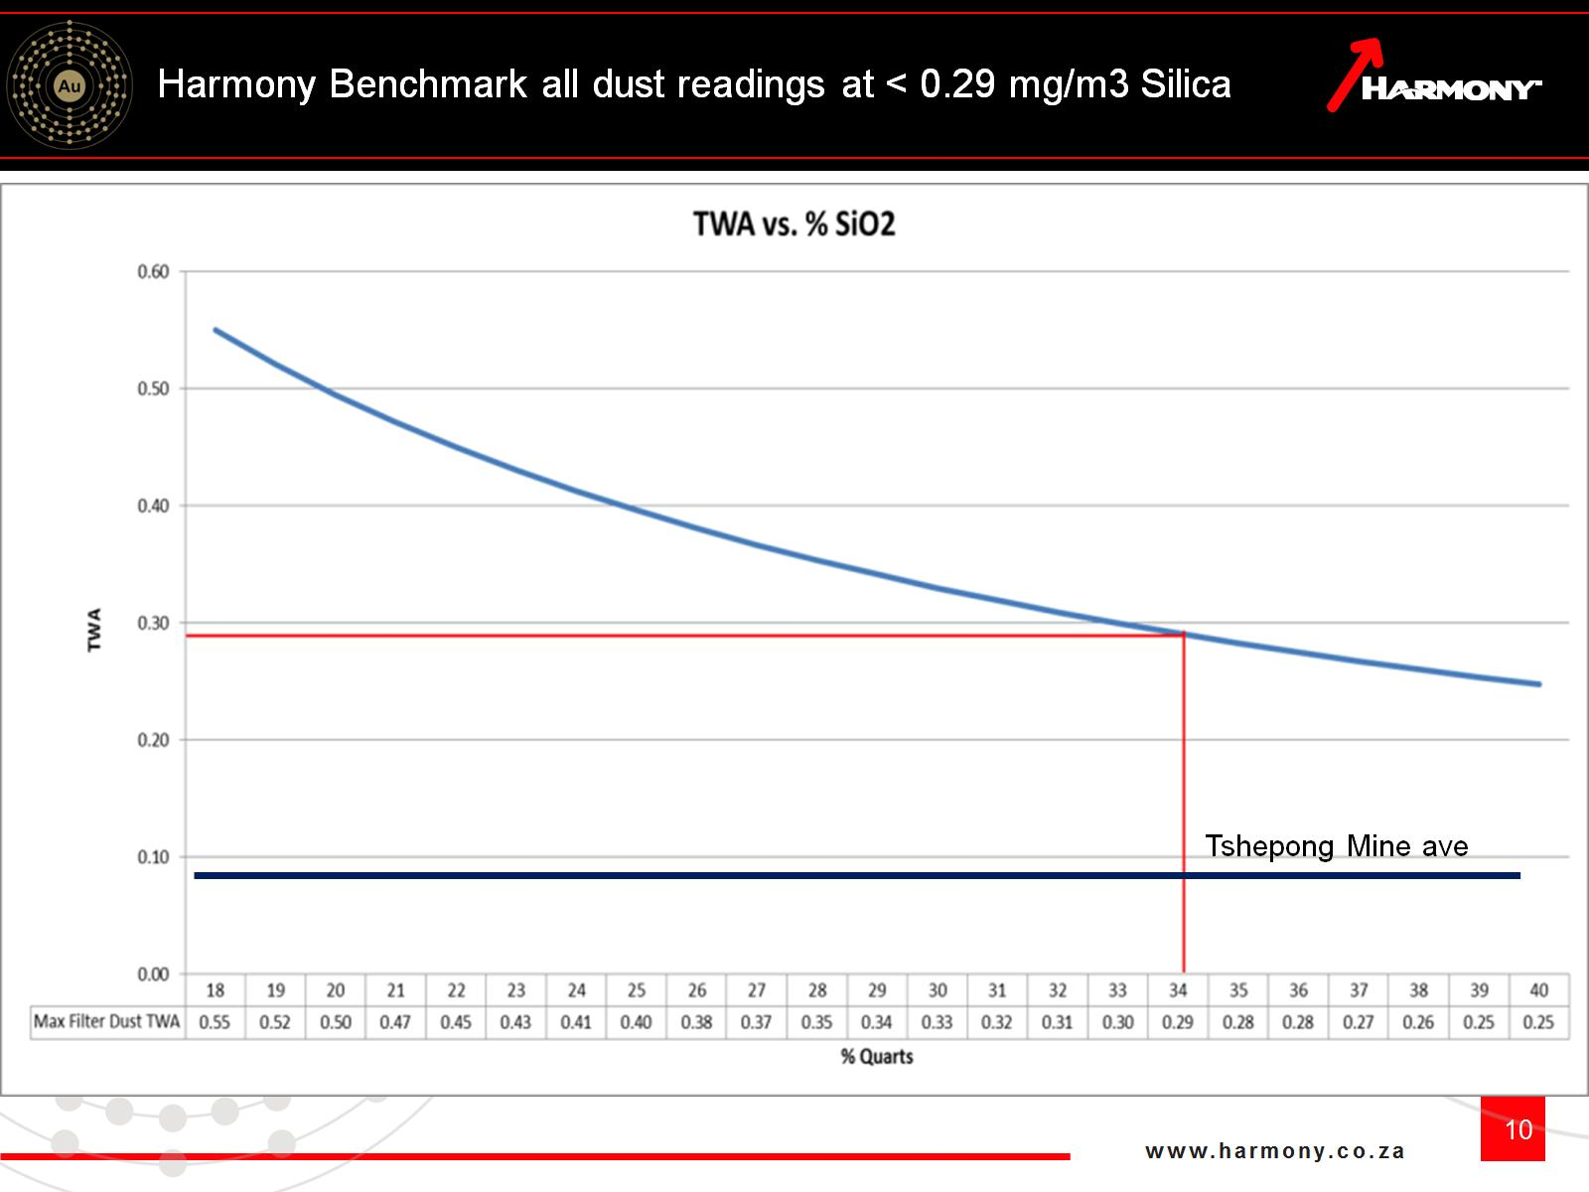
Harmony Benchmark all dust readings at < 0.29 mg/m3 Silica

Slide 11
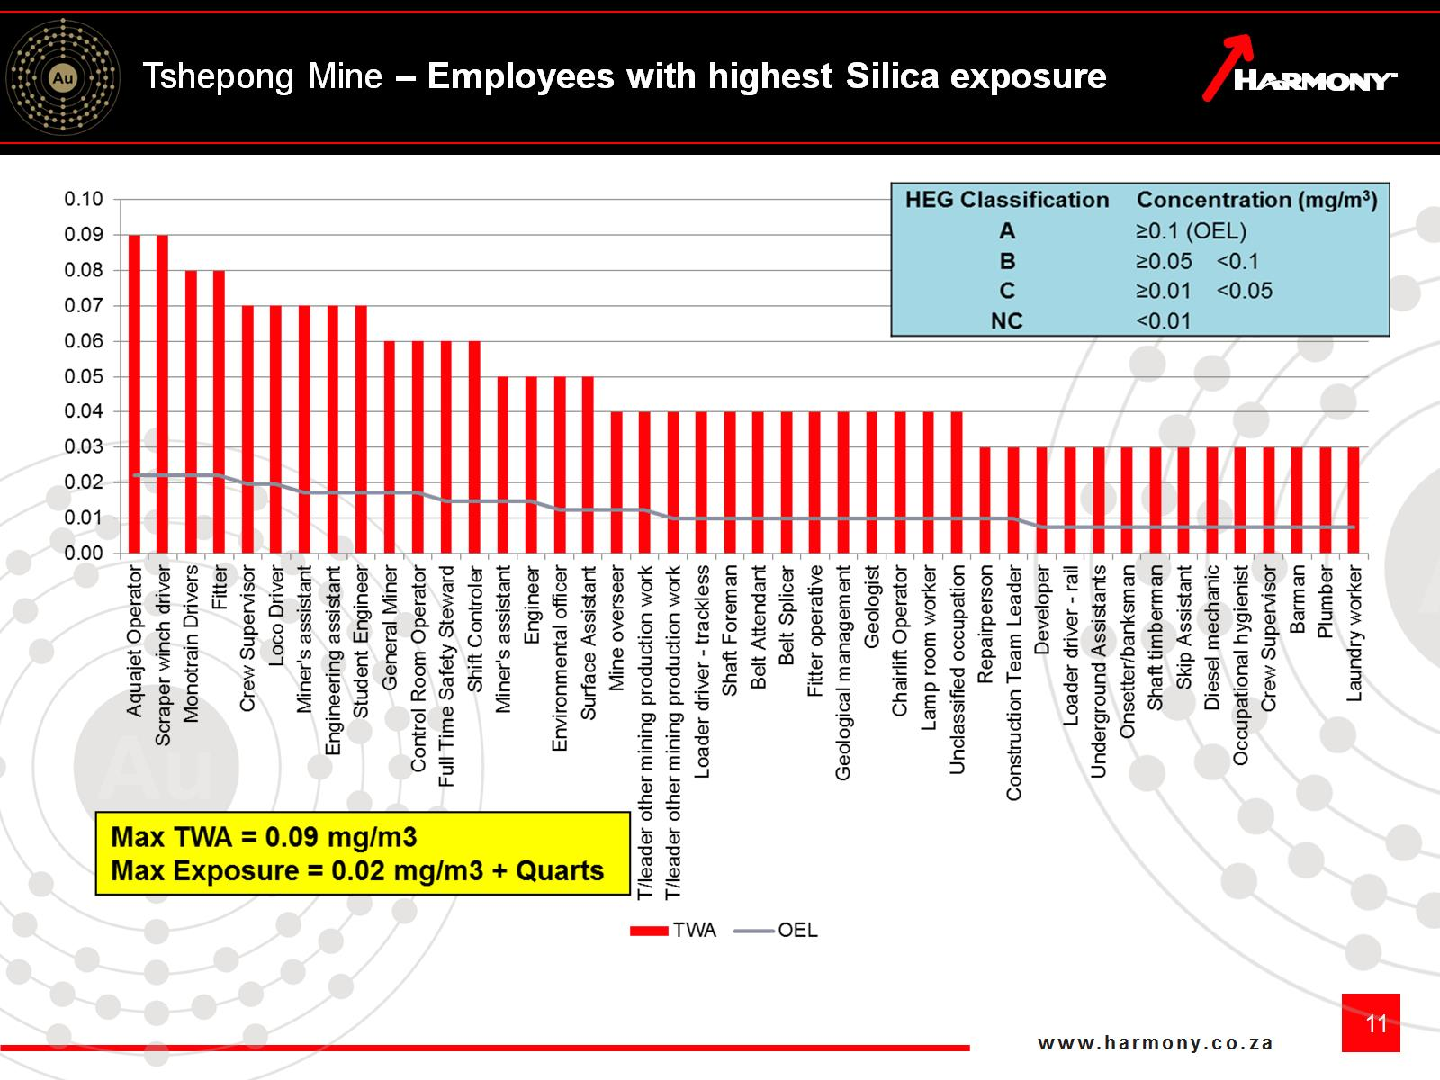
Tshepong Mine – Employees with highest Silica exposure

Slide 12
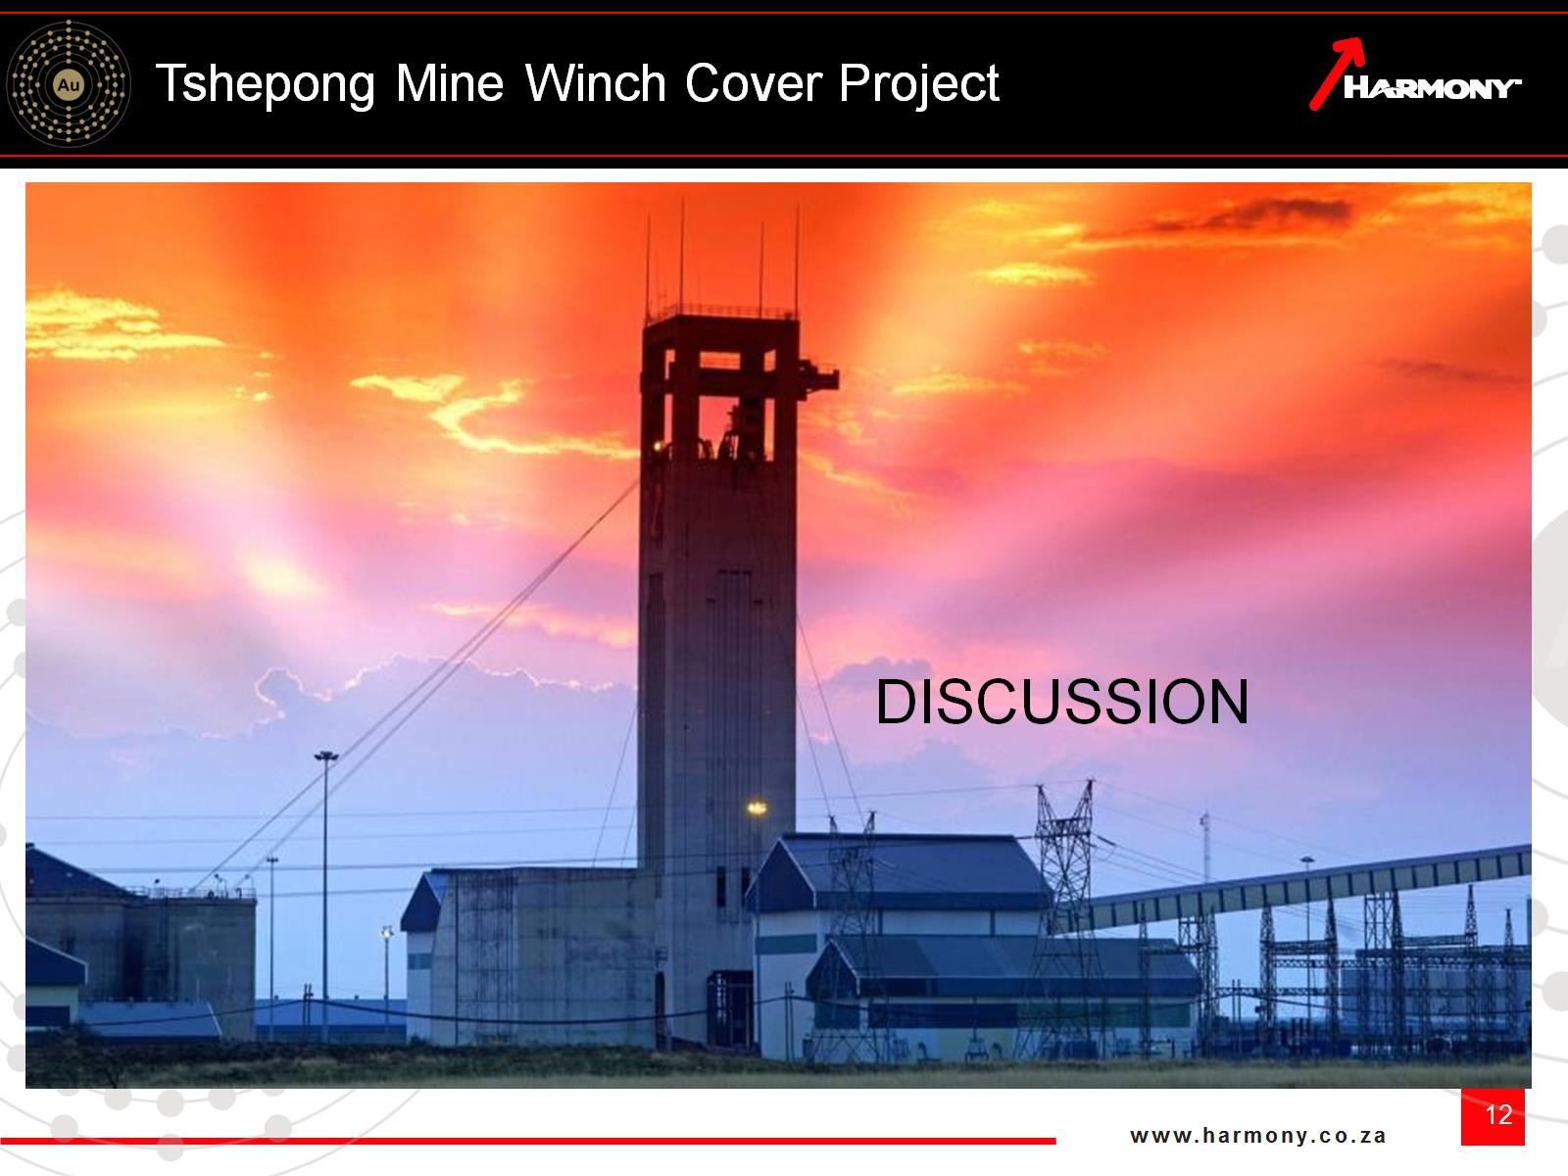
Tshepong Mine Winch Cover Project

