Slide 1


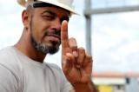
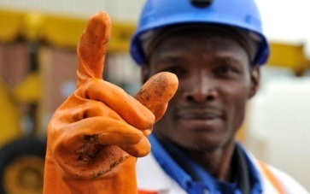
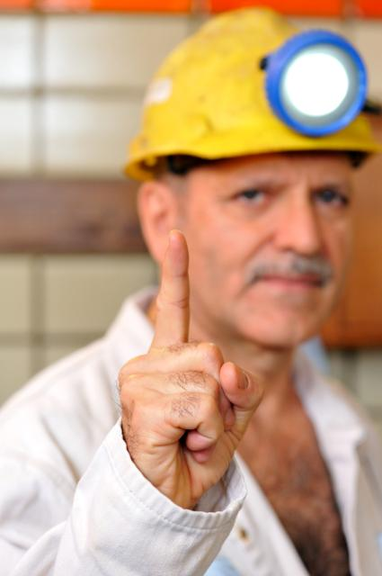
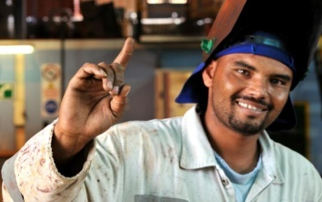


RICHARD OLIVIER
T. D .O SIMUNYE TEAM TRAINING
GATEWAY
VAAL RIVER
ANGLOGOLD ASHANTI
Drillling and Blasting - 101
1

Slide 2






OUR VALUES
Safety is our first value.
We place people first and correspondingly put the highest priority on safe and healthy practices and systems of work. We are responsible for seeking out new and innovative ways to ensure that our workplaces are free of occupational injury and illness. We live each day for each other and use our collective commitment, talents, resources and systems to deliver on our most important commitment ... to care.
We treat each other with dignity and respect.
We believe that individuals who are treated with respect and who are entrusted to take responsibility respond by giving their best. We seek to preserve people's dignity, their sense of self-worth in all our interactions, respecting them for who they are and valuing the unique contribution that they can make to our business success. We are honest with ourselves and others, and we deal ethically with all of our business and social partners.
We value diversity.
We aim to be a global leader with the right people for the right jobs. We promote inclusion and team work, deriving benefit from the rich diversity of the cultures, ideas, experiences and skills that each employee brings to the business.
We are accountable for our actions and undertake to deliver on our commitments.
We are focused on delivering results and we do what we say we will do. We accept responsibility and hold ourselves accountable for our work, our behaviour, our ethics and our actions. We aim to deliver high performance outcomes and undertake to deliver on our commitments to our colleagues, business and social partners, and our investors.
The communities and societies in which we operate will be better off for AngloGold Ashanti having been there.
We uphold and promote fundamental human rights where we do business. We contribute to building productive, respectful and mutually beneficial partnerships in the communities in which we operate. We aim to leave host communities with a sustainable future.
We respect the environment.
We are committed to continually improving our processes in order to prevent pollution, minimise waste, increase our carbon efficiency and make efficient use of natural resources. We will develop innovative solutions to mitigate environmental and climate risks.

Slide 3
WHAT DOES IT TAKE TO HAVE SUCCESSFUL DRILLING AND BLASTING?
1. Correct Supervision - Shiftboss
KNOWLEDGE DUE TO THE CORRECT GROUNDING
  Experience as a miner
  Miners learned to be mentors
  Attitude of learning.
RESPECT FOR THE POSITION AND AUTHORITY OF THE SHIFTBOSS
  Aspiration to be one
PRIDE IN THE POSITION AS A SHIFTBOSS
MANAGE THEIR WORKING PLACES WITH THE MINIMUM OF ASSISTANCE

Slide 4
WHAT DOES IT TAKE TO HAVE SUCCESSFUL DRILLING AND BLASTING?
2. Plan and Work to Standard
STRIKE GULLIES TO BE KEPT ON LINE
CENTER GULLIES TO BE KEPT CLEAN
EQUIPMENT AND SERVICES TO BE KEPT TO STANDARD WITHOUT FAIL
SUPPORT TO BE INSTALLED TIMEOUSLY NOT ALLOWING LAYERS TO BE EXPOSED

Slide 5
WHAT DOES IT TAKE TO HAVE SUCCESSFUL DRILLING AND BLASTING?
3. Attention to Drilling and Blasting Practice
MARKING AND DRILLING DISCIPLINE
CORRECT CHARGING UP AND TIMING
USE OF STEMMING

Slide 6
WHAT DOES IT TAKE TO HAVE SUCCESSFUL DRILLING AND BLASTING?
4. Managing People
Treat People with Respect
Speak and don’t rant
Demonstrate and mentor

Slide 7
Evidence that it Works
Production
Safety and Rewards
Relationships

Slide 8
Evidence that it Works
Production
Safety and Rewards
Relationships

Slide 9
Production Data

Slide 10
Production Data

Slide 11
Production Data

Slide 12
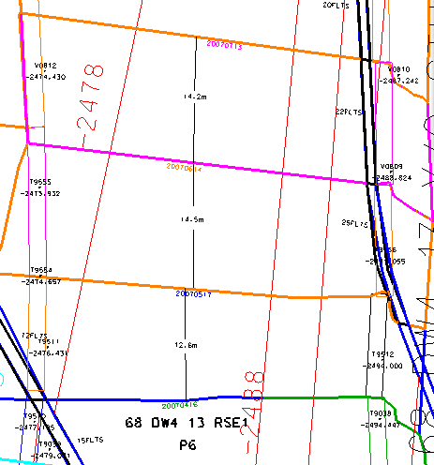
14.6m
15.5m
15,2m
F/L = 47M

Slide 13
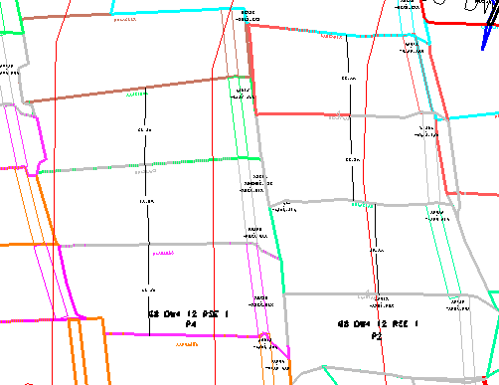
16,4m
15.4m
15.1m
14.6m
15,1m
16.2m
15.7m
15.2m

Slide 15
Evidence that it Works
Production
Safety and Rewards
Relationships

Slide 16
Safety Performance
No Fatal Accidents in the section
No serious injuries

Slide 17
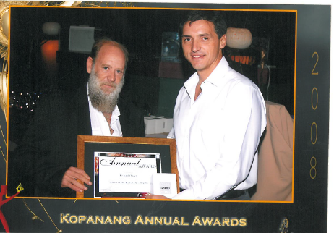
RECEIVING THE SHIFT BOSS OF THE YEAR AWARD ON MY LAST YEAR ON PRODUCTION(STOPING) AT THE AGE OF 52 WAS STILL RUNNING 6 PANELS SOMETIMES IN THREE DIFFERENT RAISE LINES

Slide 18
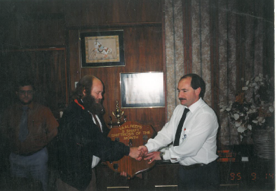
Safety Award received in 1995 – this is only achievable on a regular basis if you are visible in your working places

Slide 19

Rewards not only received for stoping. This was for 1000m linear achieved for six consecutive months - four shift bosses only .This was only achievable because OF PRIDE , EXPERIENCE AND A POSITIVE WORK ETHIC( Knowledge = proper on-the-job coaching)

Slide 20
Evidence that it Works
Production
Safety and Rewards
Relationships

Slide 21
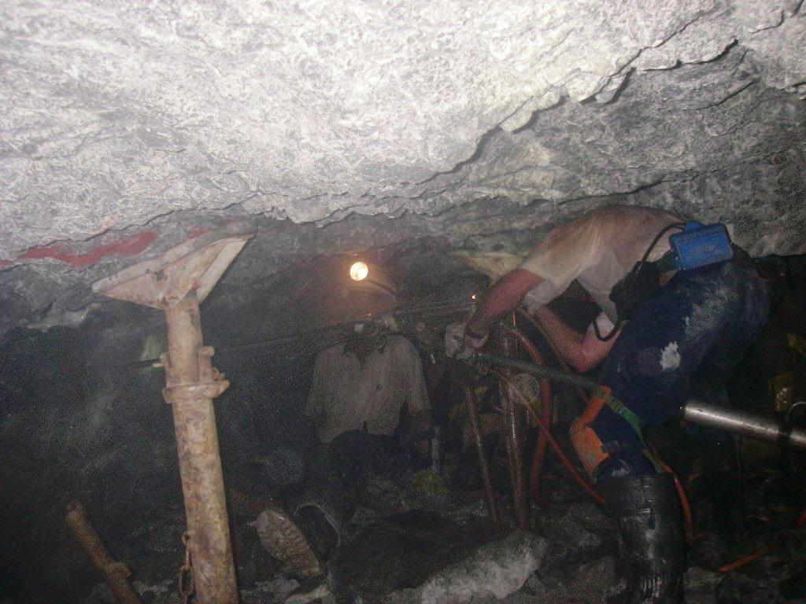
On the job coaching if you identify a shortcoming demonstrate the correct way of doing the task and don’t just rant and rave. This is a definite way of gaining respect from the people who work for you (The empty barrel makes the most noise)
Note the direction and dip of the hole being drilled as well as the prevailing hanging wall conditions and stoping width
Position whilst collaring the hole

Slide 22
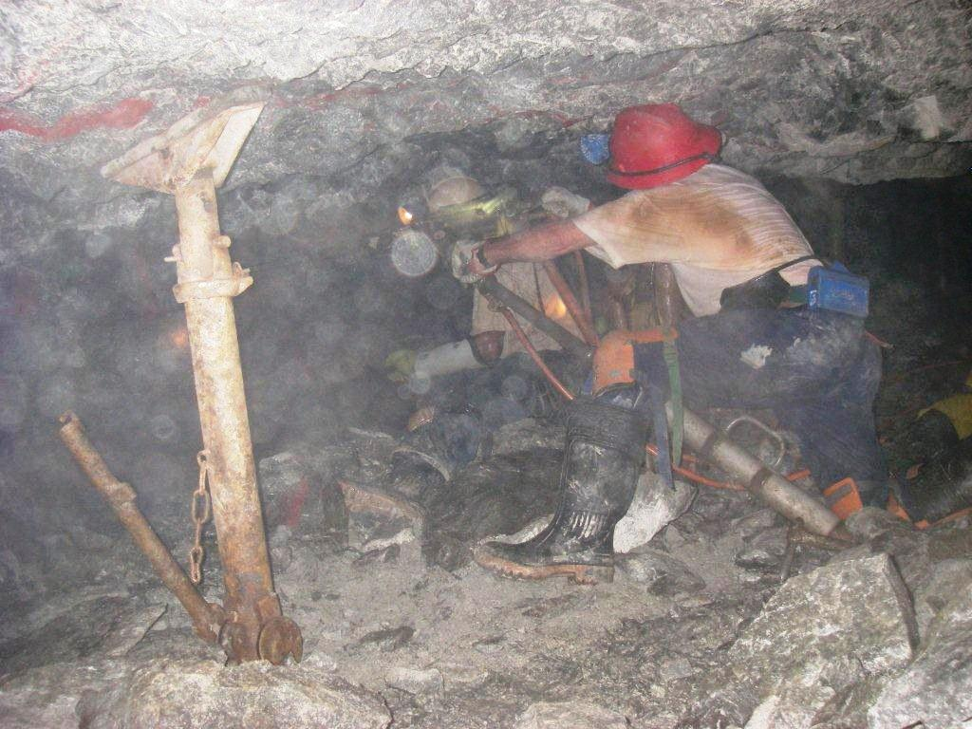
MY PERSONAL PROFILE
Stoping width control
+- 90 cm
I started my Mining career in 19…. As a ………………………….

Slide 23
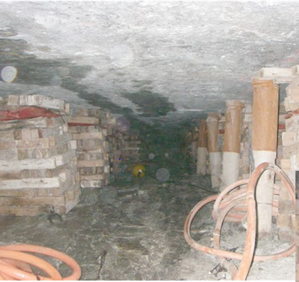
INSTALLATION OF SUPPORT AND SWEEPINGS AS PER STANDARD –IN ORDER TO HAVE HANGING AND FOOTWLL CONDITIONS LIKE THESE MARKING AND DRILLING DISCIPLINE IS IMPERATIVE. FACILITATES EASIER INSTALLATION OF SUPPORT AND CLEANING
LOOK AT THE INTEGRITY OF THE HANGING WALL SUPPORT INSTALLED AT THE CORRECT TIME

Slide 24
IS IT POSSIBLE TO REPLICATE THIS ACROSS THE INDUSTRY?
YES!

