Slide 1
SASOL CHEMICALS
BASE CHEMICALS (EXPLOSIVES)
MOSH - "Day of Learning"
2014

Slide 2

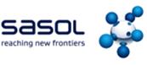

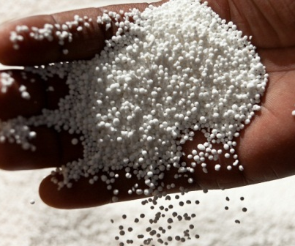
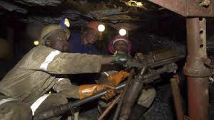
Topic:
Energy partitioning / sequential firing and the use thereof – ‘back to basics’

Slide 3
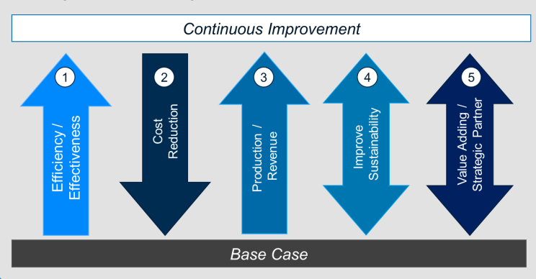
Eliminating falls of ground
Define the requirements
Define the problem and determine what is to be achieved?
Identify how it is to be achieved and keep it simple
Improve blasting results, safely

Slide 4
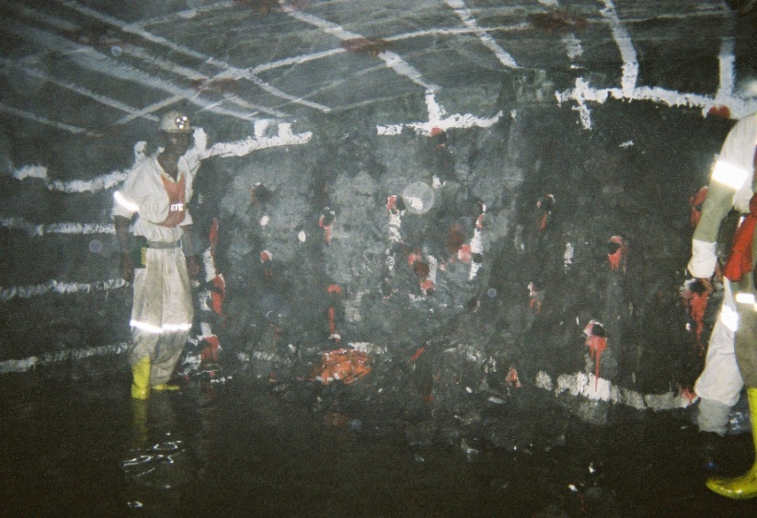
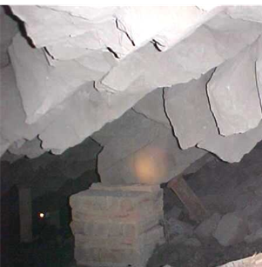
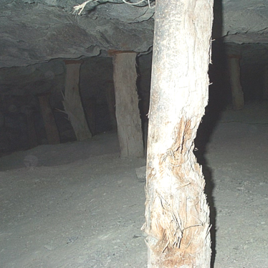
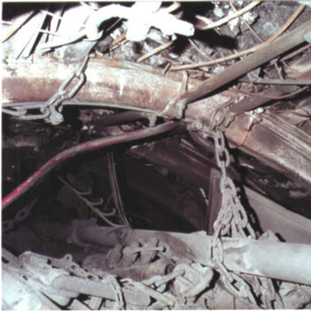
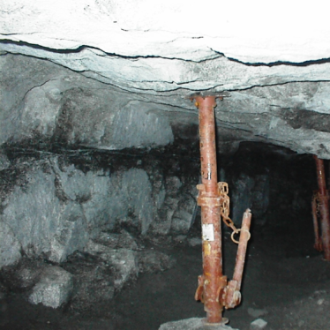
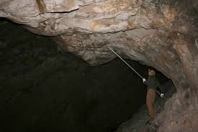
Eliminating falls of ground
Define the hazard – common reasons for ‘falls of ground’
Natural
Geological discontinuities
Rock bursts
Planning
Mining method
Mine discipline
Support or roof bolting not effective
Training
Knowledge of workers
Barring or scaling
Blasting
Incorrect use of equipment

Slide 5
Eliminating falls of ground
Define the hazard – interaction of everybody to address ‘falls of ground’
Plan for improvements in ‘falls of ground’ & accurately execute blast design
Geology
Planning
Survey
Excavation preparation
Drilling
Priming, Charging & Blasting
Loading & hauling
Plant
Plan:
blast design
Measure:
each department
in value chain
Review & Improve
Do:
departmental performance
Are you prepared to change?

Slide 6
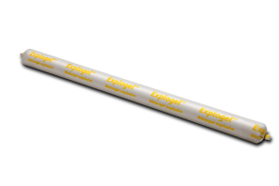
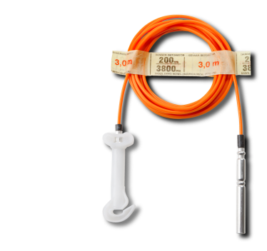
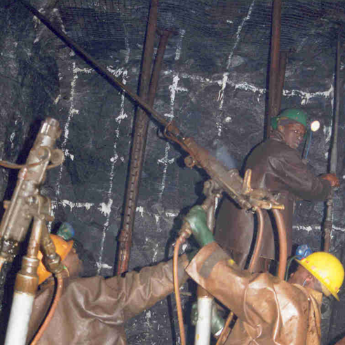
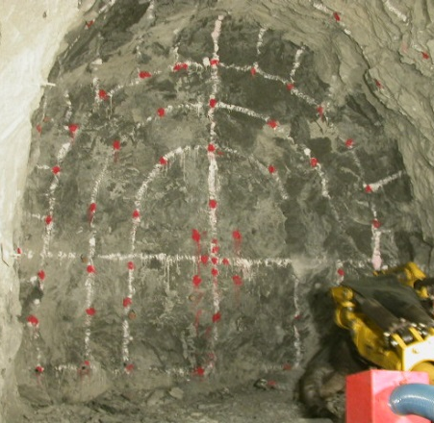
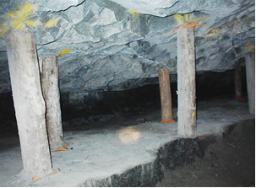
Eliminating falls of ground
Define the requirements – ‘falls of ground’ are influenced by
Energy / Energy / Energy
Energy Distribution
  Location of hole - marking
  Hole diameter
  Burden and spacing
  Careful implementation of drill pattern
  Directionality of drilling
Available Energy
  Correct amount and type of explosives for required for specific conditions
  Manage site sensitivity - geology
  Evaluate energy for special conditions – poor floor, large toe burdens, geology
Release of Energy
  Control & ensure the ‘path of least resistance’
  Correct use stemming – containment of energy
  Blast holes loaded according to geology
  Match timing to existing field conditions – wet, fractured
  Accurate delays

Slide 7
Product selection
Plan – Do – Measure - Review
Initiation control
Explosive energy
initiation
devices
starter
explosives
Charging-up
and
Stemming
Detonation
and Energy
Release
BLASTING
PROCESS
fragmentation
drilling
PREPARATION
RESULT
marking
wasted
energy
cast
preparation
Geology, Standards
and Support
damage
loading /
cleaning / hauling
Physical effort
Output of rock

Slide 8

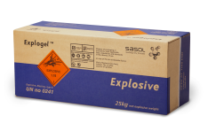
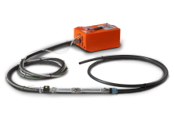
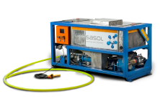
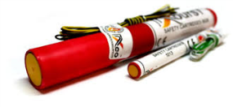
Blast optimisation
Quality ultimately equals quantity
The objectives of any blast is:
  Maximum advance per blast
  Minimise surrounding rock damage
  Minimise the effort
  Reduce overall costs (explosives & accessories, time, drilling)
  Maximise the yield
Effective relief = maximum advance with minimal perimeter damage (‘falls of ground’ reduction)
36.0cm (advance) = 1.0cm (relief required)
ADVANCE IS NOT DETERMINED BY THE SIZE OF THE EXCAVATION!

Slide 9
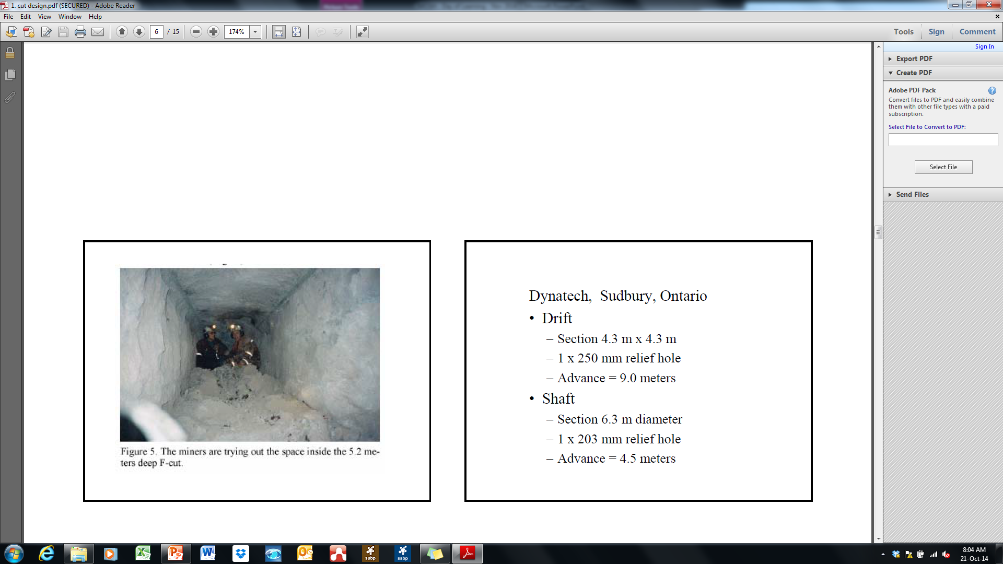
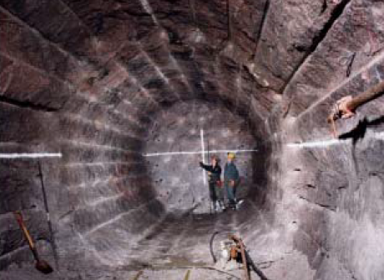

Blast optimisation
Relief + accuracy + correct level of energy = competent perimeter results
36.0cm (advance) = 1.0cm (Ø relief hole) Relief hole determination with an 38.0mm drill bit
Therefore if 3.2m advance / blast is required ${89²}/{38²}$ = 5.49 holes required
36 x (${ x}/{10}$ ) = 3.2m = 6 holes required
$x$ = 8.9cm (minimum relief required 3 holes / optimal results require 6 holes)
1.2m x 1.2m tunnel
5.2m advance
4.2m x 4.2m tunnel
8.54m advance

Slide 10
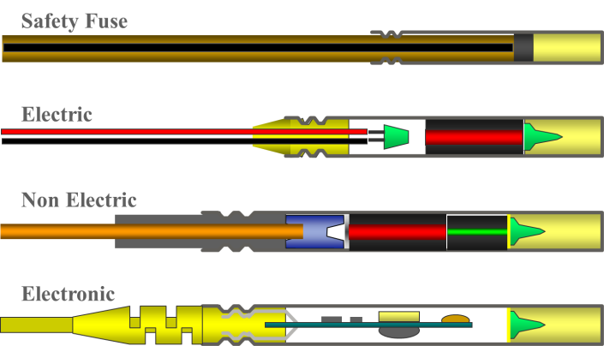
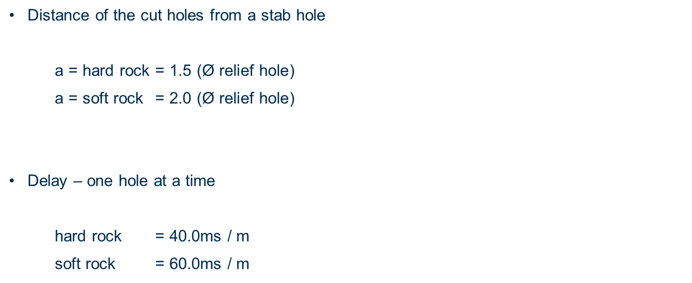
Blast optimisation
Reliability + Accuracy = Safety
38 x 6 = 228
Distance of the cut holes from a stab hole
a = hard rock = 1.5 $\text{(Ø }\text{relief} \text{hole}\text{)}$
a = soft rock = 2.0 $\text{(Ø }\text{relief} \text{hole}\text{)}$
Delay – one hole at a time
hard rock = 40.0ms / m
soft rock = 60.0ms / m
a = 171 / 190

Slide 11
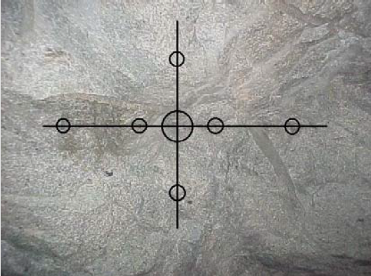
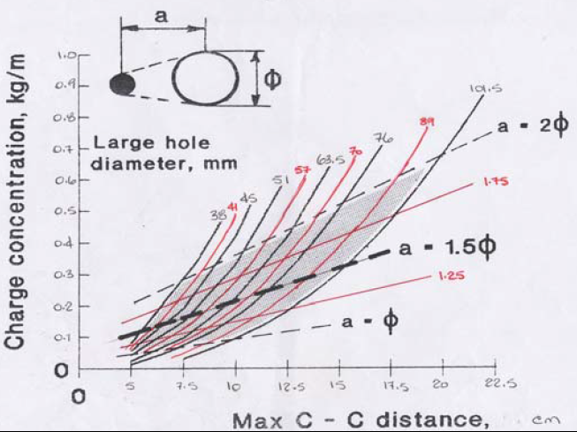
Blast optimisation
Hole distribution & charge efficiency ensures success
The cut & easers are marked as an equilateral Charge mass = 0.25 to 0.65kg / m
triangle
(base / 1.155) = height charge mass for 3.2m (@ 0.45) = 1.17kg (@ 0.65) = 1.70kg
342/ 1.155 = 296

Slide 12
Blast optimisation
15
15
15
Sequential firing / powder factor &
creating the relief
15
15
15
11
15
11
11
12
12
15
11
15
General guide
Cut = ANFO, emulsion, watergel
Easers = ANFO, emulsion, watergel
Production = ANFO, emulsion, watergel
Lifter = ANFO, emulsion, watergel
Perimeter = ANFO, emulsion, watergel
✗
✓
✓
✗
✓
✓
10
15
12
11
11
12
15
✓
✓
✓
✓
✓
✓
✗
✓
✓
14
9
13
11
10
10
11
6
5
14
6
2
13
1
3
GRADE LINE
General guide
Cut = 0.4 to 0.6 kg/m
Easers = 0.6 to 0.8 kg/m
Production = 1.40 kg/m
Lifter = 1.40 kg/m
Perimeter = 0.2 to 0.4 kg/m
14
10
9
9
10
13
4
7
8
14
11
10
9
10
11
13
17
11
16
16
16
11
17
16
16

Slide 13
Blast optimisation
Sequential firing / powder factor & creating the relief
General guide
Cut = ANFO, emulsion, watergel
Easers = ANFO, emulsion, watergel
Production = ANFO, emulsion, watergel
General guide
Cut = 0.6 to 0.8 kg/m
Easers = 0.6 to 0.8 kg/m
Production = 0.6 to 0.8 kg/m
✓
✓
✓
✓
✓
✓
✓
✓
✓

Slide 14
Accuracy the key to success & sequential firing
Standard deviation & safety
Bushing
Seal crimp
PETN Base charge
Flatland crimp
DIB
Cushion Disc
Shock tube
Isolation cup
Lead azide primary charge
7.5mm Aluminum cap shell
Pyrotechnic delay train
Fuse head
PETN Base charge
Moulded grommet
Capacitor
Cushion Disc
Lead Wire
PC board
Lead azide primary charge
Earth Spike
Micro Chip
Cushion disc

Slide 15
Mitigation of diamond damage
Mine need a “One Solution” Value – Added supplier and strategic partner
Strategic Partner
  Number of Suppliers
  Features
  Price
  “Total cost” of selling/buying
Value-Added Supplier
Increase
Decrease
Product Vendor
  Risk/Reward
  Supplier’s value-add
  Relationships
  Information Sharing
Current Supply Position
Current relationships are transactional – benefits will only be realised at strategic partner stage.

Slide 16

Questions?

