Slide 1

The MOSH Leading Practice Adoption System – a leading practice in its own right
S Malatji
and
JM Stewart
Presented at MineSAFE 2013
22-23 October 2013
1

Slide 2
Introductory comments
Much achieved since 2003
Improvements are due to action by operational management
Reluctant compliance is unlikely to be sustainable
The key is eager adoption, not reluctant compliance
Adoption requires people to voluntarily change what they do
The MOSH System addresses this challenge in a special way
This paper provides an overview of the system.

Slide 3
Motivating context for development of the System
2013 Tripartite Industry Milestones
OCCUPATIONAL SAFETY
Industry Target: Zero rate of fatalities and injuries
Milestones:
In the Gold Sector: By 2013 achieve safety performance levels equivalent to current international bench marks for underground metalliferous mines, at the least;
In the Platinum, Coal and Other Sectors: By 2013 achieve constant and continuous improvement equivalent to current international benchmarks, at the least.
OCCUPATIONAL HEALTH
Industry Target: Elimination of Silicosis
Milestones:
By 2008, 95% of all exposure measurement results will be below the occupational exposure limit for respirable crystalline silica of 0.1mg/m³
After 2013, no new cases of silicosis will occur amongst individuals unexposed prior to 2008.
Industry Target: Elimination of Noise Induced Hearing Loss (NIHL)
Milestones:
After 2008, no deterioration in hearing greater than 10% amongst occupationally exposed individuals
By 2013, the total noise emitted by all equipment installed in any workplace must not exceed a sound pressure level of 110dB (A) at any location in that workplace
Abbreviated

Slide 4
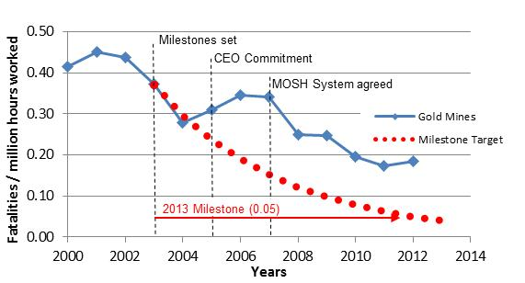
Fatality rates for gold mines

Slide 5
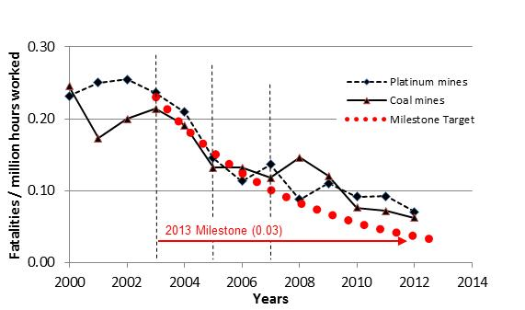
Fatality rates for platinum and coal mines

Slide 6
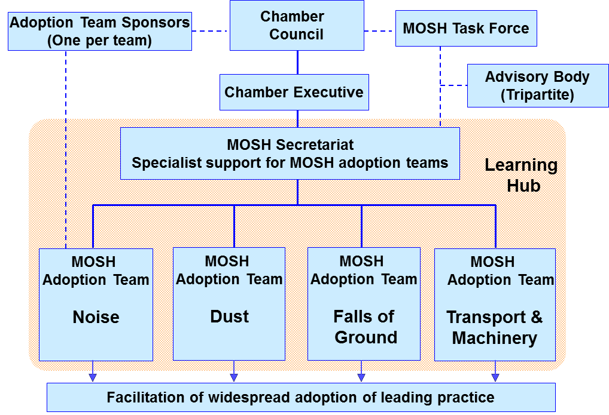
Key features of the adoption system - Industry ownership
Schematic showing the core MOSH Structures

Slide 7

Schematic of the Behaviour Change Process
Best Available Knowledge
Expert model of risk situation
Established behaviour science
Leadership behaviour plan
Analysis to establish Mental Model
Comparison to identify communication and leadership requirements
Behavioural communication plan
Direct enquiry process
Misperceptions
Poor understanding
Knowledge gaps
Disbelief
Misperceptions
↓
-Misplaced Resistance-
It makes sense to me
It will improve my safety
Safe production is important
We must make it work
↓
-Well-founded Acceptance-
Existing Mental Model
New Mental Model

Slide 8
Simple logic of the MOSH process
The basic MOSH process
Step 1
Identify the leading practice with the greatest OHS benefit
Step 2
Document the leading practice, including behavioral plans
Step 3
Facilitate widespread adoption of the leading practice

Slide 9
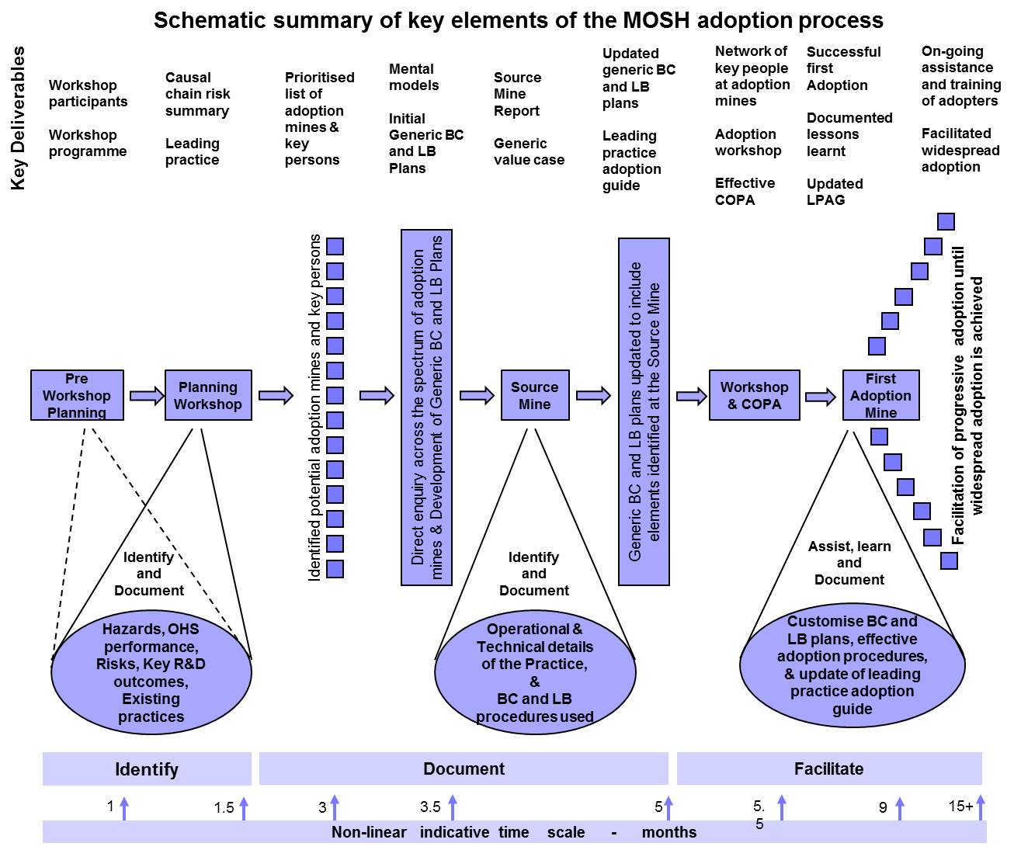
Systematic process steps of the adoption system

Slide 10
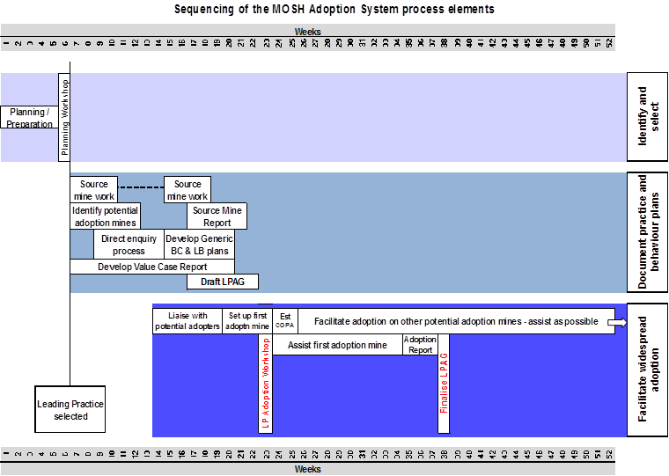
Systematic process steps of the adoption system

Slide 11
Ongoing provision of specialist support
Permanent full-time specialist secretariat to support Adoption Teams and Process
Adoption Specialist for each Adoption Team
Behaviour Specialist
Monitoring Specialist
Administrative support

Slide 12
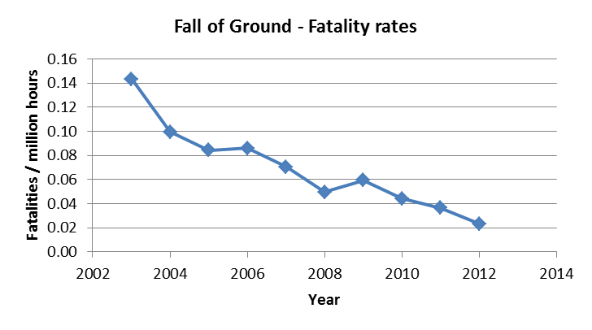
Establishment of MOSH Adoption Teams in key risk areas

Slide 13
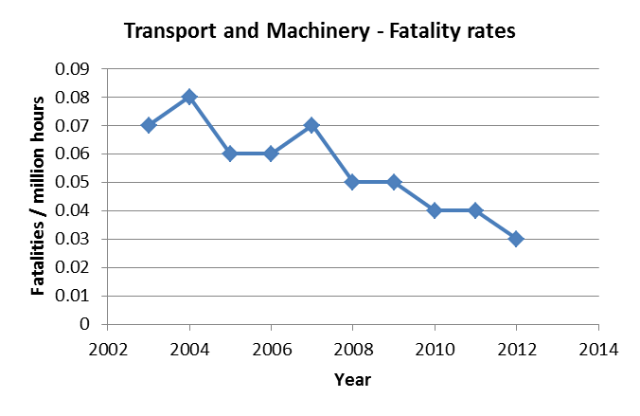
Establishment of MOSH Adoption Teams in key risk areas

Slide 14
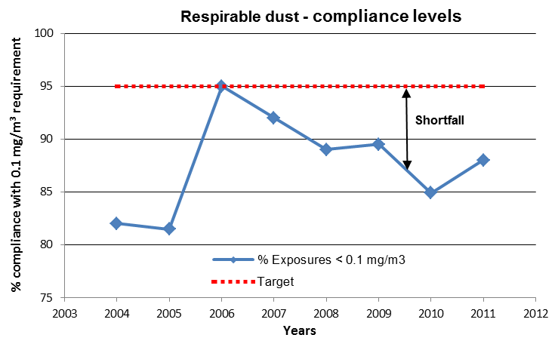
Establishment of MOSH Adoption Teams in key risk areas

Slide 15
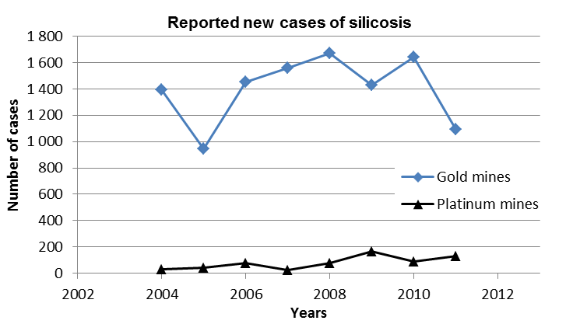
Establishment of MOSH Adoption Teams in key risk areas

Slide 16
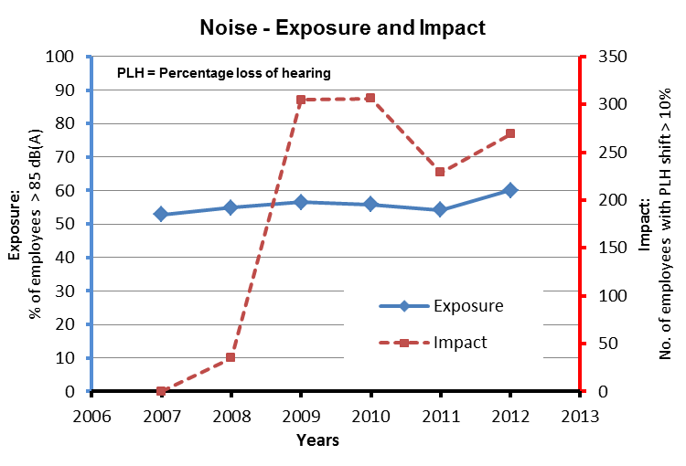
Establishment of MOSH Adoption Teams in key risk areas

Slide 17
Developing an expert understanding of the risk situation

Slide 18
Developing an expert understanding of the risk situation
Example of expert model influence diagram for the dust risk
Crushing, tipping, milling, screening, etc.
Rock processing
Effective control mechanisms to be in place and maintained
Traffic flow, Conveyor belts, Transfer/tip location, Production rate, vehicles, material handling
Rock transport
Scraping, loading, hoisting, conveyors etc.
Adequate ventilation for dilution
Correct allocation at the right place
Rock breaking
Production work plan
Ventilation control
Ventilation management
Drilling, blasting, mechanised mining, etc
Ventilation planning
Ore Body
Source / process
Insignificant
Mobility
Silica, Asbestos, Coal
Hard metals (from tool use such as grinders), lung exposure to certain fumes such as ammonia and chlorine
Significant
Exposure
Controls
Selection / installation
Biological
Health
Human Factor
Outcomes
Auditing
Monitoring
Xray changes (visible tissue change).
Lung function changes as a result of fibrosis (restrictive).
Autoimmune response resulting in increased susceptibility to TB and other connective tissue diseases, e.g. Scleroderma.
Pneumoconioses (Silicosis, Coal workers’ Pn).
Connective tissue diseases.
Restrictive/ obstructive airways diseases.
TB and other (cardiovascular diseases, pulmonary cancer).
Silicosis & TB (Severity of outcomes), morbidity/ mortality/ quality of life.
Family/ societal/ community. Compensation.
Retirement medical surveillance
Dust risk levy, Poor public image
Stock price/ share value .
Control at source was identified as the area of highest risk - see expanded detail on controls below

Slide 19
Selection of leading practice with greatest potential

Slide 20
Identify potential adoption mines and their key persons

Slide 21
Identification of mental models and behavioural plans
Identify key adopters and other stakeholders
Develop direct enquiry protocol (procedures / questions)
Select persons to be interviewed
Train interviewers and conduct enquiries
Analyse responses and establish mental model
Review mental model against expert model and behaviour science
Develop behavioural communication and leadership behaviour plans

Slide 22
Documenting the leading practice at it’s Source Mine
Technical details: Investigate and document
Detailed Source mine report
Leadership detail: Investigate and document
Communications:
Investigate and document
Example materials
Training
Communications
Signage

Slide 23
Identifying and documenting the full value case
Financial Impacts
Initial cost
Operational cost
Financial benefits
Production
Etc.
Strategic Impacts
Health & Safety
Relationships
Image
Investor support
Etc.
The Generic Value Case

Slide 24
Provision of a guide to facilitate widespread adoption
Part 1:
Strategic Context
The problem
The practice
The value case
Part 2:
Detailed Adoption Guidance
Part 3:
The Leading Practice
Technical details
Behavioural communication
Leadership behaviour
Detailed appendices:
Pro-forma plans - Worksheets -Example materials

Slide 25
Customisation of leading practice at adoption mines
Mine-specific circumstances
Review practice against mine operational standards
Conduct direct enquiries to establish mine-specific mental model issues
Customise non-core elements of Leading Practice
Customise Generic Behavioural Communication Plan
Customise Generic Leadership Behavioural Plan

Slide 26
Initiation of widespread adoption process
The Leading Practice Adoption Workshop
Workshop Purpose
To initiate the process of facilitating widespread adoption
To establish a Community of Practice for Adoption – a COPA
Who to attend?
Mine Managers
Relevant specialists
Other key stakeholders
What is covered?
Leading Practice details
Value case
Behavioural processes
Leading Practice Adoption Guide
Role and function of COPA
Establishment of COPA

Slide 27
Establishment of a Community of Practice for Adoption
Who?
Mine Managers (initially)
Relevant specialists
Mine Adoption Team Manager
Mine Behavioural Overseer
Modus operandi?
Regular meetings
Jointly implement Leading Practice Adoption Guide
Work directly with lead adopter mine
Assist other adoption mines to extent possible
COPA
Provide ongoing facilitation of the adoption process
What?
Explain / use Leading Practice Adoption Guide
Provide / arrange training
Problem solving
Provide / arrange assistance
Share adoption experience
Continuous improvement
Mine visits as appropriate

Slide 28
Continuous improvement
Disband COPA when no longer needed
Cycle of continuous OHS improvement
Identify new leading practice with best potential
Investigate / document new practice for adoption
Establish COPA and facilitate widespread adoption
The process of continuous improvement never stops

Slide 29
Concluding comments
Industry is committed to Zero Harm
Much achieved since 2003 but there is still much to do
Success will require adoption on new or improved practices
Adoption requires people to change what they do
The key is eager adoption, not reluctant compliance
The MOSH System addresses this challenge in a special way
Involvement and buy-in will determine the benefit mining companies derive from MOSH

Slide 30
The 16 steps for adoption of a leading practice
Facilitate the adoption decision
Secure support for adoption
Establish and effective mine adoption team
Prepare initial plan for adoption
Initiate baseline monitoring programme
Establish effective relationship with the COPA
Update key stakeholders on progress
Plan and conduct direct enquiries
Customise generic behavioural plans
Harmonise leading practice with mine standards
Assess risk and develop final adoption plan for approval
Develop training and communication materials
Brief and train key mine persons
Implement pilot adoption of the practice
Monitor evaluate and report on performance
Finalise and implement mine-wide roll-out plan

