Slide 1
Mining Industry
FoG Safety Performance
2013 (Based on January to 25 November 2013)
Duncan Adams
CoM – MOSH Learning Hub
29 November 2013

Slide 3
0.08
0.03

Slide 4
Intern. Benchmark
2003 level – 0,08
2013 benchmark – 0,03
Notes:
All mining sectors except gold in SA are expected to achieve current best practice of international mining by 2013.
The current average fatality rate for international mines is shown in the figure and is 0,08 fatalities per million hours worked.
The 2013 benchmark of 0,03 is also shown. This assumes that SA mining operations will improve their fatality rate by 20% per year and the international operations will improve by 10 % per year until 2013.

Slide 5
SA Gold
2004 level
0,28
SA Gold
2003 level
0,35
Intern. Benchmark
2003 level
0,15
2013 benchmark – 0,05

Slide 6
Other Mines
The rate up until the 25 November 2013 is 0.098 fatalities per million hours worked
  It is far below the Gold which is at 0.135 fatalities per million hours worked
  This is a rate above Platinum which is at 0.069 fatalities per million hours worked
  It is above Coal which is at 0.047 fatalities per million hours worked

Slide 7
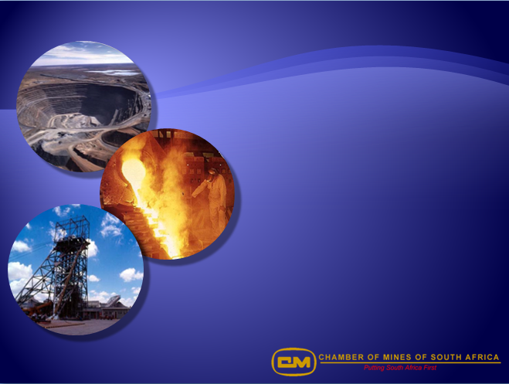
What about Falls of Ground ?

Slide 8
Total Industry Improvement
2003-2013 – 72%
Rockfall Improvement
2003-2013 – 76%
Fatalities/million hours worked
Rockburst Improvement
2003-2013 – 90%

Slide 9
FoG Fatalities in 2013 (Jan – 25 Nov)
  Gold - 13
  Platinum - 12
  Other - 3
  Coal - 0
Total for 2013(Jan – 25 Nov) - 28
Total for 2012 - 26

Slide 11
39% improvement
66% improvement

Slide 13
A rock dislodged from the hanging wall, struck him and was fatally injured.
A SEISMIC EVENT OCCURRED CAUSING A SHAKEDOWN INJURIES 3 EMPLOYEES THAT WAS BUSY INSTALLING A WINCH IN TE WINCH CUBBY.
Whilst cleaning face a rock dislodged from the hanging wall and struck him.
WHILST INJ WA HOLDING INTO POSITIO, HIS CO-WORKER WAS HITTING ITS HEAD WITH A BOARD WITH A HAMMER, A ROCK DISLODGED FROM HANGING AND STRUCK INJ.

Slide 17
Applying Allocated Days Lost

Slide 27
Current Netting and Bolting LP may have helped
6 out of 22 Fatals (27%)
100 out of 400 Reportable Injuries(25%)

Slide 28
Conclusions
Overall significant improvement in safety
FoG improved at a greater rate than the average for the industry
FoG Fatalities improved more than FoG reportable injuries
Five categories make up > 90% of FoG safety losses
Current LPs are designed to address these

Slide 29
Five Problem Areas
No Support/insufficient support
Installing support
Barring the hangingwall
Face preparation and cleaning
Drilling and charging of face

