Slide 1
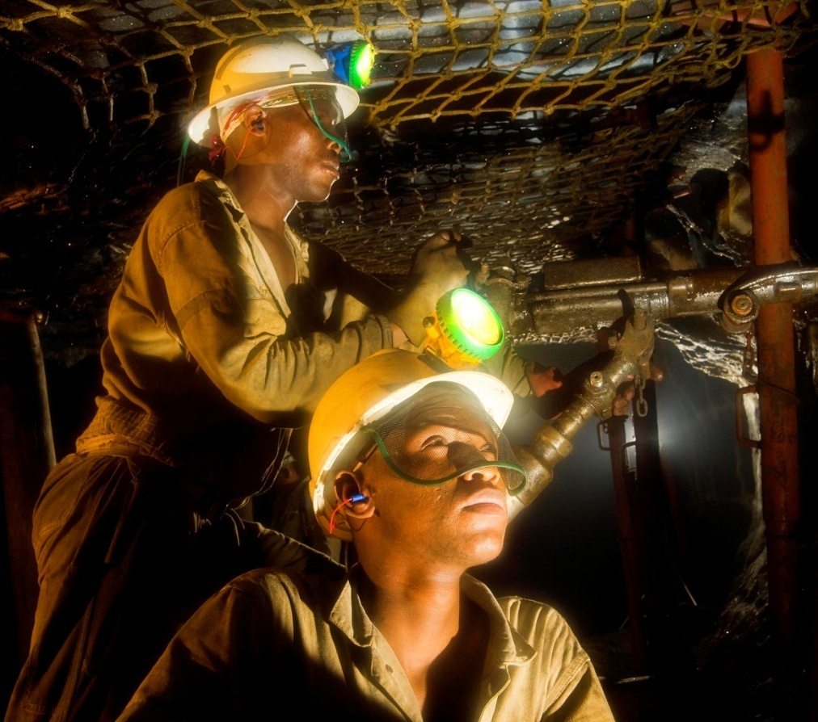
HITS ABS-P
COPA Meeting
29 November 2013
Riaan Carstens
Anglo Platinum

Slide 2
Content
Brief History
Hazards and teams
Process flow
Demarcation of working places
Communication and close out
Reference books
Animation training
Key Points

Slide 3
History
Process started in 2007 – Amandelbult Mines
Looked at Xstrata’s TARP system
Held a series of workshops
Similar system in place at Bathopele called ABS - Combined 2 system
Did not follow the MOSH adoption process per say but there was very diverse stakeholder involvement

Slide 4
Hazards
Brows
Missing support
Water
Flat dipping features < 60⁰
Falls of ground
Domes
Back break indicators
Change in face composition
Major geology
Blocky ground conditions

Slide 5
Team Composition
ABS-P Level | Action | Authority
A | Normal mining as Standards and Procedures demand (Continue). | 3 options: Miner or Team Leader or Shift Supervisor.
B | Request “B” Team intervention after Barricading. | 3 options: Strata Control Officer or Mine Overseer or Section Manager
S | Request “S” Team intervention after Barricading. | 5 options: General Manager or Production Manager or Shaft Rock Engineer or Chief Rock Engineer or Section Manager AND Strata Control Officer
Pb or Ps | The team continues as normal but with special instructions/support until the working place is declared safe to return to the normal standard “A”. | The visiting “B” or “S” team that issued the “Pb/s” instructions shall stipulate under which conditions the working place shall return to “A” status.

Slide 6
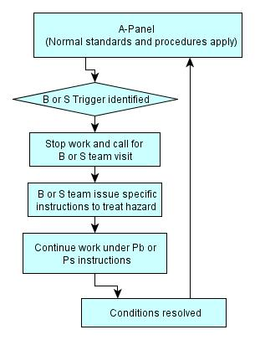
Process flow

Slide 7
Demarcation
The ABS-P status of a working place must be displayed to inform both workers and visitors of the workplace status.
In the case of development ends the workplace status must be painted on the sidewall of the development end.
In the case of stoping the workplace status must be painted on the hanging wall and/or the side wall of the gully. This sign painted on the hanging wall and/or side wall will indicate the status of the panel immediately updip of the gully.
In the case of mechanized mining the workplace status must be painted on the sidewall of the working place and this will apply for both bords and splits.
The status of the working place, A, B, S, Pb or Ps, must be painted on a daily basis.
This is the minimum requirement and the mine can stipulate additional requirements such as sign boards. If sign boards are used it must clearly state which area of the working place it refers to.

Slide 8
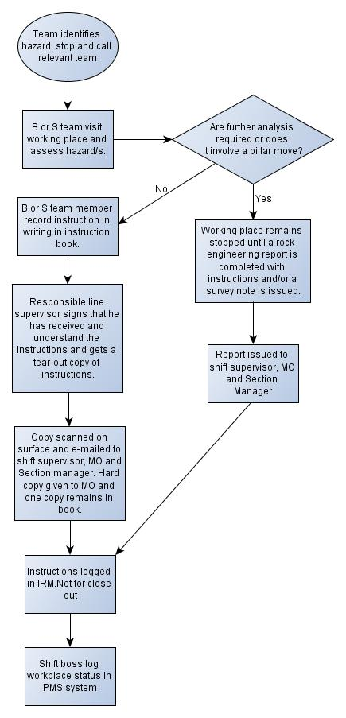
Communication

Slide 9
Printed reference material
Three books for different mining environments
Used illustrations rather than photos
Simplified language “Cessation vs Stop”
Only one topic per page
Visuals need to be as descriptive as possible

Slide 10

If drawings could talk

Slide 11
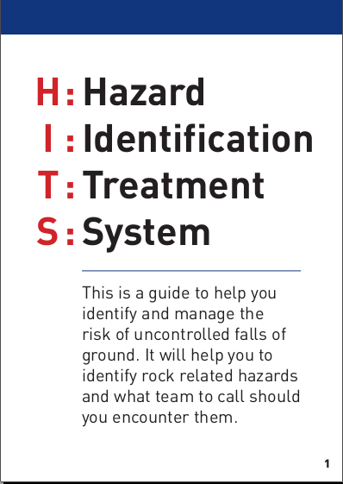
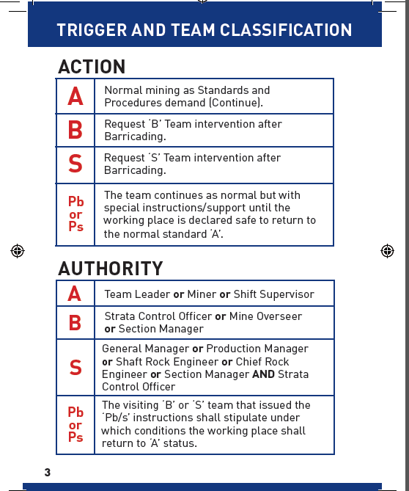
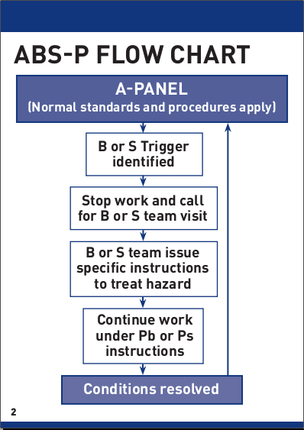
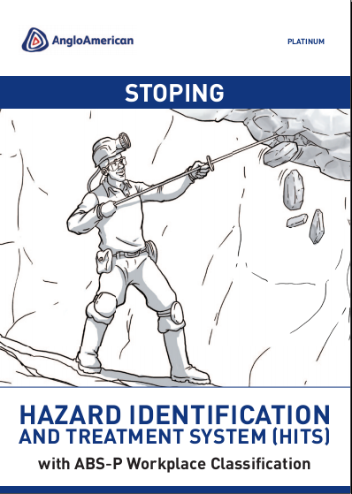
Booklet

Slide 12
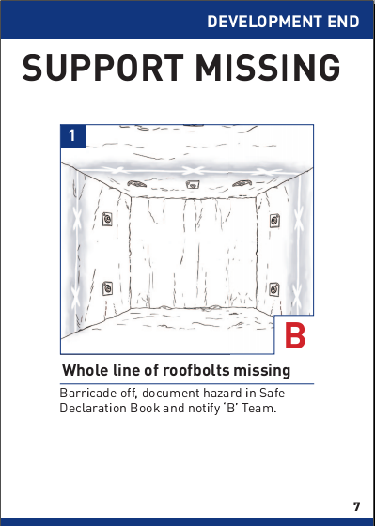
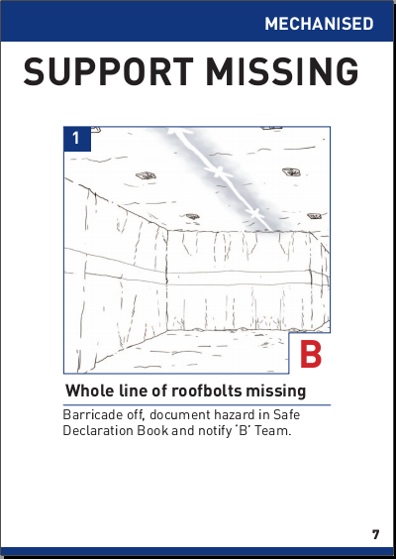
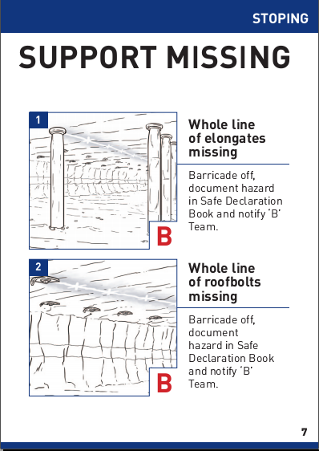
Books

Slide 13
Animation Training
Started in January 2011
Exposes the user to rock related hazardous conditions underground on a computer system using multimedia technology
Three different modules with 51 scenes
Two target populations
  Comp B and team - Identify and report
  Comp A and above - Identify, classify and report
Must pass ABSP Intro before they attempt the HITS - ABSP
Scenes for communication and demarcation included
Translated into 5 languages: Xhosa, Sepedi, Tswana, Shona and English
Testing included with tracking of pass rates
  Indicate the potential consequences of ignoring or incorrectly dealing with the hazardous conditions

Slide 14
Key Points
Be careful of creating bottlenecks when deciding on response teams
Consider certification rather than management levels
Keep it as simple as possible
Need to consider demarcation
Need to be clear on communication and close-out
Consider the extra workload on all levels of management

Slide 15
Discussion

