Slide 1
The behavioural stuff: some reflections
FOG Copa
29 November 2013

Slide 2

The diagnosis ….
The literature
Our leaders
Our people

Slide 3
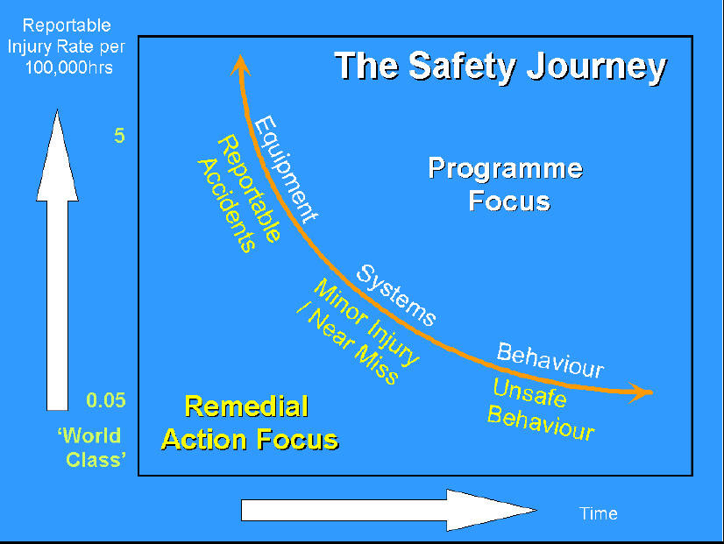

Slide 4
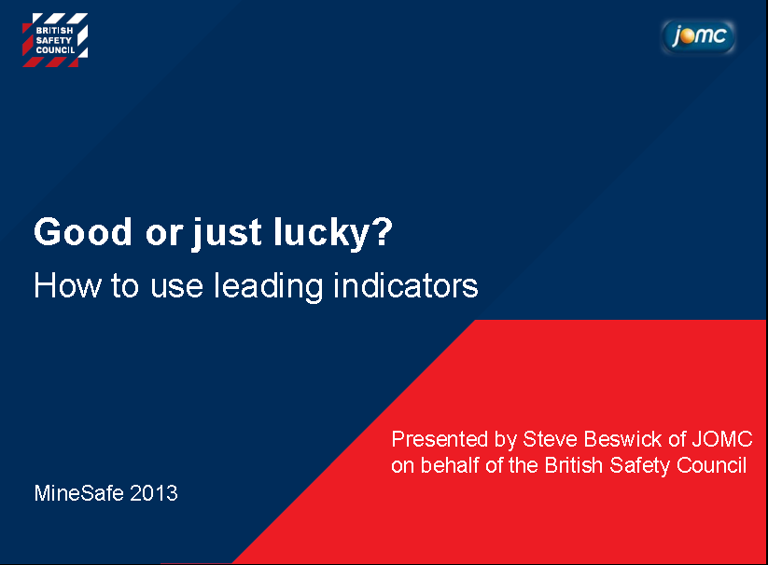

Slide 5
Interviews held with some 20 senior managers/executives, including five CEO’s:
“Involve people” (see also ‘Involvement’ above)
“Create a thorough understanding of the system.”
“Listen to feedback from people on the ground.”
“Engage people”
“Empower people and communicate continuously”
“Positive re-enforcement - give credit where credit is due”
“Walk the talk, live the values”
“Lead by example”
“Take personal ownership”
“Explain to crews why things are done and how it will make a difference”
“Unequivocal support for the system”
“Be a MOSH ambassador”
The following were cited as barriers to adoption:
“Where GM’s show resistance, it will not happen”
“(The desired behaviour) is not our natural style”
“Leaders are not disciplined enough to walk the talk”
“(Leaders are weak in) people issues, in particular the ability of supervisors to work with people”
“They need to communicate better”
“Supervisors do not listen enough and are not asking enough about the constraints”
“Blame culture and 1970’s and 80’s management styles. The new breed of workers does not respond to it”
“Lack of leadership”
Bottom Line:
Our supervisors are not good at getting the best out of their people
We know what style of leadership will work, but how do we make it stick?

Slide 6
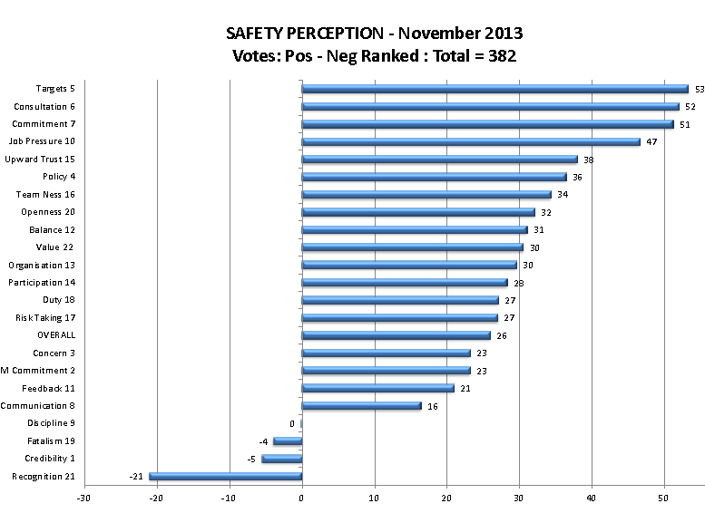

Slide 7
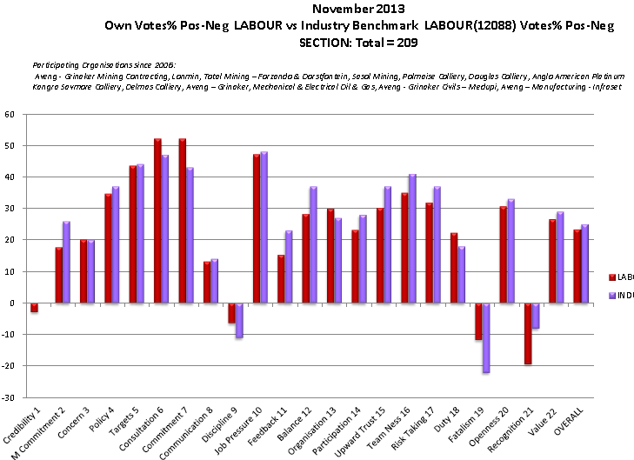

Slide 8
Towards a behavioural leading practice

Slide 10
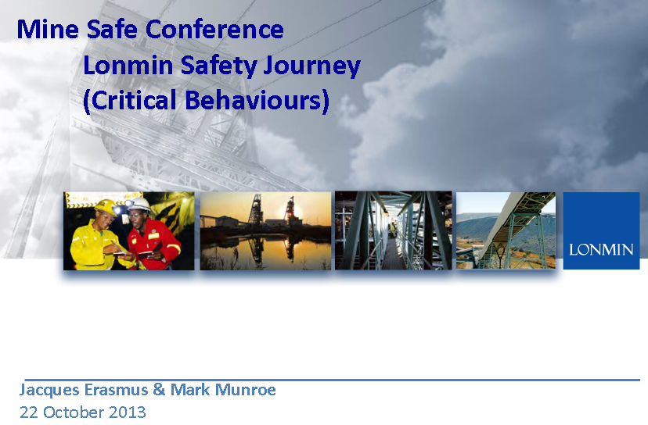

Slide 11
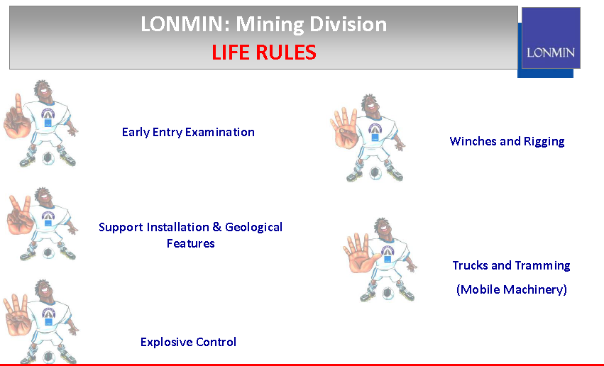

Slide 12
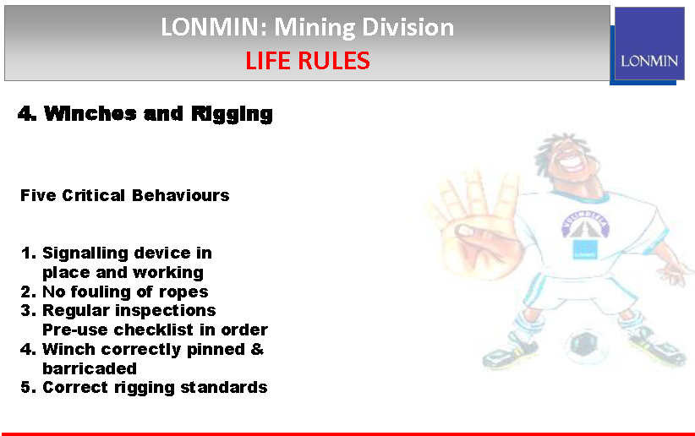

Slide 13
The shift
Traditional way
I know how
I tell you what to do
You do as I tell you
I hold you accountable for executing my instruction
Coaching way
You know how
You tell me what you’re going to do and how I can support you
You do what you commit yourself to do
I hold you accountable for executing your own plan

Slide 14
The bottom line: Desired Leadership Behaviour to ensure the LP is embraced
Positive
When you see desired behaviour - react
Immediate
When you see undesired behaviour - coach
Unconditional management support
Respectful and caring
Open communication to lowest levels,
listen!
Certain

Slide 15
The way forward
Formally constitute an interest group
Involve the whole industry (currently only Angloplats, AGA, ARM, Harmony, Implats, Lonmin, Sibanye, Goldfields)
Get the best available knowledge to participate
Search for LP’s in the areas of:
Communication materials
Behaviour standards
Training programmes
Behavioural change interventions
Measurement tools

