Slide 1


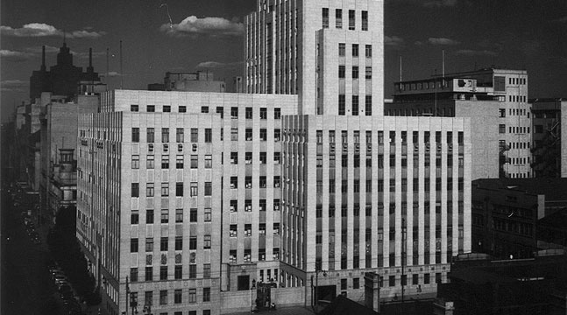

Chamber of Mines of South Africa
Learning Hub
MOSH FOG Leading Practice Adoption Team
3 May 2012
CHAMBER OF MINES OF SOUTH AFRICA
Working together for a sustainable future since 1889

Slide 2

Mission and Values - MOSH
Mission & Vision | Facilitate the adoption of leading practices to significantly improve OHS in the mineral industry through a people orientated process To be the leading and widely recognized change agent for achieving zero harm
Visionary Goals | Industry Acceptance | To ensure an increase in industry buy-in, demonstrated through participation in the Leading Practice Adoption System
 | Capacity | To create a centre of expertise through ensuring that the Learning Hub is fully staffed and skilled
 | People Focus | To ensure that the required behavioural change processes are included in the adoption of all MOSH Leading Practices
Leading the change to zero harm

Slide 3
MOSH – From where?
2003 – Industry Target : ZERO HARM
2003 - Industry Mile Stones (for 2013)
      Dust
      Noise
      Safety
2005 – CEO’s sign commitment
2006 – CEO’s establish MOSH Task Force
2007 – Task Force present work to CEO’s
2008 – MOSH Adoption Teams
      Noise
      Dust
      Falls of Ground
      Transport and Machinery
2011 – Formation of the Learning Hub
Leading the change to zero harm

Slide 4
The Goal
TRIPARTITE HEALTH AND SAFETY TARGETS AND MILESTONES
HEALTH
Target: Elimination of Silicosis and Noise-Induced Hearing Loss
Milestones:
After December 2013, no new cases of silicosis will occur amongst previously unexposed individuals
After December 2008, no deterioration in hearing greater than 10% amongst occupationally exposed individuals
By December 2013, noise emitted by equipment installed must not exceed 110dB(A) at any location in that workplace across Industry using Communities of Practice
SAFETY
Target: Zero fatalities and injuries
Milestones:
By 2013, achieve world-class safety performance
Leading the change to zero harm
Notes:
4

Slide 5
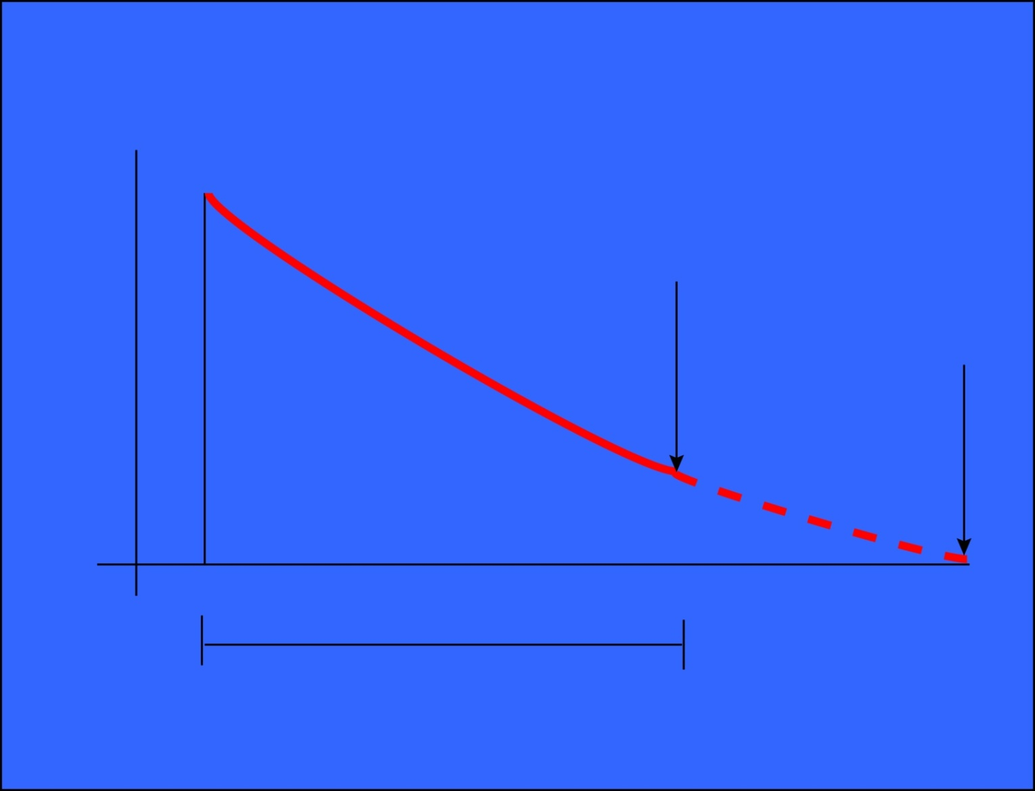
SA Mining Roadmap to Zero Harm: Safety
International benchmarks
Destination
2003
2013
20% per year
Leading the change to zero harm

Slide 6
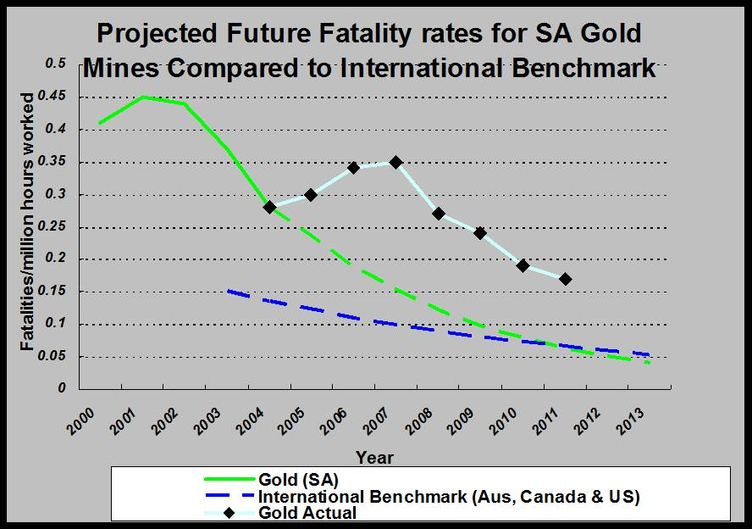
The Performance
Leading the change to zero harm

Slide 7
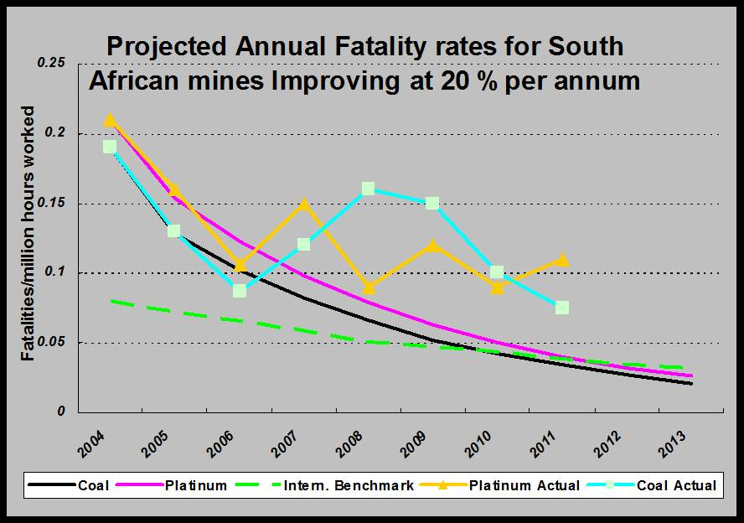
The Performance
Leading the change to zero harm

Slide 8
The Risks
HEALTH
Silicosis
Noise Induced Hearing Loss
SAFETY
Falls of Ground
Transport and Machinery
Leading the change to zero harm

Slide 9
Where do we fit in?
Executive Council
Executive Council
Executive Council
Executive Council
Executive Council
Executive Council
Executive Council
Executive Council
Executive Council
Executive Council
Executive Council
Executive Council
Executive Council
Executive Council
Executive Council
Executive Council
Executive Council
Adoption Team Sponsors
Executive Council
Adoption Team Sponsors
Adoption Team Sponsors
Adoption Team Sponsors
Adoption Team Sponsors
Adoption Team Sponsors
Adoption Team Sponsors
Adoption Team Sponsors
Adoption Team Sponsors
Adoption Team Sponsors
Adoption Team Sponsors
Adoption Team Sponsors
Adoption Team Sponsors
Adoption Team Sponsors
Adoption Team Sponsors
Adoption Team Sponsors
Adoption Team Sponsors
Executive Council
MOSH Task Force
Executive Council
Executive Council
Executive Council
Executive Council
Executive Council
Executive Council
Executive Council
Executive Council
Executive Council
Executive Council
Executive Council
Executive Council
Executive Council
Executive Council
Executive Council
FOG Team – Neville Nicolau
(One per team)
(One per team)
(One per team)
(One per team)
(One per team)
(One per team)
(One per team)
(One per team)
(One per team)
(One per team)
(One per team)
(One per team)
(One per team)
(One per team)
(One per team)
(One per team)
(One per team)
Chamber Executive
Learning Hub Advisory Committee
Learning Hub
Specialist support for industry adoption teams
MOSH Learning Hub
MOSH
MOSH
MOSH
MOSH
Industry
Industry
Industry
Industry
Industry
Industry
Industry
Industry
Industry
Industry
Industry
Industry
Industry
Industry
Industry
Industry
Industry
Industry
Industry
Industry
Industry
Industry
Industry
Industry
Industry
Industry
Industry
Industry
Industry
Industry
Industry
Industry
Industry
Industry
Industry
Industry
Industry
Industry
Industry
Industry
Industry
Industry
Industry
Industry
Industry
Industry
Industry
Industry
Industry
Industry
Industry
Industry
Industry
Industry
Industry
Industry
Industry
Industry
Industry
Industry
Industry
Industry
Industry
Industry
Industry
Industry
Industry
Industry
Industry
Industry
Industry
Industry
Adoption Team
Adoption Team
Adoption Team
Adoption Team
Adoption Team
Adoption Team
Adoption Team
Adoption Team
Adoption Team
Adoption Team
Adoption Team
Adoption Team
Adoption Team
Adoption Team
Adoption Team
Adoption Team
Adoption Team
Adoption Team
Adoption Team
Adoption Team
Adoption Team
Adoption Team
Adoption Team
Adoption Team
Adoption Team
Adoption Team
Adoption Team
Adoption Team
Adoption Team
Adoption Team
Adoption Team
Adoption Team
Adoption Team
Adoption Team
Adoption Team
Adoption Team
Adoption Team
Adoption Team
Adoption Team
Adoption Team
Adoption Team
Adoption Team
Adoption Team
Adoption Team
Adoption Team
Adoption Team
Adoption Team
Adoption Team
Adoption Team
Adoption Team
Adoption Team
Adoption Team
Adoption Team
Adoption Team
Adoption Team
Adoption Team
Adoption Team
Adoption Team
Adoption Team
Adoption Team
Adoption Team
Adoption Team
Adoption Team
Adoption Team
Adoption Team
Adoption Team
Adoption Team
Adoption Team
Adoption Team
Adoption Team
Adoption Team
Adoption Team
Adoption Team
Adoption Team
Adoption Team
Adoption Team
No 3
No 3
No 3
No 3
No 3
No 3
No 3
No 3
No 3
No 3
No 3
No 3
No 3
No 3
No 3
No 3
No 3
No 1
No 2
No 3
No 3
No 1
No 1
No 1
No 1
No 1
No 1
No 1
No 1
No 1
No 1
No 1
No 1
No 1
No 1
No 1
No 1
No 1
No 2
No 2
No 2
No 2
No 2
No 2
No 2
No 2
No 2
No 2
No 2
No 2
No 2
No 2
No 2
No 2
No 2
No 3
No 3
No 3
No 3
No 3
No 3
No 3
No 3
No 3
No 3
No 3
No 3
No 3
No 3
No 3
No 3
No 3
(Noise)
(Dust)
(Falls of Ground)
(Falls of Ground)
Dust
Noise
FOG
T&M
Facilitation of widespread adoption of leading practice
Facilitation of widespread adoption of leading practices
Facilitation of widespread adoption of leading practice
Facilitation of widespread adoption of leading practice
Facilitation of widespread adoption of leading practice
Facilitation of widespread adoption of leading practice
Facilitation of widespread adoption of leading practice
Facilitation of widespread adoption of leading practice
Facilitation of widespread adoption of leading practice
Facilitation of widespread adoption of leading practice
Facilitation of widespread adoption of leading practice
Facilitation of widespread adoption of leading practice
Facilitation of widespread adoption of leading practice
Facilitation of widespread adoption of leading practice
Facilitation of widespread adoption of leading practice
Facilitation of widespread adoption of leading practice
Facilitation of widespread adoption of leading practice
Facilitation of widespread adoption of leading practice
Leading the change to zero harm

Slide 10
Our Brief
Find the Leading Practice(s) that have the highest potential for reducing uncontrolled falls of ground and facilitate eager adoption thereof by the rest of the industry
Leading the change to zero harm

Slide 11
Our (MOSH) Programme
Identify the Leading Practice
Document at Source
Demonstrate at Demonstration Site
Post Demonstration Workshop
Issue Leading Practice Adoption Guide
Set up COPA
Roll out to Industry by way of COPA
Leading the change to zero harm

Slide 12
FOG Adoption Team Structure (Directive and Developmental)
FOG Sponsor Neville Nicolau CEO Anglo American Platinum
Chamber of Mines
Learning Hub
FOG Adoption Manager
A van Zyl
FOG Adoption Manager
D Adams
FOG Adoption Specialist
C Legodi
ARM
R Kersten
Harmony
K Brentley
Gold Fields
F Malan
AGA
G Dukes
EXXARO
F Baker
AA Plat
K le Bron
Xstrata
W v Aarde
Lonmin
M du Plessis
Impala
E du Toit
Sasol
K Louw
NUM
Dr W Lipinsky
Solidarity
L McMaster
UASA
A v Heerden
Petra
C Grove
BECSA
D Neal
Leading the change to zero harm

Slide 13
MOSH – FOG COPA Arrangements (Roll out)
COPA’s for the Introduction and Adoption of Leading Practices
FOG Adoption Team Manager
A van Zyl
D Adams
GOLD FIELDS
LONMIN
EXXARO
AA PLATINUM
AGA
ANGLO PLAT
SASOL
IMPLATS
HARMONY
UNION
TOTAL
ASA
DRD GOLD
E Plats
ATC
ARM
N-Cape?
R. URANIUM
XSTRATA
BHP
E. CHROME
SIMMERS
OTHERS
OTHERS
NKOMATI
GOLD
BUSHVELD
COAL
E-LIMB
Leading the change to zero harm

Slide 14
Leading the change to zero harm

Slide 15
Leading the change to zero harm

Slide 16
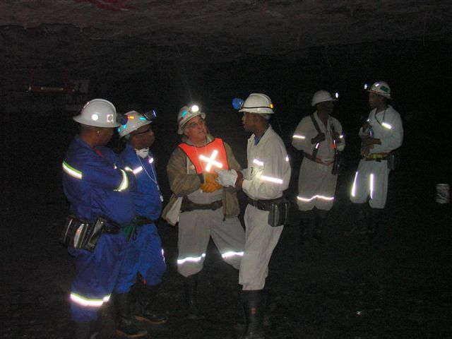
FOG Team Activities
FOG Adoption Team Visits
STS Graphics, Kroondal Chrome,
Union Mine, TauTona Mine
Inter Mine Visits
SASOL to ARNOT, ARNOT to Modikwa, Exxaro to Union Mine
Events
“Day of Learning”, Planning workshop to Identify New Leading Practice, MOSH Annual Review
Presentations
Seminars, Conferences and Individual Mines
Leading the change to zero harm

Slide 17
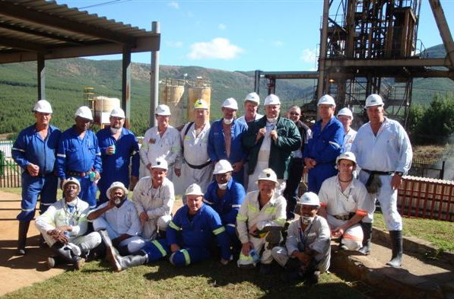
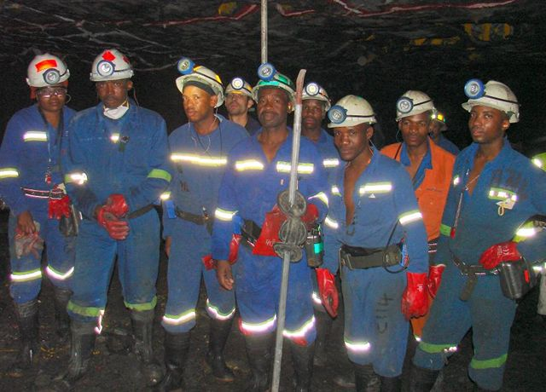
FOG Team Activities
Meetings
Regular FOG Adoption Team Meetings
Four Main COPA areas
Tripartite Forum Meetings
(Free State, North West Bushveld, Limpopo, Vaal River, Merafong etc.)
Assistance
“Late Comers” and Non Chamber Mines
( Anglo Thermal Coal, Petra Diamonds, Ezulwini, Village Main, Northam Platinum etc.)
Leading the change to zero harm

Slide 18
Leading Practices
Entry Examination and Making Safe
A team based HIRA process with “empowered “ team members
Source - Impala Platinum Mines
Demo - Driefontein Mine
Adoption - 92% of identified teams
trained (65 Mines)
Leading the change to zero harm

Slide 19
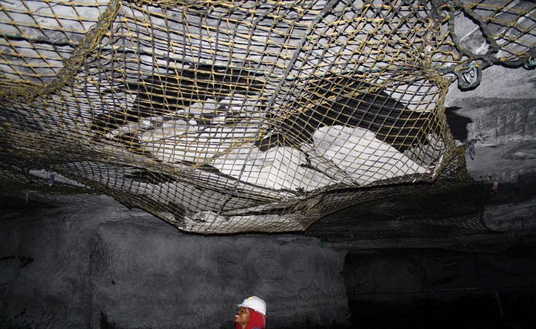
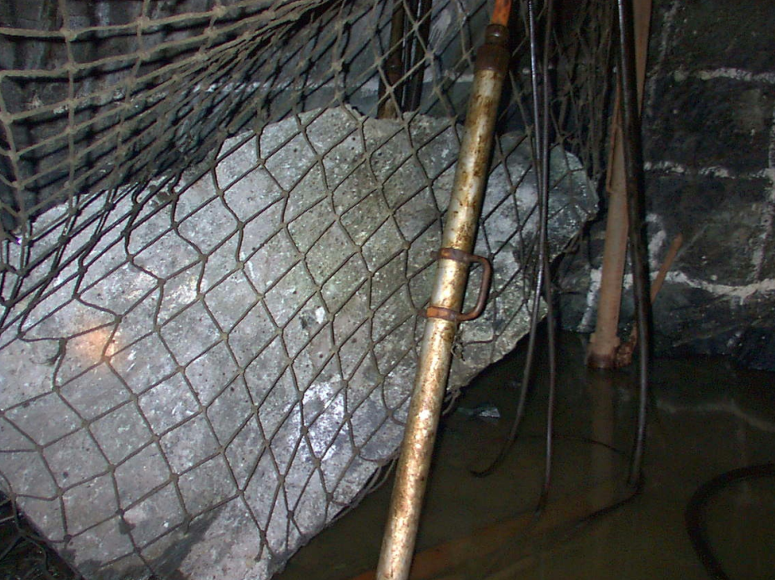
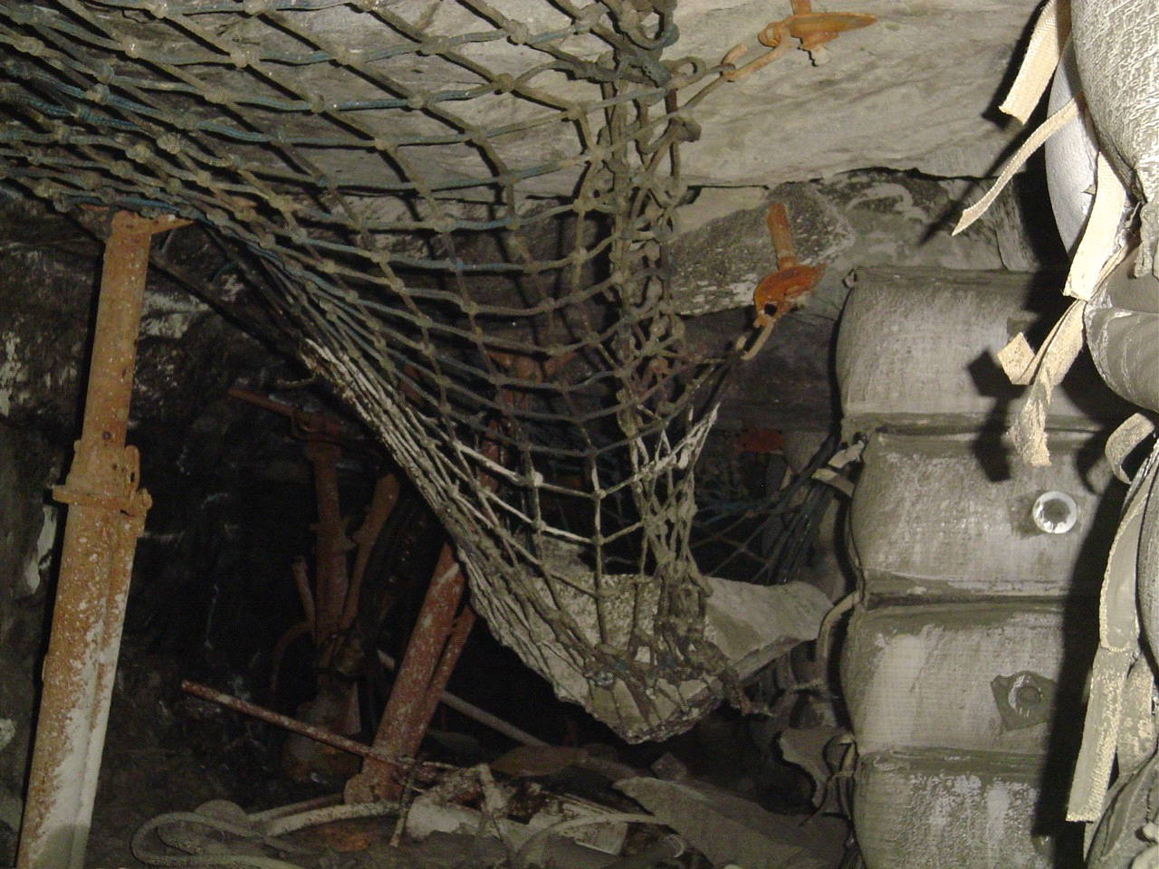
Leading Practices
Nets with Bolts
Hangingwall Net installation Integrated with Roof Bolt Support system
Source - Union Mine
Demo - Kusasalethu Mine - (Post Demo Workshop 3 Feb 2012)
Adoption - COPA established 1 March 2012 - KDC
Leading the change to zero harm

Slide 20
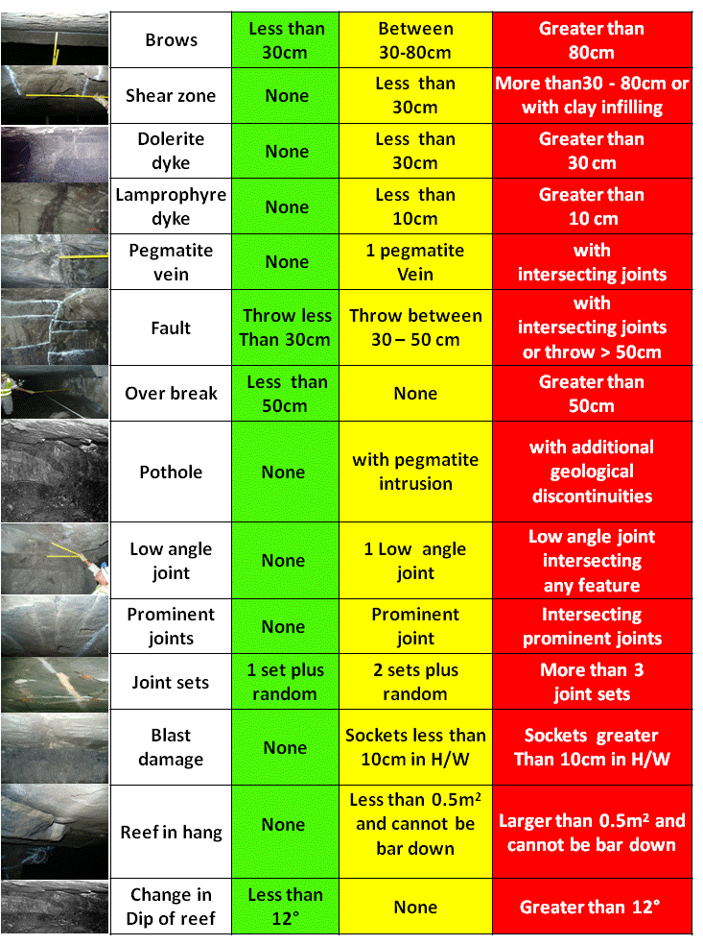
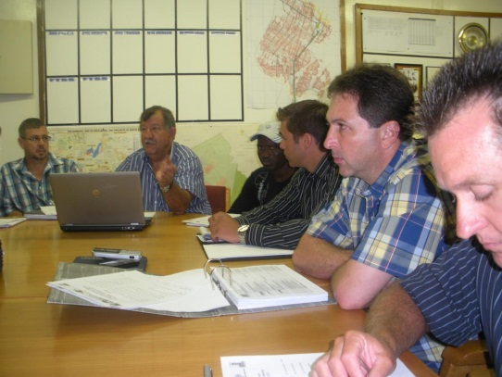
Leading Practices
TARP (TRAP / TSM / ABS-P)
Rock Condition Hazard Classification System coupled with escalated decision making relative to the risk
Source - Kroondal Chrome Mine
Demo - Joel Mine
(in progress)
Adoption - COPA to be formed
Leading the change to zero harm

Slide 21
Leading Practices - Health
Noise
  HPD Selection and Training Tool (TAS_Tool)
Dust (mainly aimed at Silicosis prevention)
  Foggers
  Footwall and Sidewall treatment
  Strategies for Objective Measurement and Area Monitoring
Leading the change to zero harm

Slide 22
MOSH Adoption process
Review your risk and decide to adopt or not the Leading Practice
  Involve all role-players – especially Organized Labour
Set up a Multi-discipline Adoption Team
Brief the mine on your intent
Draw up an Adoption Plan
Customize the Operating Procedure
Conduct direct inquiry and customize Mental Models, Leadership Behaviour and Behavioural Communications Plans
Risk assess envisaged changes or identify new risks
Finalize procedure and draw up Training Material
Draw up training plan and roll-out plan
Update Management Review parameters
Introduce to pilot section
Roll out to the rest of the mine.
Evaluate progress and do follow-up up audits and inspections
Leading the change to zero harm

Slide 23
Challenges
Correct Level of Participation at various forums
Understanding Mental Models and Entrenching Leadership Behaviour and Behavioural Communications plans
Continuity of Representatives at Meetings
Alignment with Coal Mining Initiatives
Understanding that you as a Leader are the “attitude” of your team
Leading the change to zero harm

Slide 24
Way Forward
COPA formation for Nets with Bolts (1 March 2012)
Post Demonstration Workshop and COPA inclusions for TARP ( + July ‘12)
Planning Workshop for New Leading Practice to be adopted ( Aug ‘12)
Leading the change to zero harm

Slide 25
Performers
TauTona > 3,5 Years FOG Fatal Free!!!!
Roland Shaft >12,9 Million FOG Fatal Free Shifts!
Blyvooruitzicht >4½ Million FOG Fatal Free Shifts!
Doornkop Mine > 5 Million FOG Fatal Free Shifts
Modikwa – FOG “Injury Free” for 2010
Achieved +8 million fatal free shifts
Leading the change to zero harm

Slide 26
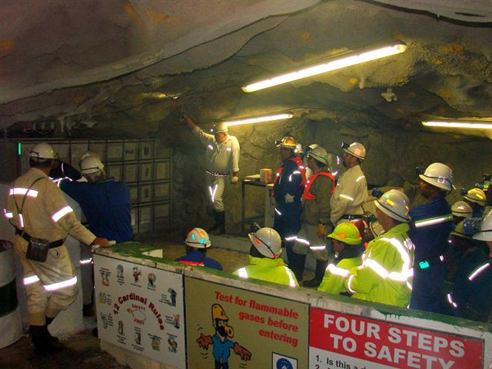
All SA Mines
How are you progressing toward the Target of Zero Harm?
How are you performing against the 2013 Milestones
for your Mine or Company?
Thank you…….. any Questions??
Leading the change to zero harm

