Slide 1


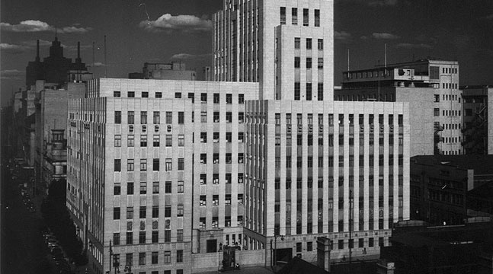

Chamber of Mines of South Africa
Learning Hub
The FOG MOSH Adoption Team
2 February 2012
CHAMBER OF MINES OF SOUTH AFRICA
Working together for a sustainable future since 1889

Slide 2

Where do we fit in?
Executive Council
Executive Council
Executive Council
Executive Council
Executive Council
Executive Council
Executive Council
Executive Council
Executive Council
Executive Council
Executive Council
Executive Council
Executive Council
Executive Council
Executive Council
Executive Council
Executive Council
Adoption Team Sponsors
Executive Council
Adoption Team Sponsors
Adoption Team Sponsors
Adoption Team Sponsors
Adoption Team Sponsors
Adoption Team Sponsors
Adoption Team Sponsors
Adoption Team Sponsors
Adoption Team Sponsors
Adoption Team Sponsors
Adoption Team Sponsors
Adoption Team Sponsors
Adoption Team Sponsors
Adoption Team Sponsors
Adoption Team Sponsors
Adoption Team Sponsors
Adoption Team Sponsors
Executive Council
MOSH Task Force
Executive Council
Executive Council
Executive Council
Executive Council
Executive Council
Executive Council
Executive Council
Executive Council
Executive Council
Executive Council
Executive Council
Executive Council
Executive Council
Executive Council
Executive Council
FOG Team – Neville Nicolau
(One per team)
(One per team)
(One per team)
(One per team)
(One per team)
(One per team)
(One per team)
(One per team)
(One per team)
(One per team)
(One per team)
(One per team)
(One per team)
(One per team)
(One per team)
(One per team)
(One per team)
Chamber Executive
Learning Hub Advisory Committee
Learning Hub
Specialist support for industry adoption teams
MOSH Learning Hub
MOSH
MOSH
MOSH
MOSH
Industry
Industry
Industry
Industry
Industry
Industry
Industry
Industry
Industry
Industry
Industry
Industry
Industry
Industry
Industry
Industry
Industry
Industry
Industry
Industry
Industry
Industry
Industry
Industry
Industry
Industry
Industry
Industry
Industry
Industry
Industry
Industry
Industry
Industry
Industry
Industry
Industry
Industry
Industry
Industry
Industry
Industry
Industry
Industry
Industry
Industry
Industry
Industry
Industry
Industry
Industry
Industry
Industry
Industry
Industry
Industry
Industry
Industry
Industry
Industry
Industry
Industry
Industry
Industry
Industry
Industry
Industry
Industry
Industry
Industry
Industry
Industry
Adoption Team
Adoption Team
Adoption Team
Adoption Team
Adoption Team
Adoption Team
Adoption Team
Adoption Team
Adoption Team
Adoption Team
Adoption Team
Adoption Team
Adoption Team
Adoption Team
Adoption Team
Adoption Team
Adoption Team
Adoption Team
Adoption Team
Adoption Team
Adoption Team
Adoption Team
Adoption Team
Adoption Team
Adoption Team
Adoption Team
Adoption Team
Adoption Team
Adoption Team
Adoption Team
Adoption Team
Adoption Team
Adoption Team
Adoption Team
Adoption Team
Adoption Team
Adoption Team
Adoption Team
Adoption Team
Adoption Team
Adoption Team
Adoption Team
Adoption Team
Adoption Team
Adoption Team
Adoption Team
Adoption Team
Adoption Team
Adoption Team
Adoption Team
Adoption Team
Adoption Team
Adoption Team
Adoption Team
Adoption Team
Adoption Team
Adoption Team
Adoption Team
Adoption Team
Adoption Team
Adoption Team
Adoption Team
Adoption Team
Adoption Team
Adoption Team
Adoption Team
Adoption Team
Adoption Team
Adoption Team
Adoption Team
Adoption Team
Adoption Team
Adoption Team
Adoption Team
Adoption Team
Adoption Team
No 3
No 3
No 3
No 3
No 3
No 3
No 3
No 3
No 3
No 3
No 3
No 3
No 3
No 3
No 3
No 3
No 3
No 1
No 2
No 3
No 3
No 1
No 1
No 1
No 1
No 1
No 1
No 1
No 1
No 1
No 1
No 1
No 1
No 1
No 1
No 1
No 1
No 1
No 2
No 2
No 2
No 2
No 2
No 2
No 2
No 2
No 2
No 2
No 2
No 2
No 2
No 2
No 2
No 2
No 2
No 3
No 3
No 3
No 3
No 3
No 3
No 3
No 3
No 3
No 3
No 3
No 3
No 3
No 3
No 3
No 3
No 3
(Noise)
(Dust)
(Falls of Ground)
(Falls of Ground)
Dust
Noise
FOG
T&M
Facilitation of widespread adoption of leading practice
Facilitation of widespread adoption of leading practices
Facilitation of widespread adoption of leading practice
Facilitation of widespread adoption of leading practice
Facilitation of widespread adoption of leading practice
Facilitation of widespread adoption of leading practice
Facilitation of widespread adoption of leading practice
Facilitation of widespread adoption of leading practice
Facilitation of widespread adoption of leading practice
Facilitation of widespread adoption of leading practice
Facilitation of widespread adoption of leading practice
Facilitation of widespread adoption of leading practice
Facilitation of widespread adoption of leading practice
Facilitation of widespread adoption of leading practice
Facilitation of widespread adoption of leading practice
Facilitation of widespread adoption of leading practice
Facilitation of widespread adoption of leading practice
Facilitation of widespread adoption of leading practice
Leading the change to zero harm

Slide 3
Our Brief
Find the Leading Practice(s) that have the highest potential for reducing uncontrolled falls of ground and facilitate eager adoption thereof by the rest of the industry
Leading the change to zero harm

Slide 4
FOG Adoption Team Structure
FoG Sponsor Neville Nicolau CEO Anglo American Platinum
Chamber of Mines
MOSH Learning Hub
FOG Adoption Manager
A van Zyl
FOG Adoption Manager
D Adams
FOG Adoption Specialist
C Legodi
ARM
R Kersten
Harmony
K Brentley
Gold Fields
Vacant
AGA
G Dukes
EXXARO
S Roos
AA Plat
K le Bron
Xstrata
W v Aarde
Lonmin
M du Plessis
Impala
E du Toit
Sasol
K Louw
NUM
W Lipinsky
Solidarity
L McMaster
UASA
A v Heerden
BRMO
K Kabaah
BECSA
D Neal
Leading the change to zero harm

Slide 5
MOSH – FOG COPA Arrangements
COPA’s for the Introduction and Adoption of Leading Practices
FOG Adoption Team Manager
A van Zyl
GOLD FIELDS
LONMIN
EXXARO
AA PLATINUM
AGA
ANGLO PLAT
SASOL
IMPLATS
HARMONY
UNION
TOTAL
ASA
DRD GOLD
E Plats
ATC
ARM
N-Cape?
R. URANIUM
XSTRATA
BHP
E. CHROME
SIMMERS
OTHERS
OTHERS
NKOMATI
GOLD
BUSHVELD
COAL
E-LIMB
Leading the change to zero harm

Slide 6
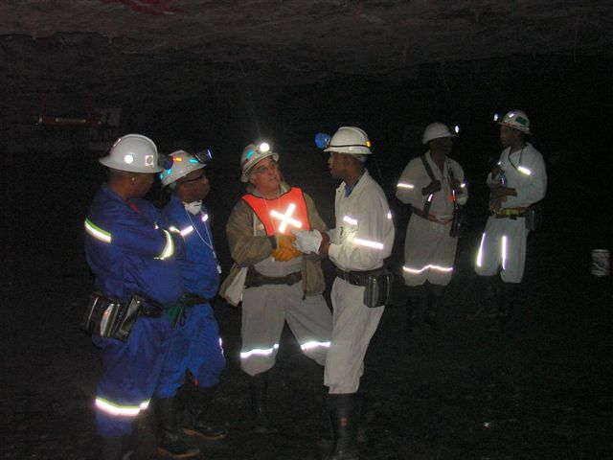
FOG Team Activities
FOG Adoption Team Visits
STS Graphics, Kroondal Chrome,
Union Mine, TauTona Mine
Inter Mine Visits
SASOL to ARNOT, ARNOT to Modikwa, Exxaro to Union Mine
Events
“Day of Learning”, Planning workshop to Identify New Leading Practice
Presentations
Seminars, Conferences and Individual Mines
Leading the change to zero harm

Slide 7
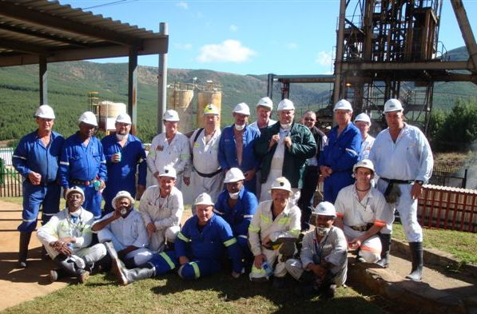
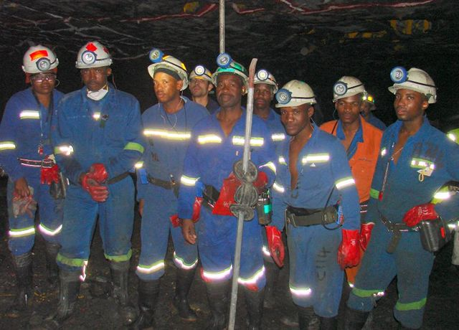
FOG Team Activities
Meetings
Regular FOG Adoption Team Meetings
Four Main COPA areas
Tripartite Forum Meetings
(Free State, North West Bushveld, Limpopo, Vaal River)
Assistance
“Late Comers” and Non Chamber Mines
( Anglo Thermal Coal, Petra Diamonds, Ezulwini, Buffelsfontein, Northam Platinum etc.)
Leading the change to zero harm

Slide 8
Leading Practices
Entry Examination and Making Safe
A team based HIRA process with “empowered “ team members
Source - Impala Platinum Mines
Demo - Driefontein Mine
Adoption - 92% of identified teams
trained (65 Mines)
Leading the change to zero harm

Slide 9
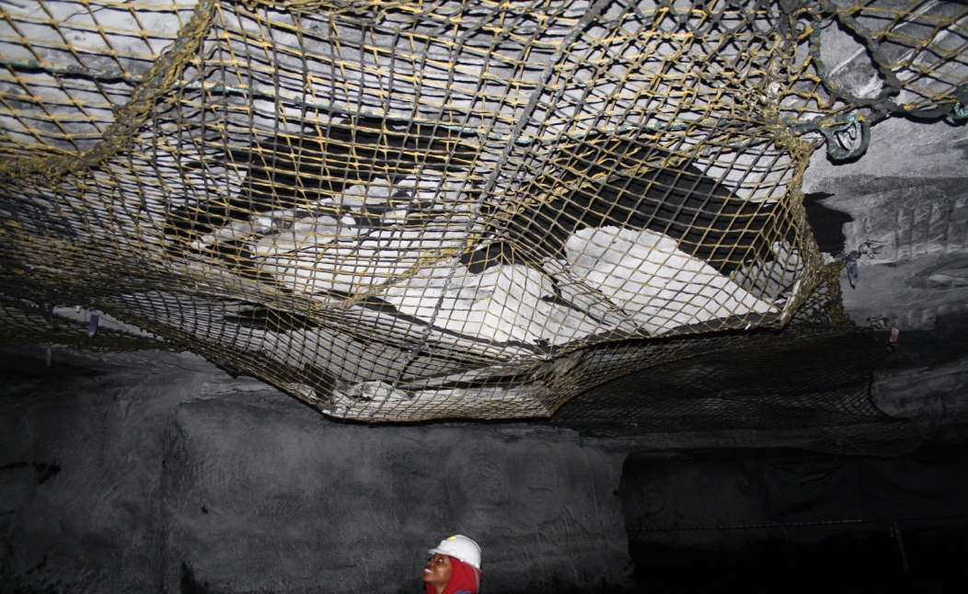
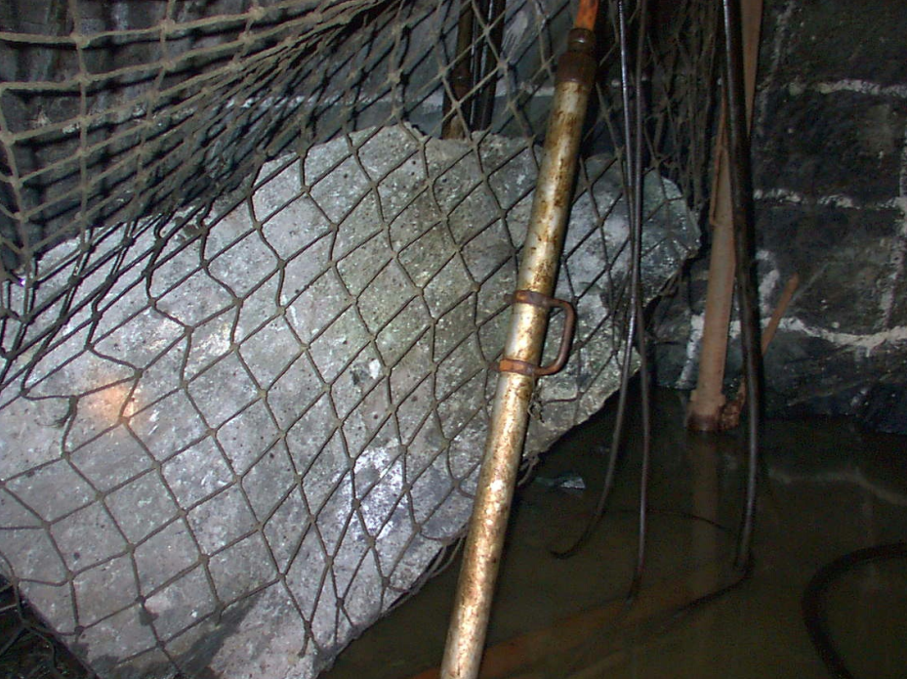
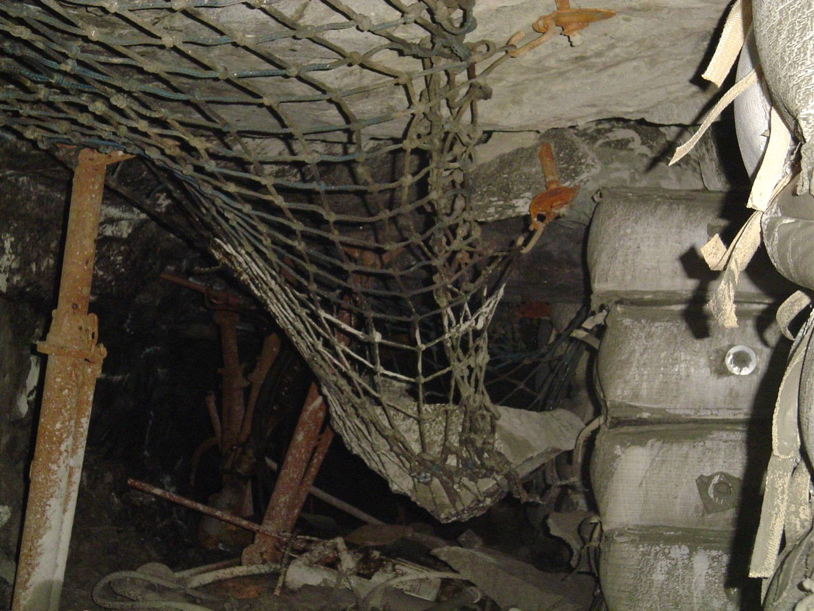
Leading Practices
Nets with Bolts
Hangingwall Net installation Integrated with Roof Bolt Support system
Source - Union Mine
Demo - Kusasalethu Mine (workshop 3 Feb 2012)
Adoption - COPA to be formed
Leading the change to zero harm

Slide 10
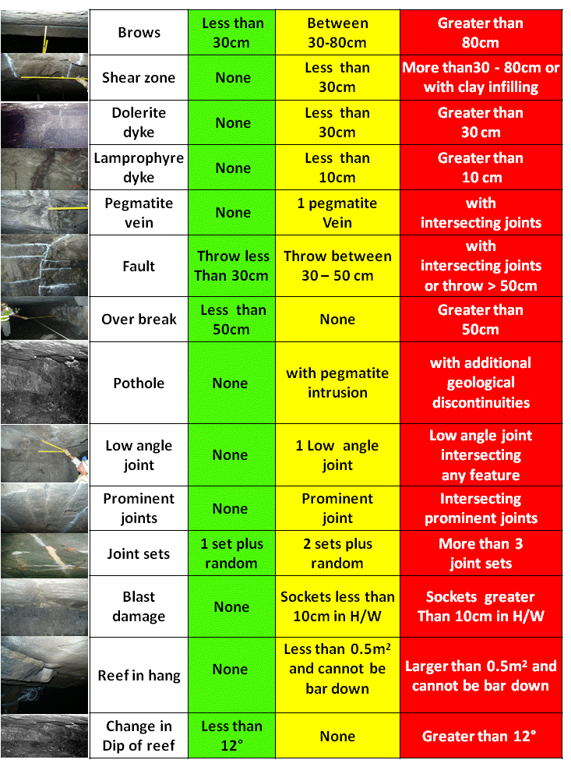
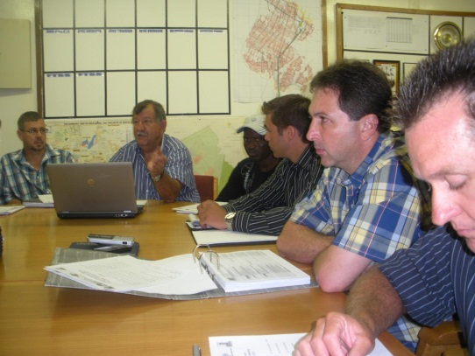
Leading Practices
TARP (TRAP / TSM / ABS-P)
Rock Condition Hazard Classification System coupled with escalated decision making commensurate with the risk
Source - Kroondal Chrome Mine
Demo - Joel Mine
(in progress)
Adoption - COPA to be formed
Leading the change to zero harm

Slide 11
Challenges
Correct Level of Participation at various forums
Understanding Mental Models and Entrenching Leadership Behaviour and Behavioural Communications plans
Continuity of Representatives at Meetings
Alignment with Coal Mining Initiatives
Leading the change to zero harm

Slide 12
Way Forward
Post Demonstration Workshop and COPA formation for Nets with Bolts (3 Feb ‘12)
Post Demonstration Workshop and COPA inclusions for TARP (June/ July ‘12)
Planning Workshop for New Leading Practice to be adopted ( Aug ‘12)
Leading the change to zero harm

Slide 13
Performers
TauTona > 3Years FOG Fatal Free!!!!
Roland Shaft >12 Million FOG Fatal Free Shifts!
Blyvooruitzicht >4½ Million FOG Fatal Free Shifts!
Modikwa – FOG “Injury Free” for 2010
Achieved +8 million fatal free shifts
Leading the change to zero harm

Slide 14
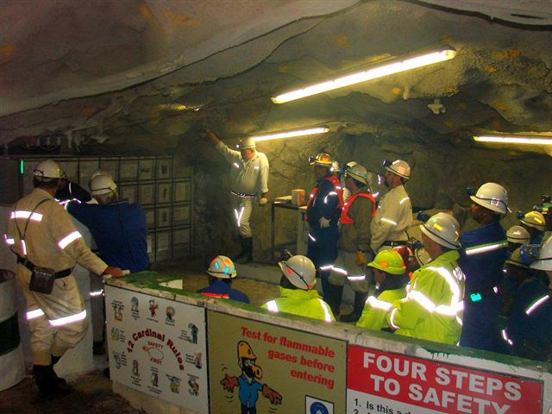
All SA Mines
How are you progressing toward the Target of Zero Harm?
How are you performing against the 2013 Milestones
for your Mine or Company?
Thank you…….. any Questions??
Leading the change to zero harm

