Slide 1




FALLS OF GROUND
APRIL
2012
CHAMBER OF MINES OF SOUTH AFRICA
Working together for a sustainable future since 1889

Slide 2
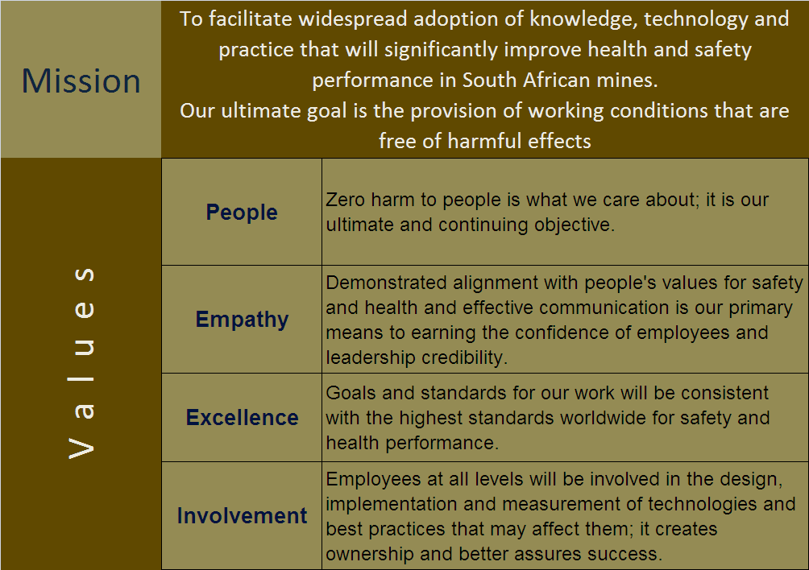

Mission and Values - MOSH
This is who we are

Slide 3
Progress for the Months February/March
Netting with Bolting
 | Highlights (Achievements, Commendations & Lessons Learnt) | Lowlights (Issues, Risks, Concerns) | Priority Action Steps to Address Lowlights | Due Date | Resp. Person
 | 3 more mines joined, now 16 | PI 2012 Strategy(instructing mines to implement) | GPA to engage | Ongoing | GPA
 | Coal Producers keen to customize it for their mines | Lack of organisational support from Coal sector | Strengthen the Coal Industry Team | On Going | Adoption Team
 | HR people happy to be involved and want to participate | Do not get invitations from the adoption managers | Invited to the next COPA meeting on the 4 May | ongoing | C legodi

Slide 4
Progress for the Months February/March
TARP System
 | Highlights (Achievements, Commendations & Lessons Learnt) | Lowlights (Issues, Risks, Concerns) | Priority Action Steps to Address Lowlights | Due Date | Resp. Person
 | BC- LB customisation completed |  | Singed off on 27 march | 27 March | A Van Zyl
 | Success/Failure measurements agreed
 | E Learning completed |  | Start Training | On Going | A Van Zyl

Slide 5
Progress for the Months March/April

Slide 6
FOG Team Activities for Month March/April
Andre Van Zyl
Conducted LH Strategy Review meeting
Tarp Source Mine Documentation
Duncan Adams
Christopher Legodi
Attended Training by Decision Partners
Visited Phakisa mine(invited as a follow up from COPA meeting
Met Anglo Platinum Health and Safety Head
Petra Diamond Management
Tripartite meeting (Vaal River and Rustenburg)
Chaired both Hard Rock and Coal adoption team meetings
NW tripartite (Rustenburg)

Slide 7
FOG Team Medium Term Plan
Jan-12 | Feb-12 | Mar-12 | Apr-12 | May-12 | Jun-12 | Jul-12 | Aug-12 | Sep-12 | Oct-12 | Nov-12 | Dec-12 | Jan-13 | Feb-13 | Mar-13 | Apr-13 | May-13 | Jun-13
EE
NETS WITH BOLTS(COPA PHASE)
TARP (DEMO PHASE)
TARP (COPA PHASE)
NEW LP PREP
NEW LP DOCMT and Demo

