Slide 1
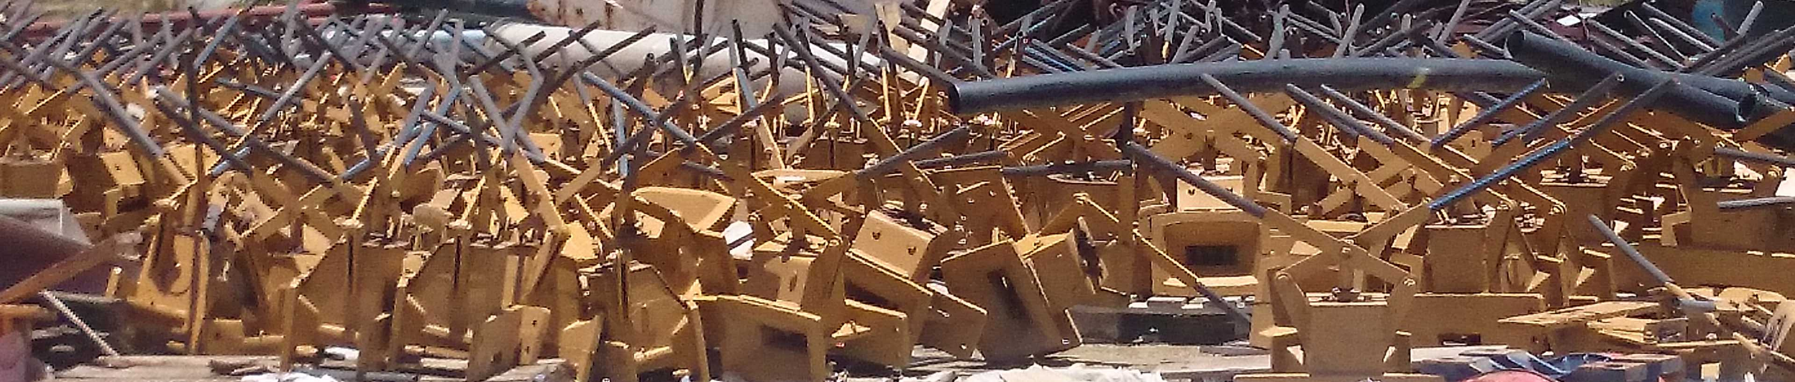

OCTA TRIGGER TYPE AUTO-LOCK SAFETY BUFFER
REGISTERED PATENT NUMBER: 2011/02614
13 May 2015

Slide 2
Safety in Mines Research Advisory Committee
Project number : GAP 703
Date : September 2000
Where underground transport is carried out in an environment with:
• Good quality trackwork
• Standardised rolling stock
• Well maintained rolling stock and buffers
• Skilled and well trained operators
• Effective and reliable communication between driver and guard
• A culture of safe working practices then the system of links and pins as used by the industry for many decades would probably be adequate.
Designing the auto-coupling safety buffer (2009-2011):

Slide 3
In an attempt to connect buffers with heads hanging down, the couplings have to be lifted before the pin can be fitted.
One has not enough hands to carry out the above duties safely, with the result that workers hands get trapped between the buffers.”
Designing the auto-coupling safety buffer (2009-2011):

Slide 4
1. The motive for designing such a buffer/coupling arrangement is SAFETY.
2. To be safe, remote or automatic coupling of buffers are required.
3. The buffer needs to withstand the underground conditions
4. The buffer needs to be able to host a solid draw-bar
5. A single design for all applications (hoppers, rolling stock, declines etc.)
6. A buffer system which can randomly and partially integrate with the existing buffers.
7. Underground rail conditions, elevation differences, sharp curves
7. A simple operational system with minimal confusion and minor training
8. Robust, safe, simple, effective and trustworthy.
9. Total cost of ownership
Designing the auto-coupling safety buffer (2009-2011):

Slide 5
The Trigger buffer was developed and introduced into the mining sector in 2011 at Anglo Platinum’s Khomanani 1 and -2 shafts in their Rustenburg section.
Anglo Platinum reviewed other auto-couplers and safety buffers but agreed that the Octa Trigger type buffer had the required characteristics and necessary design specifications which corresponds with mining requirements and applicable laws. Anglo Platinum then proceeded with purchase orders.
The roll-out began and in some instances an external 3rd party company were assisting the shafts with the fitment of buffers onto hoppers and rolling stock.
We developed an OEM risk assessment with training manuals and maintenance schedules for the operators and shaft maintenance crews.
We assisted the Anglo Platinum shafts and training centers with the training of the operators and the maintenance crews involved with the Trigger buffer.
Underground implementation of the Trigger buffer (2011):

Slide 6
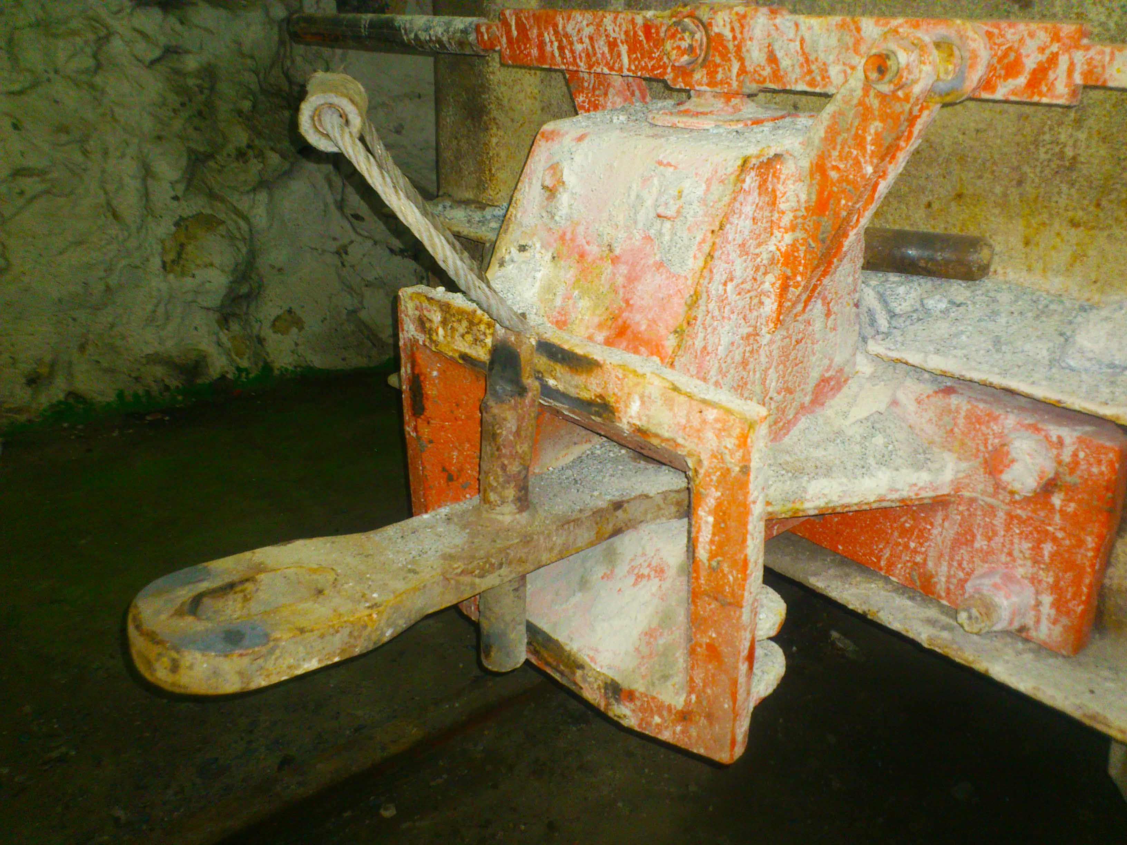
Underground implementation of the Trigger buffer (2011):

Slide 7
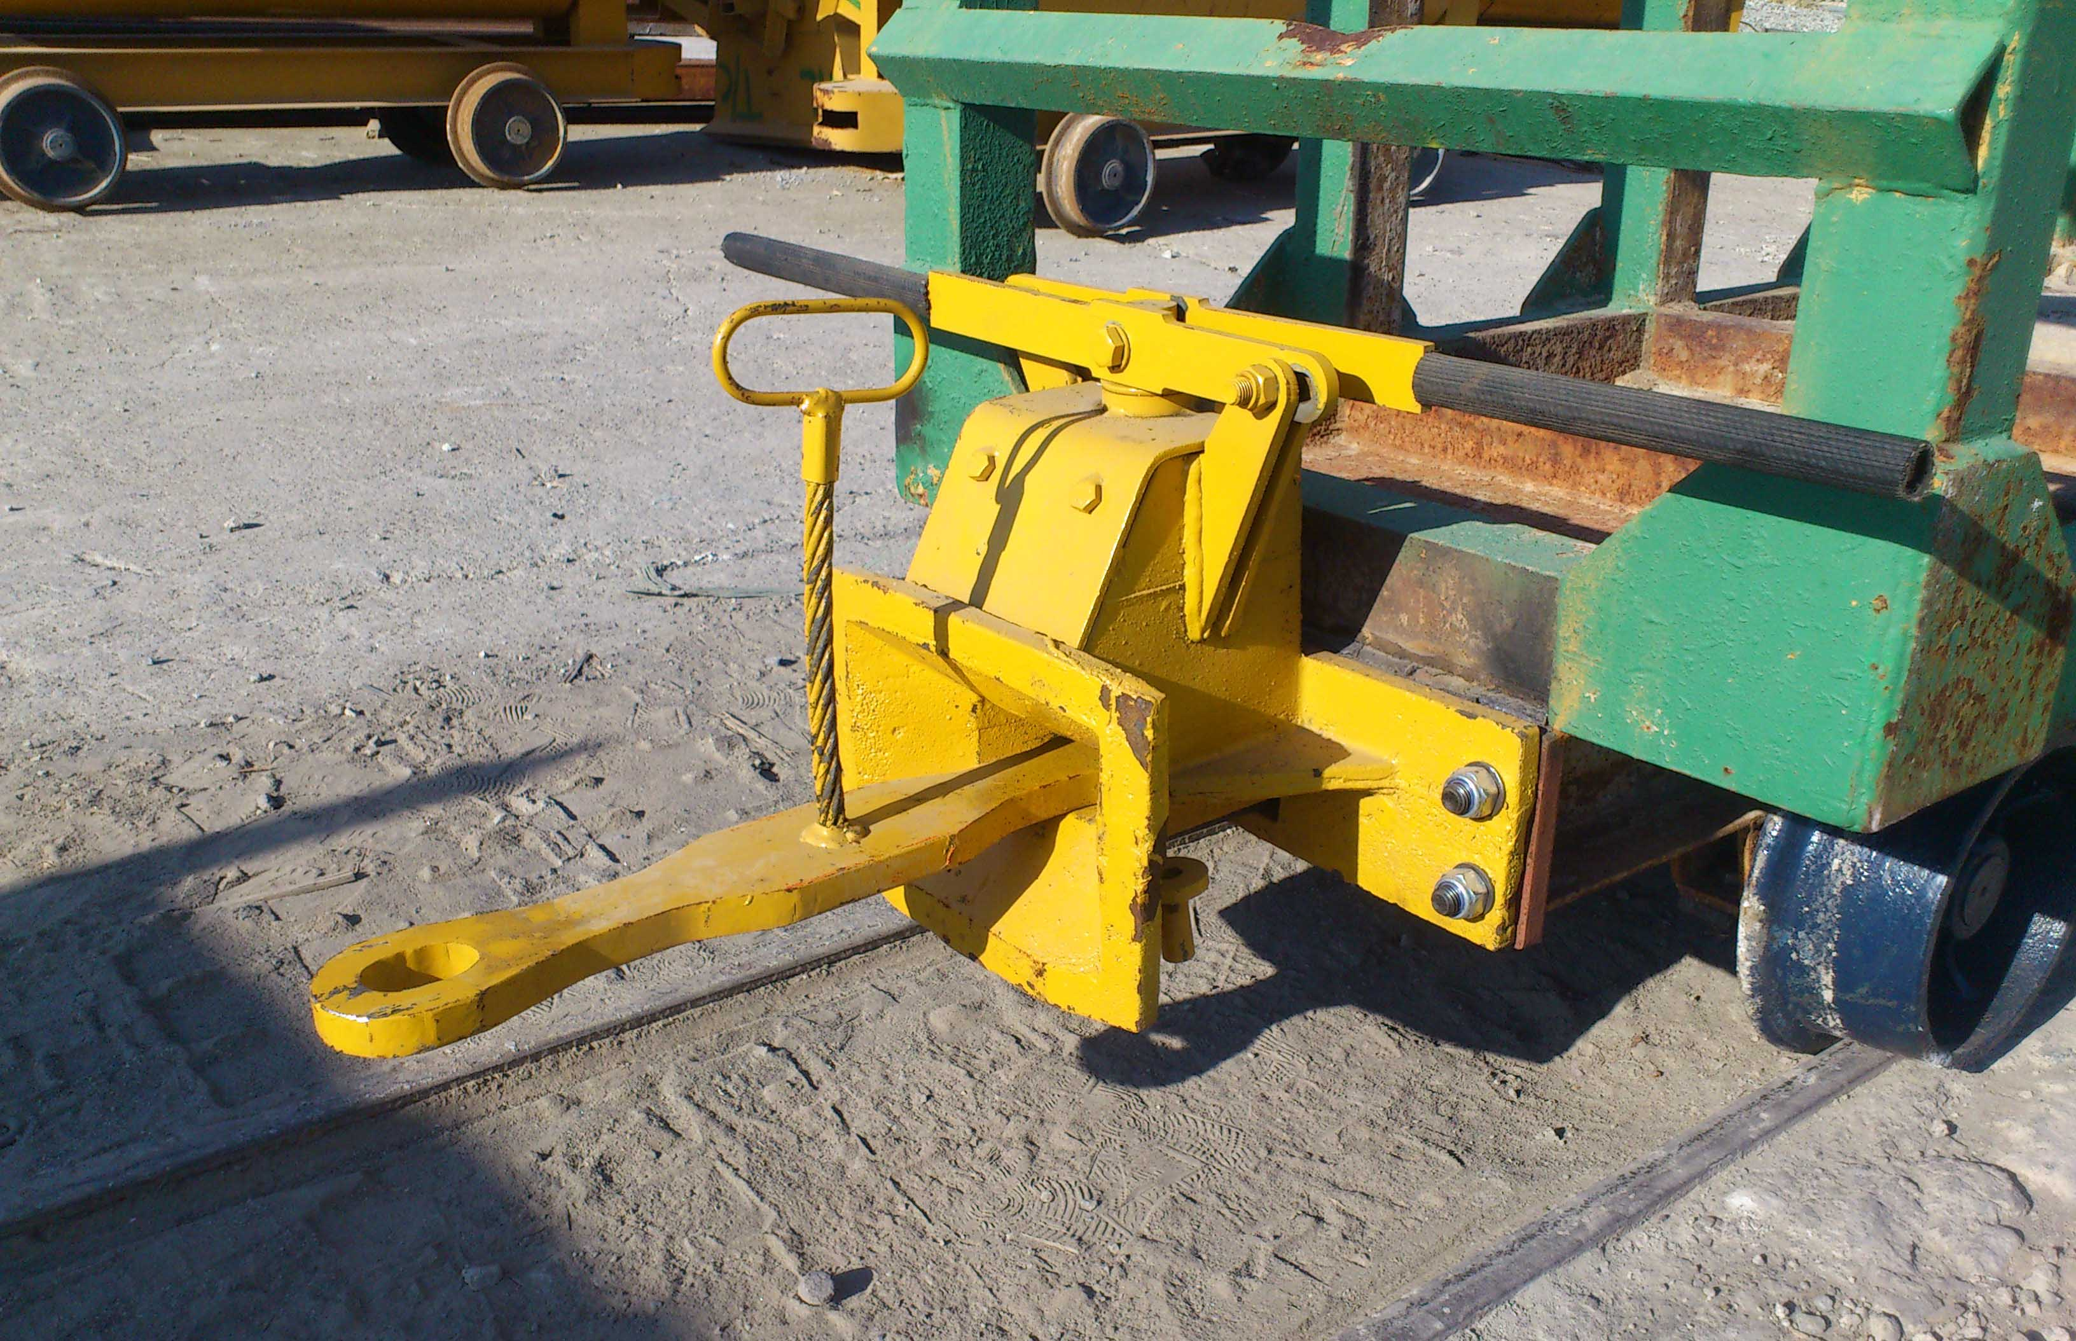
Underground implementation of the Trigger buffer (2011):

Slide 8
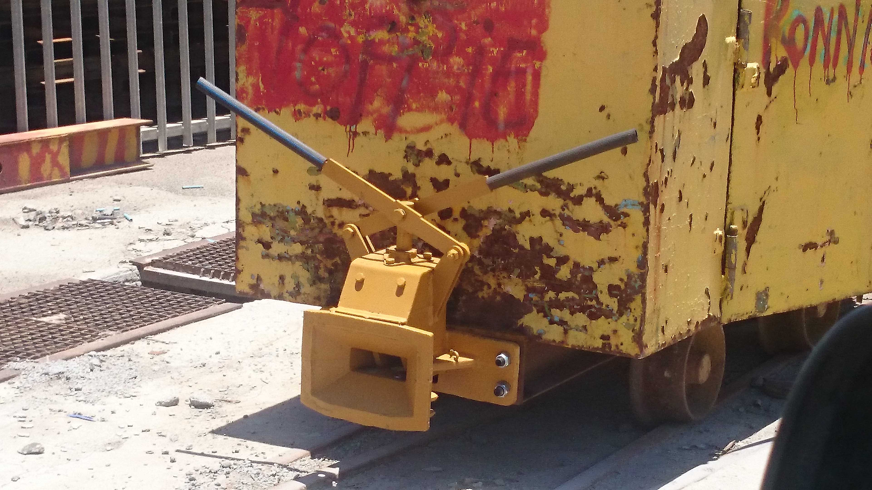
Underground implementation of the Trigger buffer (2011):

Slide 9
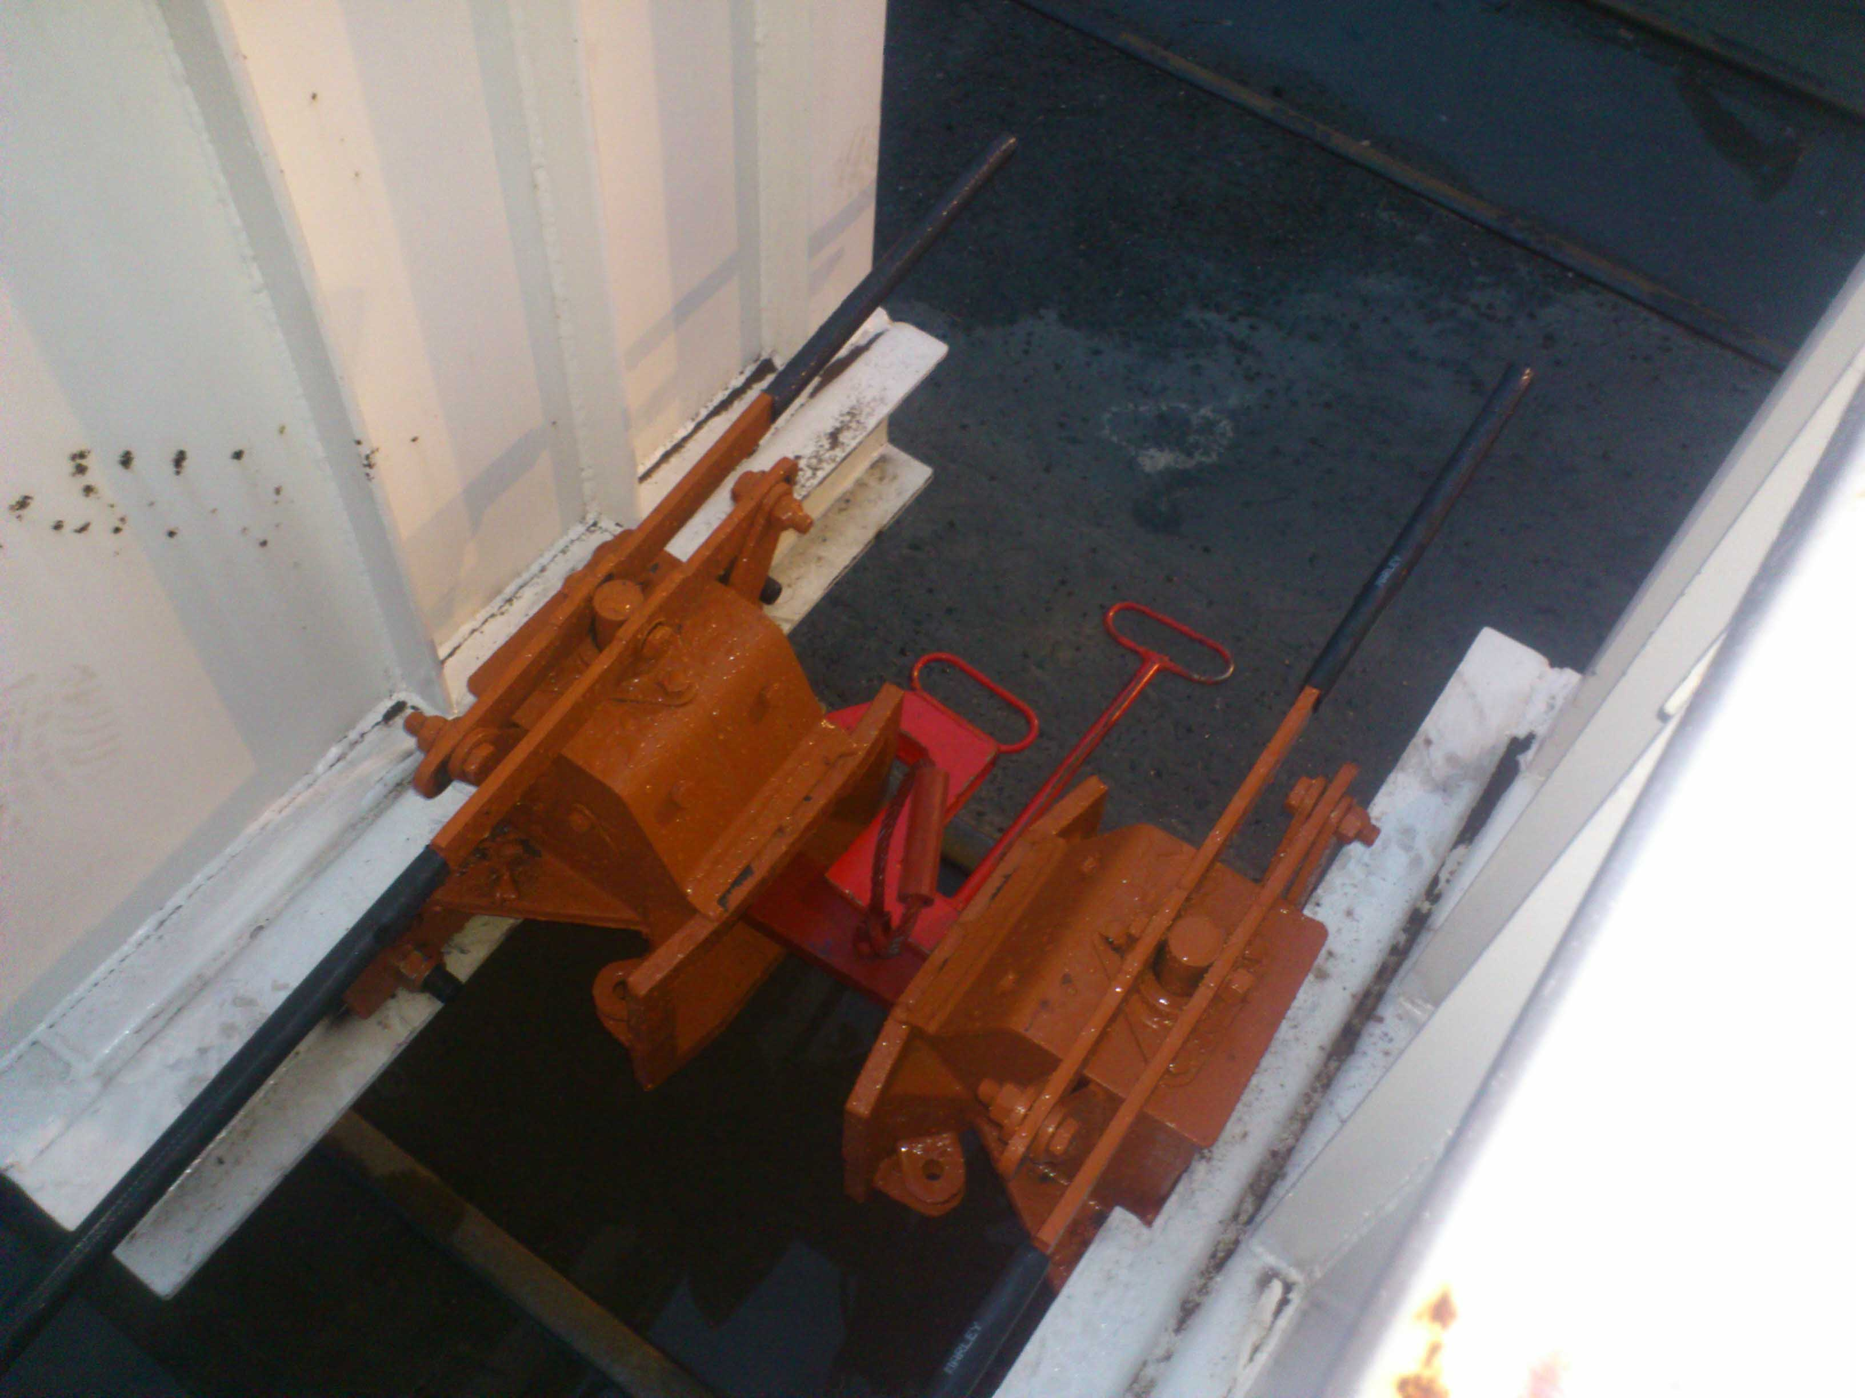
Underground implementation of the Trigger buffer (2011):

Slide 10
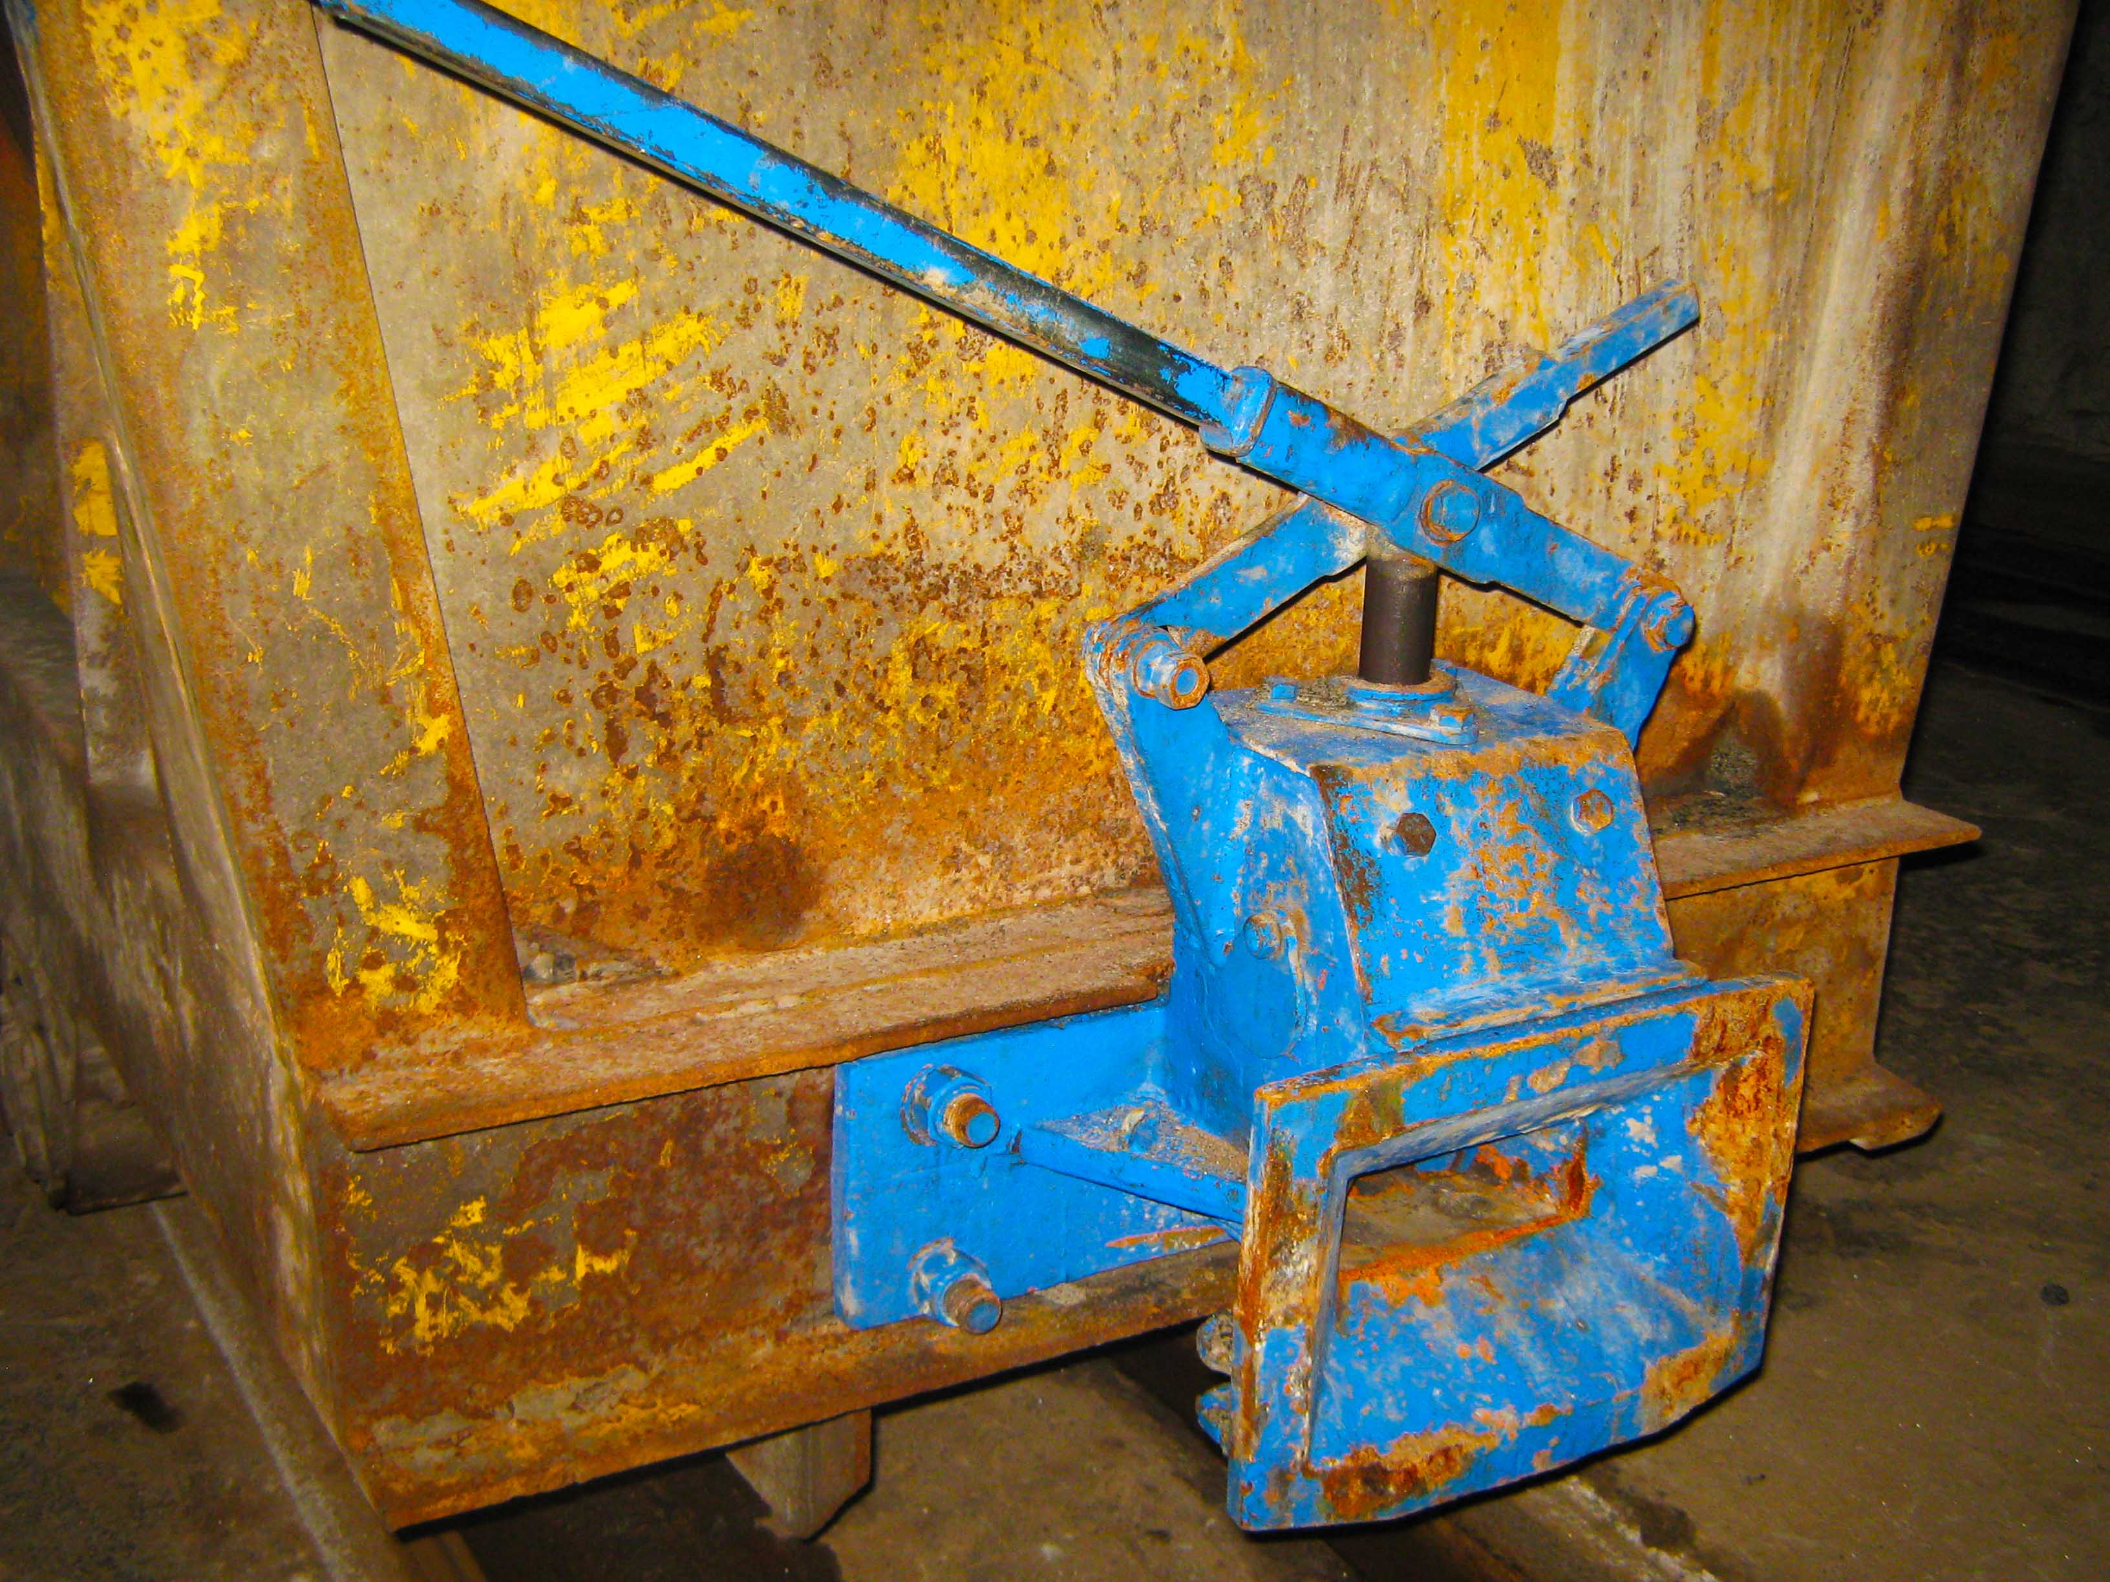
Underground implementation of the Trigger buffer (2011):

Slide 11
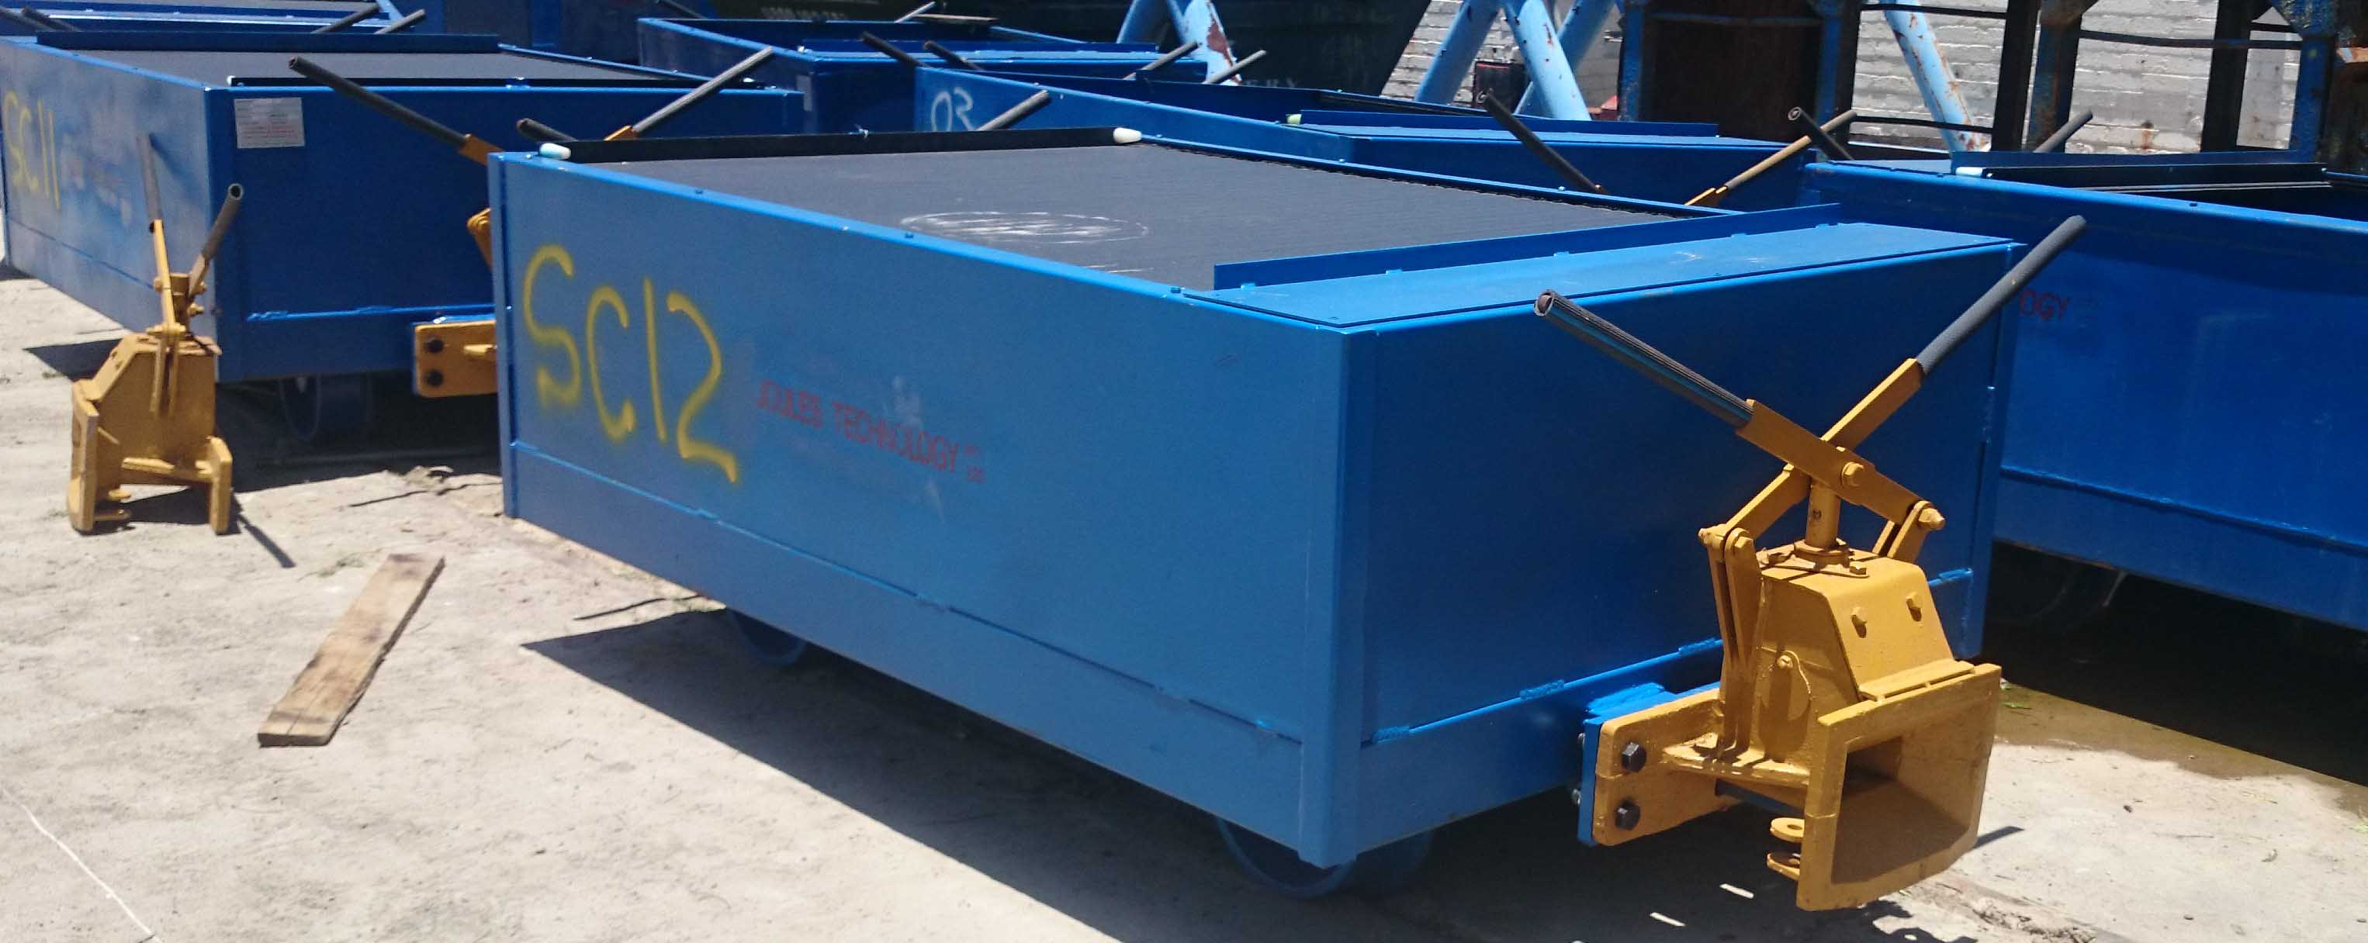
Underground implementation of the Trigger buffer (2011):

Slide 12
Once in full operation the buffers were closely monitored to gather feedback concerning the general operation and also to determine where the design and/or technical specifications could be improved.
As with any new concept we discovered some quality and design issues which were always jointly resolved between Anglo Platinum and Octa Engineering, to improve the product and it’s effectiveness as much as possible.
This buffer soon became the new standard and needed to be installed on all hoppers and rolling stock, old and new.
Ensuring that the operators and maintenance crews are trained and proficient, the general buffer operation is correct, maintaining the buffers in accordance to the set intervals and procedures, and a continuous positive attitude towards daily housekeeping tasks and elimination of spillage etc. will increase the buffer longevity and the effectiveness of the operation, whilst reducing total cost of ownership.
Underground implementation of the Trigger buffer (2011):

Slide 13
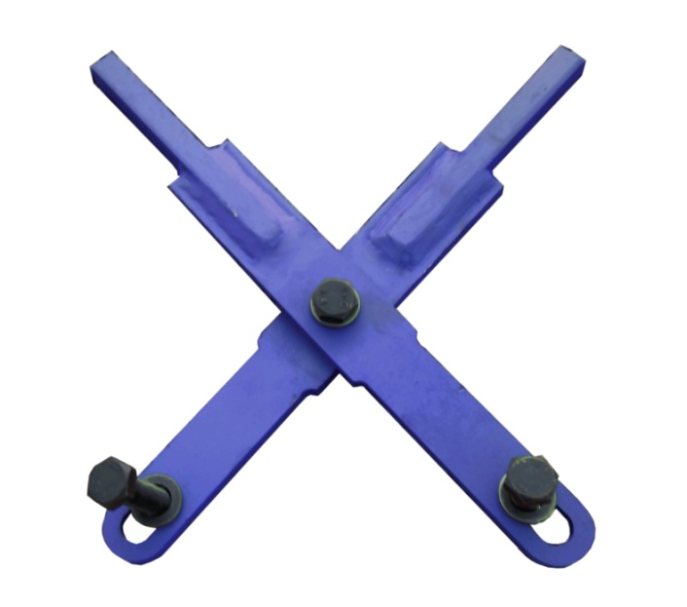
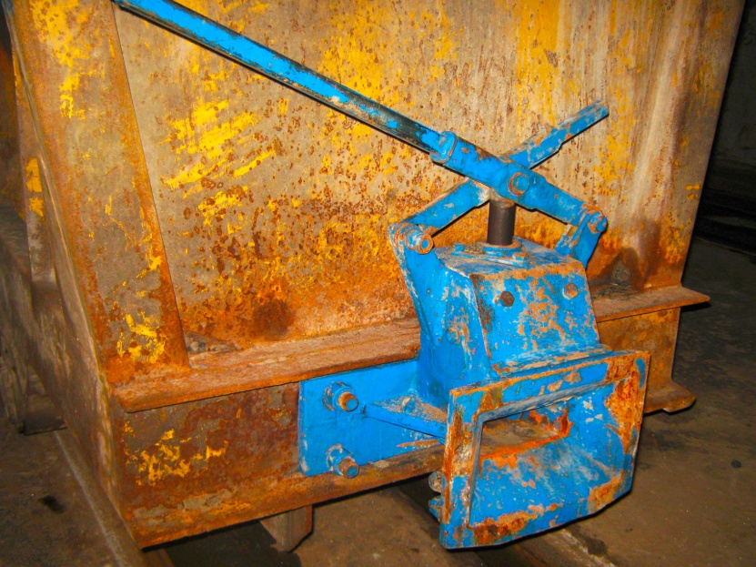
1. We had discovered hairline cracks on some castings after they were placed into operation. We established that the castings were not heat-treated to standard as we had requested. We have been working with a new casting supplier which greatly improved the quality of our castings.
2. We fitted a second handle to the buffer to allow the operator to have full functionality of the buffer and the safety critical operation from either side of the buffer.
3. We then upgraded the handle material from mildsteel to springsteel . We added the shorter handle option to the list of availabilities, depending on the buffer application.
Design improvements made since our first concept:

Slide 14
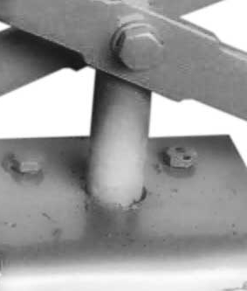
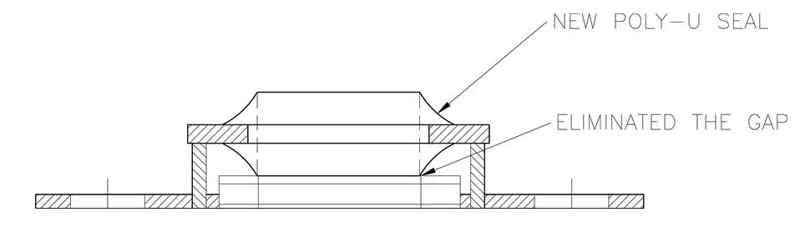
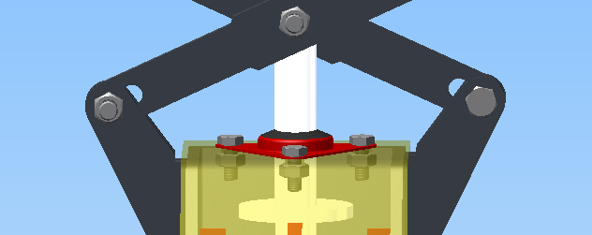
4. We implemented a sealing arrangement around the pin to eliminate fine ore entering the inner housing of the buffer. We started with no sealing arrangement, upgraded to welded steel washers and bushes with rubber O-rings and various wiper-seal applications. We are currently supplying revision 9 of the top-seal arrangement. We have been using it for the last 2 years.
Design improvements made since our first concept:

Slide 15
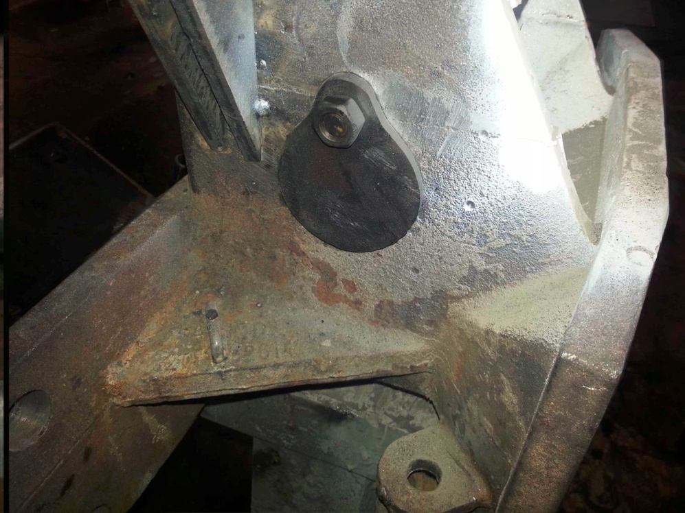
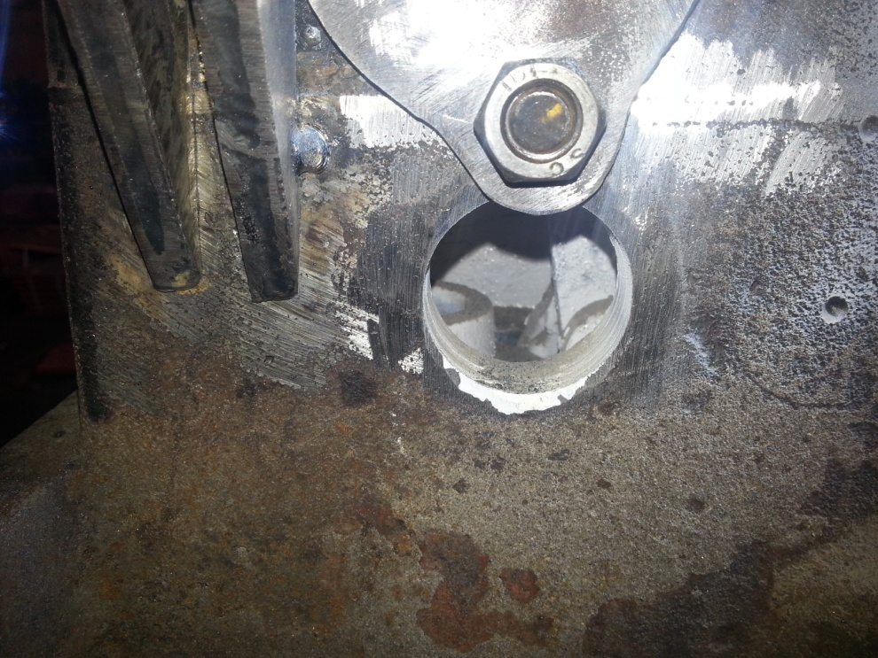
5. The top-plate cover has been redesigned to reduce the fine ore entry.
6. Inspection hole drilled into side for inspections of internals and for cleaning.
Design improvements made since our first concept:

Slide 16
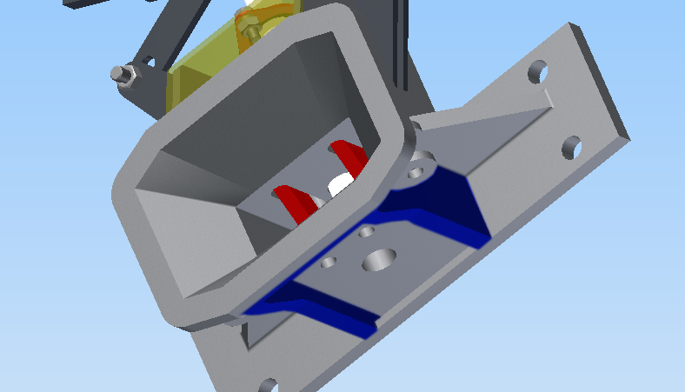
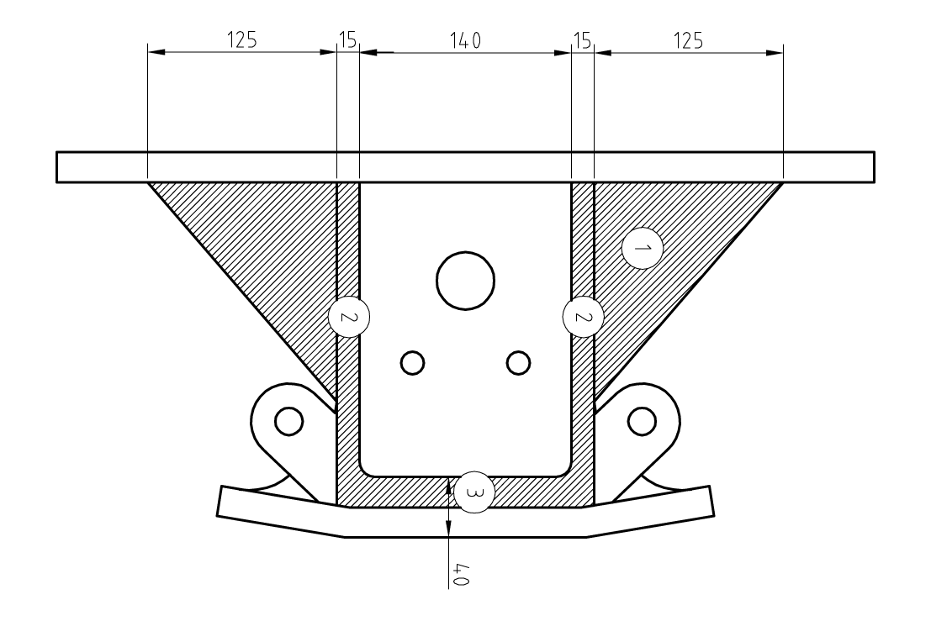
7. Casting recently been improved by increased thicknesses and extra support gussets to strengthen the buffer cast-body.
8. The mildsteel twin-knuckle clamp assembly which clamps onto the coupling inside the buffer mouth, has been upgraded to Roctuff 700 material to reduce wear on the primary contact surface.
Design improvements made since our first concept:

Slide 17
Advantages.
1. Safety. No operator needs to be near any moving equipment or rail bound equipment during the coupling procedure as the buffer internals are designed to press down onto the coupling to keep it in a horizontally level position. With coupling sagging eliminated, the operator doesn’t have to be present when the coupling of the two cars through rail bound movement commences.
2. Internal pin. This EN24 pin remains inside the buffer enclosure and can’t be removed and therefore not lost. Hundreds of pins and/or rope-handles, among other consumables are scattered underground.
3. Flawless integration between new & old coupling systems. As the principal remains the same with only the functioning improved, integration can commence seamlessly.
4. Operator Training. Operators have had the exact same system in operation. They need only to understand when the buffer mouth is open and ready to be coupled, and how to inspect to ensure a successful coupled arrangement .
Advantages and disadvantages:

Slide 18
Disadvantages.
1. Maintenance. Although only monthly, the maintenance schedule needs to be adhered by. The moving parts inside the buffer housing needs to be greased and the buffer needs to be cleaned properly.
2. Housekeeping. Continuous housekeeping around buffer to remove spillage from boxes etc. significantly improves the buffer life and day to day operational efficiency.
Advantages and disadvantages:

Slide 19
Features and drawings of the Trigger buffer:

