Slide 1

Semi Auto Coupling on Hoppers
Presented by: John Vogts
Date: 13 May 2015

Slide 2

Contents
Background
Semi Auto coupling – Concept Decision
Initial Tests
Buffer Selection
Issues identified & Solutions
Further considerations – Impact Loading
Discussion

Slide 3
Background
The gold and platinum sector typically use hoppers to transport ore and broken rock from the working place to the shaft tips.
Typically there are 6 to 10 hoppers in a span pulled by one locomotive
The hoppers weigh between 4 and 10 tons (gross)
Depending on the applications there is a frequent need for coupling and uncoupling of hoppers (shunting purposes and development).
In 2000 around 20% of all rolling stock accidents were during coupling.
It can be estimated that the number of locomotive drivers and guards in a mine constitutes around 5% of the mine employees.
The locomotive drivers and guards are not highly educated.
Rail conditions underground are generally poor and the tramming speed limits are medium to slow.

Slide 4
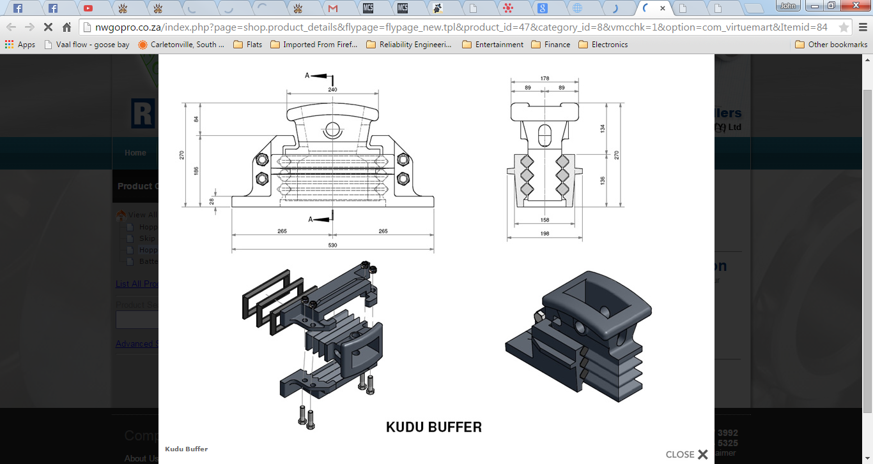
Background
The most common conventional buffer in use was the Kudu Buffer.

Slide 5
Semi Auto Coupling – Concept decision
In 2000 research done by the Safety in Mines Advisory Committee (SIMRAC) found that; almost all accidents that occurred were during coupling, with very few accidents during uncoupling.
AngloGold Ashanti then took the decision to identify a system that would allow coupling to take place while the guard was in a safe position. i.e. Not positioned in the danger area between the rolling stock.
A semi automatic coupling system needed to be installed.

Slide 6
Initial Tests
Test Criteria
Semi-Automatic coupling
Sufficient strength
Resilience
Coupling around bends
Derailment behaviour
Reliability
Maintainability
Compatibility
3 types of buffers were tested
Clayton Semi-auto couplers
Deton Automatic coupler
Galison APC Semi-auto couplers

Slide 7
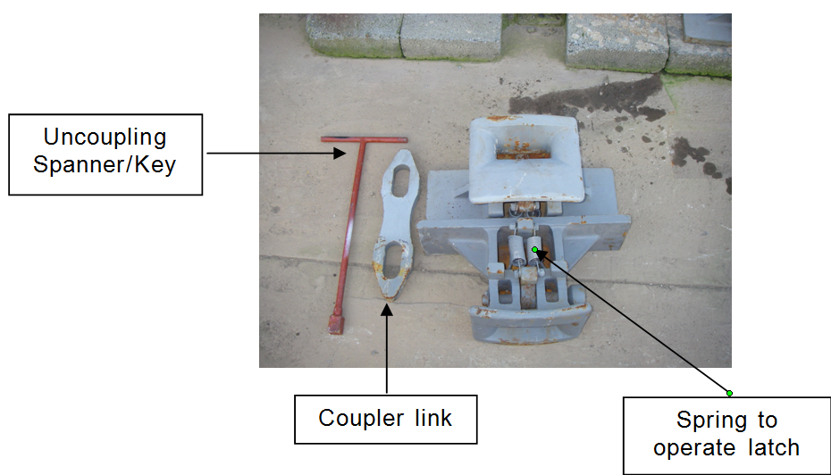
Initial Tests – Clayton Semi-auto coupler
Features
Integrated Pin/ latch
Spring operation
Rigid buffer (no resilience)
Separate tool provided for uncoupling
Not compatible with current Kudu buffers

Slide 8
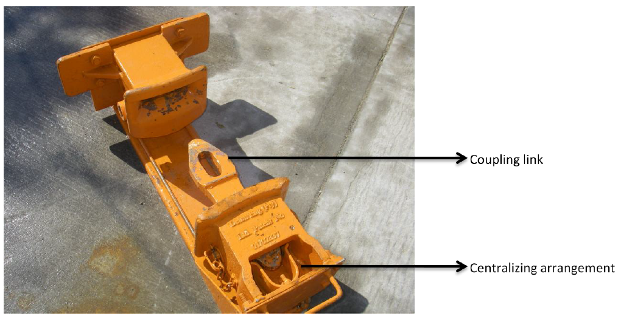
Initial Tests – Deton Automatic coupler
Features
Integrated Pin/ latch
Spring operation
Rigid buffer (no resilience)
Separate tool provided for uncoupling
Not compatible with current Kudu buffers

Slide 9
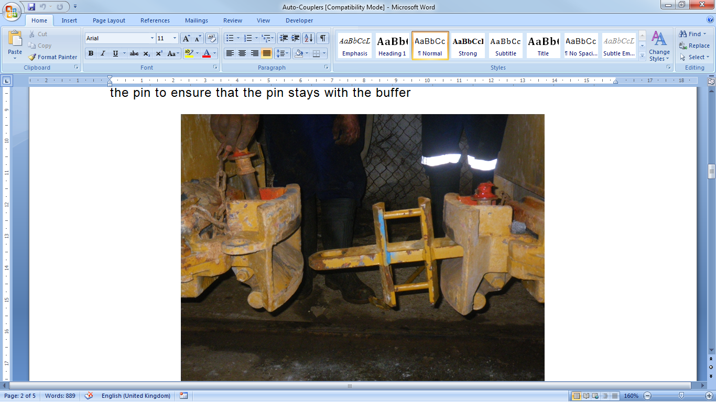
Initial Tests – Galison APC Semi-automatic coupler
Features
Separate Pin
Counter weight operation
Resilient buffer
Compatible with current Kudu buffers
Selected for Installation at AGA

Slide 10
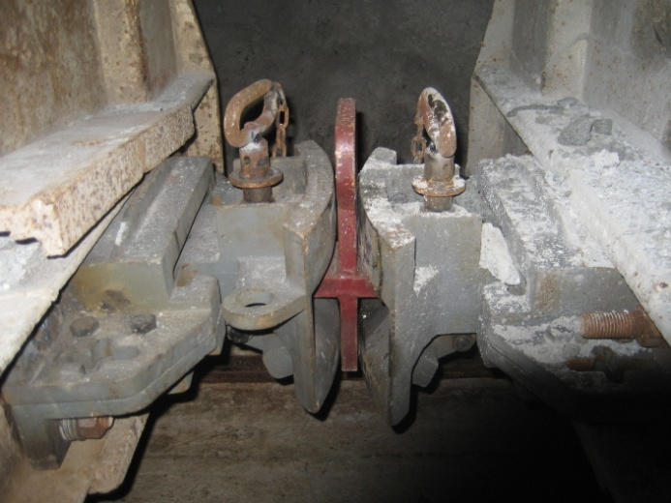
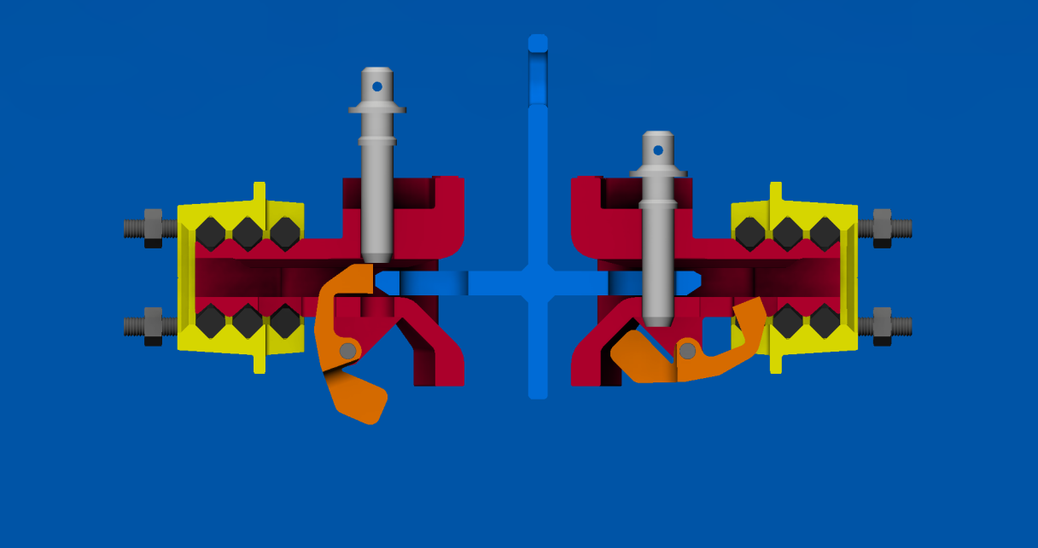
Galison APC Semi-automatic coupler
Uncoupled
Coupled
Pin
Counter Weight
Shackle

Slide 11
Issues Identified & Solutions
Incorrect Pins resulting in breaking the counter weight
Incorrect shackles, preventing auto coupling
Auto coupling with a locomotive.
Premature failing of the resilience, preventing auto coupling

Slide 12
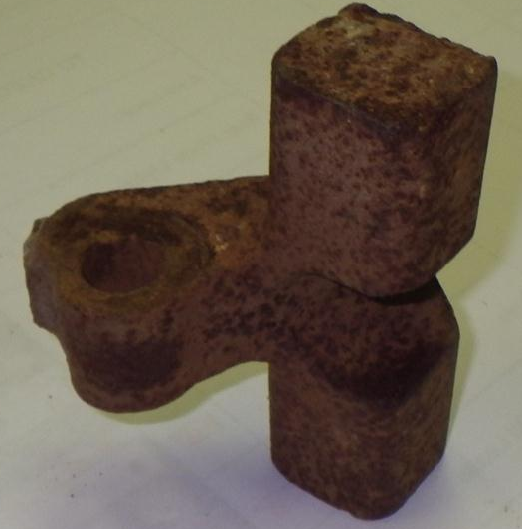
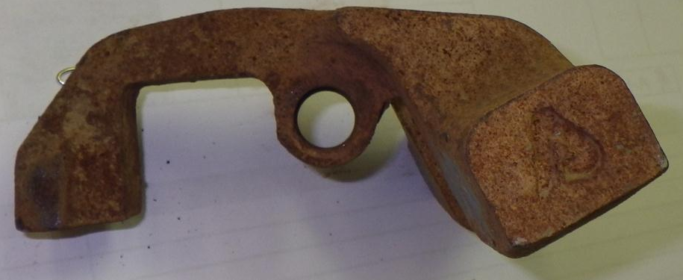
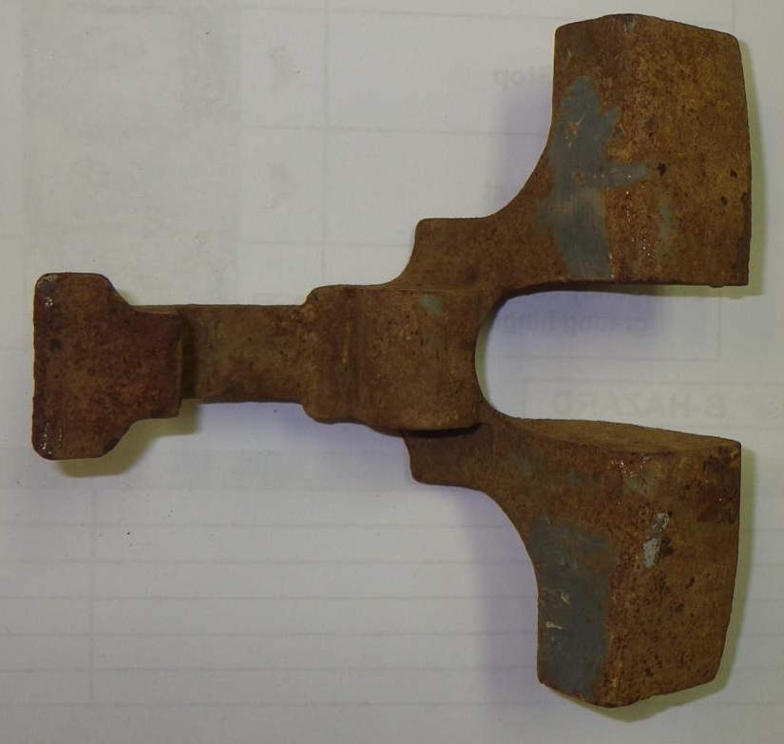
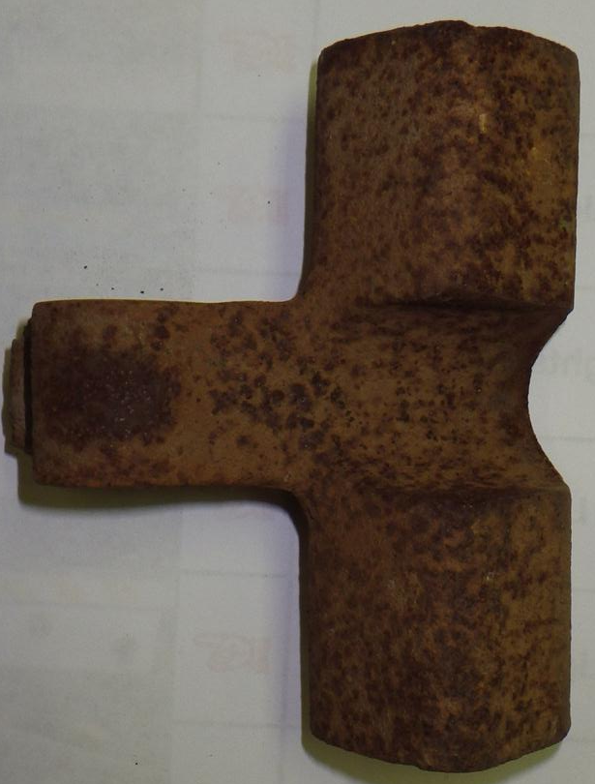
Issues Identified & Solutions
1. Incorrect Pins resulting in breaking the counter weight
Old counter weight
(Broken)
New counter weight

Slide 13
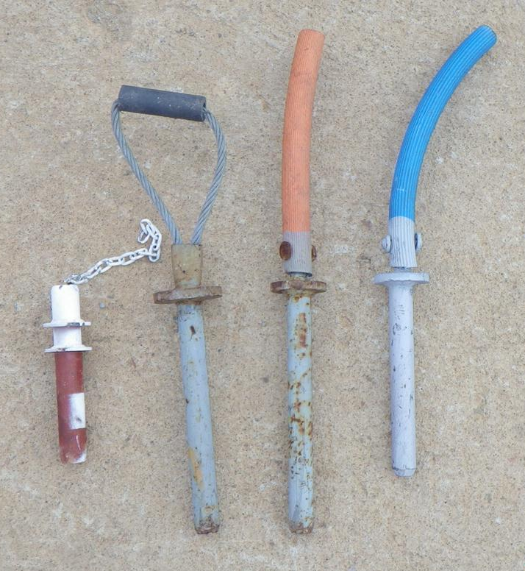
Issues Identified & Solutions
1. Incorrect Pins resulting in breaking the counter weight
Pin standardised throughout the mine
Original pin supplied with the auto coupling buffers

Slide 14
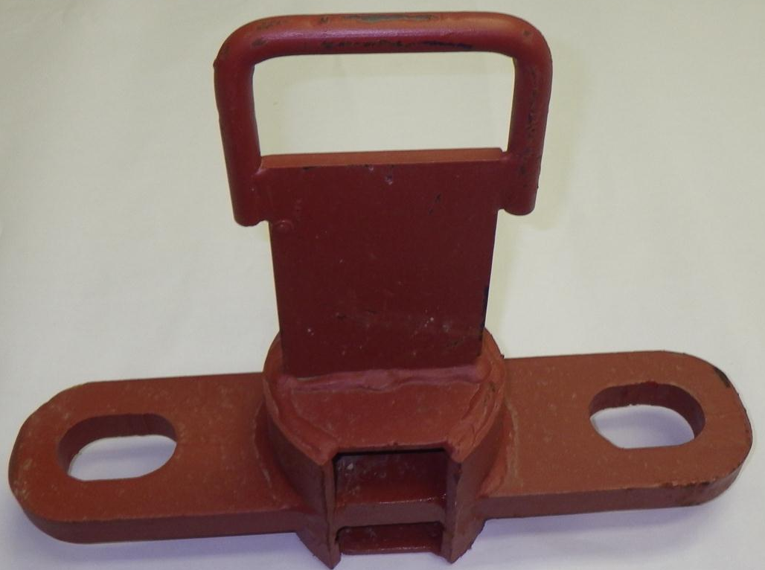
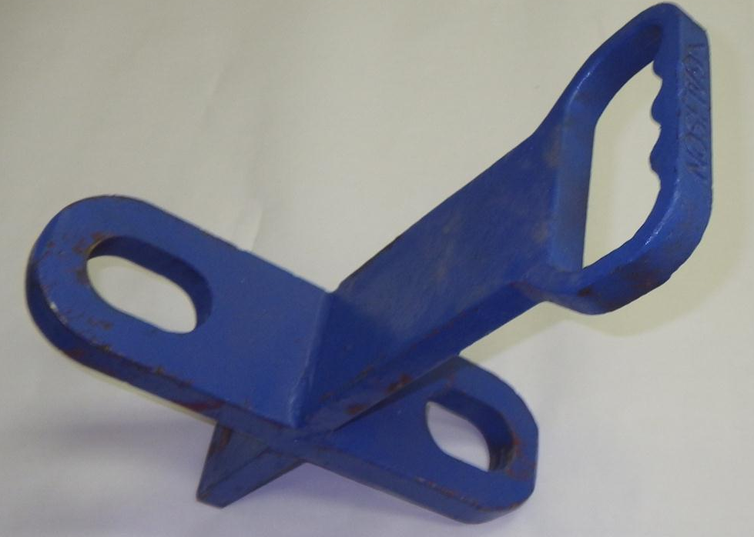
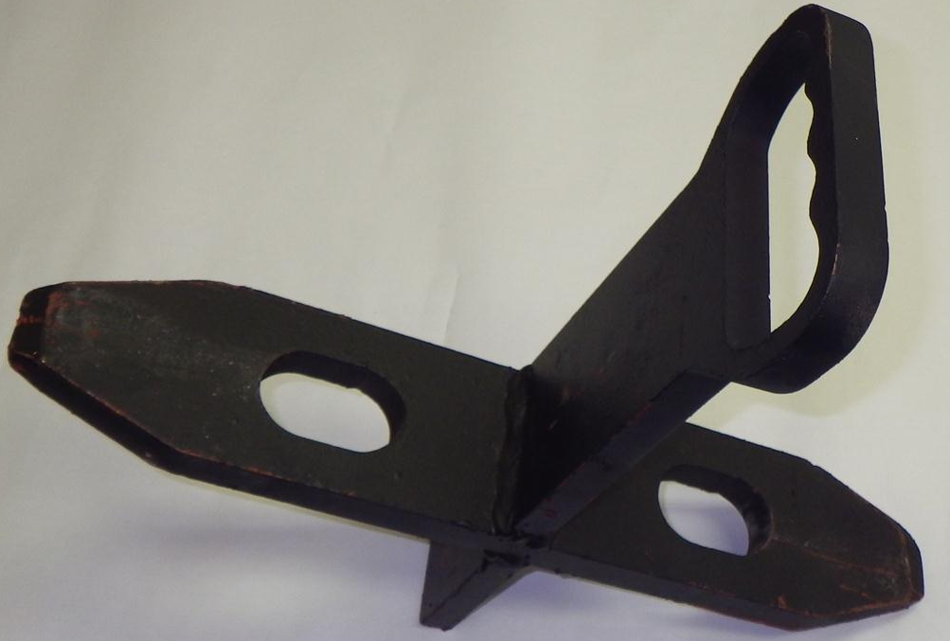
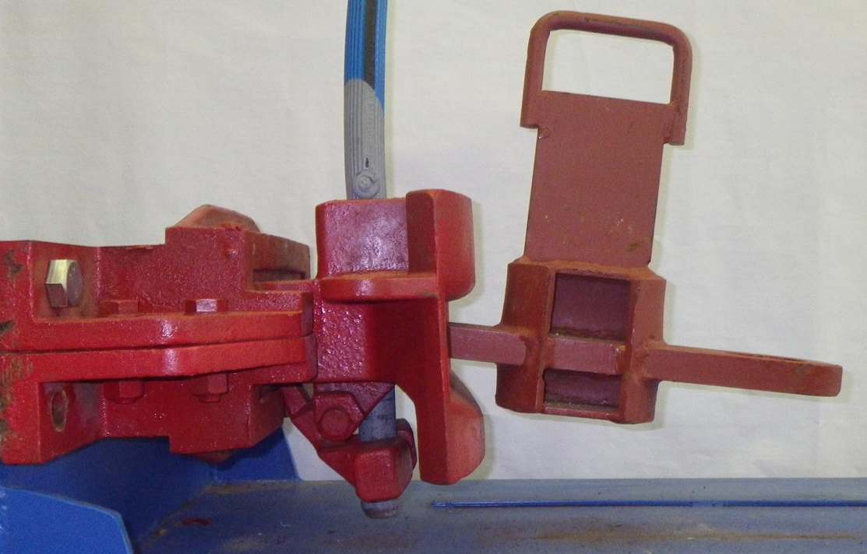
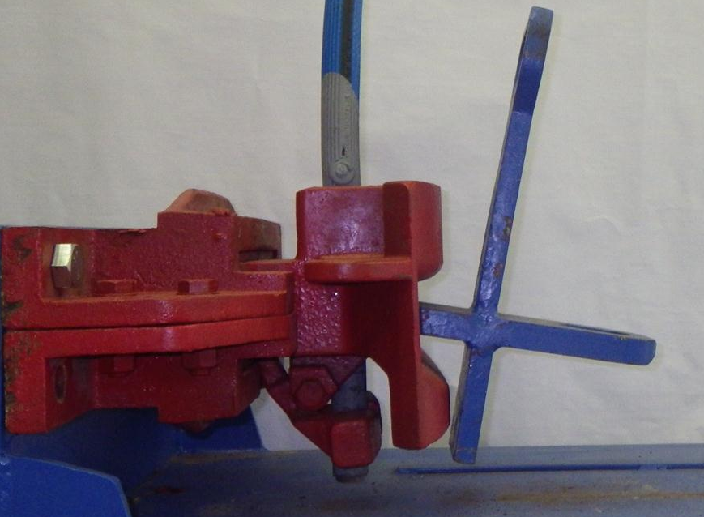
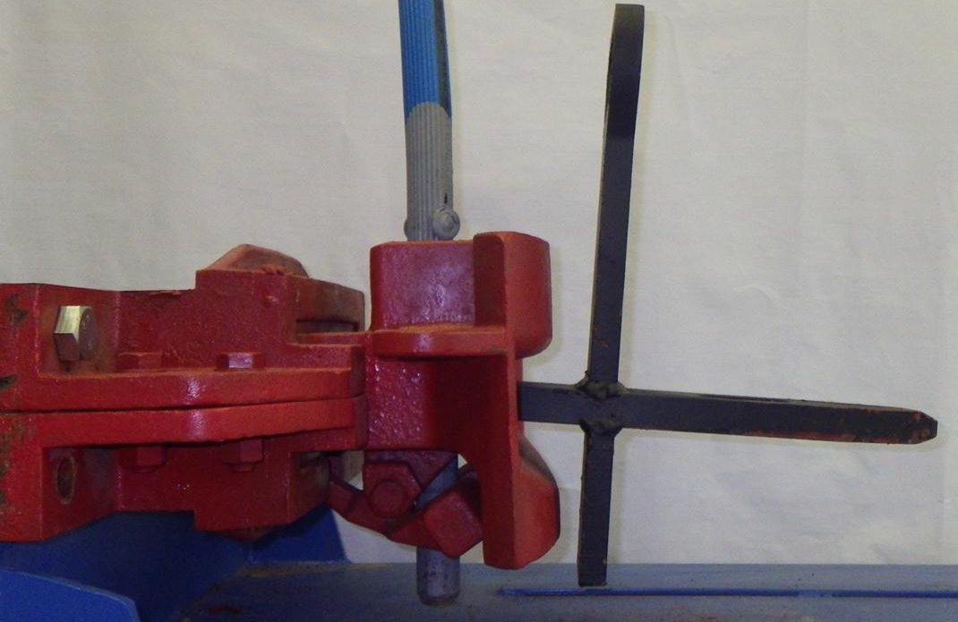
Issues Identified & Solutions
Incorrect shackles
The material car shackles are too long, increasing the sagging
Initial hopper shackles also resulted in a large amount of sagging
New lengthened hopper shackles reduced the sagging to a minimum

Slide 15
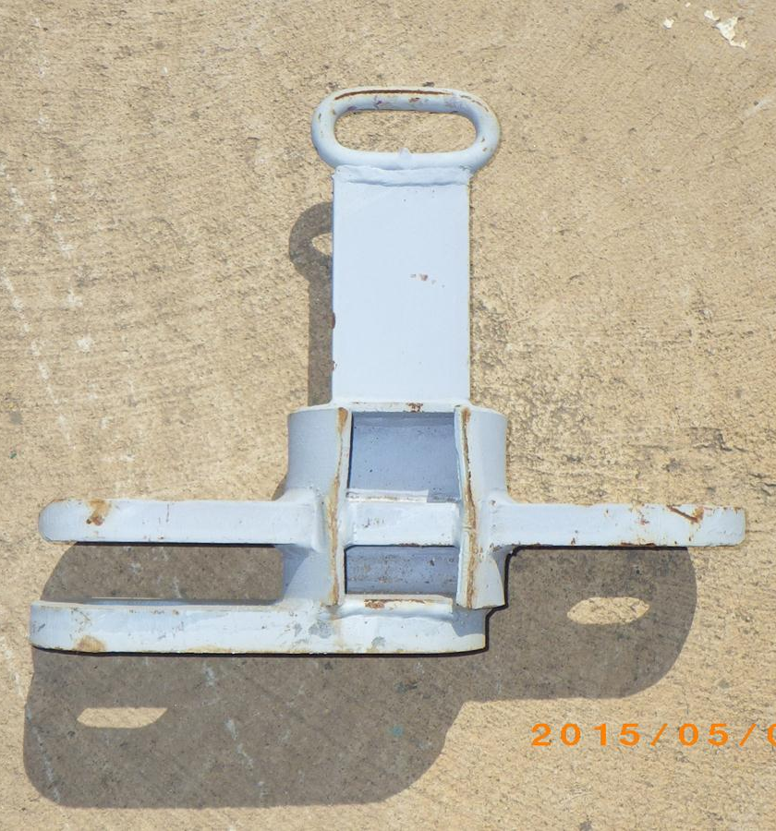
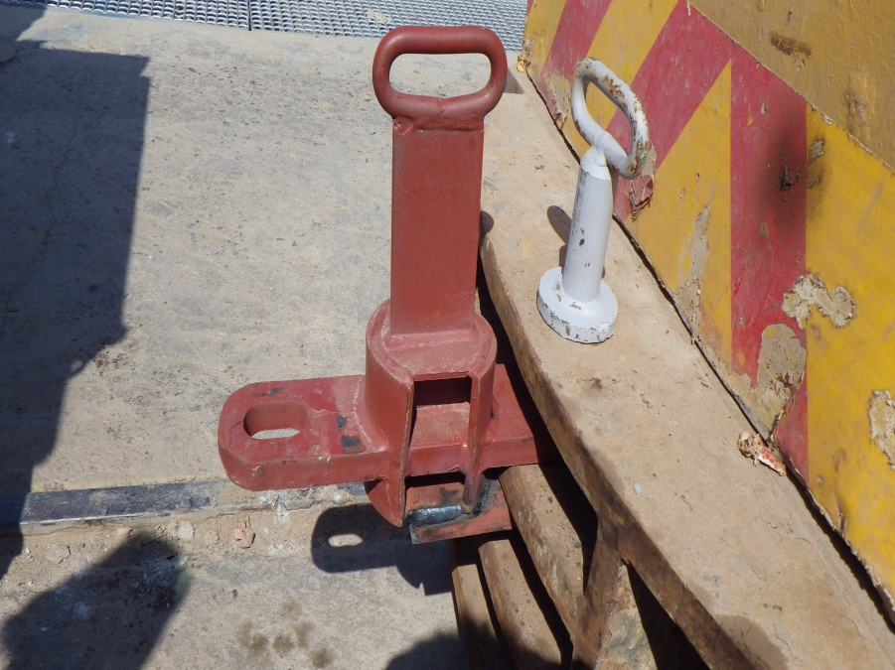
Issues Identified & Solutions
Coupling to a loco.

Slide 16
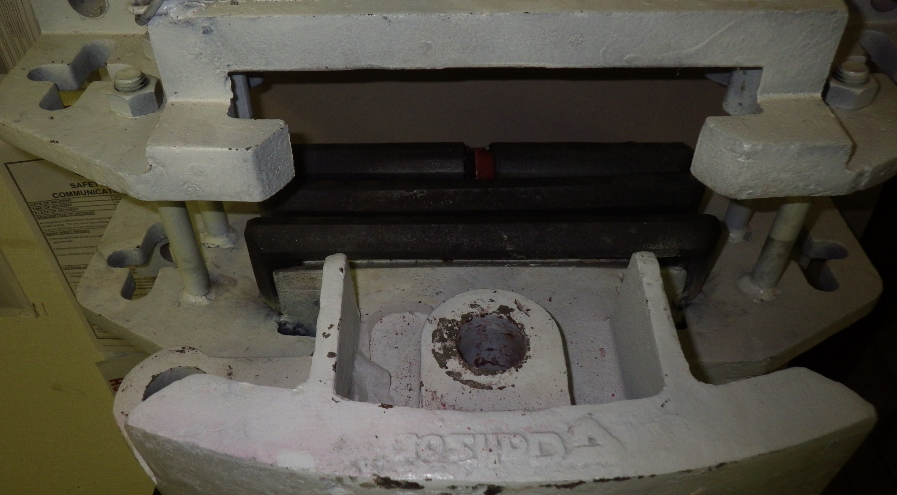
Issues Identified & Solutions
Pre mature failing of the resilient rubbers in the buffer, resulting in sagging

Slide 17
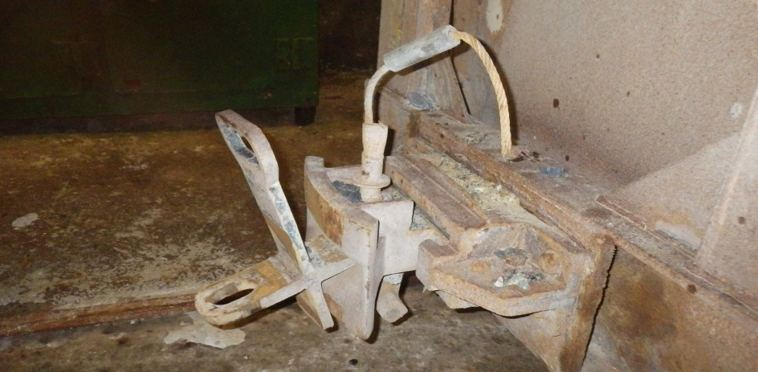
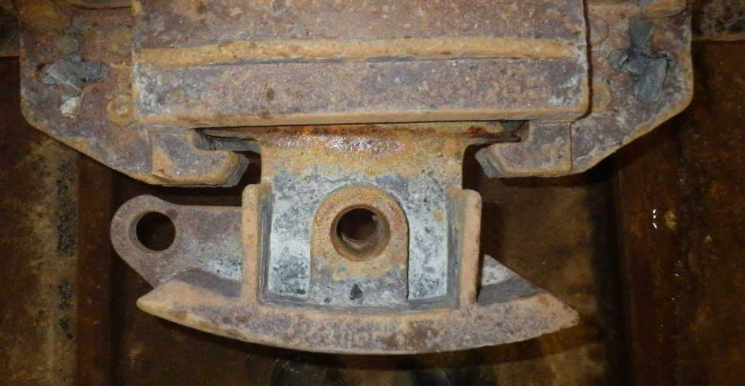
Issues Identified & Solutions
Pre mature failing of the resilient rubbers in the buffer, resulting in sagging

Slide 18

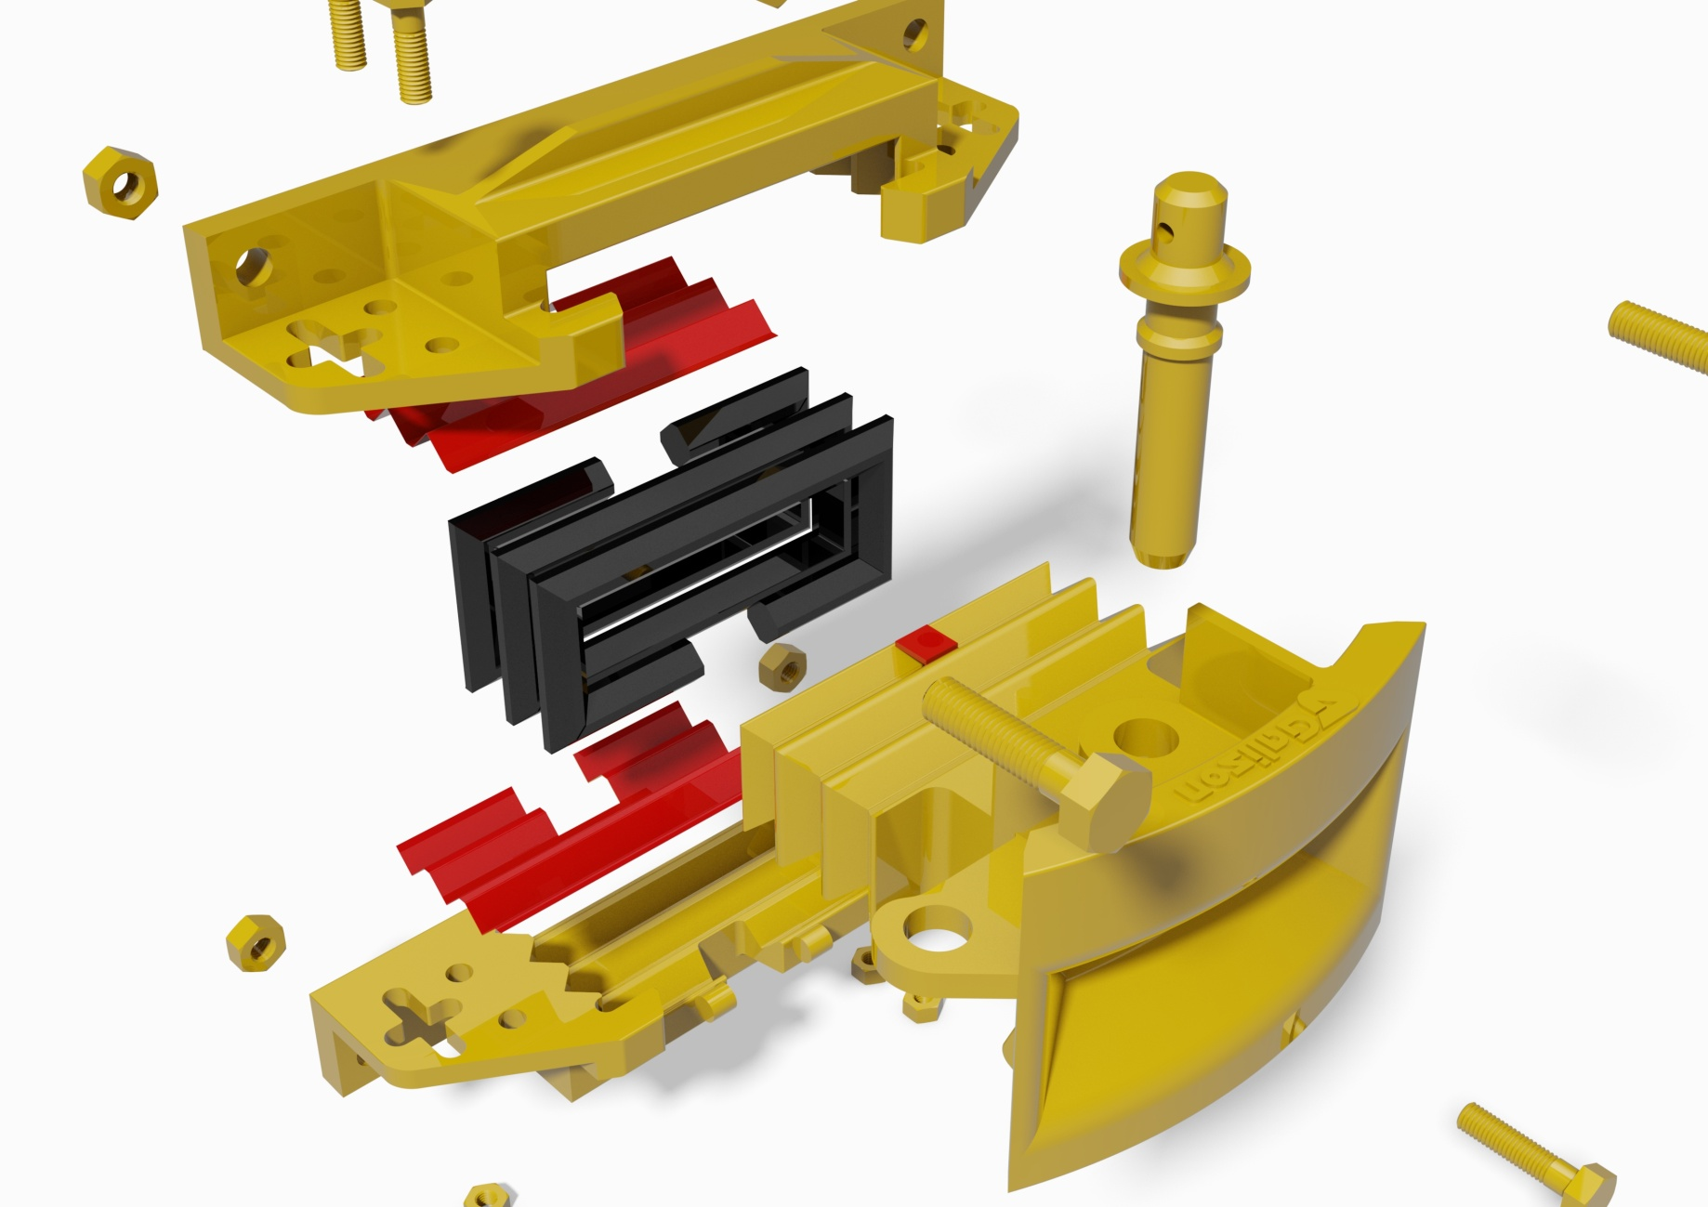
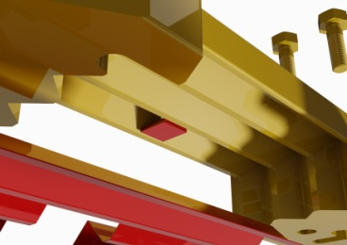
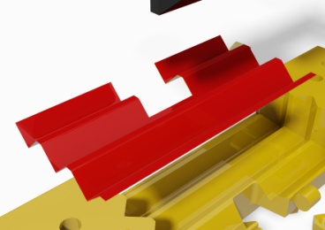
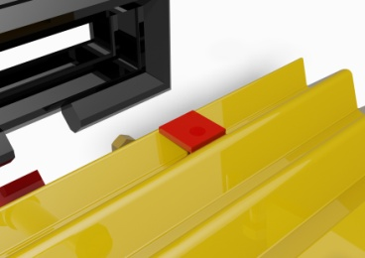
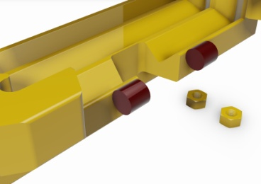
Modifications to the APC coupler to prevent the head from drooping
Flat bar welded to the rear of top casting between the ribs as shown.
Shim plates inserted top and bottom
Flat bar welded to the rear of the coupler head between the ribs at the top as shown.
Round bars welded to bottom casting. Welded that the coupler head is in contact with the round bar

Slide 19
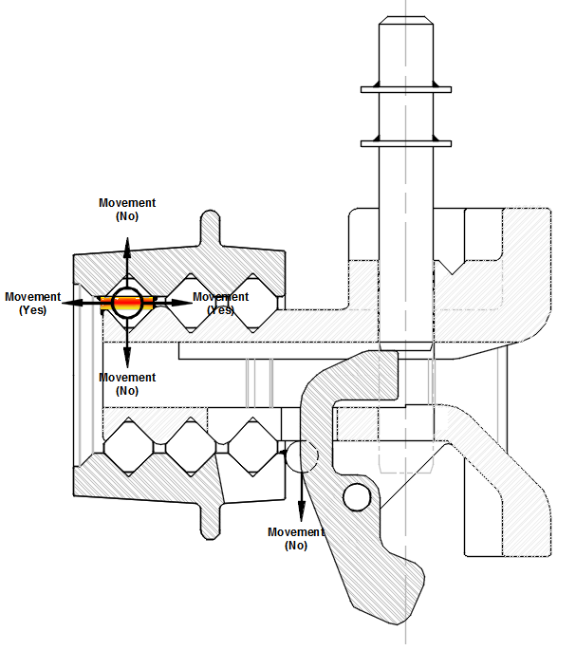
Coupler Pin
Top casting
Flat bar welded to the rear of top casting between the ribs as shown.
Coupler Head
Round bars welded to bottom casting only. Welded that the coupler head is in contact with the round bar.
Flat bar welded to the rear of the coupler head between the ribs at the top as shown.
Bottom casting
Rectangular Rubbers
Counter Weight

Slide 20
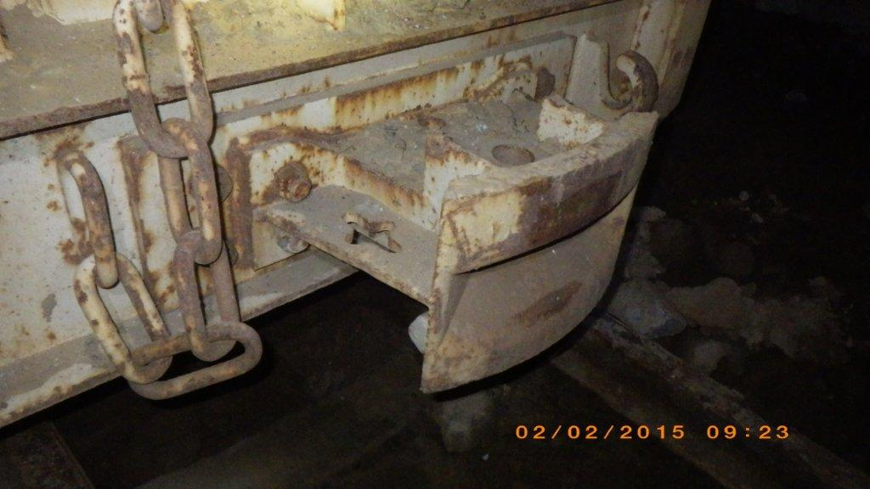
Issues Identified & Solutions
Non Resilient buffer

Slide 21
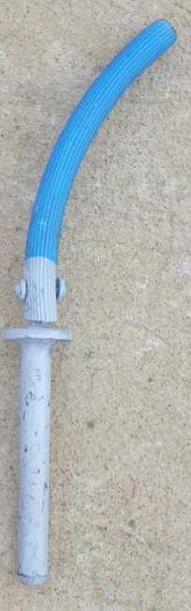
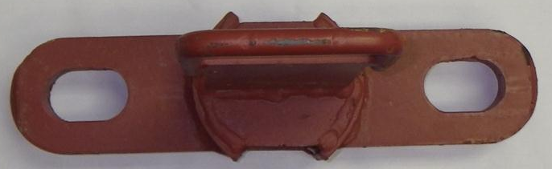
Further Considerations – Impact loading
Impact loading due to coupling slack
Coupling equipment is designed with inherent slack (typically ranging from 60 to 120mm)
32mm
70mm
Buffer pin hole = 35mm
Total coupling slack
2 x (70mm – 32mm) + 2 x (35mm – 32mm) = 82mm
When the loco moves and takes up the slack, the coupling experiences an impact load. This impact load is typically far greater than the static load that the coupling will experience.

Slide 22
Further Considerations – Impact loading
SIMRAC simulation example
A report done by SIMRAC (Coupling systems and designs in use in the Gold and Platinum sector), estimates that typical impact loads experienced may be in the region of 38 tons.
This would result in stresses of over 550 Mpa, exceeding the cast iron yield stress of around 250 MPa.
The result of this continual impact will be:
Excessive wear on the buffers
Plastic deformation of the pins and shackles
Pre mature failing of the resilience (which will increase the amount of coupling slack)
Loosening of the buffer mounting bolts
Possible chassis fatigue and damage
Simulation Assumptions
Coupling slack – 100mm
Pin diameter – 30mm
Buffer type – Kudu (with resilience)
Impulse time – 10ms
Resultant Impulse displacement of 6.98mm
To lower the Impact effect:
Reduce the coupling slack
Increase the diameter of the pins
Increase the resilience
Ensure that the loco has gradual initial speed increase and decrease

Slide 23
References
“Coupling systems and designs in use in the Gold and Platinum sector” 2000, Safety in Mines Research Advisory Committee. (SIMRAC)
www.nwgopro.co.za

Slide 24
In Closing
Questions?

