Slide 1
MOSH Falls of Ground Team
Leading Practice
Adoption Team
Activity Report
August 2013

Slide 2

Contents
Mission and Values reminder
Progress update – key indicators
Highlights
Challenges
Key lessons learnt

Slide 3

Mission and Values - MOSH
To facilitate the adoption of leading practice through a people oriented process to significantly improve occupational health and safety in the minerals industry
Our ultimate goal is the provision of working conditions that are free from harmful effects
Values
Leading the change to zero harm

Slide 4
FOG Adoption Team Planner
Revisiting adoption at mines and tightening the loose ends
Re- presentation at Rustenburg Tripartite Forum done on 1 August 2013
DMR very supportive
12 th COPA Meeting was held on the
26 th July 2013 at Randfontein Golf Club.
27 Mines are participating. + 80 % complete for Nets with Bots
TARP is 15%- Most mines completed interviews
Next meeting scheduled for 6 September 2013 at Randfontein Golf Club.
Assisting individual mines in 4 regions of Central COPA through additional COPA meetings
Eastern Limb COPA revived
Review EE&MS Quality of Adoption
Progressing with TARP Adoption
Last meeting held 17 July Nkomati Mine
13 Mines participating
Good progress by some mines
J 12 | J 12 | A 12 | S 12 | O 12 | N 12 | D 12 | J 13 | F 13 | M 13 | A 13 | M 13 | J 13 | J 13 | A 13 | S 13 | O 13 | N 13 | D 13
EE&MS
N Cape COPA has been formed
Petra Diamond Mines and
Black Rock (ARM) and
Wessel (BHP) participating
TARP Presentation to NCMMA 12 July 13
Good interaction with NCMMA and AMMSA President and Council
COPA held 14 August 2013 at Finsch
Next COPA on 2 October 2013 at Finsch
Hard Rock COPA (N&B’s, TARP)
Eastern Limb COPA (EE&MS, TARP)
NC COPA (EE&MS, TARP)
COAL COPA (Coal Specific Practices)
Preparations are advanced for the Coal industry workshop to identify Leading Practices
SACMA Branch meetings were held on the 27 June (North) and 18 July (South)
Met with Rock Engineers at end July
Date set for Leading Practice Identification workshops for underground and surface domains for 27 August and 5 September respectively
Plan
2014 Planning Workshop – 14 November 2013 at Glenburn Lodge
Planning for about 50 delegates, E upper and above
Delegates to guide us for the 2014 progress planner and LP Adoption Plan
Prevention of All Uncontrolled Falls of Ground

Slide 5
Progress for the Month of July / August 2013
No` | Highlights (Achievements, Industry Interactions)
1 | All tripartite forums visited and positively participated
2 | Good interaction with AMMSA (NCMMA and AMMSA Council Members)
3 | Establishing Presence in the Coal Industry (Collieries Committee and SACMA councils). Two workshop dates have been set for the FoG Leading Practice identification
4 | Established additional support with COPA members . Visiting them in their respective areas. Unisel, Lonmin and Kusasalethu.
5 | Follow up meetings held with Mines regarding information on FOG Fatalities sustained.
6 | Good information coming in relating to lives saved through net installations in the narrow reef hard rock stoping environment
7 | Request from mines to help with TARP roll out. Impala, Modikwa, Marula and Phakisa. Meetings and assistance given to these mines from Adoption Team Management.
Leading the change to zero harm

Slide 6
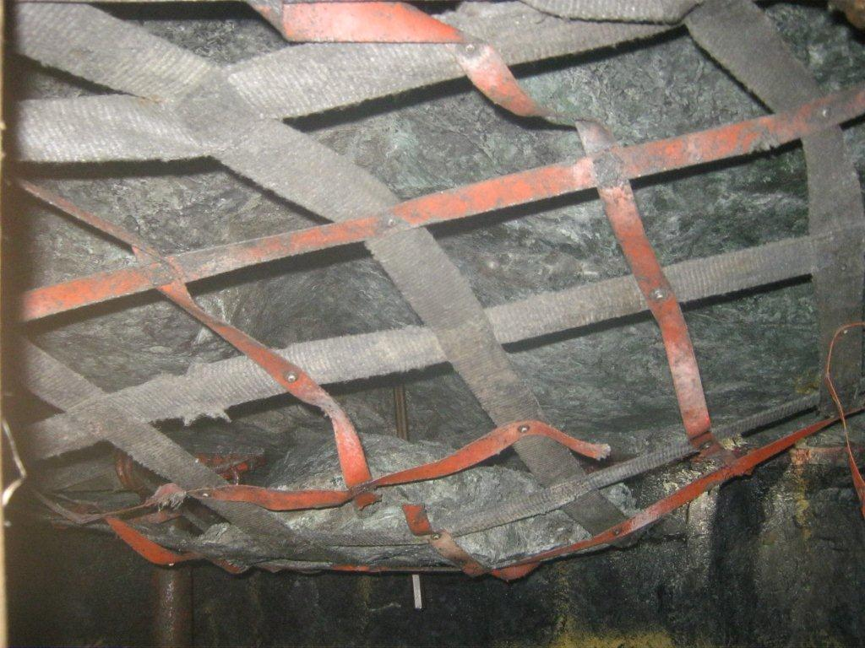
5 July 2013 – Rock drill Operator life saved at Newman Shaft - Lonmin

Slide 7
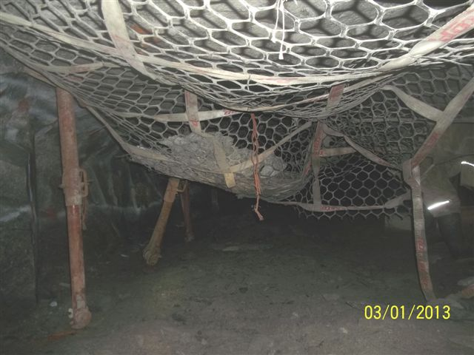
3 January 2013 – Rock fall during drilling operations – Impala Platinum Mine
No injuries

Slide 8
Progress for the Month of July / August 2013
No | Challenge (Issues, Risks, Concerns) | Response - Remedial Action | Due Date | Resp. Person
1 | No continuity of attendees at COPA meetings | Lobby MOSH Task Force and Senior Management of Mining Companies for appropriate representation | On going | AvZ DA
2 | Poor reaction to assistance offered to mines who struggle with adoption in their respective mining regions | Take-up with COPA’s and MOSH FOG Industry Adoption Team Members | On going | AvZ DA
3 | Analysis of the rock related safety data for coal, platinum and gold shows little improvement for serious injuries | In considering any new Leading Practices attention must be paid to addressing these issues as rigorously as fatalities | At next LP identification work-shops | AvZ DA
Leading the change to zero harm

Slide 9
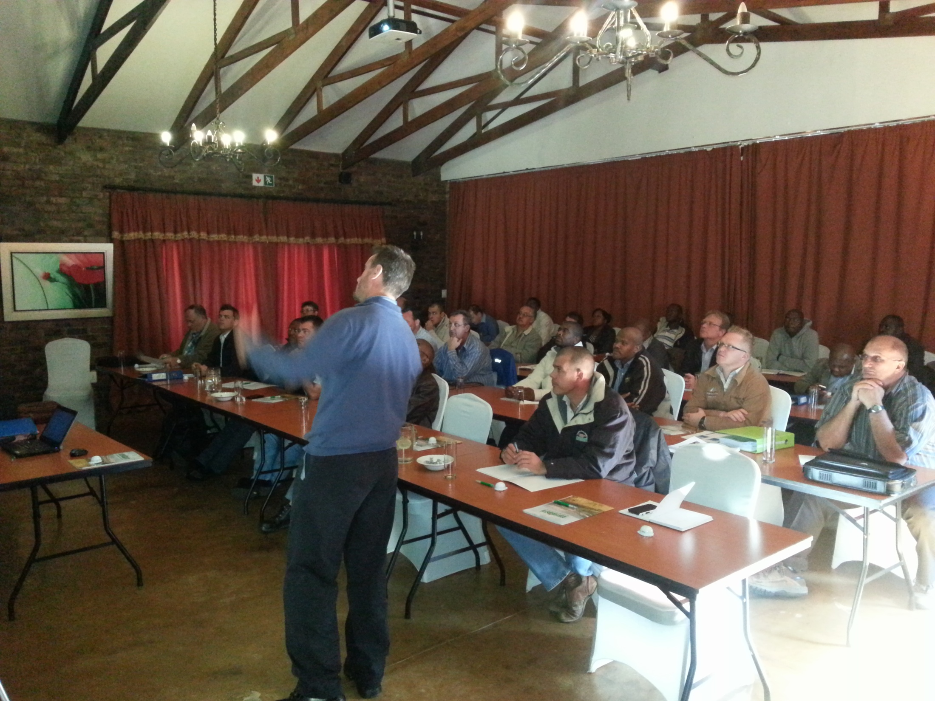

Slide 10
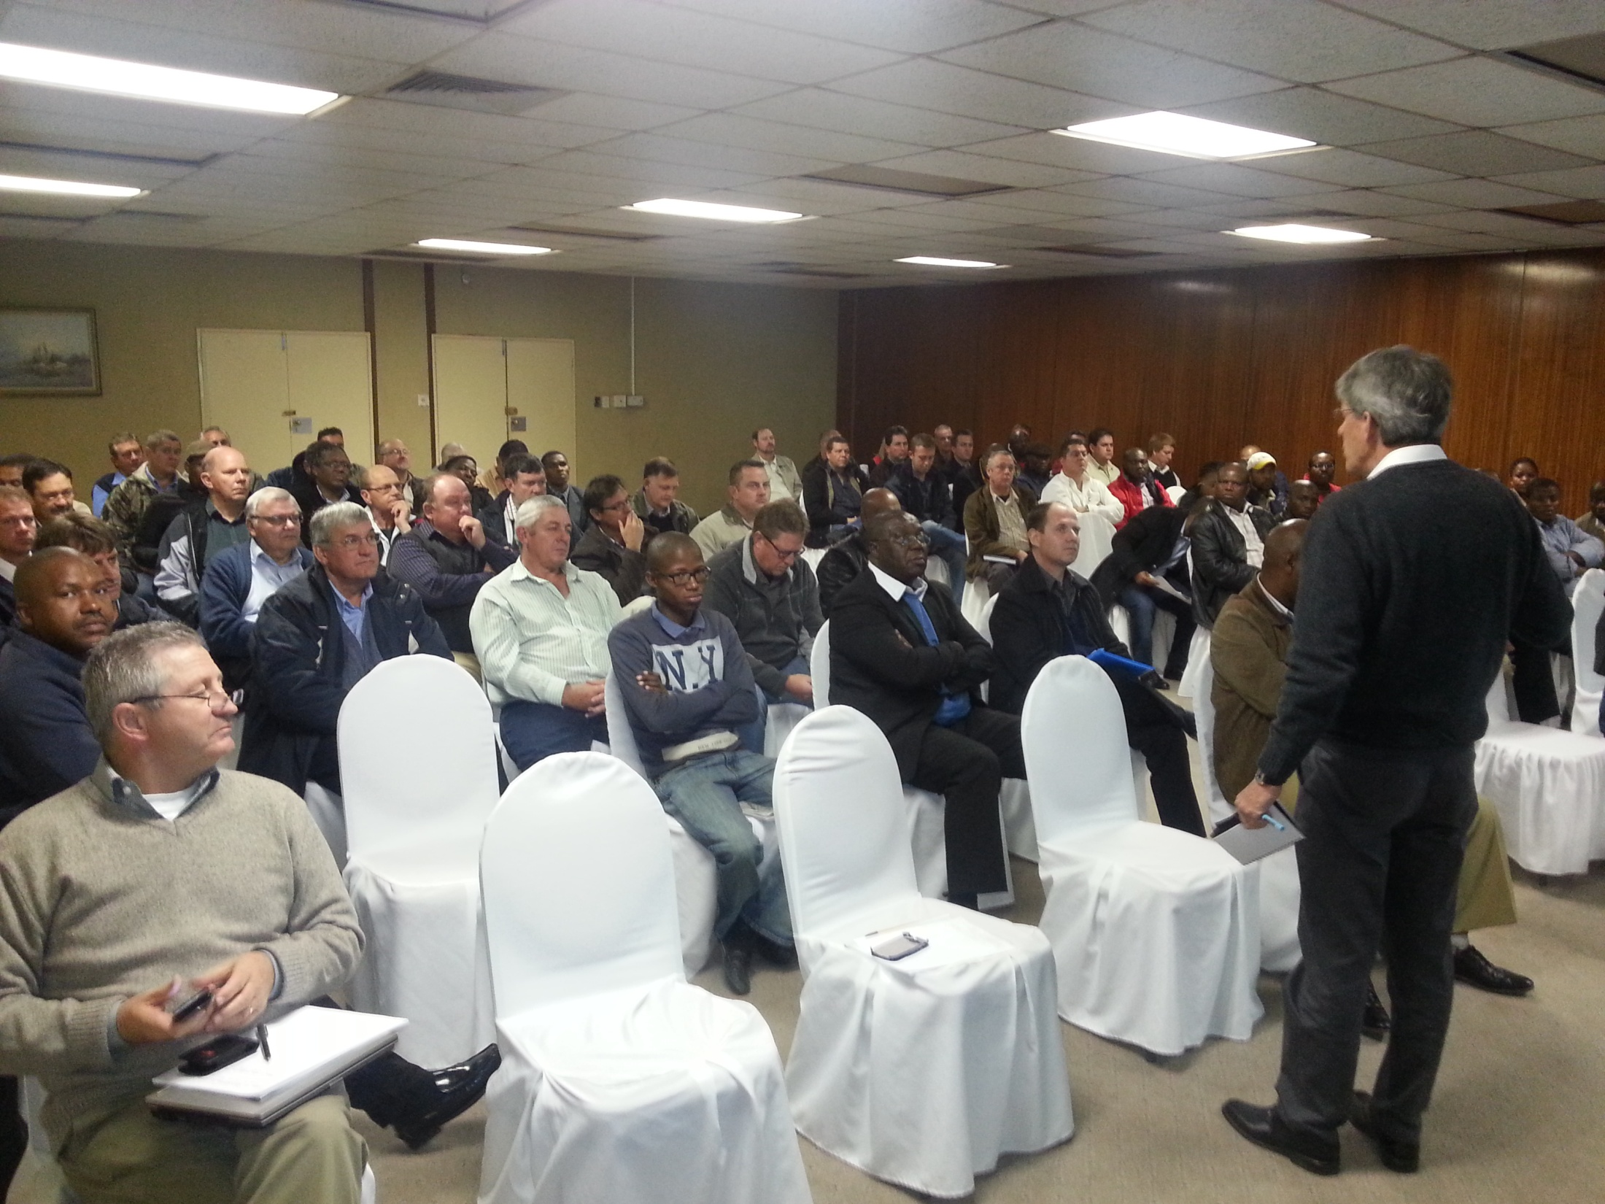

Slide 13
