Slide 1


DUST TEAM u p - d a t e
January 2014 to date
by
Gerrie Pienaar, Johan Janse van Rensburg and Dr Audrey Banyini
21 February 2014
CHAMBER OF MINES OF SOUTH AFRICA
Putting South Africa First

Slide 2

Contents
Mission and values reminder
Progress update
Highlights
Lowlights
Key lessons learnt
Leading the change to zero harm

Slide 3

Mission and Values – MOSH
To facilitate the adoption of leading practice through a people oriented process to significantly improve occupational health and safety in the minerals industry
Our ultimate goal is the provision of working conditions that are free from harmful effects
Values
Leading the change to zero harm

Slide 4
Mission and Values – MOSH Dust
To facilitate the adoption of leading practices through a people oriented process to significantly improve occupational health and safety in the minerals industry with specific focus on THE ELIMINATION OF SILICOSIS AND DUST RELATED DISEASES
Values
Leading the change to zero harm

Slide 5
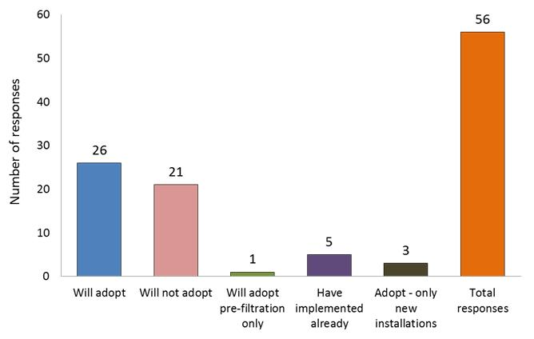
  MULTI-STAGE FILTRATION SYSTEMS: UNDERGROUND TIPPING POINTS
Leading the change to zero harm

Slide 6
  MULTI-STAGE FILTRATION SYSTEMS: UNDERGROUND TIPPING POINTS
Leading the change to zero harm

Slide 7
  MULTI-STAGE FILTRATION SYSTEMS: UNDERGROUND TIPPING POINTS
Leading the change to zero harm

Slide 8
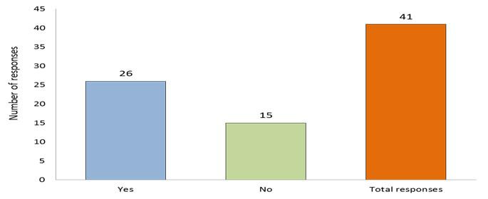
  MULTI-STAGE INVESTIGATE POTENTIAL- OTHER U/G APPLICATIONS
Leading the change to zero harm

Slide 9
  MULTI-STAGE INVESTIGATE POTENTIAL- OTHER U/G APPLICATIONS
LONMIN | Investigate this further as part of the Platinum dust working group
IMPLATS | 01 Shaft | X | Risk assessment includes conveyor tipping points/ Conveyor System
 | 10 Shaft | X
 | 11 Shaft | X
 | 12 Shaft | X
 | 16 Shaft | X
 | 17 Shaft | X
 | Marula Clapham | X
 | Marula Driekop | X
Leading the change to zero harm

Slide 10
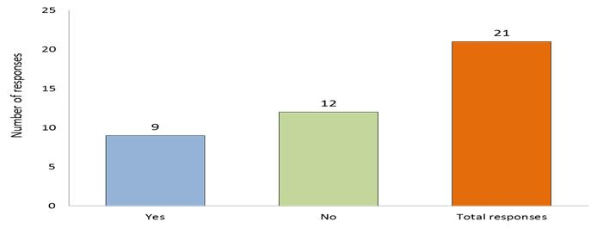
  MULTI-STAGE INVESTIGATE POTENTIAL- SURFACE APPLICATIONS
Leading the change to zero harm

Slide 11
  MULTI-STAGE INVESTIGATE POTENTIAL- SURFACE APPLICATIONS
AGA | N/A for other installations other than the underground ore-transfer points
Sibanye | All
BECSA-Processing | Investigated-Not applicable
Harmony | Kusasalethu | Will investigate and run own tests first
 | Joel | 3# |  | Maybe | Under investigation
 | Tshepong | 1# |  | Maybe | Under investigation
 | Phakisa | Phakisa |  | Maybe | Risk assessment(in addition to personal dust sampling) will be carried out to establish the necessity(awaiting PDR 1500)
Total Coal | Have no application for practice
Lonmin (Process Division) | Merensky Concentrator |  | Fogger system & Dust suction system
 | EPL Concentrator |  | Fogger System & Negative pressure dust collection fan
 | Rowland Concentrator |  | Dust suction system
 | UG2 Concentrator |  | Dust extraction system, New bag house to be installed in FY 14
 | Smelter |  | Fogger system
Impala Platinum | Processing |  | The above risk assessment includes conveyor tipping points
 | Laboratories |  | Mainly Donaldson Extraction Filtration Systems are installed/A cyclone extraction system for the Laboratory furnaces is installed.
Leading the change to zero harm

Slide 12
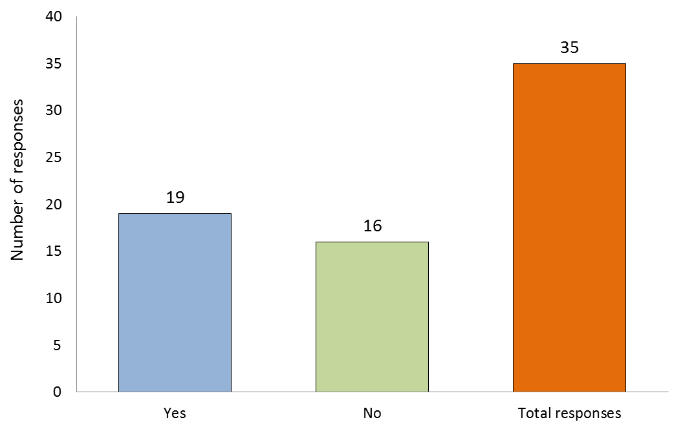
WINCH COVERS ADOPTION
Leading the change to zero harm

Slide 13
Winch operators
Leading the change to zero harm

Slide 14
On the horizon
Real time monitoring:
Kopanang Mine
New Vaal
Important dates:
28 Feb 2014-MOSHIAT-D Colliery
19 March 2024- Interest Group Meeting
Leading the change to zero harm

