Slide 1
MOSH Falls of Ground Team
Leading Practice
Adoption Team
Activity Report
18 February 2015

Slide 2

Contents
Mission and Values reminder
Progress January February 2015
Leading Practice Adoption
Activities
Challenges
Positives

Slide 3

Mission and Values - MOSH
To facilitate the adoption of leading practice through a people oriented process to significantly improve occupational health and safety in the minerals industry
Our ultimate goal is the provision of working conditions that are free from harmful effects
Values
Leading the change to zero harm

Slide 4
Leading Practice Adoption
Leading Practice | Mines | % Adoption | No of Crews Trained | No of Persons Influenced
Entry Examination and Making Safe | Central 74 E/Limb 16 N/Cape 6 | 98% 95% 72% | 6990 694 160 | 71000 13880 3200
Bolts with Nets | Central 49 | 97% | 2531 | 30000
TARP (FoG) | Central 41 E/Limb 16 N/Cape 6 | 71% 66% 72% | 1444 395 280 | 27000 7900 560
Value Added Drilling and Blasting (Investigation Phase) | Position Paper drawn up
“Ledging” (Investigation Phase) | Interviews and data gathering process
Leading the change to zero harm

Slide 5
Progress for the Month of January / February 2015
No` | Activities
1 | Tripartite forums visited and positively participated . (Free State, North West, Rustenburg). Engaged with Limpopo OH&H Working Group
2 | MOSH FOG Industry Adoption Team – good participation and DMR involvement Working on Expert Model and Influence Diagramme for FoG Working on stimulation programmes for COPA’s
3 | Special assistance to Harmony Mines (Coordinating TARP Adoption), Unisel, Kopanang, SAMANCOR ECM, Smokey Hills, Barberton Mine etc..
4 | Three COPA Meetings held during this time, Central COPA, Eastern Limb COPA and Northern Cape COPA
5 | Drafted position Paper on Value Added Drilling and Blasting processes
6 | Conducting interviews on “Ledging” Sibanye Gold – Prof. Malan and Duncan Scott Harmony Gold – Beyers Nel and James Mufara and other senior Managers Anglo-American Platinum – Piet Becker and Dishaba Mine Management Team Discussed Obtained Stats from DME (Shakes Kgosiemang and Kevin Hewitson)
7 | Assistance to S vd Woude in terms of work required for the establishment of the Centre of Excellence
8 | Various inputs into MOSH Learning Hub Strategy programme developments
Leading the change to zero harm

Slide 6
Progress for the Month of January / February 20154
No | Challenge (Issues, Risks, Concerns) | Response - Remedial Action | Due Date | Resp. Person
1 | Maintaining value in COPA’s | Get Host Mine Managers to do Mine Presentations and overviews at COPA Meetings Meetings moved to Quarterly in some instances Discussions on variations e.g.. Barring at Heights to be included etc.. Underground visits to areas of successful Adoption Presentation of “Certificate of Adoption” by HoLH at TPF Meetings or AMMSA Meetings?? Following up on FoG related Section 54 Instruction s | On Going | Team
2 | Generating “New Leading Practices” for adoption | Working on Value Added Drilling and Blasting and Ledging with the view to rolling out to industry by way of “Day of Learning “/ Principles of Good Practice etc.. | On going | Team
3 | Working with “Lagging Mines” | Improve communications with MOSH Task Force | On-going | DJA AvZ CL
Leading the change to zero harm

Slide 7
Developments
Issue | Action | TimeLine
Include Ledging in the MOSH FOG Adoption Team Scope | Information gathering in progress Need data on fatalities per square metre of hanging wall exposed | Preliminary Report scheduled for end 2nd Quarter 2015
Team to conduct Mine Visits following FOG Fatalities | Fatalities and Learning Points are discussed at the MOSH FOG Industry Adoption Team Level | Ongoing
Tracking Documents should include No. Of People Influenced by Adopted Practice/s | Tracking Documents updated to include these figures, currently being updated | Done
Analysis to show impact on Hierarchy of Control | EE&MS – Admin Control TARP – Admin Control NwB – Engineering Control | Done
Leading the change to zero harm

Slide 8
Work that still needs to be done
Issue | Action | TimeLine
Conduct a comparative analysis of impact of adoption | Information gathering in progress. Analysis framework being drafted | Not yet defined
Tracking document to include % of mines experiencing FOG Problems | Research currently underway to quantify | Not yet defined
Leading the change to zero harm

Slide 9
Challenge!!
Commodity | 2014 YTD | 2015 YTD | % Change
Total | 18 | 9 | 50%
Gold | 14 | 3 | 80%
Coal | 1 | 2 | -100%
Platinum | 1 | 3 | -200%
Other: Silica | 1 | 1 | 0%
Cause of Accident | 2014 | 2015 YTD
FOG | 25 (30%) | 4(44%)
Transport and Mining | 13 (15%) | 4(44%)
Machinery | 4 (5%) | 0 (0%)
Other | 41 (49%) | 1(12%)
Unknown | 1 (1%) | 0 (0%)
Total | 84 | 9

Slide 10
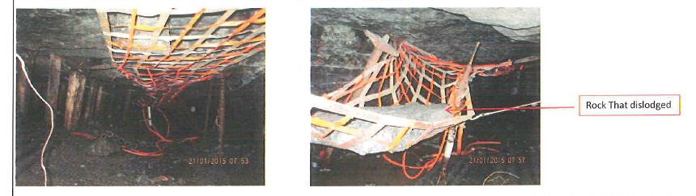
Successes
Finsch Diamond Mine:
  Reduction in Injuries, increase in production over past three years
Lonmin
  In-stope Net saves a life...

Slide 11
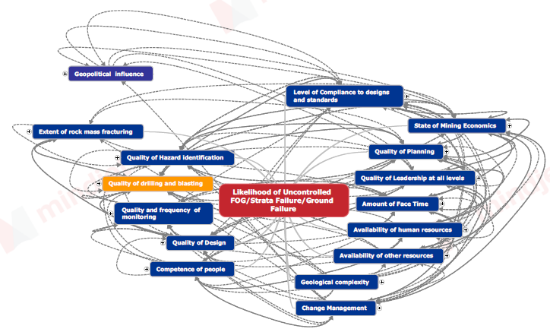
Influence Diagramme Stage 1
Leading the change to zero harm

Slide 12
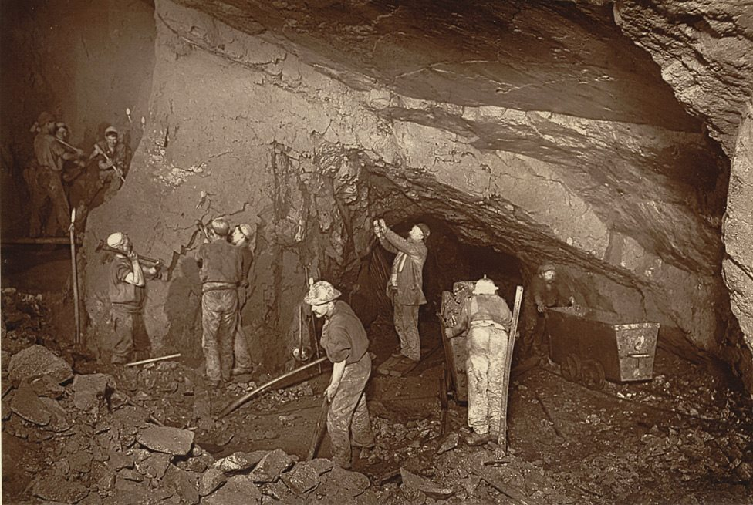
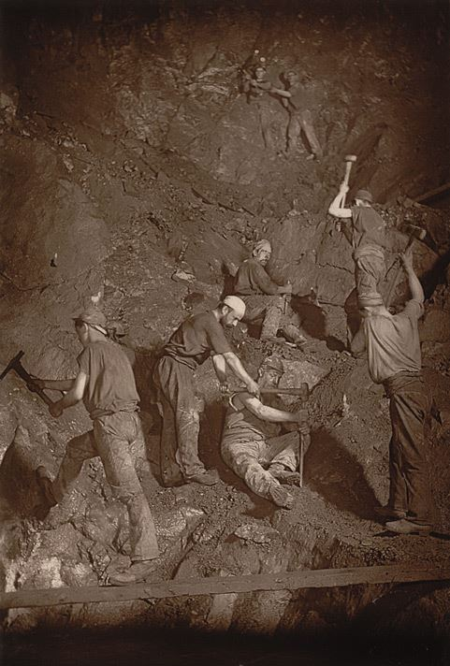
Questions or Discussion?
Leading the change to zero harm

