Slide 1

MOSH Noise Team SCOPE for the 2024 Milestones
January 2015
1

Slide 2


Introduction
Objective
  Scope the contribution of the MOSH Noise Team towards the 2024 Milestones
  Manage expectations and avoid surprises – using lessons from 2003 Milestones
2

Slide 3
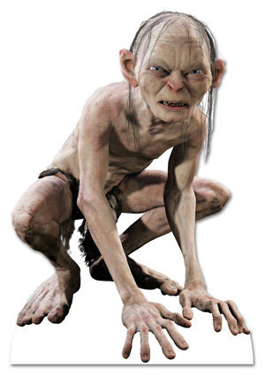
Step 2 - Identify Equipment in those (Step 1) workplaces
  Baseline
(OEMS, Type, Operating pressures, etc.)
  Follow CIoM instruction OH-5 2005
Rock type, number of people exposed and other relevant data
Step 1 - Identify MPNL (107dB) for every workplace
“By December 2024, the total operational or process noise emitted by any equipment must not exceed a milestone sound pressure level of 107 dB(A).”
Solicit Data from the GEEs
Data Delays and integrity
Number of workplaces ≥ 107 dB
GEE Circular 46/14 - (This milestone of the sound pressure levels will be verified by initiatives under the CoE and MOSH and reviewed in 2016)
3

Slide 4


Step 3 – Data Analysis
Potential Leading practice for a particular environment - Refer to Noise Expert Model -2012
Input to the IBMQI
Reporting to the GEEs and Milestone Review
Step 2 - Identify Equipment in those (Step 1) workplaces
  Baseline
6 Months Data Collection
  Assist industry in instances where there is more than one machine in an identified work place
  2 Months Data analysis
4

Slide 5

Quo Vadis
Sensitize stakeholders - GEEs; Industry Teams, CM&EEs and Learning Hub
  What is expected from them
  Importance of data integrity, data correlation and comparison
  Effects of delays - no baseline and need for regular reporting
Detailed Plan with expected outputs to follow
5

