Slide 1
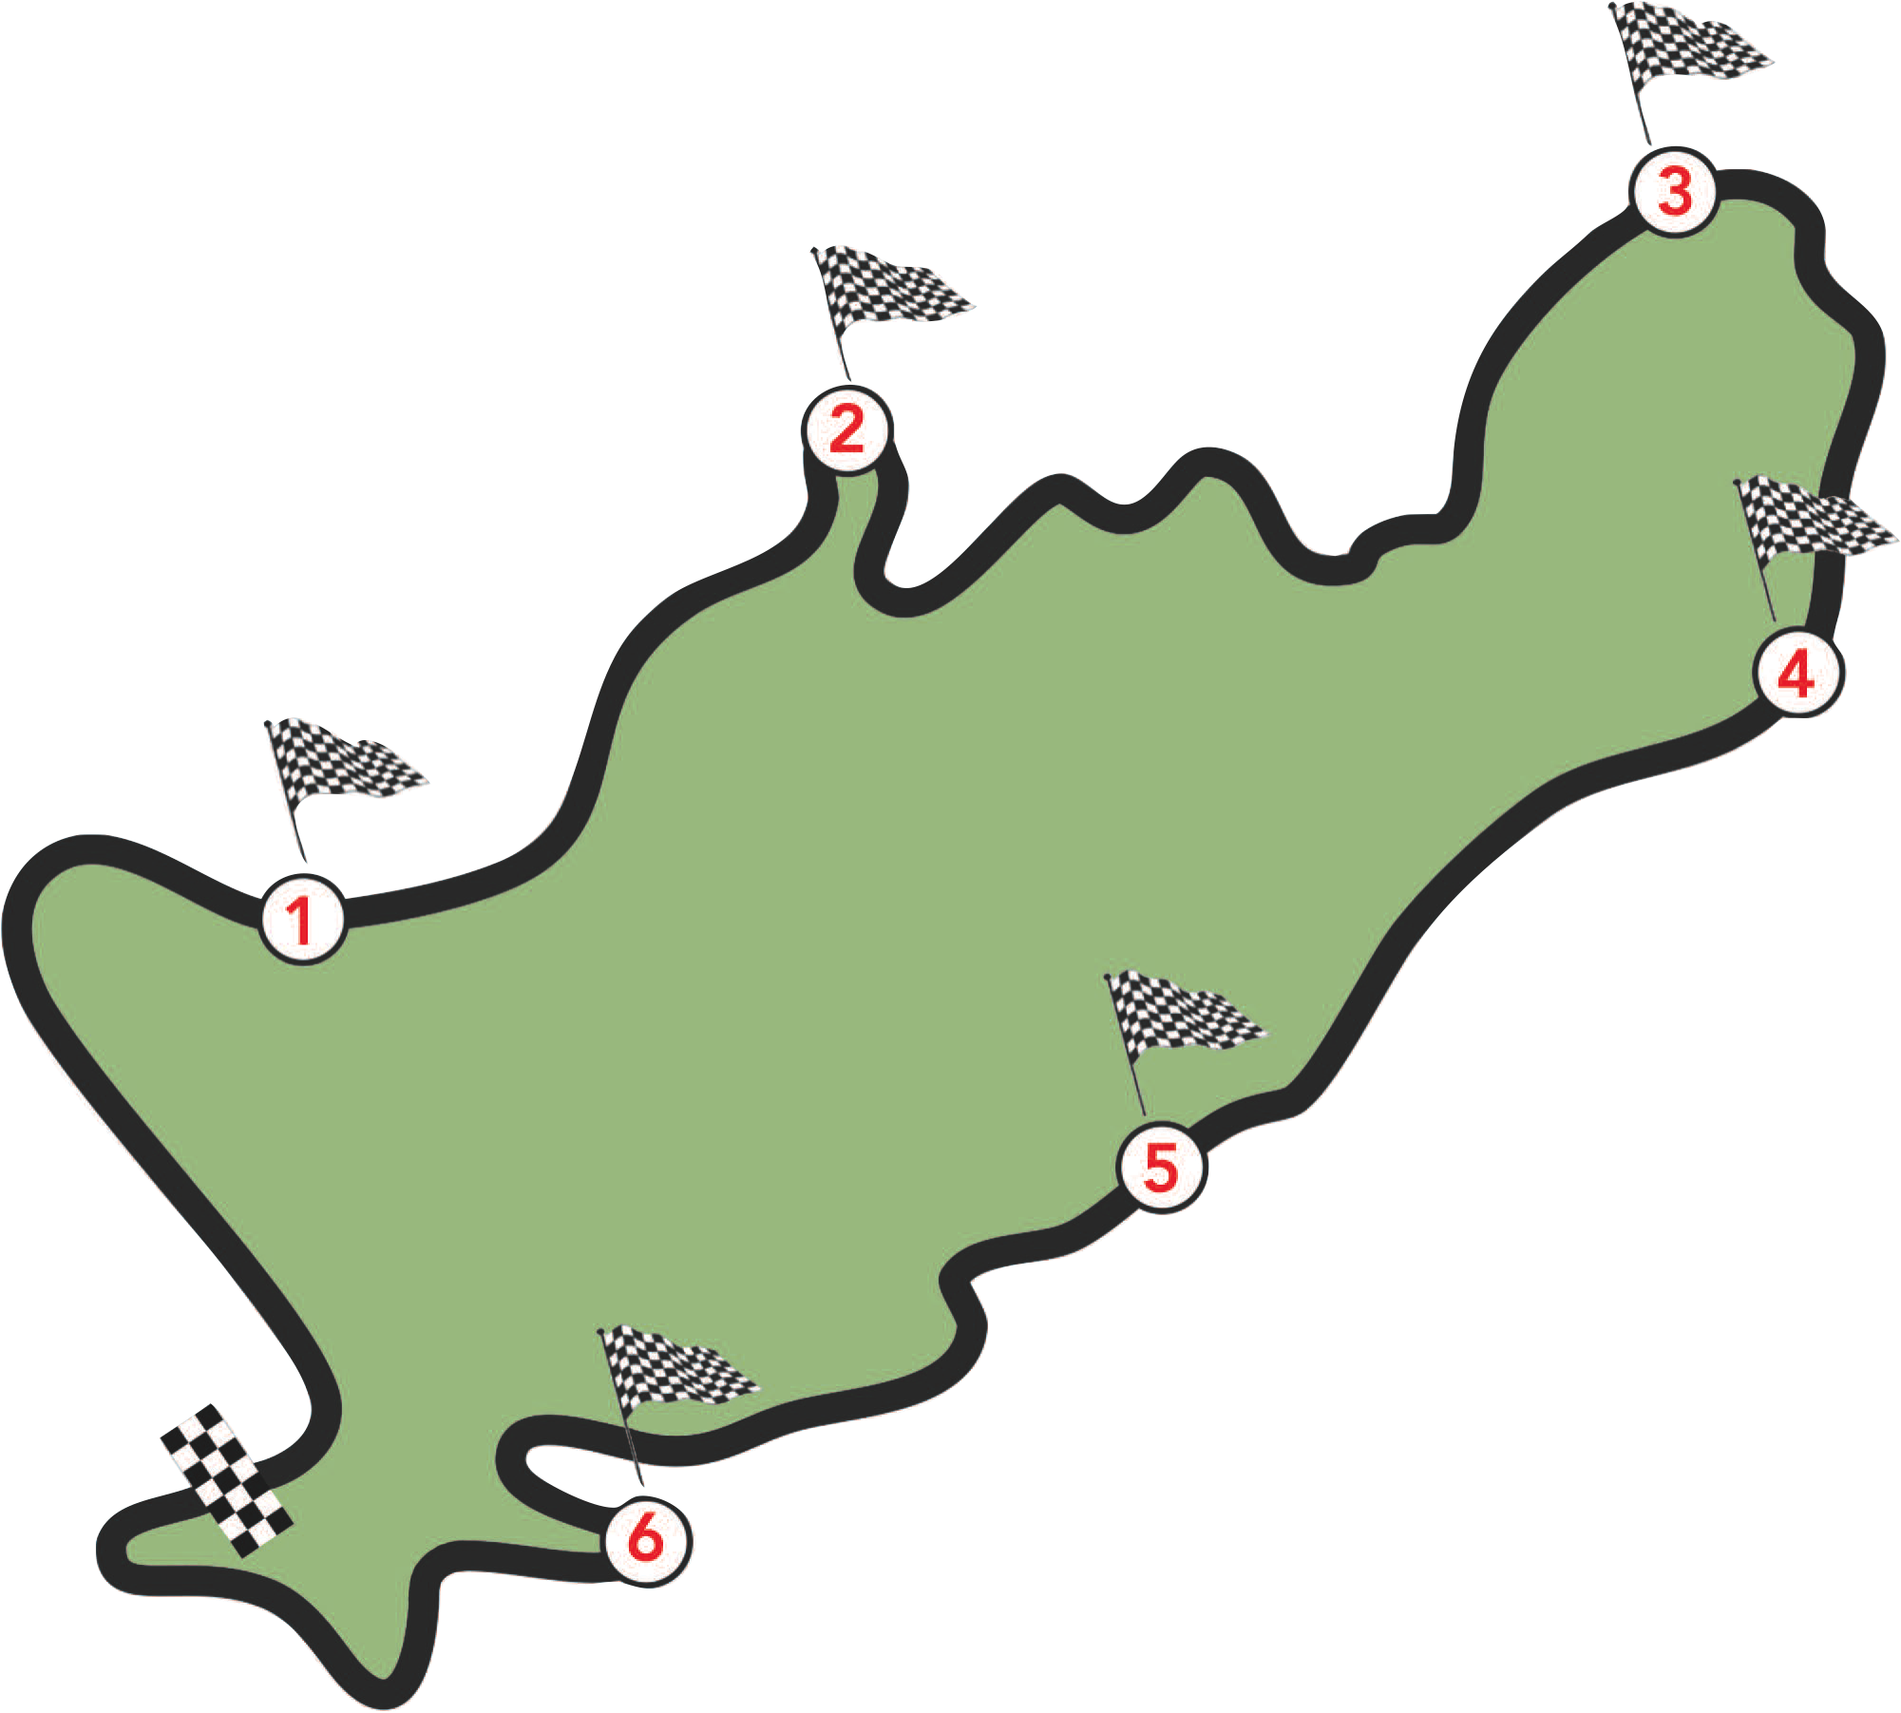

WARMUP LAP – 6 Months
Proposal to the CEOs and MOSH Taskforce
IBMQI (Industrywide Buy Maintain Quiet Initiative) awareness
Workshops with relevant stakeholders
Presentations e.g. Mine safe 2013

Slide 2
RACE START – 6 Months
Establish an Industry-wide Buy and Maintain Quiet Working Group
Operationalising the Working Group (Detailed
Scoping, election of Chair, etc)

Slide 3
PIT STOP 1 – 4 Months
Establishment of Task Specific
Working Groups
Detailed Scoping with the Task
Specific Working Groups
Data gathering and
consolidating of data by the
Task Specific Working Groups

Slide 4
PIT STOP 2 – 6 Months
Draft Noise Reduction Targets
Framework for a standardized way of measuring noise at source

Slide 5

PIT STOP 3 – 6 Months
Draft Framework for engaging OEMs and Suppliers
Round table discussions with OEMS and Supplier executives
Consensus with OEMs and Suppliers on the IBMQI
Consensus with OEMs and Suppliers on the Noise Reduction Targets

Slide 6
PIT STOP 4 – 6 Months
Industry, OEMs and Suppliers commit to the implementation of IBMQI

Slide 7
2016

