Slide 1


DUST TEAM u p - d a t e
March 2015 to date
by
Gerrie Pienaar, Johan van Rensburg and Dr Audrey Banyini
17 April 2015
CHAMBER OF MINES OF SOUTH AFRICA
Putting South Africa First

Slide 2

Contents
Mission and values reminder
Progress update – key indicators
Highlights
Lowlights
SLP progress
Leading the change to zero harm

Slide 3

Mission and Values – MOSH
To facilitate the adoption of leading practice through a people oriented process to significantly improve occupational health and safety in the minerals industry
Our ultimate goal is the provision of working conditions that are free from harmful effects
Values
Leading the change to zero harm

Slide 4
Mission and Values – MOSH Dust
To facilitate the adoption of leading and/or simple leading practices through a people oriented process to significantly improve occupational health in the minerals industry with specific focus on THE ELIMINATION OF SILICOSIS AND DUST RELATED DISEASES
Values
Leading the change to zero harm

Slide 5
Leading Practice - key indicators
KPA No | Key Performance Area | KPI No | KPI | Continuous real-time monitoring of airborne pollutant engineering controls
A1 | Appropriate persons to select leading practice | T4 | Approved participants list | 100% (100%)
A2 | Appropriate plans for planning workshop | T8 | HOH review and approval | 100% (100%)
A3 | Detailed expert model of risk story | T12 | Detailed expert models | 100% (100%)
 |  | T14 | Peer Group assessment | 100% (100%)
A4 | Leading practice with greatest OHS impact | T19 | Credibility of selected Leading Practice | 100% (100%)
A5 | Adoption mines and key people | T22 | Prioritised list of mines and key people | 100% (100%)
A6 | Direct enquiry protocol | T27 | Direct enquiry protocol | 100% (100%)
A7 | Effective direct enquiry process | T30 | Interview process | Moab Khutsong: Completed Beatrix: Completed Phakisa: Completed Mamatwan: Completed Impala Platinum: Completed
A8 | Detailed mental models report | T33 | Mental models report | 100% (0%)
 |  | T34 | Identification of implications | 100% (0%)
Leading the change to zero harm

Slide 6
Leading Practice - key indicators
KPA No | Key Performance Area | KPI No | KPI | Continuous real-time monitoring of airborne pollutant engineering controls
A9 | BC Plan for deciders | T35 | BC plan for deciders | 100% (0%)
A10 | Generic BC plan for adoption mines | T38 | BC plan for adoption mines | 100% (0%)
A11 | Generic LB plan for adoption mines | T41 | LB plan for adoption mines | 100% (0%)
A12 | Peer reviewed value case report | T47 | Final peer reviewed report | 100% (0%)
A13 | Implemented BC plan for deciders | T50 | Implementation of Decider BC plan | 100% (0%)
A14 | Source mine report | T55 | Final source mine report | 100% (0%)
A15 | Source investigations summary report | T57 | Summary of behavioural work | 100% (0%)
 |  | T58 | Source investigations summary report | 100% (100%)
 |  | T59 | Peer Group assessment | 100% - 25-02-15 (100%)
A16 | Draft leading practice adoption guide | T61 | Draft LPAG for use at mines | 100% - 27-02-15 (100%)
 |  | T62 | Peer Group assessment | Awaiting comments
Leading the change to zero harm

Slide 7
Leading Practice - key indicators
KPA No | Key Performance Area | KPI No | KPI | Continuous real-time monitoring of airborne pollutant engineering controls
A17 | Leading practice industry workshop | T65 | Workshop programme | Completed and distributed
 |  | T66 | Effective key presentations | Planned for: 20-04-2015
A18 | Establishment of effective COPA | T68 | Updated LPAG | 14th or 27th
 |  | T72 | COPA membership | -
 |  | T73 | COPA attendance | -
 |  | T75 | COPA effectiveness | -
A19 | Working relationship with first adoption mine | T78 | Agreement with Mine Manager | -
A20 | Report on adoption at first adoption mine | T79 | Agreed adoption plan | -
 |  | T81 | Direct enquiry process | -
 |  | T82 | Customised BC & LB plans | -
 |  | T84 | Monitoring and evaluation plan | -
Leading the change to zero harm

Slide 8
Leading Practice - key indicators
KPA No | Key Performance Area | KPI No | KPI | Continuous real-time monitoring of airborne pollutant engineering controls
 |  | T85 | Effectiveness of BC & LB plans | -
 |  | T88 | Documented findings | -
 |  | T90 | Signed off report on first adoption | -
 |  | T91 | Peer Group assessment | -
A21 | Final leading practice adoption guide | T93 | Final Leading Practice Adoption Guide | -
 |  | T94 | Peer Group assessment | -
Leading the change to zero harm

Slide 9
SLP - Key Indicators
KPA No | KPA | KPI No | KPI | Multi-stage Filtration Systems | Winch Covers | Water Blast | Telescopic Spray | Real-time monitoring of airborne pollutants at a point source
IDENTIFY
A 23 | SLP adoption | T112 | Identified potential SLP adoption mines | Yes | Yes | Yes | Yes | Yes
 |  | T113 | Full Adoption Team assessment of SLP | Yes | Yes | Yes | Yes | Yes
 |  | T114 | Contact manager of source mine to arrange access | Yes | Yes | Yes | Yes | Yes
 |  | T115 | Identify key contact person at source mine | Yes | Yes | Yes | Yes | Yes
DOCUMENT
 |  | T116 | Conduct investigations at source mine | 100% (100%) | 100% (100%) | 100% (100%) | 100% (100%) | 100% (100%)
 |  | T117 | Prepare documents for formal SLP assessment | 100% (100%) | 100% (100%) | 100% (100%) | 100% (100%) | 100% (100%)
 |  | T118 | Confirm accuracy of prepared documents with source mine | 100% (100%) | 100% (100%) | 100% (100%) | 100% (100%) | 100% (100%)
 |  | T119 | Final review of documents against SLP criteria by adoption team | 100% (100%) | 100% (100%) | 100% (100%) | 100% (100%) | 100% (100%)
 |  | T120 | Submit motivation of SLP to Head of Hub | 100% (100%) | 100% (100%) | 100% (100%) | 100% (100%) | 100% (100%)

Slide 10
SLP - Key Indicators
KPA No | KPA | KPI No | KPI | Multi-stage Filtration Systems | Winch Covers | Water Blast | Telescopic Spray | Real-time monitoring of airborne pollutants at a point source
DOCUMENT (cont.)
 |  | T121 | Convene SLP review panel | 100% (100%) | 100% (100%) | HoLH to advice | HoLH to advice | 100% (100%)
 |  | T122 | Formal review of SLP by review panel | 100% (100%) | 100% (100%) | - | - | 02-04-15 (Done)
 |  | T123 | Conduct any necessary follow-up investigations | Not required | 100% (100%) | - | -
 |  | T124 | Prepare customised SLP behaviour plans | 100% (100%) | 100% (100%) | - | - | -
 |  | T125 | Develop guidance notes for SLP adoption | 100% (100%) | 100% (100%) | - | - | -
 |  | T126 | Prepare SLP Adoption Brief | 100% (100%) | 100% (100%) | - | - | -
 |  | T127 | Critical review of SLP Adoption Brief | 100% (100%) | 100% (100%) | - | - | -
It was decided that this practice does not qualify as a SLP and will form part of the Continious Real-time Monitoring of Airborne Pollutant Engineering Controls leading practice
Planned for 1st QTR 2015??
Way forward needs to be finalised
Leading the change to zero harm

Slide 11
SLP - Key Indicators
KPA No | KPA | KPI No | KPI | Multi-stage Filtration Systems | Winch Covers | Water Blast | Telescopic Spray | Real-time monitoring of airborne pollutants at a point source
FACILITATE
 |  | T128 | Update list of potential adoption mines | 100% (100%) | 100% (100%) | - | - | -
 |  | T129 | Identify key contact persons at potential adoption mines | 100% (100%) | 100% (100%) | - | - | -
 |  | T130 | Arrange SLP Briefing Workshop | 100% (100%) | 100% (100%) | - | - | -
 |  | T131 | Circulate SLP Adoption Brief to potential adoption mines | 100% (100%) | 100% (100%) | - | - | -
 |  | T132 | Conduct SLP Briefing Workshop | 100% (100%) | 100% (100%) | - | - | -
 |  | T133 | Establish SLP interest group if required | 100% (100%) | 100% (100%) | - | - | -
 |  | T134 | Initiate process of mines reporting on adoption | 100% (100%) | 100% (100%) | - | - | -
 |  | T135 | Provide SLP adoption brief for use at other meetings | 100% (100%) | 100% (100%) | - | - | -
 |  | T136 | Monthly follow-up communication with potential adoption mines | Scheduled meetings finalised |  | - | - | -
 |  | T137 | Arrange meetings / terminate SLP Interest Group as necessary | Scheduled meetings finalised |  | - | - | -

Slide 12
Progress for the Month
No | Highlights (Achievements, Industry Interactions)
1 | Advisory Committee meeting: 03-03-15
2 | Strategic meeting: 04-03-15
3 | Rustenburg Tri-partite Forum: 05-03-15
4 | 2nd Dust Indaba: 11-03-15
5 | GEE meeting: 13-03-15
6 | Kopanang underground visit with Terence Goodlace: 17-03-15
7 | Monthly MOSH meeting: 19-03-15
8 | Planning of the Continious Real-time Monitoring of Airborne Pollutant Engineering Controls LP workshop (20th April 2015): on-going and work in progress
Leading the change to zero harm

Slide 13
Progress for the Month
No | Lowlights (Issues, Risks, Concerns) | Response - Remedial Action | Due Date | Resp. Person
 | None to report on
Leading the change to zero harm

Slide 14
Key lessons learnt
No | Key lessons learnt
1 | None to report on
Leading the change to zero harm

Slide 15
SLP Progress Report
Winch Covers
56.7
Previous month
Leading the change to zero harm

Slide 16
SLP Adoption Tracker
Winch Covers
Leading the change to zero harm

Slide 17
SLP Progress Report
Multi-stage Filtration System
86.6
Previous month
Leading the change to zero harm

Slide 18
SLP Adoption Tracker
Multi-stage Filtration
System
Leading the change to zero harm

Slide 19
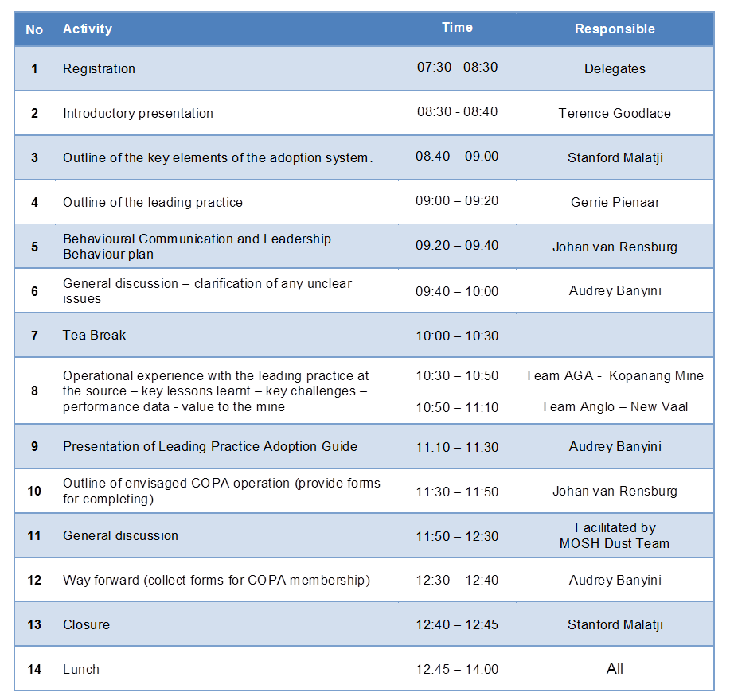
LP Workshop (20-04-15)
Programme
Leading the change to zero harm

Slide 20


L E A R N I N G H U B
DUST TEAM
011 498 7100
Or visit our website: www.mosh.co.za
Dr Audrey Banyini
ABanyini@chamberofmines.org.za
Gerrie Pienaar
gerriepienaar69@gmail.com
Johan van Rensburg
johan.c.vanrensburg@angloamerican.com
L E A R N I N G H U B

