Slide 1
MOSH Behavioural Perspective
Change Management International Practice
April 2015
Rina Müller
rinamuller@outlook.com

Slide 2
Prosci Research History
1998 First Change Management Study – 102 participants
2000 Second Change Management Study – 152 participants
2003 Third Change Management Study – 288 participants
2005 Fourth Change Management Study – 411 participants
2007 Fifth Change Management Study – 426 participants
2009 Sixth Change Management Study – 575 participants
2011 Seventh Change Management Study – 650 participants
2013 Eighth Change Management Study – 822 participants

Slide 3
2013/4 Study Highlights
Greatest contributors to success
For the eighth consecutive study, active and visible executive sponsorship was identified as the greatest contributor to success. Six of the seven contributors were consistent with previous studies, with a slight change in ranking. Engagement and integration with project management is a new addition to the list of the greatest contributors to success.
1. Active and visible executive sponsorship
2. Structured change management approach
3. Dedicated change management resources and funding
4. Frequent and open communication about the change and the need for change
5. Employee engagement and participation
6. Engagement and integration with project management
7. Engagement with and support from middle management

Slide 4
2013/4 Study Highlights
Greatest obstacles to success
The top five obstacles to success identified in the 2013 benchmarking study are similar to findings from the 2011 study; however, poor communication was not identified as a top obstacle. A new obstacle, division between project management and change management, was identified.
1. Ineffective change management sponsorship
2. Resistance to change from employees
3. Insufficient change management resourcing
4. Division between project management and change management
5. Middle management resistance

Slide 5
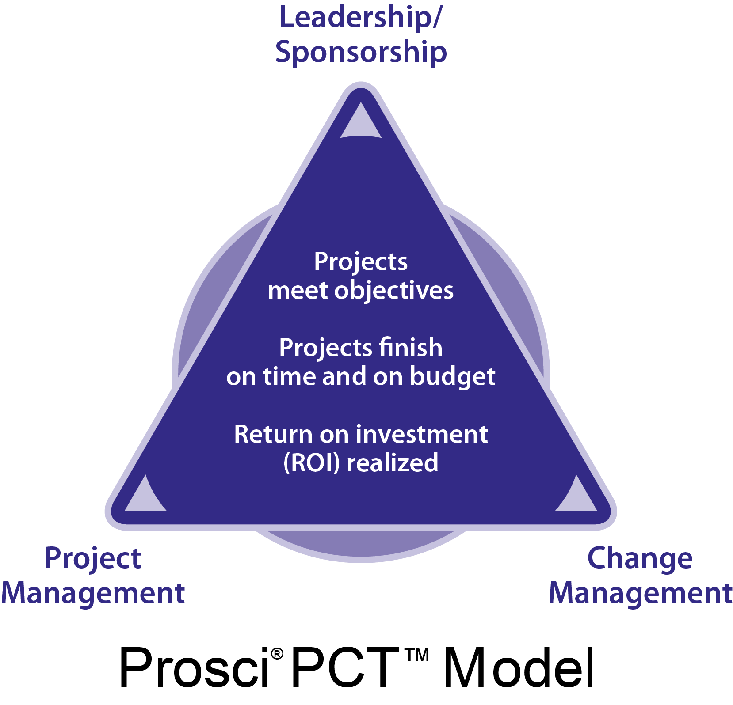

Slide 6
Integration of Project Management and Change Management
Project management
Solution is designed, developed and delivered effectively
(Technical side)
+
Current
state
Transition
state
Future
state
Solution is embraced, adopted and utilized effectively
(People side)
Change management
= Success
Project management and change management have a joint value proposition oriented toward business results.

Slide 7
Comparing Change Management and Project Management
Focus:
Technical side of moving from current state to future state
Process:
Initiation
Planning
Executing
Monitoring/
controlling
Closing
Tools:
Statement of work
Project charter
Business case
Work breakdown structure
Budget estimations
Resource allocation
Schedule
Tracking
Project management
Current
state
Transition
state
Future
state
Process:
Organizational:
Preparing for change
Managing change
Reinforcing change™
Individual:
ADKAR®
Tools:
Individual change model
Readiness assessment
Communication plans
Sponsor roadmaps
Coaching plans
Training plans
Resistance management
Reinforcement
Change management
Focus:
People side of moving from current state to future state

Slide 8
2013/4 Study Highlights
What to do differently on the next project
By a two-to-one margin, the top suggestion by participants for what they would do differently on their next project was to more effectively engage sponsors by involving them early and ensuring they are active and visible throughout the project. The next most common responses were to secure sufficient resources for change management and emphasize the preparation and planning activities.
Top trends in change management within organizations
For the fourth consecutive study, the top trend identified by participants was a greater awareness of the need for and value of change management. Additional trends included the broader application of change management, increased leadership support for change management and the establishment of dedicated functional groups or a Change Management Office (CMO).
Change management effectiveness
Projects with effective change management programs were more likely to meet objectives, stay on schedule and stay on budget than those with ineffective change management. This direct correlation mirrors the findings from the 2007, 2009 and 2011 studies. Projects with excellent change management programs were six times more likely to meet or exceed their objectives than those with poor change management programs.

Slide 9
2013/4 Study Highlights
Use of a methodology
The percentage of participants that reported using a particular methodology increased to 79%, up from 72% in 2011, 60% in 2009, 58% in 2007, 55% in 2005 and 34% in 2003. Participants who reported using a particular methodology reported higher levels of overall change management effectiveness than those who did not. The most common uses of the methodology were to provide general guidance and as an activities checklist.
Sponsorship
Participants identified active and visible participation in the project as the most important activity for sponsors in support of change, followed by direct communication to employees, and building and maintaining a healthy coalition of support. There was a direct correlation between sponsor effectiveness and meeting project objectives. Participants engaged sponsors in the change by holding regular meetings and updates, outlining objectives and communicating directly with sponsors.
Managers and supervisors
Participants identified the most important activities for managers and supervisors during change as communicating the change to their direct reports and advocating for the change. Managers and supervisors were least effective at coaching direct reports through change and managing resistance. Communicating effectively and building awareness of the need for change were identified as approaches to get managers and supervisors on board with the change so they can effectively lead their direct reports.

Slide 10
2013/4 Study Highlights
Preferred senders of change messages
As in previous studies, an employee’s supervisor was identified as the preferred sender of personal messages, while senior leaders were identified as the preferred senders of business-level or organizational-level messages about why the change was needed and how the change aligned with the organization’s direction.
Communication messages
The business reasons for the change were identified as the most important messages for employees and the second most important for managers and senior leaders, behind expectations and their role in the change. Change details were often low on the list relative to the reasons for change.
Resistance
Participants provided five tactics for identifying resistance, led by observing behavior and using feedback tools. Resistance was most severe during project implementation. The top reasons for employee resistance and manager resistance paralleled previous studies, led by a lack of awareness of the need for change.

Slide 11
2013/4 Study Highlights
Change saturation and portfolio management
More participants reported being near, at or past the point of saturation than in previous studies (77% of participants in 2013, 73% in 2011, 66% in 2009 and 59% in 2007). Forty-eight percent reported saturation universal across the organization while 37% reported localized saturation. Participants outlined several specific change management tactics for their particular project to address the organizational level of saturation. Less than one-third (32%) reported that they were actively managing the portfolio of change and only 20% reported that there was a high or extremely high interest in addressing the portfolio of change. The top motivator for those managing the portfolio of change was to mitigate and alleviate change saturation.
Percent of projects applying change management
Overall, participants reported that 39% of projects in their organization were applying change management; however, nearly half of participants (49%) stated that less than one in four projects in their organization applied change management. Compared to the 2011 results, more projects were applying change management
Change management capability and competency building
Overall, participants in the 2013 study identified that their level of organizational maturity in change management had increased in the past two years. Over half of participants (53%) reported that they were actively working to deploy change management, up from 46% in 2011. Leadership commitment to and support of change management were critical factors for building change management capabilities and competencies.

Slide 12
2007 Study Highlights
Aids to successful adoption: Communicating with management and the workforce, and demonstrating personal commitment were identified most often as aids to successful adoption of technology and best practice. This was followed by the provision of active support to implementation activity and ensuring that appropriate technology was being adopted.
Barriers to successful adoption: The barriers to successful adoption identified most often were the resistance to change factor, cost constraints, the workforce not seeing the benefit of the of the technology or best practice, the technological challenge involved and a lack of management buy-in.
Effective communication: Effective communication was identified by 95% of those interviewed as the key to successful implementation of technology or best practice. The means of effective communication most often identified was personal interaction, meetings and workshops, and underground site visits.
From sharing to widespread adoption of technology and best practice to
improve occupational health and safety in mines
Final Report
J M Stewart Consulting
June 2007

Slide 13
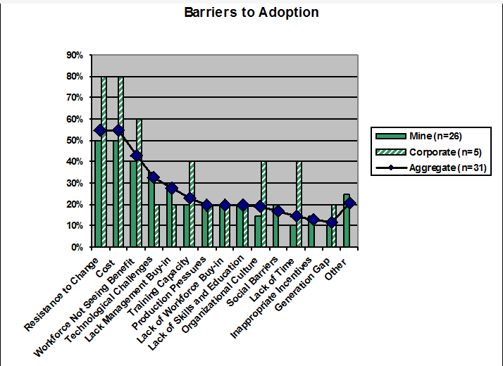
2007 Study Highlights

Slide 14
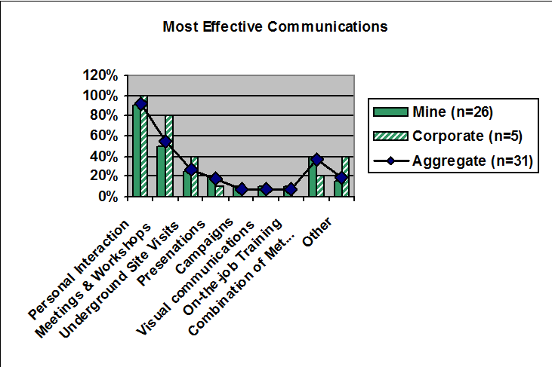
2007 Study Highlights

Slide 15
2007 Study Highlights
As research and experience show, communications is the most powerful influence on people’s decision-making and behaviour. Effective communications – leaders’ deeds plus their messages – supported by appropriate formal and informal communications will be critical to encouraging, supporting, and reinforcing adoption behaviour at all levels of the organization.
Behaviour-focused communications processes, methods and tools could be deployed by the industry as a best practice. The purpose of such communications is to build shared understanding that enables individuals to make well-informed decisions and take appropriate actions. Behaviour-focused communications would include all communications messages and interactions that can influence behaviour.
The industry could draw on relevant disciplines, such as psychology, decision science, risk communications and risk management, along with over 40 years of research in risk perception to develop a state-of-the-science approach tailored to the specific needs of the industry.

Slide 16
2007 Study Highlights
Chamber of Mines: Key concepts and insights from past work on technology transfer, March 2007.
Chamber of Mines: Current processes and mechanisms for technology and best practice transfer, May 2007.

Slide 17
MOSH Behavioural Perspective
April 2015
Rina Müller
rinamuller@outlook.com

Slide 18

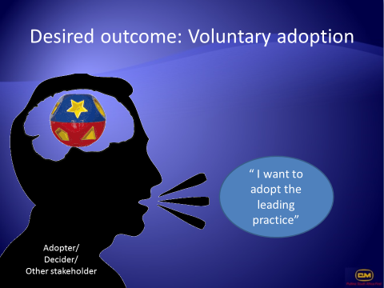
Leading Practice Adoption

Slide 19
Leading Practice Adoption
Practice
Position
Plans
People
Purpose
Achieved

Slide 20
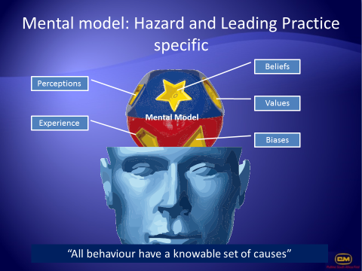
Leading Practice Adoption
Practice
P1
Position
P2
Plans
P3
People
P4
Purpose
P5
Well constructed Practice
Clear Understanding of the Organisation and Mental Models
Interviews and Survey
Plans to deal with Mental Models and Resistance
Leader Behaviour Plans
Behaviour Comm Plans
Training Plans
Aware or Risks
Ideal Situation Accepted
Desire to Make to make it work
Attitude
Skills
Knowledge
Practice Adopted
Zero Harm Achieved
Speed
Utilization
Project Cost

Slide 21
Leading Practice Adoption
Practice
P1
Position
P2
Plans
P3
People
P4
Purpose
P5
Well constructed Practice
Position Leadership Strategy | Plan Leadership Activities | People Outcomes | Purpose Achieved
#Scope the Change #Scope the Organisation #Scope the Mental Models #Scope Risk and Challenges #Prepare the Adoption Team #Prepare the Sponsor | #Leadership Behavioural Plans #Behavioural Comm Plans #Training Plans #Coaching Plans #Resistance Management Plans #Sponsorship Roadmap | Awareness Ideal State Desire Attitude Skills Knowledge | Adoption of Practice
INTERNAL ANALYSIS | VISIBLE ACTIVITIES | EACH PERSON HAS A JOURNEY | BUSINESS IMPERATIVES
Situation/
Risk
Solution/
Resolution

Slide 22
Position Leadership Strategy | Plan Leadership Activities | People Outcomes | Purpose Achieved
#Scope the Change #Scope the Organisation #Scope the Mental Models #Scope Risk and Challenges #Prepare the Adoption Team #Prepare the Sponsor | #Leadership Behavioural Plans #Behavioural Comm Plans #Training Plans #Coaching Plans #Resistance Management Plans #Sponsorship Roadmap | Awareness Ideal State Desire Attitude Skills Knowledge | Adoption of Practice
INTERNAL ANALYSIS | VISIBLE ACTIVITIES | EACH PERSON HAS A JOURNEY | BUSINESS IMPERATIVES
Situation/
Risk
Sponsored
Leading Practice
Solution/
Resolution
Project
Management
Change
Management

Slide 23
Leading Practice Adoption

Slide 24
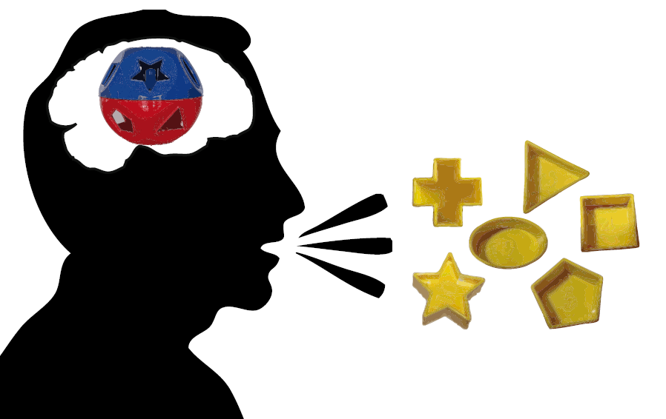
P 2 - Direct inquiry
“Unpack” the mental model to identify aids and barriers to adoption
Look for erroneous and incomplete elements
Beliefs
Biases
Views
Values
Perceptions
Knowledge
Adopter/
Decider/
Other stakeholder

Slide 25

P 2 Results - Mental model: Hazard and Leading Practice specific
Beliefs
Perceptions
Values
Mental Model
Experience
Biases
Managing the Resistance to Change by dealing with the Mental Models

Slide 26
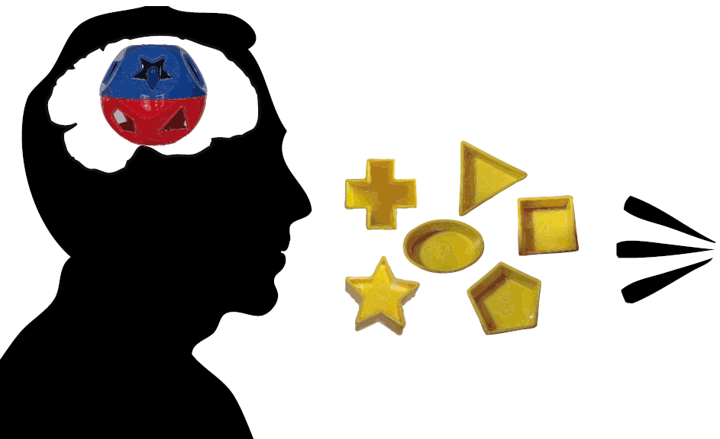
P 3 – Plans
Leadership Behaviour
Behavioural Communication
Training Plans
Beliefs
Biases
Views
Values
Perceptions
Knowledge
Adopter/
Decider/
Other stakeholder

Slide 27
P 3 – Plans
Leadership Behaviour
2008 Tripartite Action Plan
Biases
MOSH makes reference the ABC model
Antecedents – what the leader needs to know or do in order to achieve sustainable adoption;
Behaviour – what the leader needs to say or do in actually adopting the leading practice; and
Consequences – the nature of feedback / reinforcements leaders should provide to those they supervise to aid adoption of the leading practice

Slide 28
Leading Practice Adoption
Practice
Position
Plans
People
Purpose
Achieved

Slide 29
MOSH Behavioural Perspective
Behavioural Communication
Plans Observations
April 2015
Rina Müller
rinamuller@outlook.com

Slide 30
Concept Clarification
Is there a difference between
Behavioural Communication Plans and Risk Communication?

Slide 31
Plans – Behavioural Communication
In broad terms, mental models research undertaken for the purpose of designing and implementing behavioural communications seeks to establish:
What people know now about a situation or risks that is correct and essential to making an informed decision;
What people may misunderstand that is consequential;
What they do not know that is consequential;
What they want to know that is important to them; and
What criteria they use to judge the trustworthiness and competence of people, organizations, and communications.

Slide 32
Plans – Behavioural Communication
Hypotheses should be prepared for each of the priority adopters and stakeholders identified in Worksheet Doc #18. In each case an hypothesis statement complete with its supporting rationale should be prepared for each of the following questions:
What do the key adopters/stakeholders know about the key risks and their management today?
What is it that they may not know or misunderstand that could be consequential for their decision making (i.e. if they did know these facts, they would be able to make an appropriately well-informed decision about the risk and its management)?
What might be adopters’/stakeholders’ key values that could affect their understanding and decision making about the key risks and their management?
What factors might adopters/stakeholders consider to be most important when making judgments or decisions related to the key risk and its management?
Who do adopters/stakeholders most trust to manage and communicate about the key risks and their management?
What might adopters/stakeholders want to know about the key risks and their management?
What type of communications might adopters/stakeholders prefer?

Slide 33
Plans – Mental Models Approach to Risk Communication
Create an expert model
Conduct and analyze lay public mental models interviews. Identify knowledge gaps.
Conduct structured interviews or surveys to estimate prevalence of beliefs in population
Draft risk communication
Evaluate risk communication
Iterate until communication is understood as intended by target audience

Slide 34
Plans –Risk Communication Requirements
The minimum that enables a person to construct an adequate mental model of the risky process, allowing people to know which facts are relevant and how they fit together.

Slide 35
Structured Interviews
Create a confirmatory questionnaire whose items capture the beliefs expressed in the open-ended interviews and the expert model.
Administer it to larger groups, sampled appropriately from the intended audience, in order to estimate the population prevalence of these beliefs

Slide 36
Mental Model Interviews
Conduct “open-ended” interviews eliciting people’s beliefs about the hazard, expressed in their own terms
The interview protocol is shaped by the influence diagram, so that is covers potentially relevant topics.
It allows the expression of both correct and incorrect beliefs and ensures that the respondents’ intent is clear to the interviewer.
Responses are recorded and analyzed in terms of how well the mental models correspond to the expert model.

Slide 37
Morgan, M. G., B. Fischhoff, A. Bostrom and C. J. Atman (2002). Risk Communication: A Mental Models Approach. Cambridge, UK, Cambridge University Press.

Slide 38
Draft Risk Communication
Use the results from the interviews and questionnaires, along with an analysis of the decisions that people face, to determine which incorrect beliefs most need correcting and which knowledge gaps most need filling
Draft a communication and subject it to expert review to ensure its accuracy

