Slide 1


DUST TEAM u p - d a t e
April 2015 to date
by
Gerrie Pienaar, Johan van Rensburg and Dr Audrey Banyini
21 May 2015
CHAMBER OF MINES OF SOUTH AFRICA
Putting South Africa First

Slide 2

Contents
COPA Launch Plans
Highlights/ Lowlight
Important dates/events
Leading the change to zero harm

Slide 3
Leading Practice - key indicators
Leading the change to zero harm

Slide 4
SLP - Key Indicators

Slide 5
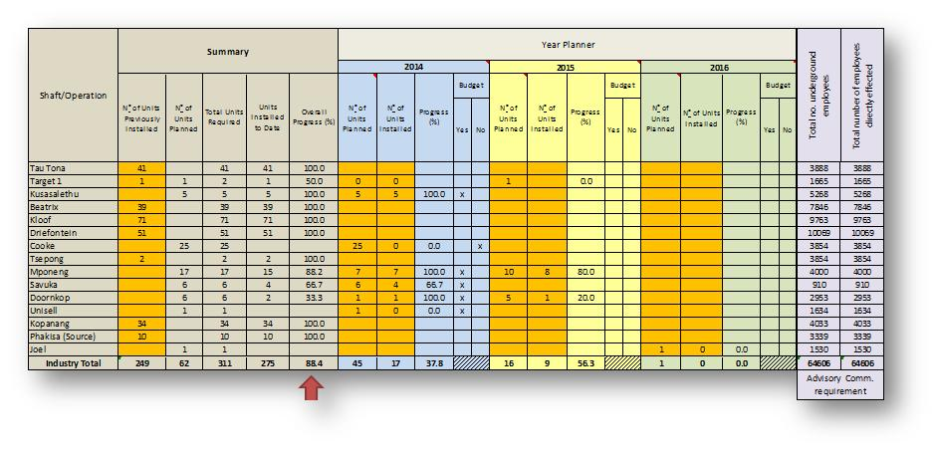
SLP Adoption High Lights and low lightsTracker
Previous: 86.6
Leading the change to zero harm

Slide 6
SLP Adoption High Lights and low lightsTracker
Previous: 56.7
Leading the change to zero harm

Slide 7
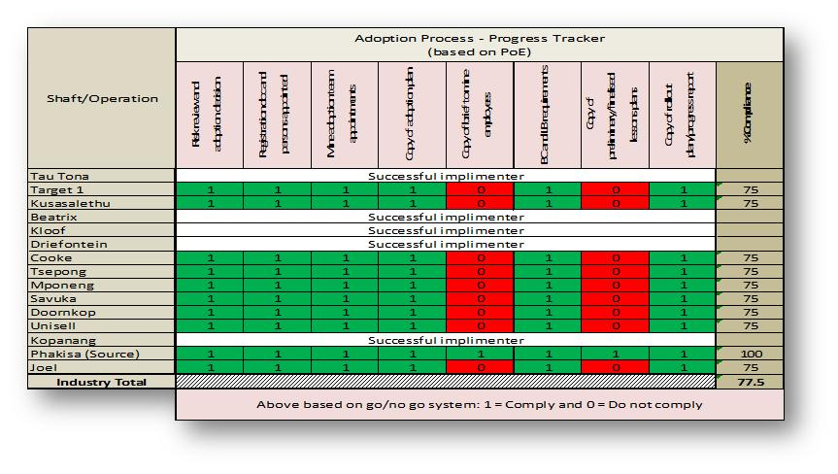
SLP Adoption High Lights and low lightsTracker
Leading the change to zero harm

Slide 8
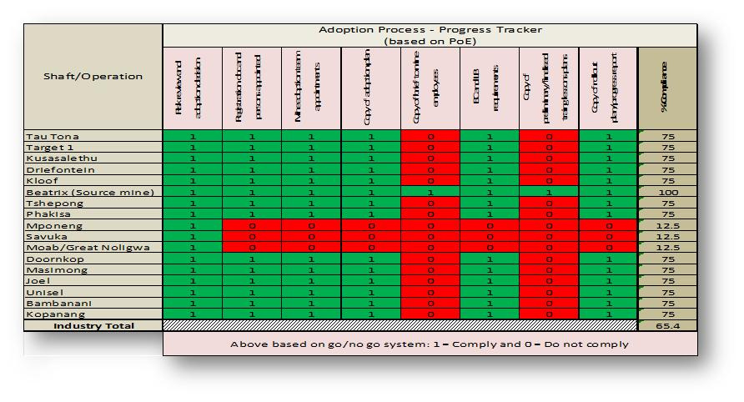
SLP Adoption High Lights and low lightsTracker
Leading the change to zero harm

Slide 9
Important dates/events
Rustenburg Tripartite 7 May 2014
Chamber of Mines Colliery Council: 13 May 2015
Free State occ hygiene tripartite: 14 May 2015
GEE: 15 May 2015
COPA LAUNCH : 28 MAY 2015
Free State Tripartite presentation: 4 June 2015 (COPA)
Leading the change to zero harm

Slide 10


L E A R N I N G H U B
DUST TEAM
011 498 7100
Or visit our website: www.mosh.co.za
Dr Audrey Banyini
ABanyini@chamberofmines.org.za
Gerrie Pienaar
gerriepienaar69@gmail.com
Johan van Rensburg
johan.c.vanrensburg@angloamerican.com
L E A R N I N G H U B

