Slide 1
MOSH Falls of Ground Team
Leading Practice
Adoption Team
Activity Report
21 May 2015

Slide 2

Contents
Mission and Values reminder
Progress April / May 2015
Leading Practice Adoption
Activities
Challenges
Positives

Slide 3

Mission and Values - MOSH
To facilitate the adoption of leading practice through a people oriented process to significantly improve occupational health and safety in the minerals industry
Our ultimate goal is the provision of working conditions that are free from harmful effects
Values
Leading the change to zero harm

Slide 4
Leading Practice Adoption
Leading Practice | Mines | % Adoption (Documents) | Portfolios of Adoption | No of Crews Trained | No of Persons Influenced
Entry Examination and Making Safe | Central 74 E/Limb 16 N/Cape 6 | 98% 95% 72% | 2 2 | 6990 694 160 | 71000 13880 3200
Bolts with Nets | Central 49 | 97% |  | 2531 | 30000
TARP (FoG) | Central 41 E/Limb 16 N/Cape 6 | 71% 66% 72% | 2 1 | 1444 395 280 | 27000 7900 560
Value Added Drilling and Blasting | Position Paper drawn up and circulated to experts Preparing to Identify possible Leading Practices
“Ledging” | Meeting of expert team and meeting with Sponsor held on 15 April 2015 and 21 April 2015) and presented outcomes to CEO Elimination of Fatalities Team on 15 May 2015 Day of Learning Agreed to – planning to follow.
Leading the change to zero harm

Slide 5
Progress for the Month of April / May2015
No` | Activities
1 | Tripartite forums visited and positively participated . Engaged with Limpopo OH&H Working Group – MOSH Process and Emergency Preparedness
2 | MOSH FOG Industry Adoption Team – Held meeting on 15 April to discuss outcomes of “Increased Risks in Ledging” and to formulate presentation – next meeting 28 May 2015
3 | Special assistance to TauTona (2 Underground visits), Kopanang (weekly meetings), Barberton Mines and South Deep, with various FoG Leading Practices and assessments of progress with MOSH Leading Practices.
4 | COPA Meetings held in the Northern Cape at Wessels mine with an underground visit on 20 May and at Randfontein Central COPA on 24 April.
5 | Position Paper on Value Added Drilling and Blasting processes finalised and circulated for expert comment – busy identifying possible Leading Practices. Use of video technology is being explored to understand the behavior issues with Drilling and Blasting
6 | Held quarterly COPA meeting of the Eastern Limb on 8 May at Twickenham Mine (with inclusion of AMMSA representatives and DMR). Goal: Common Safe Declaration Documentation and re-adoption of Entry Examination and Making Safe Leading Practice for the region
7 | Presented outcomes of “Increased Leading Risk” to CEO Elimination of Fatalities Task Team
8 | Organised, participated and presented at the Day of learning on Gas Outbursts with MHSC on 8th May. A good day and good level of attendance - excellent participation.
Leading the change to zero harm

Slide 6
Progress for the Month of April / May 2015
No | Challenge (Issues, Risks, Concerns) | Response - Remedial Action | Due Date | Resp. Person
1 | Maintaining value in COPA’s | Get Host Mine Managers to do Mine Presentations and overviews at COPA Meetings Underground visits to areas of successful Adoption Presentation of “Certificate of Adoption” by HoLH at TPF Meetings or AMMSA Meetings?? Following up on FoG related Section 54 Instruction s Planning “Internal Review” for MOSH FOG Adoption Team Interested parties | On-Going | Team
3 | Working with “Lagging Mines” | Improve communications with MOSH Task Force Conducting visits to individual mines | On-going | DJA AvZ CL
Leading the change to zero harm

Slide 7
Developments
Issue | Action | TimeLine
Include Ledging in the MOSH FOG Adoption Team Scope | Presented the Outcomes to CEO’s - Day of Learning to follow | Day of Learning – Last Quarter 2015
Team to conduct Mine Visits following FOG Fatalities | Fatalities and Learning Points are discussed at the MOSH FOG Industry Adoption Team Level | On-going
Tracking Documents should include No. Of People Influenced by Adopted Practice/s | Tracking Documents updated to include these figures, currently being updated | Figures communicated regularly
Analysis to show impact on Hierarchy of Control | EE&MS – Admin Control TARP – Admin Control NwB – Engineering Control | On-going
Leading the change to zero harm

Slide 8
Work that still needs to be done
Issue | Action | TimeLine
Conduct a comparative analysis of impact of adoption | Information gathering in progress. Analysis framework being drafted | Not yet defined
Tracking document to include % of mines experiencing FOG Problems | Research currently underway to quantify | Not yet defined
Learning's from Drilling and Blasting Workshop | Identify possible Leading Practices for Adoption | Q4 2015
Include Ledging in MOSH FOG Team Portfolio | Need to arrange a Day of Learning to spread learning's and to identify possible Leading Practices for Adoption | Q4 2015
Leading the change to zero harm

Slide 9
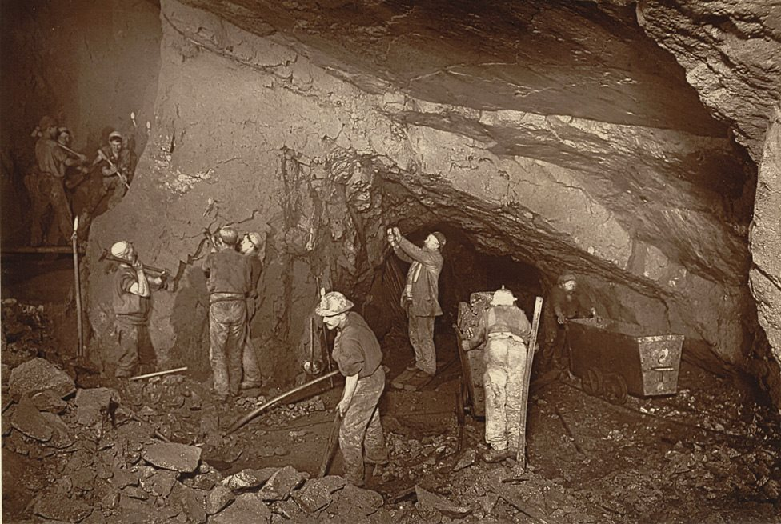
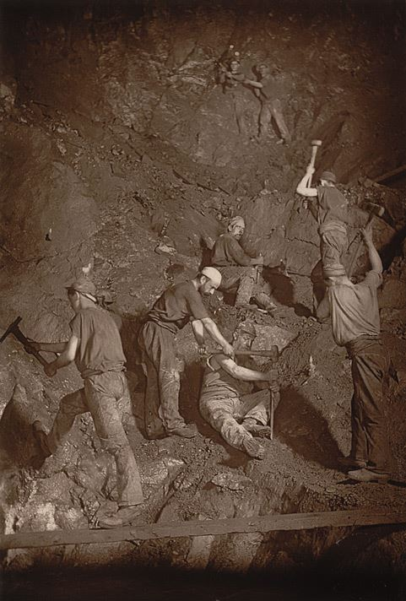
Questions or Discussion?
Leading the change to zero harm

