Slide 1
MOSH Website
- Analytics on Functionalities-
January – April 2015

Slide 2
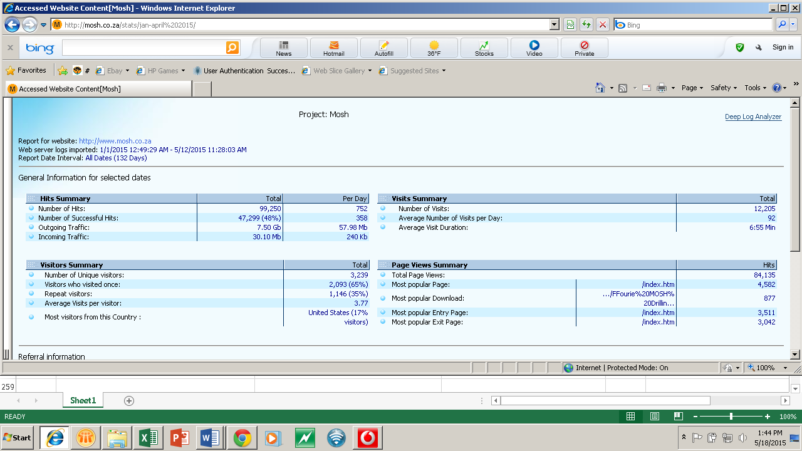

Slide 3
Top pages Visited

Slide 4
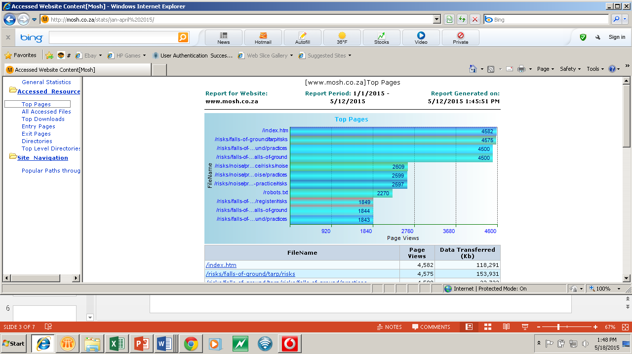

Slide 5
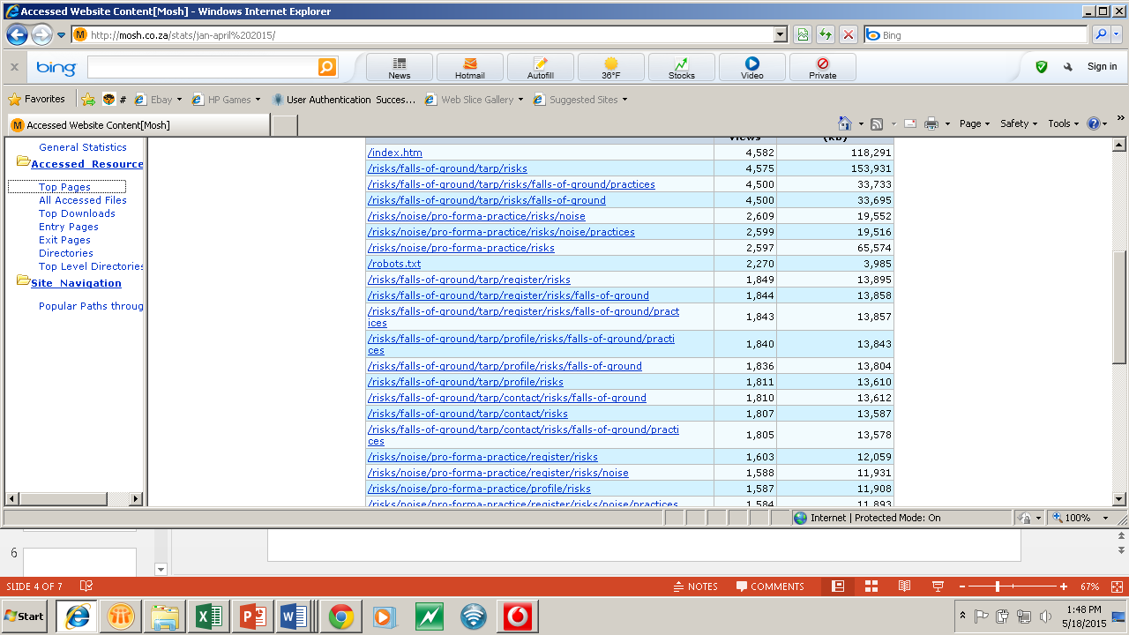

Slide 6
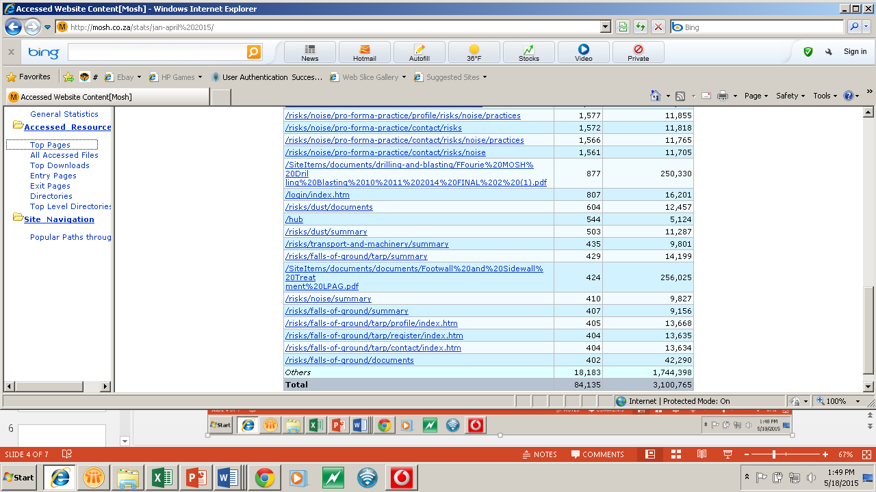

Slide 7
Top Downloads

Slide 8
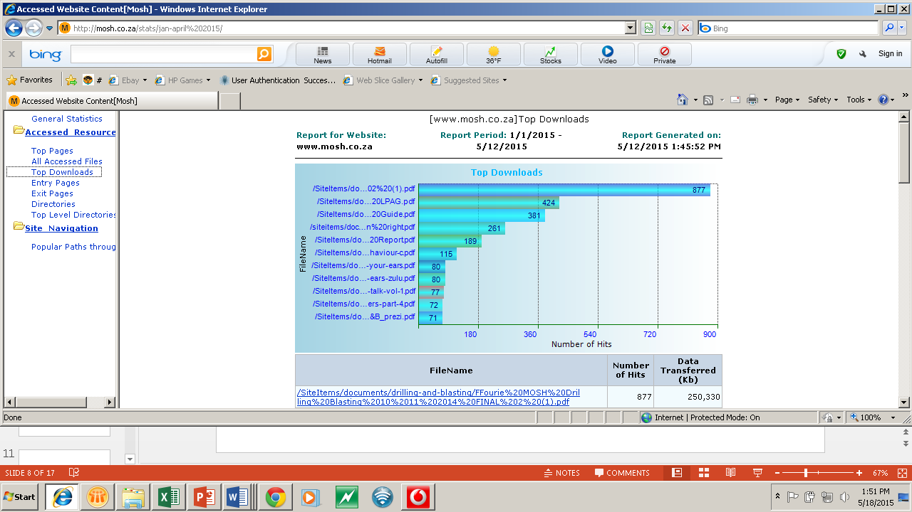

Slide 9
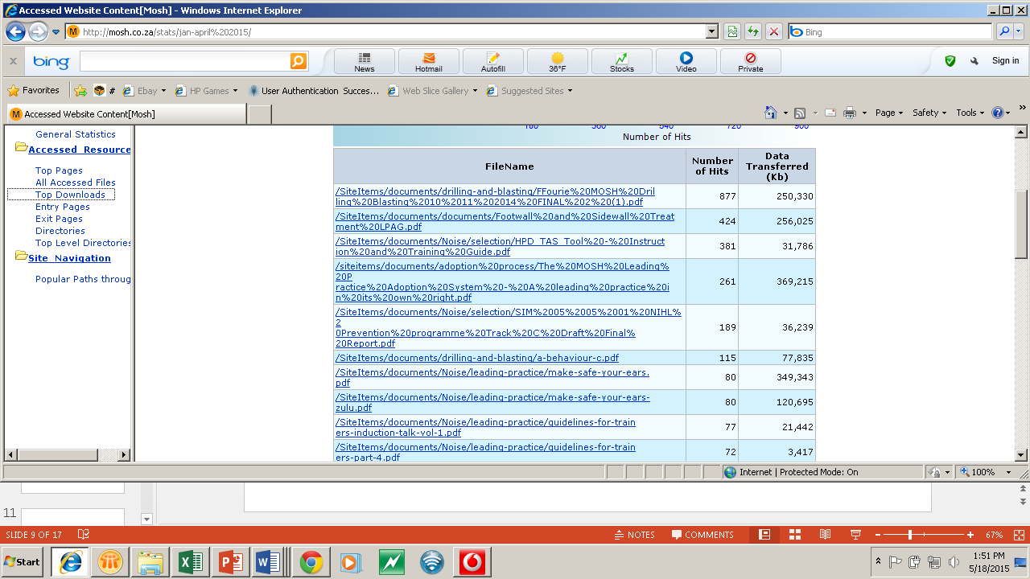

Slide 10
