Slide 1
MOSH Falls of Ground Team
Leading Practice
Adoption Team
Activity Report
13 August 2015

Slide 2

Contents
Mission and Values reminder
Progress April / May 2015
Leading Practice Adoption
Activities
Challenges
Positives

Slide 3

Mission and Values - MOSH
To facilitate the adoption of leading practice through a people oriented process to significantly improve occupational health and safety in the minerals industry
Our ultimate goal is the provision of working conditions that are free from harmful effects
Values
Leading the change to zero harm

Slide 4
Leading Practice Adoption
Leading Practice | Mines | % Adoption (Documents) | Portfolios of Adoption | No of Crews Trained | No of Persons Influenced
Entry Examination and Making Safe | Central 74 E/Limb 16 N/Cape 6 | 98% 95% 72% | 2 2 | 6990 694 160 | 71000 13880 3200
Bolts with Nets | Central 49 | 97% | 1 | 2550 | 64806
TARP (FoG) | Central 41 E/Limb 16 N/Cape 6 | 75% 66% 72% | 6 2 1 | 1972 395 280 | 65000 7900 560
Value Added Drilling and Blasting | Preparing to Identify possible Leading Practices Working to identify behavioural issues at AP SoM Site for explosive and non-explosive rock breaking at SibanyeGold
“Ledging” | Paper prepared for MineSAFE Meeting with Sponsor Peter Turner on 10 July 2015 Day of Learning – planning underway, date set for 27 October
Leading the change to zero harm

Slide 5
Progress for the Month of July/August 2015
No` | Activities
1 | Tripartite forums visited and positively participated . Assisting Limpopo Health and Hygiene Forum with "Emergency Preparedness" reviews Attended the Rustenburg Tripartite Forum
2 | Limpopo FoG COPA held at Twickenham Northern Cape MOSH FOG COPA meeting with U/G visit at Black Rock Mine Randfontein Central COPA on 12 June and 24 July
3 | Special assistance to individual mines Kopanang (weekly meetings) with netting, South Deep(TARP), Tshepong(TARP)
4 | Use of video technology is being explored to understand the behaviour issues with Drilling and Blasting – AP School of Mines
5 | Presentation on “Increased Leading Risk” prepared for Mine SAFE. Assisting AngloGold Ashanti with internal Ledging Review processes.
6 | Meeting with Sponsor to discuss Ledging and Drilling and Blasting. Conventional and non-explosive blasting discussed. Met with non-explosive supplier.
7 | Addressed the WITS final year students on MOSH
8 | MOSH FOG Industry Adoption Team Meeting
9 | Working with Kimberley Mines to restart their Adoption Programme FOG Team.
10 | Mine Review of TARP Adoption - Bambanani
Leading the change to zero harm

Slide 6
On-going Issues and their Actions
Issue | Action | TimeLine
Team to conduct Mine Visits following FOG Fatalities | Fatalities and Learning Points are discussed at the MOSH FOG Industry Adoption Team Level | On-going
Tracking Documents should include No. Of People Influenced by Adopted Practice/s | Tracking Documents updated to include these figures, currently being updated | Figures communicated regularly
Analysis to show impact on Hierarchy of Control | EE&MS – Admin Control TARP – Admin Control NwB – Engineering Control | On-going
Review of Mines progress with LP adoption(PoE) | Pilot Mines have been identified. Bambanani held on 21 and 22 July. | 4 Mines by the end of August 2015
Leading the change to zero harm

Slide 7
On-going Issues and their Actions
Issue | Action | TimeLine
Conduct a comparative analysis of impact of adoption | Information gathering in progress. Analysis framework being drafted | Not yet defined
Tracking document to include % of mines experiencing FOG Problems | 21 Mines responsible for 25 Fatalities. 14 companies responsible for 25 fatalities. Gold 17, Platinum 4, Coal 2, Chrome 2(2014) | On-going
Learning's from Drilling and Blasting Workshop | Identify possible Leading Practices for Adoption. Work planned at AP SoM and SibanyeGold | Q4 2015
Include Ledging in MOSH FOG Team Portfolio | Day of Learning to spread learning's and to identify possible Leading Practices for Adoption | Q4 2015
Leading the change to zero harm

Slide 8
Challenges for the Month of July/August 2015
No | Challenge (Issues, Risks, Concerns) | Response - Remedial Action | Due Date | Resp. Person
1 | Maintaining value in COPA’s | Get Host Mine Managers to do Mine Presentations and overviews at COPA Meetings Underground visits to areas of successful Adoption – PoE reviews – report back to meetings | On-Going | Team
2 | Working with “Lagging Mines” | Improve communications with MOSH Task Force Conducting visits to individual mines | On-going | DJA AvZ CL
3 | Getting understanding of behaviour embedded on mines | Include behaviour on every agenda of mine or COPA meetings | On-going | DJA AvZ CL
4 | Progress with Drilling and blasting | Working with APlats SoM, Sites at SibanyeGold | Sept 15 | DA CL
5 | Possible Strike Action | How can behavioural issues from MOSH be used to best advantage? | Soonest | LH
Leading the change to zero harm

Slide 9
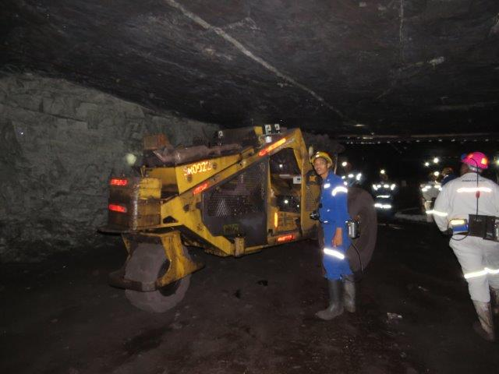
Questions or Discussion?
Leading the change to zero harm

Slide 16
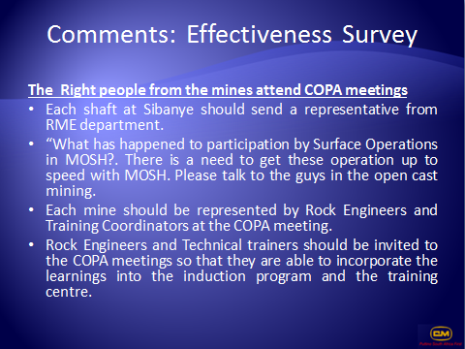

Slide 17
