Slide 1


The MOSH Leading Practice Adoption System
19 June 2012
HR Workshop
Glenburn Lodge

Slide 2
Au - 134k Pt - 182k Coal - 76k

Slide 3
SA Gold
2004 level
0,28
Intern. Benchmark
2003 level
0,15
2013 benchmark – 0,05

Slide 4
Intern. Benchmark
2003 level – 0,08
2013 benchmark – 0,03
Notes:
All mining sectors except gold in SA are expected to achieve current best practice of international mining by 2013.
The current average fatality rate for international mines is shown in the figure and is 0,08 fatalities per million hours worked.
The 2013 benchmark of 0,03 is also shown. This assumes that SA mining operations will improve their fatality rate by 20% per year and the international operations will improve by 10 % per year until 2013.

Slide 5
Fatality rate/million hours worked

Slide 6
Fatality rate/million hours worked

Slide 7
Total Industry
63%
Fatality rate/million hours worked
69%
92%

Slide 8

Where do we fit in?
Executive Council
Executive Council
Executive Council
Executive Council
Executive Council
Executive Council
Executive Council
Executive Council
Executive Council
Executive Council
Executive Council
Executive Council
Executive Council
Executive Council
Executive Council
Executive Council
Executive Council
Adoption Team Sponsors
Executive Council
Adoption Team Sponsors
Adoption Team Sponsors
Adoption Team Sponsors
Adoption Team Sponsors
Adoption Team Sponsors
Adoption Team Sponsors
Adoption Team Sponsors
Adoption Team Sponsors
Adoption Team Sponsors
Adoption Team Sponsors
Adoption Team Sponsors
Adoption Team Sponsors
Adoption Team Sponsors
Adoption Team Sponsors
Adoption Team Sponsors
Adoption Team Sponsors
Executive Council
MOSH Task Force
Executive Council
Executive Council
Executive Council
Executive Council
Executive Council
Executive Council
Executive Council
Executive Council
Executive Council
Executive Council
Executive Council
Executive Council
Executive Council
Executive Council
Executive Council
FOG Team – Neville Nicolau
(One per team)
(One per team)
(One per team)
(One per team)
(One per team)
(One per team)
(One per team)
(One per team)
(One per team)
(One per team)
(One per team)
(One per team)
(One per team)
(One per team)
(One per team)
(One per team)
(One per team)
Chamber Executive
Learning Hub Advisory Committee
Learning Hub
Specialist support for industry adoption teams
MOSH Learning Hub
MOSH
MOSH
MOSH
MOSH
Industry
Industry
Industry
Industry
Industry
Industry
Industry
Industry
Industry
Industry
Industry
Industry
Industry
Industry
Industry
Industry
Industry
Industry
Industry
Industry
Industry
Industry
Industry
Industry
Industry
Industry
Industry
Industry
Industry
Industry
Industry
Industry
Industry
Industry
Industry
Industry
Industry
Industry
Industry
Industry
Industry
Industry
Industry
Industry
Industry
Industry
Industry
Industry
Industry
Industry
Industry
Industry
Industry
Industry
Industry
Industry
Industry
Industry
Industry
Industry
Industry
Industry
Industry
Industry
Industry
Industry
Industry
Industry
Industry
Industry
Industry
Industry
Adoption Team
Adoption Team
Adoption Team
Adoption Team
Adoption Team
Adoption Team
Adoption Team
Adoption Team
Adoption Team
Adoption Team
Adoption Team
Adoption Team
Adoption Team
Adoption Team
Adoption Team
Adoption Team
Adoption Team
Adoption Team
Adoption Team
Adoption Team
Adoption Team
Adoption Team
Adoption Team
Adoption Team
Adoption Team
Adoption Team
Adoption Team
Adoption Team
Adoption Team
Adoption Team
Adoption Team
Adoption Team
Adoption Team
Adoption Team
Adoption Team
Adoption Team
Adoption Team
Adoption Team
Adoption Team
Adoption Team
Adoption Team
Adoption Team
Adoption Team
Adoption Team
Adoption Team
Adoption Team
Adoption Team
Adoption Team
Adoption Team
Adoption Team
Adoption Team
Adoption Team
Adoption Team
Adoption Team
Adoption Team
Adoption Team
Adoption Team
Adoption Team
Adoption Team
Adoption Team
Adoption Team
Adoption Team
Adoption Team
Adoption Team
Adoption Team
Adoption Team
Adoption Team
Adoption Team
Adoption Team
Adoption Team
Adoption Team
Adoption Team
Adoption Team
Adoption Team
Adoption Team
Adoption Team
No 3
No 3
No 3
No 3
No 3
No 3
No 3
No 3
No 3
No 3
No 3
No 3
No 3
No 3
No 3
No 3
No 3
No 1
No 2
No 3
No 3
No 1
No 1
No 1
No 1
No 1
No 1
No 1
No 1
No 1
No 1
No 1
No 1
No 1
No 1
No 1
No 1
No 1
No 2
No 2
No 2
No 2
No 2
No 2
No 2
No 2
No 2
No 2
No 2
No 2
No 2
No 2
No 2
No 2
No 2
No 3
No 3
No 3
No 3
No 3
No 3
No 3
No 3
No 3
No 3
No 3
No 3
No 3
No 3
No 3
No 3
No 3
(Noise)
(Dust)
(Falls of Ground)
(Falls of Ground)
Dust
Noise
FOG
T&M
Facilitation of widespread adoption of leading practice
Facilitation of widespread adoption of leading practices
Facilitation of widespread adoption of leading practice
Facilitation of widespread adoption of leading practice
Facilitation of widespread adoption of leading practice
Facilitation of widespread adoption of leading practice
Facilitation of widespread adoption of leading practice
Facilitation of widespread adoption of leading practice
Facilitation of widespread adoption of leading practice
Facilitation of widespread adoption of leading practice
Facilitation of widespread adoption of leading practice
Facilitation of widespread adoption of leading practice
Facilitation of widespread adoption of leading practice
Facilitation of widespread adoption of leading practice
Facilitation of widespread adoption of leading practice
Facilitation of widespread adoption of leading practice
Facilitation of widespread adoption of leading practice
Facilitation of widespread adoption of leading practice
Leading the change to zero harm

Slide 9
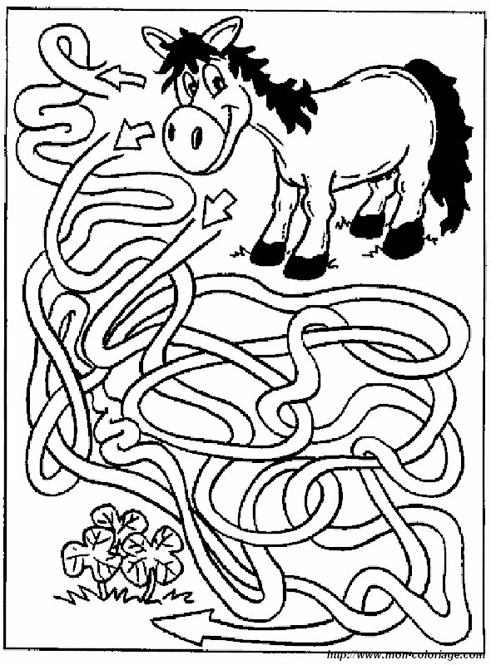
How does it work?
MOSH
Successful Adoption of a Leading Practice

Slide 10
Roll out the practice on COPA member mines
Identify Leading practice
Identify the Source Mine and Document
Demonstrate the practice at a new mine and document
Establish a Community of Practice for Adoption (COPA)
Hold a demonstration workshop

Slide 11
Demonstration Workshop
Leading Practice Adoption Guide
COPA Invitation
COPA FORMATION
Mine Sign Up
Mine Attends COPA
Process of Adoption
Mine Adoption Team
Plan Adoption
Interviews/Mental Models
Leadership and Communication Behaviour plans
Lesson Plans
Measurements

Slide 12
Roll out of Leading Practice
Identify Crews to be Trained
Roster of Training
Assess Impact
Improved Safety
Improved adherence to Standards
Underground Implementation
Culture Transformation

Slide 13
Adoption Decision by COPA member mine
Formation of Mine Adoption Team
Review the plan for Adoption
Interview stakeholders and adopters
Establish Mental Models
Develop Leadership Behaviour & Behavioural Communication models
Modify lesson Plans
Train Adopters
Roll out leading practice across the mine
Establish a COPA

Slide 14

Start

Slide 15
Start
Many excellent practices in South African Mines to improve health and safety significantly
Sniff them out(Adoption team)
Workshop of experts to choose a leading practice (Adoption Team + others)
Get agreement from the mine(Source mine)
Interview staff to find out staff mental models
Document practice on the Source Mine
Conduct industry wide interviews

Slide 16

The Back Stretch
Find a mine that wants to adopt the leading practice (Demonstration Mine)
Visit the Source Mine
Help that mine to adopt
  Introduce practice
  Interviews
  Mental Models
  Leadership behaviour Plans
  Behavioural communications Plans
  Modification of lesson plans
  Implementation

Slide 17

The Back Stretch
Document all that they do during the adoption process
Write up experience in a Leading Practice Adoption Guide (LPAG)
Measure impact
Document success and failures

Slide 18

The Home Straight
Hold a demonstration workshop for the rest of industry
Form a Community of Practice for Adoption (COPA)
Gathering of mines (senior decision makers) who want to adopt the leading practice
Workshop for learning and sharing of experience
Progress is reported and monitored

Slide 19
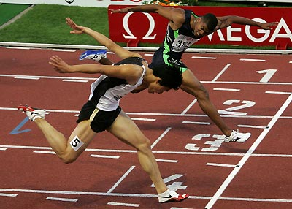
The Finish
Wide-spread sustainable adoption of the leading practice
Measureable contribution of the leading practice to increased safety performance
Closer to zero harm

Slide 20
Thank you

Slide 21
