Slide 1

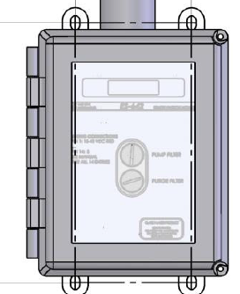
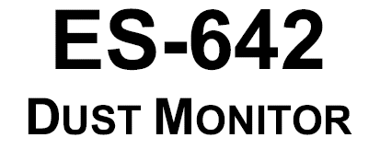


Slide 2
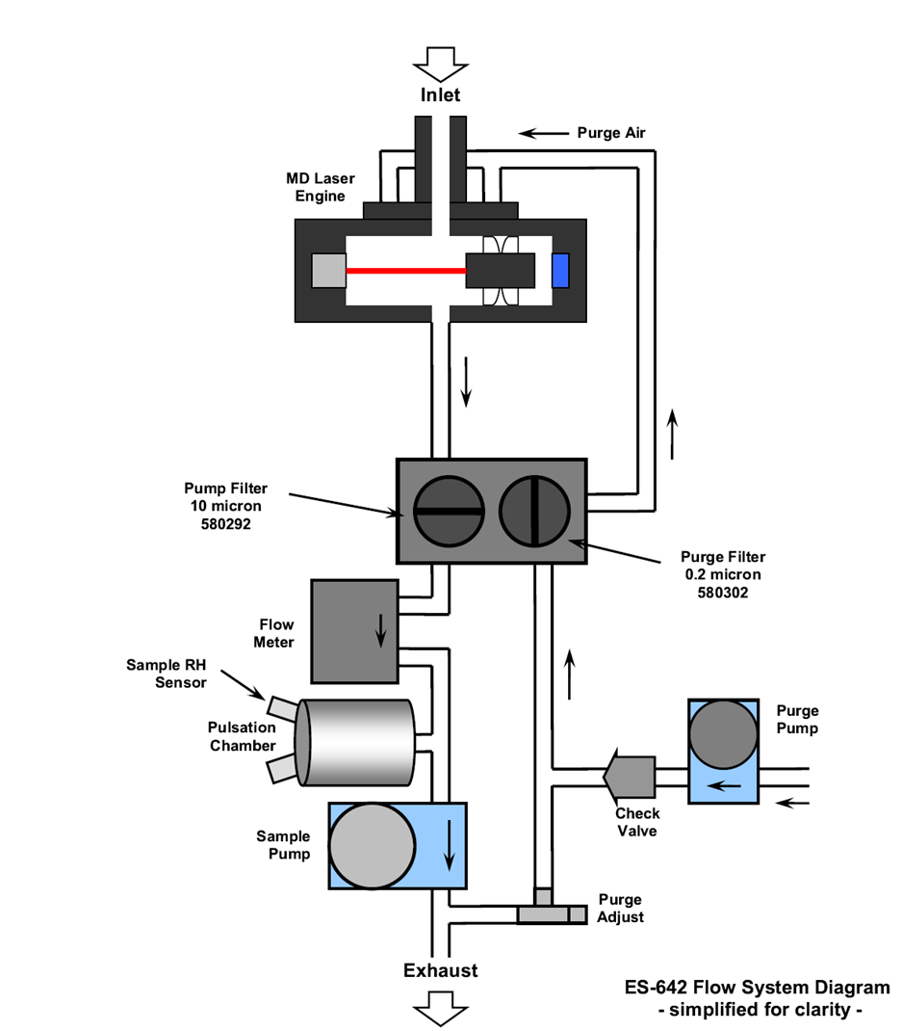
PRINCIPLE OF OPERATION
The Met One Instruments model ES-642 is an active flow nephelometer which measures,
by means of interchangeable sharp cut cyclones, PM10 & PM2,5 or TSP aerosol concentration levels using the principle of forward laser light scatter. Furthermore, with a heated inlet, the ES-642 is able to compensate for elevated levels of humidity. This function is user-selectable however the norm is to activate the compensation at the 40% level.
Notes:
Principle of Operation

Slide 3
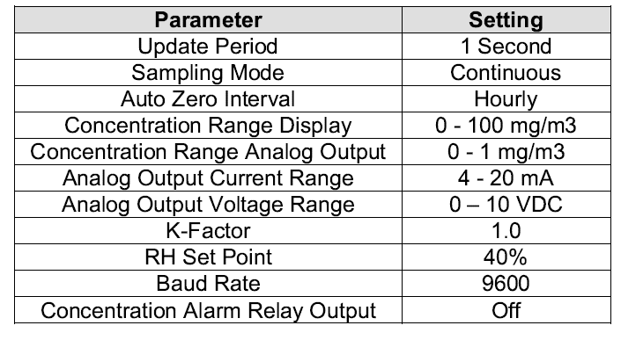
FACTORY SETTINGS

Slide 4
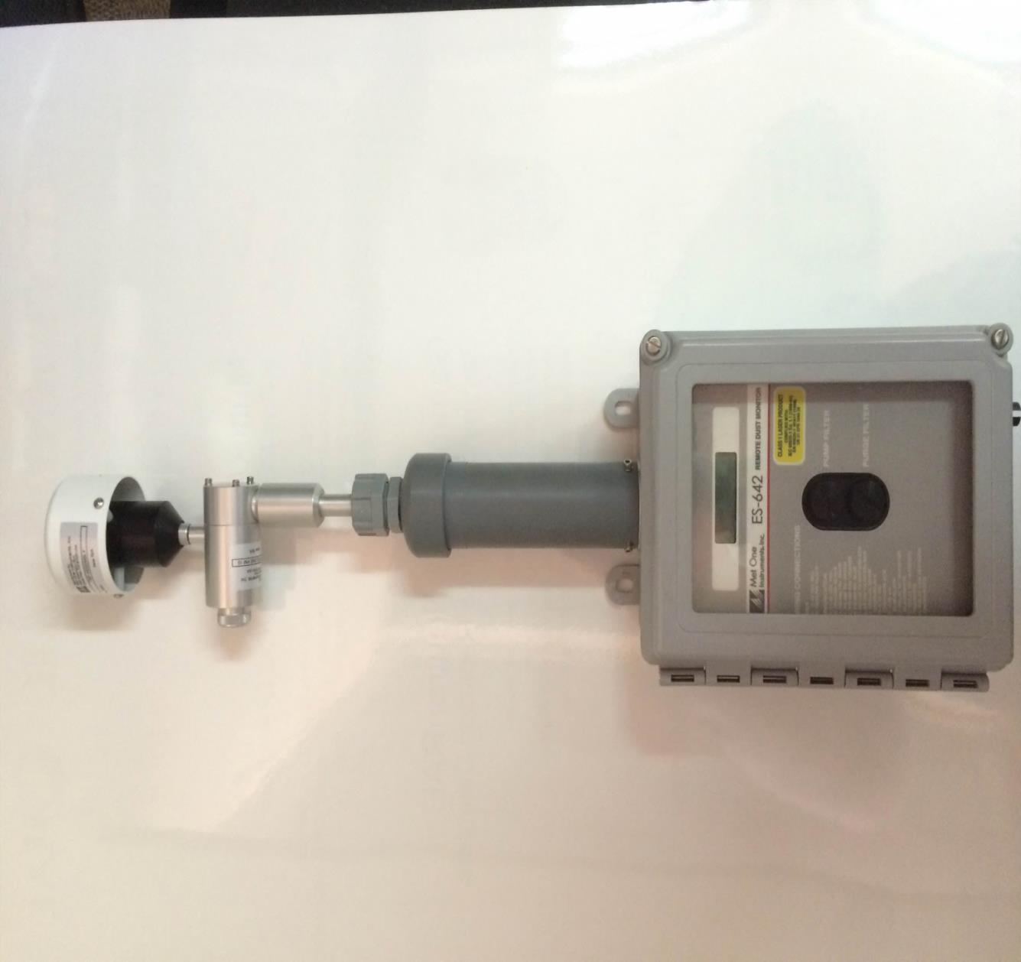
KEY FEATURES
TSP INLET
PM 10 SHARP CUT CYCLONE
(PM2.5)
ACTIVE HEATED INLET
ACTIVE SAMPLING PUMP
PUMP FILTER
PURGE FILTER

Slide 5
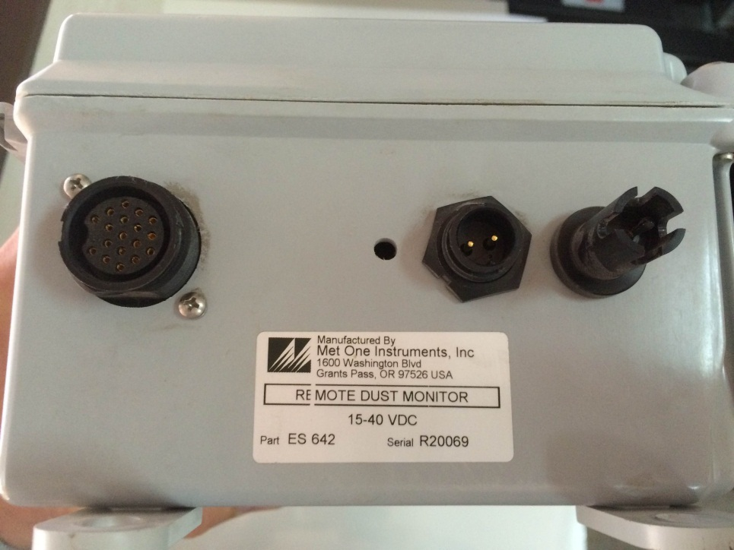
CONNECTIONS
Power Requirements
The ES 642 operates on 15 – 40 Volt D/C
Output
Notes:
Outputs

Slide 6

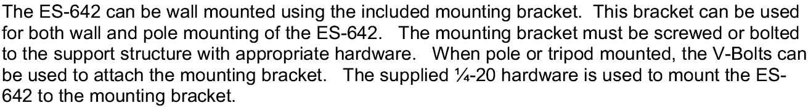
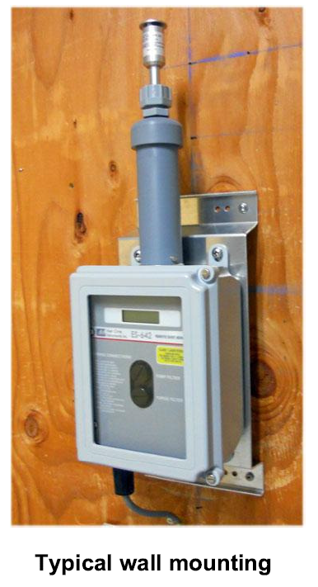
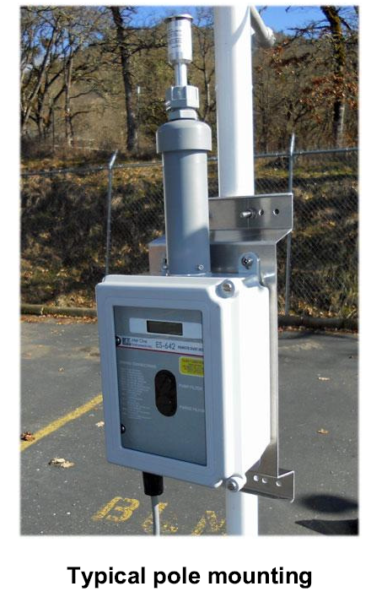
INSTALLATION OPTIONS

Slide 7
METONE INSTRUMENTS – THE E-SAMPLER

Slide 8
THANK YOU

Slide 9

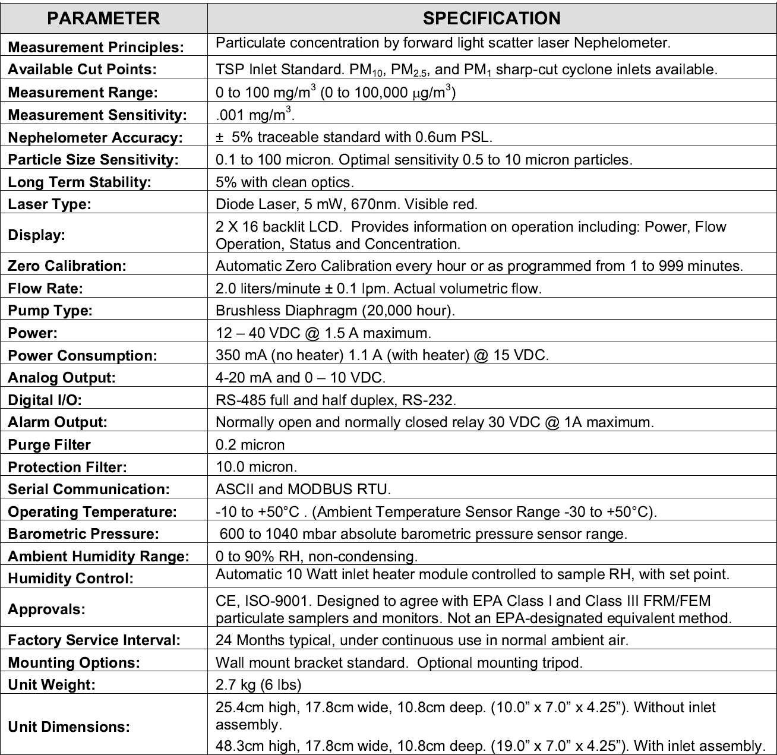

Slide 10
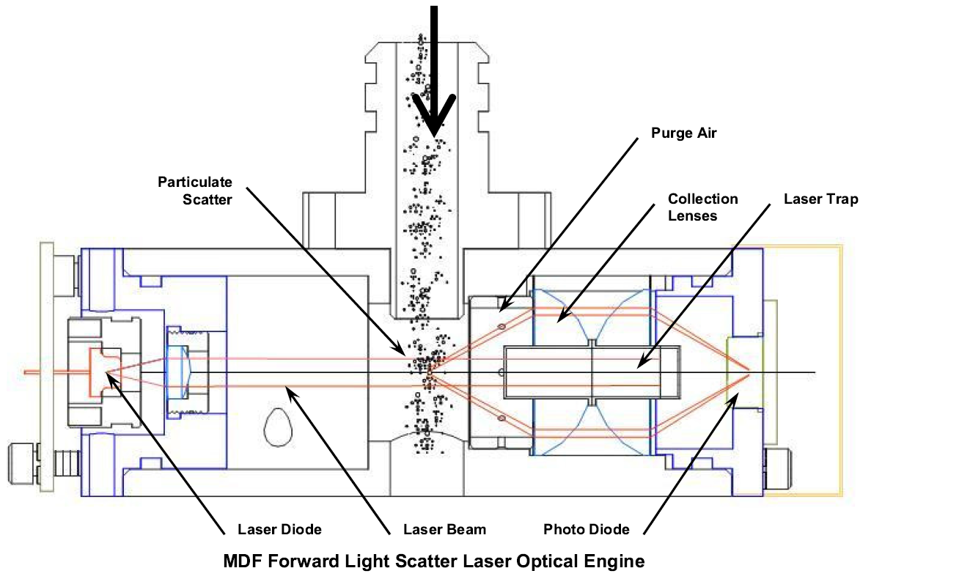

Slide 11
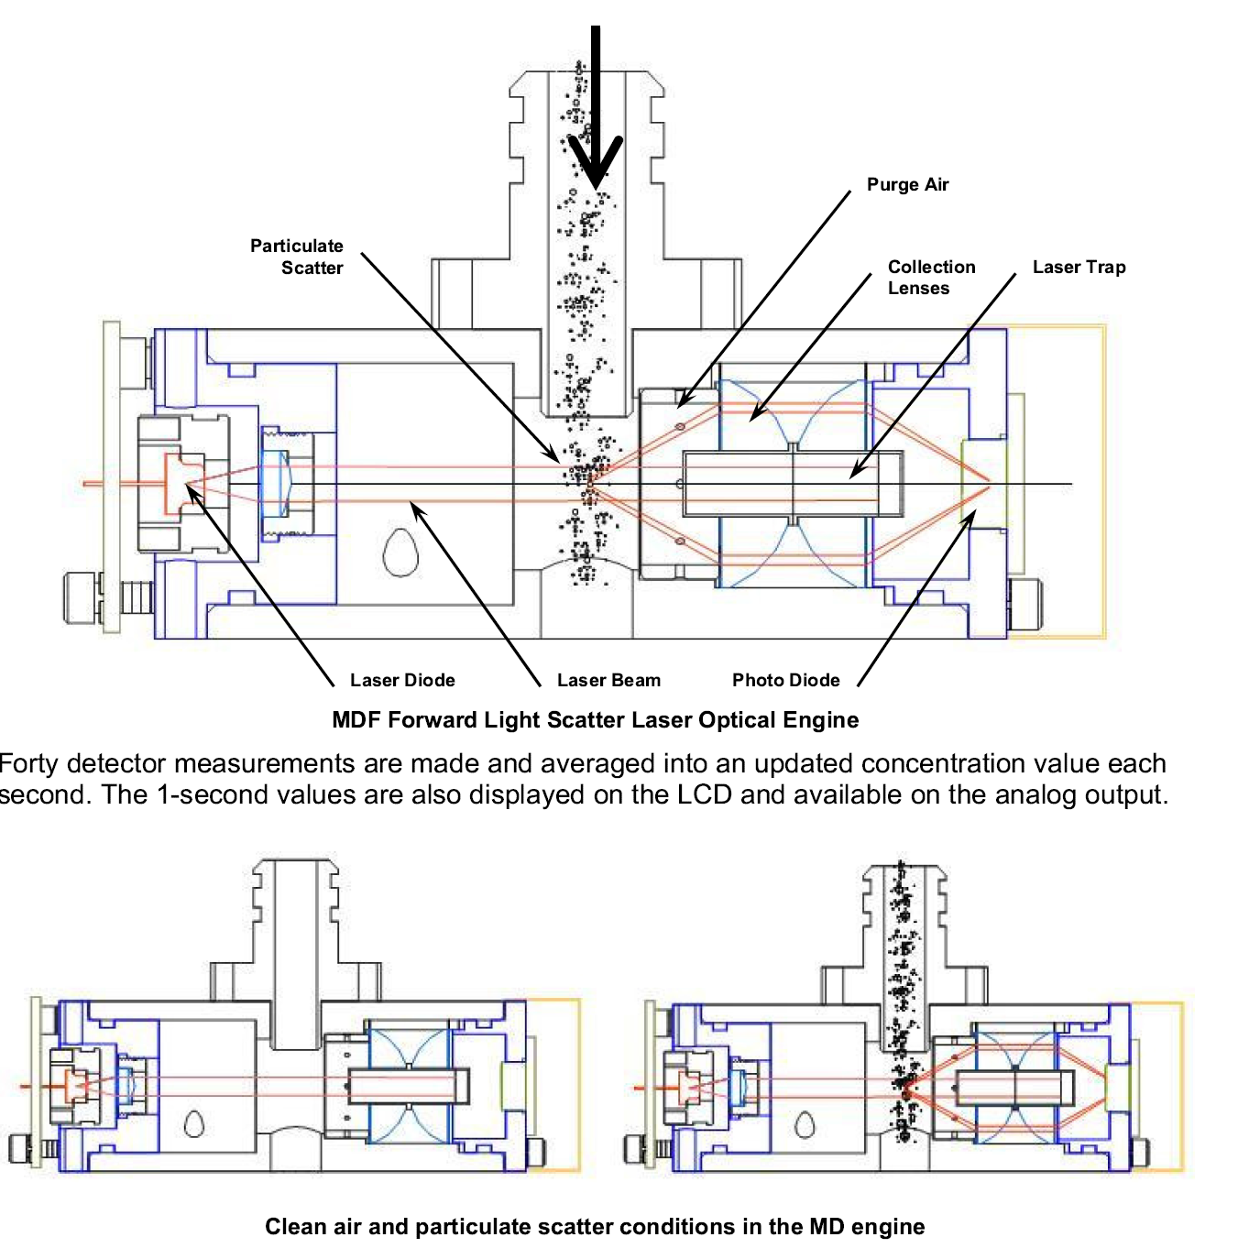

Slide 12
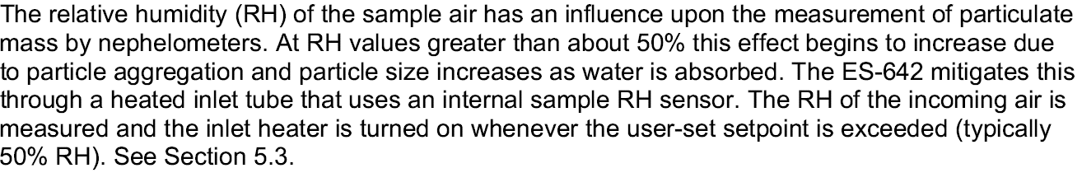

Slide 13
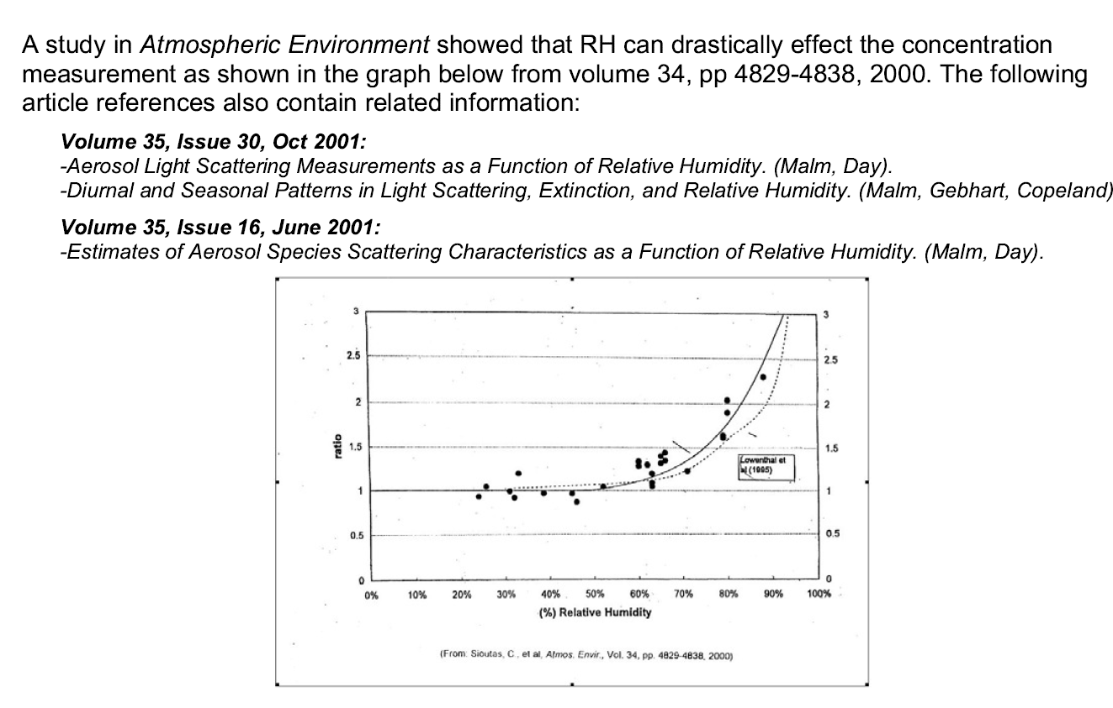

Slide 14


