Slide 1

PROPOSAL FOR AN INDUSTRY-WIDE BUY QUIET INITIATIVE
July 2013
1

Slide 2

Introduction
Purpose
To provide the Mining Industry Leaders with a consolidated industry-wide strategy for a Buy Quiet Initiative as well as a practical path-forward to execute the strategy
What is it?
A standing decision from mining companies to procure only equipment and machinery that comply with specific noise emission requirements
What we want ?
Input from CM& EE
Active participation
Ownership
2

Slide 3
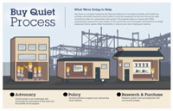
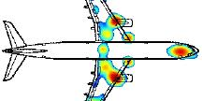

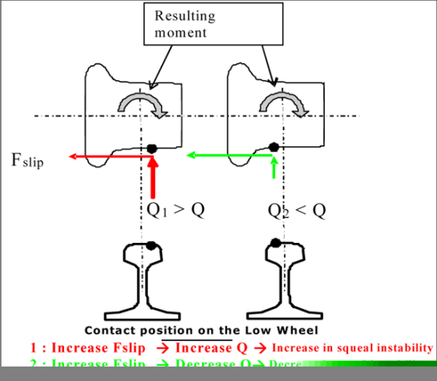
Motivation
Most Companies have individual Buy Quiet Policies
Need to Manage noise at the “real source”
Mining Industry to motivate Suppliers to invest into development of quieter equipment
Collective demand from the industry will motivate Suppliers to focus MORE on noise reduction as part of their product development
Cheaper to manage noise hazard at the design phase
3

Slide 4
Pathway to an industry wide BC Initiative
Identify and rank noise sources throughout the industry
‘stretched’ nose emission targets per machine/ equipment
aggregate demand of specific machinery – value case -
1
2
3
Engage suppliers at executive level to commit to 2 and 3
Mining Industry commits to 2 and 4
Manage progress towards the agreed milestones
4
5
6
4

Slide 5




Critical steps to be achieved
Establishing a mining industry Buy Quiet Initiative Task Team
Set-up executive Round Table discussions with the suppliers
Establish specific standards based on equipment/machinery life –cycle cost as opposed to purchase cost.
Specific Task Teams establish realistic and equipment specific noise reduction targets and milestones
Monitor and manage progress towards the milestones
5

Slide 6

Challenges
Inability to collaborate
Fixation on purchase cost vs. life cycle cost
Suppliers resistance based on international product specifications
Suppliers needing upfront investments for R&D
Competition and monopoly issues
Intellectual property issues
6

Slide 7

Conclusion
Strategy manages noise at the ‘real source’
Continuous ALARP will lead us to Zero Harm
Its much more cost effective to manage noise at ‘real source’
‘Thought-provoking’ benchmark
  Engineering leads; OH monitor, measure, inspects, legals etc
7

Slide 8
Cost of Noise
Cost of a rock drill = R15K
Cost to muffle = R500 (separate) or R2,5K (muffled cylinder)
Total number of rock drills in the mining industry = 30K
Cost to muffle the rock drills = R60M
Compensation cost for 2011 = R40M
Note calculation does not include other equipment (LHDs, fans etc)
Cost of NIHL = Compensation Cost + Cost to Manage Noise
Cost to Manage Noise = Cost to (Measure+ Eng Controls +
Admin + Future litigation + Maintenance)
8

