Slide 1



Chamber of Mines of South Africa
Learning Hub
MOSH Noise Industry Team Meeting
26 September 2012
CHAMBER OF MINES OF SOUTH AFRICA
Working together for a sustainable future since 1889

Slide 2
Discussion Points
Meeting Objectives
Recap of August Workshop
Planned Activities

Slide 3

Meeting Objectives
Industry Team Future activities
Adoption of the expert model
Shared Understanding of a comprehensive Buy quiet policy
‘Actual’ cost of noise
Ways of increasing the Perception Of Value (POV) that the industry has towards noise team activities
Industry Team Members have some basic understanding of MOSH
Leading the change to zero harm

Slide 4
Guiding Criteria for a new LP
Use previous experience to come-up with a ‘wow’ leading practice
The identified leading practice must be appealing to most mines
Source elimination (LP) will be top price
All activities are directed towards the ‘wow’ leading practice
Understand the hazard that we are addressing vs. MOSH Process
Leading the change to zero harm

Slide 5

Workshop Recap
  Delegates
  90% attendance (70 of 80)
  Spread over10 commodities representing a total of 20 mining houses
  Important stakeholders such as the Unions, Research Institutes
  Survey on workshop content & satisfaction, workshop design & organisation and the strategy of the MOSH Noise Team.
Leading the change to zero harm

Slide 6

Workshop Recap
  Theme & Team Activities
  Hearing loss prevention vs. Hearing compensation prevention
  Objective : move the industry to a paradigm that focuses on hearing loss prevention
  Team activities and some operational challenges.
Leading the change to zero harm

Slide 7
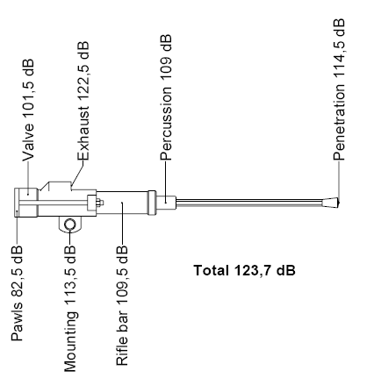
Workshop Recap
  Source Elimination of Current Machines
  Noise sources are, Exhaust noise, Mechanical noise, Drill steel ringing, Steel on steel on rock, ambient noise, vibration and Echo
  Current focus is on exhaust muffling initiatives .
  Five more noise sources that can be leveraged on - potential leading practice
Leading the change to zero harm

Slide 8
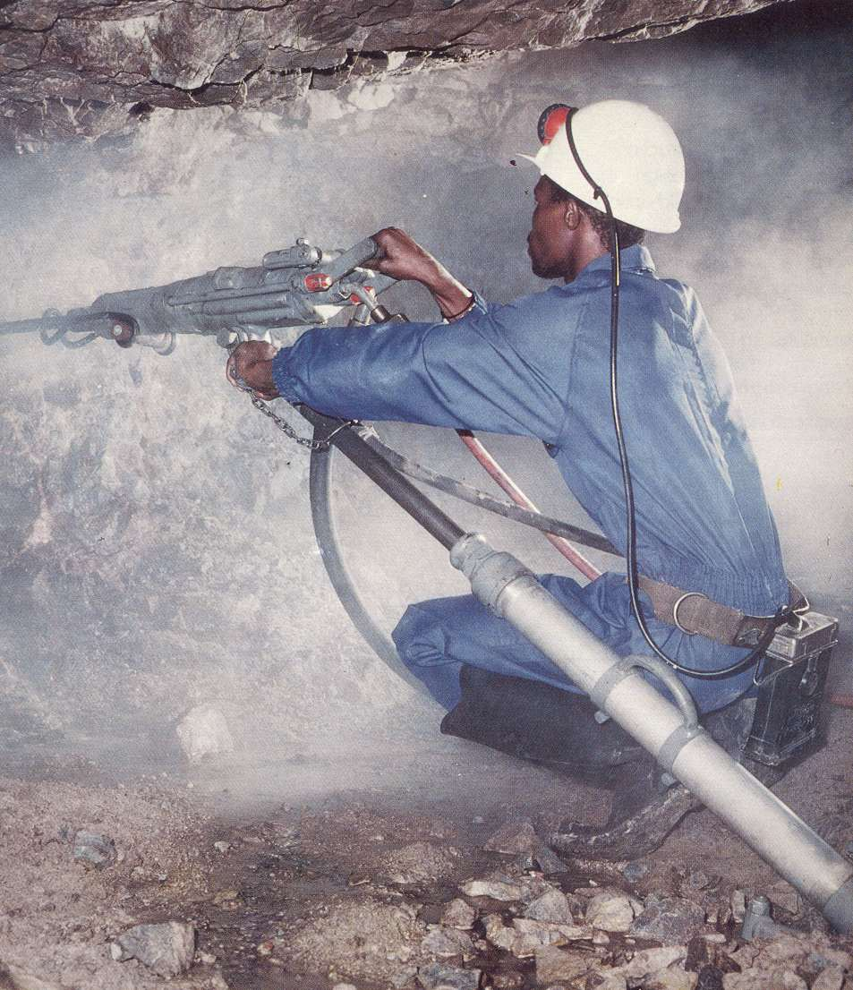
Having addressed the exhaust noise, what about the rest?
1
5
2
3
Exhaust noise
Mechanical noise
Drill steel ringing
Steel on steel on rock
Ambient noise
Echo
4
6

Slide 9
Discussion Points
Meeting Objectives
Recap of August Workshop
Planned Activities

Slide 10
Workshop Recap
  Source Elimination - Future mines and expansion projects
  not explicitly catered for by MOSH process
  Need forum where it can influence the direction towards the usage of quieter rock breaking mechanisms such as hydraulic, electric drills
  The decision to use quieter rock breaking mechanisms is part of mine design and feasibility studies hence the benefits will be longer-term side
Leading the change to zero harm

Slide 11

Workshop Recap
  HPD TAS
  few mines are adopting
  Only adopt segments of the leading practice.
  Need for an assessment tool that will surface the underlying reasons behind the slow rate of adoption be developed
  The Noise will form an HPD TAS interest group – adopters and implementers
Leading the change to zero harm

Slide 12
Discussion Points
Meeting Objectives
Recap of August Workshop
Planned Activities

Slide 13
Planned way forward
Source Elimination – Current Machines
  Collaborate with T& M Team and CM& CCs , University of Pretoria & other research institutions – 28 Sept 2012
  Regular progress reports at Industry Team Meetings
Source Elimination - Expansion projects and new mine
  Discuss the proposed workshop with the MOSH Taskforce - 19 Oct 2012
  Obtain a list of design personnel from the MOSH Taskforce – 16 Nov 2012
  Drilling Selection Tool - Nov 2012
  Regular progress reports at Industry Team Meeting
HPD TAS Tool
  Daft Assessment Tool – 13 Sept 2012
  Assist the adopter and Implementers – Dec 2012
  Facilitate Interest group activities – 14 Nov 2012
  Regular progress reports at Industry Team Meetings

Slide 14
Planned way forward
Source Elimination Repository
  Compile summary of the practices and contact personnel – 19 Oct 2012
  Design the SLP usage tracking mechanism – 13 Sept 2012
  CoM to Design the booklet – 19 Oct 2012
Industry Team Meetings & Workshops
  1st Industry Team Meeting - 26 Sept 2012
  2nd Industry Team Meeting Orientation - 14 Nov 2012
  Industry Team Workshop - 13 February 2013
  3rd Industry Team Meeting - 13 Mar 2013
  4th Industry Team – 15 May 2013
  5th Industry Team - 14 August 2013
  REFER TO THE WORK DOC.
MOSH Leading practice
  Identification Phase– 13 February 2013
  Documentation Phase – Feb to April 2013
  Demonstration Phase - April to Aug 2013
  Facilitation Phase – Aug to Jan 2014

