Slide 1


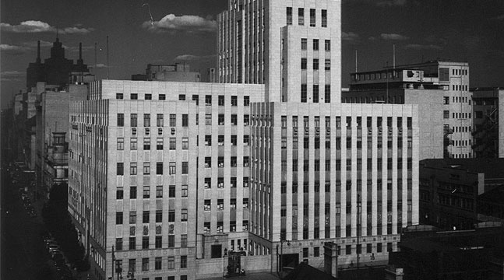

MOSH Leading Practice Adoption System - NOISE Team Initiatives
Noise Team
CHAMBER OF MINES OF SOUTH AFRICA
Working together for a sustainable future since 1889

Slide 2

Introduction
…all employees wear HPDs from bank to bank…
(is this a common practice/motto)?
…do we have OH challenge? YES
…do we have a Noise problem relative to other OHS challenges?
Is the Noise Team effectively contributing towards Zero Harm? NO
Do we have a successfully Adopted Noise Leading Practice? NO
Use of Trends viz Numbers to inform direction
Leading the change to zero harm

Slide 3
The Problem
Nature of the Hazard
  Prolonged exposure to high levels of noise can result in permanent & irreversible damage to hearing
Elimination
– Substitution -
-Isolation-
Engineering Controls
– Silencers-
- Noise filters-
Administrative Controls
– Removal of persons from the hazard –
- Reducing exposure times –
Personal Protective Equipment
– PPE - Last resort
Leading the change to zero harm

Slide 4
The Problem
Global profile of NIHL
  NIHL has been recognized by World Health Organisation (WHO)
    Program for Prevention of Deafness and Hearing Impairment (PDH)
  NIHL prevalence of 120 Million
    Member states to setup National Programs on Noise
  WHO-PDH rates NIHL as the most prevalent irreversible industrial disease and most compensable occupational disease
Leading the change to zero harm

Slide 5
The Problem
State Intervention
  Compensation for Occupational Injuries and Diseases Act 130/1993 (COID Act)
    Instruction - 168, 171
    Simplification & fairness the compensation mechanism
    Punishes employers who allow the hearing ability of employees to deteriorate due to noise exposure at work places – Part of the National Program
    Baseline Audiogram test
  DMR’s Hearing Conservation Guidelines
    Hearing Conservation Programs in Mines
    Medical surveillance Programs
Leading the change to zero harm

Slide 6
The Problem
Industry Response
  1988 - Concern through the establishment of HCP User Guide No. 11
    Voluntary
  Mining Occupational Health Advisory Committee (MOHAC) - Tripartite advisory body
    Adopted the 2003 Industry milestones
    Implemented the DMR/DME ‘s HCP Guidelines
      Elimination,
      Engineering Noise Control
      Administrative Control measures
      Personal Protection
      Medical surveillance
Leading the change to zero harm

Slide 7
The Problem
Industry Response (cont.)
    HPD to be used as an interim protective measure while permanent engineering solutions are being investigated and developed – world wide applicable standard
      DMR approach
      World wide applicable standard/approach
Leading the change to zero harm

Slide 8
The Problem
Prevalence of NIHL are derived primarily from compensation data
  Only once workers are compensable (10% PLH shift from the baseline assessment) are they documented as having NIHL
  Any degree of hearing loss that is not compensable is not reported in public data
  70% of South African miners are exposed to noise levels exceeding the legislated Occupational Exposure Level (OEL) of 85 dBA
Leading the change to zero harm

Slide 9
The Problem
Source: Rand Mutual Assurance
Impact of the Hazard
  NIHL has cost the Industry R890 M – 1997 to 2007
    R370 M – 2005 to 2009
  Single biggest occupational disease in workforce
  Total NIHL claims in 2011 – R 44M
    Direct Cost – R37M
    Subsequent cost – R5M
    Days off - R 175K
  Very good progress
  Overwhelming Literature
    Data : Scarce , unreliable not standardized (different criteria for different countries etc)
    General absence of a ‘ helicopter view’
Leading the change to zero harm

Slide 10
The Problem
Source: Rand Mutual Assurance
Leading the change to zero harm

Slide 11
The Problem Relative to OHS Challenges
NB: Numbers are used to inform direction (frequencies viz. sound)
  Safety Challenges
    121 lost lives
    Estimated total cost to the Industry = R 1.5 Bn (R 12M x 121
  OHS Challenges
    Estimated total cost to the Industry =approx. 5 X 1.5Bn = R7.5bn
    Total NIHL claims = R 44M
  The Noise Problem viz Safety Challenges
    Noise induced hearing loss was recognised as a major problem in the mining industry in 1994 by the Leo Commission
    Safety Problem : Noise Problem = 33: 1
    Dust Problems : Noise Problem = 170: 1
    Approx. 2 Orders of Magnitude
Source: Mining Weekly (3/11/2010) and Dr Frankel – Falling Ground
Source: Mine Health & Safety Council – 2012 MMPA Presentation
Leading the change to zero harm

Slide 12
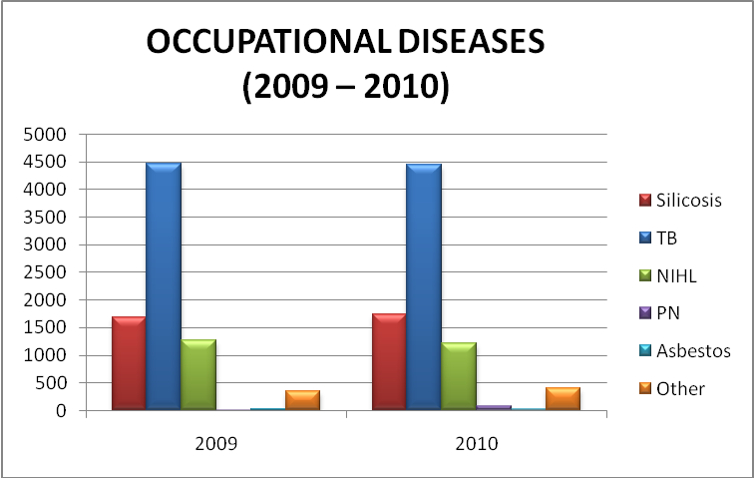
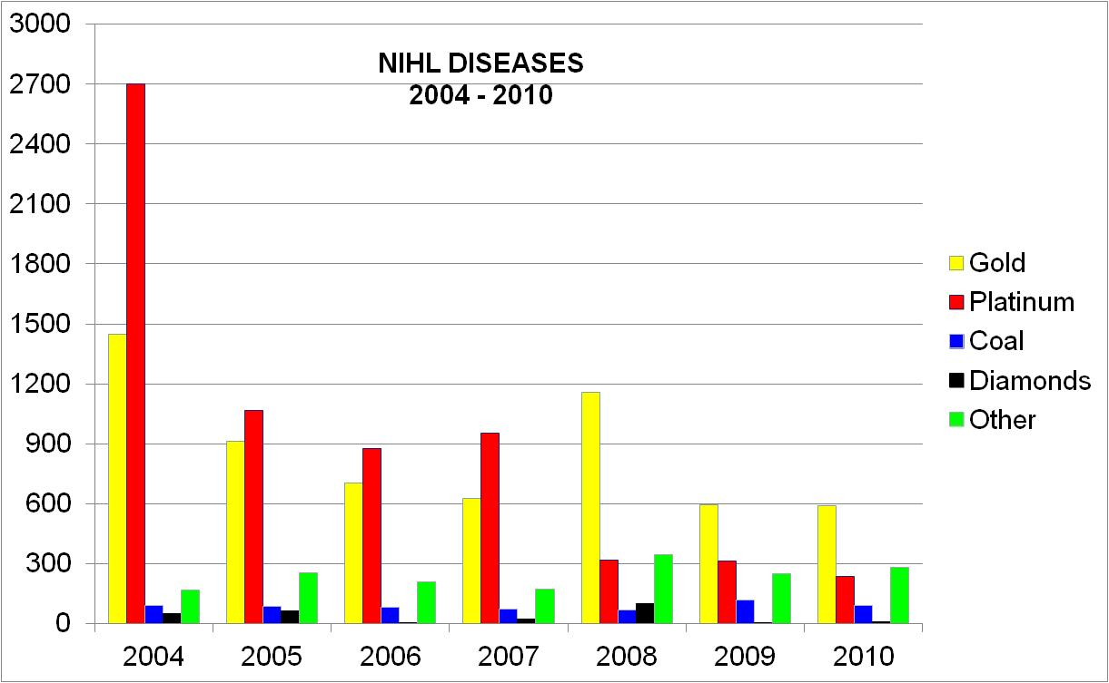
Health - Occupational Diseases
Source: Mine Health & Safety Council – 2012 MMPA Presentation
Same areas in the last few years
SILICOSIS
TB
NIHL
Notes:
12

Slide 13
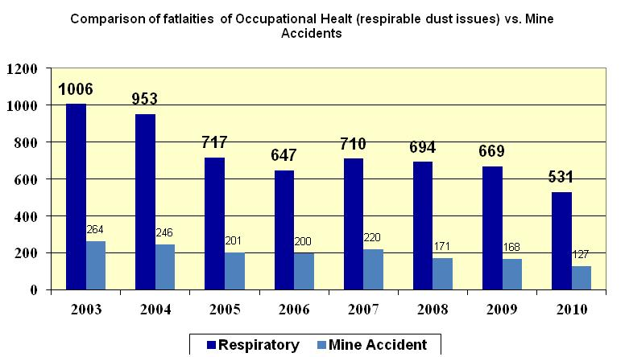
Safety vs. Health
Source: Mine Health & Safety Council – 2012 MMPA Presentation
Prior to 2003 milestones, focus was on safety
Respirable related deaths approx 80%

Slide 14
CLINICAL CAUSES OF DEATH
2003 - 2010
Source: Mine Health & Safety Inspectorate – 2012 Presentation

Slide 15
Source: Tia- Mari Hoffman (RFA – AGA & ANGLO Platinum) – MMPA 2012 Presentation
(Group representation expressed as a percentage of the total number of clients with pathology, not of the gross overall number of clients)
Notes:
The prevalence of pathology in the sample group is skewed, mainly due the fact that most assessments are performed for placement purposes of new recruits according to their physical and functional work capacity. New recruits mostly present without pathology. This may possibly be attributed to the fact that underlying pathology has not been diagnosed during their initial assessment.
Diagnoses are captured by means of the ICD 10 coding system and grouped according to ICD10 groups. In case of using ICD 10 groups for viewing of the distribution of pathology;
identification of pathology linked to lifestyle (e.g. hypertension, diabetes etc.) is not possible. Primary and secondary diagnoses captured on the database combined were used to report on the prevalence of pathology.
It is however important to note that the presence of medical conditions and injuries cannot be disregarded when performing assessment of work fitness; the risk assessment tool must be sensitive enough to quantify the impact of pathology on actual work capacity.

Slide 16
Implications
Do we have a Noise Problem?? YES
  Zero Harm Commitment
Do we have a Nose Problem RELATIVE to other OHS Challenges (Dust, TB, Fatigue and Safety)? NO
  NOTE: International standards for Safety = 34 deaths per year (more than 70% of the mark!!!!!)
  Noise = ???
  Should the Noise Problem compete for space and time with other OHS challenges (Dust, TB and Safety)??
  Should we have the have the same approach ??
  Is there a need for a Paradigm shift in our approach? YES; WHY?
    Hearing Conservation Programs in Mines: where do currently focus? & where should we focus?
Leading the change to zero harm

Slide 17
MOSH Noise Team Initiatives
1st Leading Practice - Noise Elimination (2008)
  Electric Drilling Machine
    World-wide accepted approach
    Not successful
      Right answer in a wrong paradigm – Galileo
    Is concept worth revisiting? YES
2nd Leading Practice - PPE and Administrative Control (2010 -2011)
  Hearing Protection Device , Training ,Awareness and Selection Tool (HPD _ TAS)
    Only segments of the Leading Practice implemented
    Is it worth revisiting?
    Prof. Cas Badenhorst ‘s MMPA presentation – “It is wrong to protect with PPE and then use medical surveillance to measure our success or failure . Occupational medicine and hygiene as disciplines are not the “silver bullet”
Leading the change to zero harm

Slide 18
MOSH Noise Team Initiatives (cont.)
Engineering Controls
  Suite of Leading Practices
    Need based approach
    Collaboration with suppliers
    Should they be the primary focus?
HCP | Leading Practice
Elimination ,Isolation etc | 1st Leading Practice - (Electric Drilling machines)
Engineering Controls | Ongoing - (Suite of Simple Leading Practices)
Administrative Controls | 2nd Leading Practice - (HPD_TAS Tool)
Personal Protective Equip. (PPE)
Leading the change to zero harm

Slide 19
The Direction of the Solution
Source: (Franz, et al., 1997; Dekker et al.,2007).
Comparison of reported average noise exposure in gold mines
Occupation (Gold Mines) | 1997 | 2007 | % Improvement
Driller | 111.4 | 105.5 | 200%
Winch Operator | 98.3 | 92.1 | 200%
Loco Driver | 95 | 95.3
Shiftboss | 104.9 | 89.7 | 500%
Miner | 103.2 | 90.4 | 400%
Stoper | 102.3 | 91.2 | 400%
Team Leader | 104.9 | 93.2 | 400%
Leading the change to zero harm
Notes:
Driller = 200% improvement
Winch Operator = 200% improvement
Shiftboss = 500% improvement
Miner = 400% improvement
Stoper = 400% improvement
Team Leader = 400% improvement

Slide 20
The Direction of the Solution
Source: None but can be inferred
HCP | Current
Elimination ,Isolation etc | 10%?
Engineering Controls | 10%?
Administrative Controls | 10%?
Personal Protective Equip. (PPE) | 70%?
Leading the change to zero harm

Slide 21
The Direction of the Solution
Source: None but can be inferred
Duty of Care & ALARP Zone
HCP | Current | Future
Elimination ,Isolation etc | 10%? | 60%
Engineering Controls | 10%? | 20 %
Administrative Controls | 10%? | 10%
Personal Protective Equip. (PPE) | 70%? | 10%
Leading the change to zero harm

Slide 22
The Direction of the Solution
Consensus with the Industry on the need for paradigm shift
  Consensus on future management of the Noise Problem i.e. need a Paradigm shift (Strategy, ALARP - buy Quiet Policy)
    Aligning HCPs and Noise Improvement programs to the suggested approach
    Challenges of an employee profile of a Developed Country viz Developing Country – Understanding of quality of life
    Do we REALLY NEED a MOSH Noise Team? Viz other pressing OHS Challenges
    Implications ??
    Manage variation viz IMPACT of variation? – employee profile
    Leading Practice Approach?
Leading the change to zero harm

Slide 23
Conclusion
Noise challenge is at a different phase (importance, maturity, tipping point, development, etc) than other MOSH teams and other OH challenges (e.g. MMPA conference)
  Need for a different approach
  Maybe leading practices need conducive paradigm
Focus on Source Elimination - revisit the source elimination concepts such as electric, hydraulic drills etc
  In-depth review of source elimination concepts – long term view
  Not as a leading practice but part of Mining System
    Longer timelines (>10 yrs)
    Report on the new mines, expansion projects etc that are now designed/ compatible for electric, hydraulic drills etc
    Standardized Buy quiet policies etc
  Not as compliance to the Mining Charter
  Reach a consensus on NHIL targets for next two & five years
Leading the change to zero harm

Slide 24
Conclusion (cont.)
Continue with Engineering controls but not as a primary focus for the MOSH Noise Team
  guide the Team on how to effectively manage and promote these Simply Leading Practices
  More of an Engineering challenge than a people challenge
‘Closure’ strategy on the HPD _TAS Tool Leading Practice - (remember the Hilti)
Leading the change to zero harm

Slide 25
Questions
Questions
Leading the change to zero harm

