Slide 1
THE MOSH ADOPTION SYSTEM
Dick Coutts
NOISE TEAM

Slide 2
Chamber of Mines
Learning Hub
Industry Adoption Teams
Dust
Transport & Machinery
Noise
FoG
2013 Milestones and Zero Targets for Health and Safety

Slide 3

Form a MOSH Industry Adoption Team
Identify Leading Practice
Source Mine
Demonstration Mine
Post Demonstration Workshop
COPA
Widespread Adoption
Form Industry Adoption Team

Slide 4

Identify a Leading Practice that will have a significant impact on improving safety or health in SA Mines
Identify Leading Practice
Source Mine
Demonstration Mine
Post Demonstration Workshop
COPA
Widespread Adoption
Form Industry Adoption Team

Slide 5
A leading Practice
Technology, process or practice
Leadership behaviour
Behavioural communications
How do we make it a MOSH Leading Practice ?
Identify Leading Practice
Source Mine
Demonstration Mine
Post Demonstration Workshop
COPA
Widespread Adoption
Form Industry Adoption Team

Slide 6
Interviews across industry
General perceptions of risk problem
Introduction of leading practice
What should leaders do and not do to get it adopted on their mine?
What messages should be communicated and how?
Identify Leading Practice
Source Mine
Demonstration Mine
Post Demonstration Workshop
COPA
Widespread Adoption
Form Industry Adoption Team

Slide 7
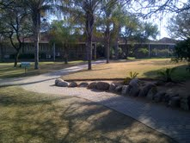
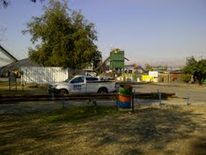
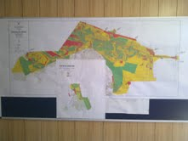
Document the Leading Practice at a Source Mine
Identify Leading Practice
Source Mine
Demonstration Mine
Post Demonstration Workshop
COPA
Widespread Adoption
Form Industry Adoption Team

Slide 8
Behavioural issues at Source Mine
One-on-one interviews
What is the leadership behaviour like
What behavioural communications are used
Identify Leading Practice
Source Mine
Demonstration Mine
Post Demonstration Workshop
COPA
Widespread Adoption
Form Industry Adoption Team

Slide 9
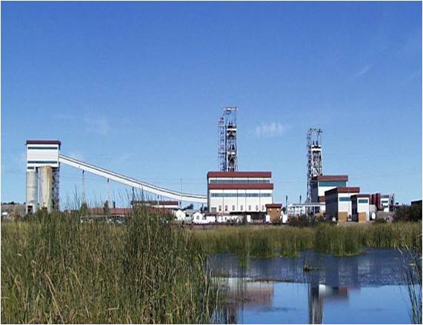
Demonstrate adoption at a Demonstration Mine
Identify Leading Practice
Source Mine
Demonstration Mine
Post Demonstration Workshop
COPA
Widespread Adoption
Form Industry Adoption Team

Slide 10



Mental Models of those using the leading practice
One-on-one interviews
Develop Leadership Behaviour plans
  How must leaders act and not act
Develop Behavioural Communication plans
  What messages must be communicated that change people’s behaviour and through what means
Identify Leading Practice
Source Mine
Demonstration Mine
Post Demonstration Workshop
COPA
Widespread Adoption
Form Industry Adoption Team

Slide 11

Hold a Post Demonstration Workshop
Identify Leading Practice
Source Mine
Demonstration Mine
Post Demonstration Workshop
COPA
Widespread Adoption
Form Industry Adoption Team

Slide 12

Form a COPA (Community of Practice for Adoption)
Tell
Questions
?
Share
Identify Leading Practice
Source Mine
Demonstration Mine
Post Demonstration Workshop
COPA
Widespread Adoption
Form Industry Adoption Team

Slide 13

Widespread Adoption in the Mining Industry
Identify Leading Practice
Source Mine
Demonstration Mine
Post Demonstration Workshop
COPA
Widespread Adoption
Form Industry Adoption Team

Slide 14

THANK YOU

