Slide 1


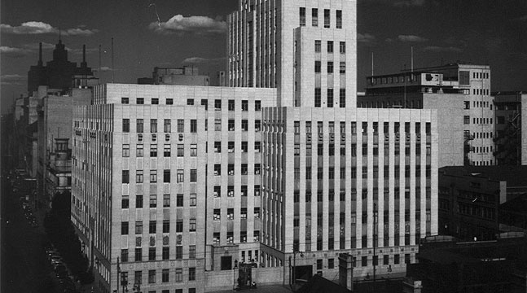

WORKSHOP THEME
Preventing Hearing loss viz Preventing Compensating for hearing loss
Dr. Anita Edwards - CSIR
CHAMBER OF MINES OF SOUTH AFRICA
Working together for a sustainable future since 1889

Slide 2

2013 Industry Milestones
  December 2008 - No deterioration in hearing greater than 10%PLH shift
  December 2013 – Total noise emitted by all equipment in any workplace<110dBA
Leading the change to zero harm

Slide 3
Prevent Hearing Loss not Compensation for NIHL
Need For Paradigm Shift
1998 to 2008 = R890 million in NIHL compensation claims
Leading the change to zero harm

Slide 4
Despite efforts towards NIHL reduction - In 2011 - 948 NIHL cases were reported to DMR
Need For Paradigm Shift
Leading the change to zero harm

Slide 5
Paradigm Shift is needed
  Prevent Hearing Loss not Compensation for NIHL
Leading the change to zero harm

Slide 6
Preventing Compensation for NIHL
  Focus on compliance only
  Only achieve minimum standard
  Focus needs to be on best practice
  Focus needs to be on Zero Harm
Leading the change to zero harm

Slide 7
Preventing Compensation for NIHL
  Report on 5%PLH shift
  Report on 10%PLH shift
  Permanent hearing loss
  Failed systems- not continual improvement
  Annual hearing test = “Documenting the path to deafness”
Leading the change to zero harm

Slide 8
Preventing Compensation for NIHL
  All have a “COP for Noise”
  If we are honest that is a COP for noise measurement
  It has very little to say about preventing hearing loss
  Revised version is in the pipeline that is much more specific about preventing hearing loss… but where is it???
Leading the change to zero harm

Slide 9
Preventing NIHL
  If we really want to prevent hearing loss we have to use Hearing levels as the measure of our success
Leading the change to zero harm

Slide 10
Preventing NIHL
  Hearing and the development of hearing loss is:
  individual
  influenced by many factors
Leading the change to zero harm

Slide 11
Preventing NIHL
  Therefore prevention of NIHL requires systems that:
  Take individual differences into account
  Have processes that manage prevention on individual basis
  Have systems that manage large numbers of workers
Leading the change to zero harm

Slide 12
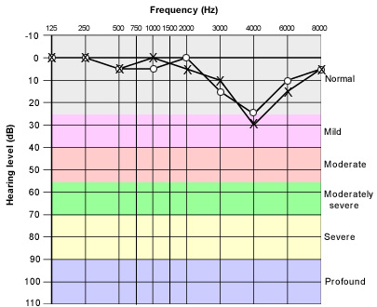
Noise Induced Hearing Loss
Leading the change to zero harm

Slide 13
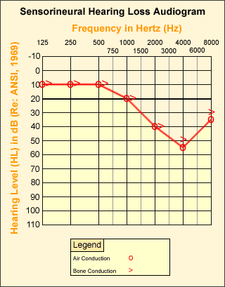
Noise Induced Hearing Loss
Leading the change to zero harm

Slide 14
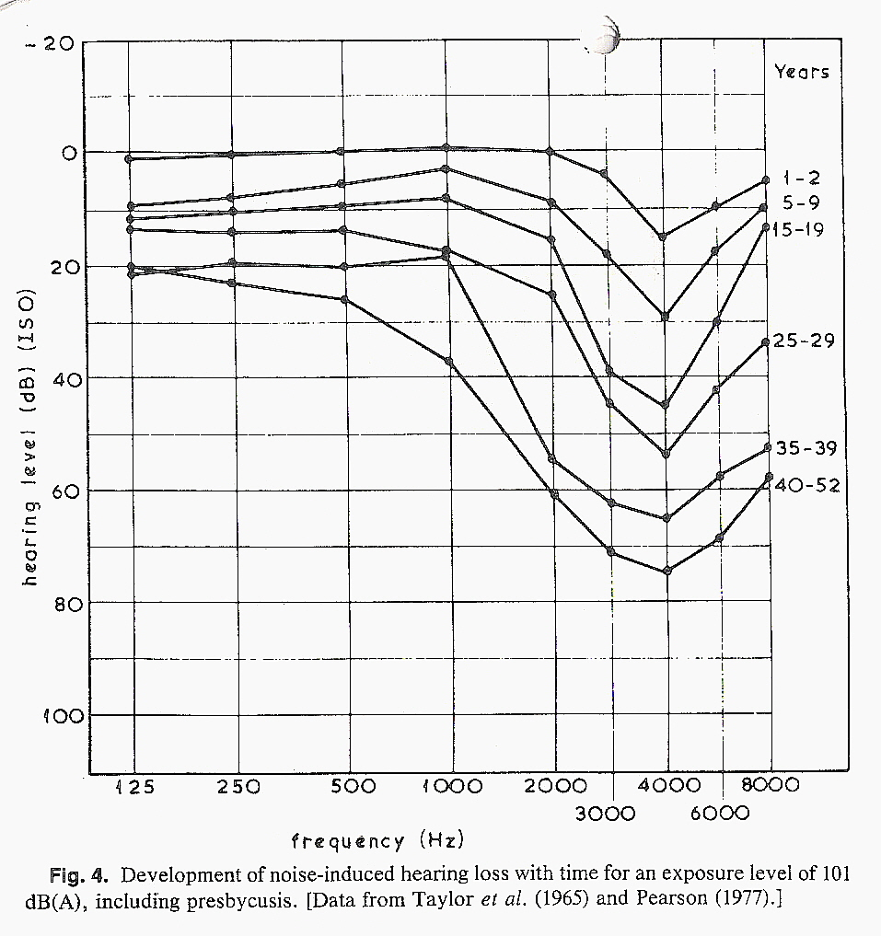
Noise Induced Hearing Loss
Leading the change to zero harm

Slide 15
Noise Induced Hearing Loss
Leading the change to zero harm

Slide 16
Noise Induced Hearing Loss
Leading the change to zero harm

Slide 17
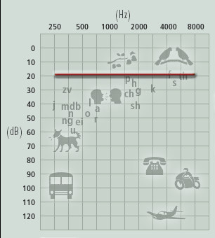
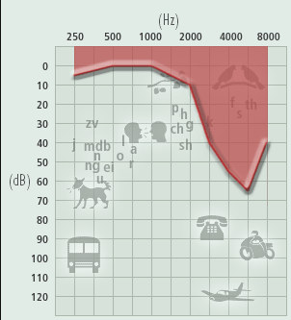
Noise Induced Hearing Loss
With all thresholds at 20dB = 3% PLH
With all thresholds <15dB =1.1% PLH
PLH=9.4%
Leading the change to zero harm

Slide 18
Quality of life
Hearing Handicap Inventory for Adults (HHI-A)
Category of Hearing handicap | Number of questions | Area probed by questions | Examples of questions
Situational hearing Handicap | 12 questions | Investigates hearing handicap in different everyday life situations | Group discussions, use of telephone, complex listening situations
Emotional hearing handicap | 13 questions | Investigates hearing handicap with reference to emotional well being of the affected person | Impact on self-image, frustrations experienced, limitations on lifestyle as a result of hearing loss
Leading the change to zero harm

Slide 19
Quality of life
Hearing Handicap Inventory for Adults (HHI-A)
PLH categories | Degree of hearing handicap
<4% | None
4-10% | 40-50%
10-40% | 50-60%
>40% | >60%
Leading the change to zero harm

Slide 20
Preventing NIHL
  Emphasis must be based on individual fitting of HPDs:
  Personal noise exposure
  History of ear problems
  Shape of ear canal
  Hearing levels
  Effective fitting
Leading the change to zero harm

Slide 21
Preventing NIHL
Emphasis must be based on early identification of NIHL
development:
  High risk employees e.g. exposure, smoking, awareness training, history of ear problems
  10dB shift in 2-3 frequencies
  Otoacoustic emission shift
Leading the change to zero harm

Slide 22
Preventing NIHL
Emphasis must be on leading indicators:
  Temporary threshold shift
  Presence of tinnitus
  Awareness training results
  HPD compliance for use
  HPD fit testing
  Otoacoustic emission shift
Leading the change to zero harm

Slide 23
End
THANK YOU

