Slide 1

MOSH Noise Team
2013 Strategic Plan
8 March 2013
1

Slide 2


Background
All mining equipment to be less than 85dBA
Technology to detect early NIHL
NIHL systems that take individual differences into account & processes that manage NIHL prevention on an individual basis
Real leading Indicators for early NIHL Prevention
All employees to be knowledgeable and appreciate NIHL hazard
Prevention of NIHL to be part of everyone’s KPIs
2

Slide 3
BACKGROUND
Milestone 1
After December 2008, the hearing conservation programme (HCP) implemented by the industry must ensure that there is no deterioration in hearing greater than 10% amongst occupationally exposed individuals.
Milestone 2
By December 2013, the total noise emitted by all equipment installed in any workplace must not exceed a sound pressure level of 110 dB (A) at any location in that workplace (including individual pieces of equipment).
Chamber of Mines 2011 Strategic Plan and Learning Hub exposed individuals.
3

Slide 4


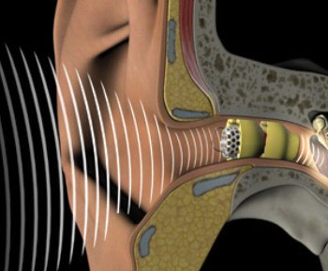
REALITY OF NIHL HAZARD
10%PLH shift is not sensitive enough for ‘Zero Harm to ears’ i.e. Hearing loss happens long before 10%PLH
4% Percentage Loss of Hearing (PLH) results in significant hearing handicap
NIHL is 100% preventable
4

Slide 5
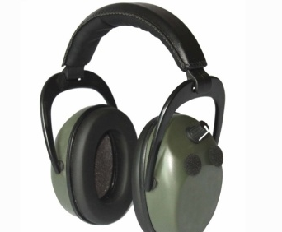


REALITY OF NIHL HAZARD
SANS 10083:2012 requires implementation of preventative intervention strategies at 6.4% PLH shift
2006 SIMRAC baseline study showed that 73% of mineworkers are exposed to levels above 85dBA
NIHL impacts differently on different individuals
5

Slide 6
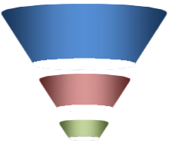

7 Mining Houses are now adopting @ different stages
Adoption is through Mine Executives not OH
Leading Practices
HPD TAS
Source Elimination
Cost of Noise
HPD TAS
Electric Drill
Part of Mine Design
Source Elimination
Cost of Noise
Integrated Hearing Conservation program
Electric Drill
Eradicate NIHL
Current Machines – Poor response
Future Mines -
Drilling Model research
Buy Quiet
6

Slide 7
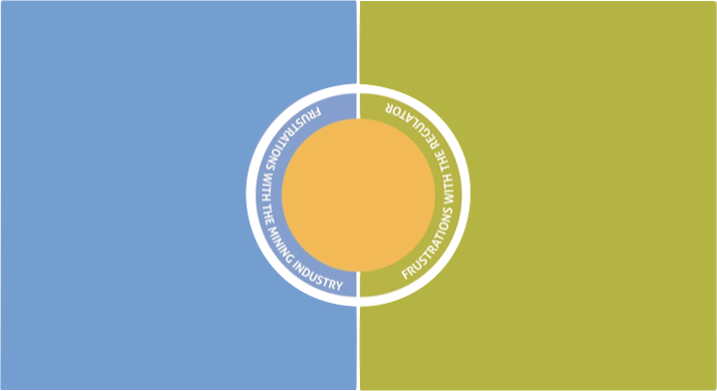
CHALLENGES
Safety is prioritized more than Occupational Health (OH)
Safety is prioritized more than Occupational Health (OH)
Absence of ‘real’ leading indicators for NIHL prevention
No Clear long term strategies to combat NIHL
Original commitments are not met – i.e. be it Mining Charter commitments to adopt HPD TAS tool, Communicating the commitments to employees on the ground, provision of potential practice, feedback on discussion documents etc
7

Slide 8
CHALLENGES
General lack of knowledge on Noise issues by deciders.
Deciders are knowledgeable on safety issues but tend to abdicate OH issues (knowledge and execution) to Hygienist who are mostly operating at levels 1 and 2 (using the Stratified Systems Theory).
Solutions are long term in nature, multi disciplinary and should be integrated across different organizational functions.
Availability of reliable data
8

Slide 9
CHALLENGES
Also related to (iii), OH departments are not optimally structured
The current paradigm within the industry is that of preventing NIHL compensation rather than prevention of NIHL
General lack of knowledge of the adoption process
Absence of ‘real’ leading indicators for noise
9

Slide 10
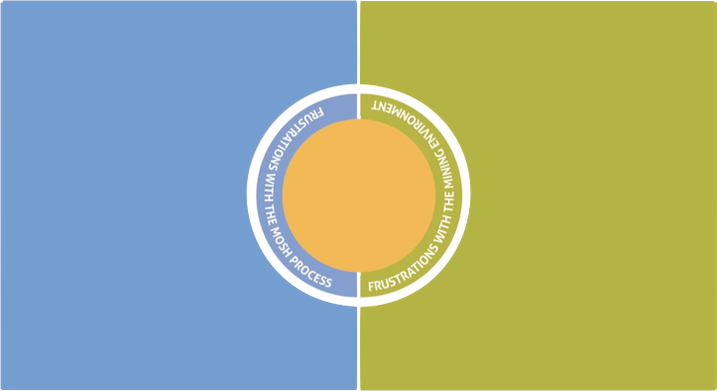
CHALLENGES
MOSH process is difficult to understand (user friendliness) and is open to different interpretations, assumptions etc
There is a tendency to force operational (mining) realities to satisfy the MOSH Process.
Current mining challenges (labour unrest, retrenchments, Higher operational costs, lower metal prices etc)
10

Slide 11
CHALLENGES
The nature of the noise hazard requires a long-term and systems-based thinking approach to the solution. This necessary approach is not there in the current noise set-up in the industry hence potential leading practices from the industry lack the ‘wow’ factor.
Lack of appreciation that OH (Noise) needs a longer term focus, multi disciplinary and integrated strategy to become a true leading practice
11

Slide 12
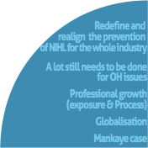

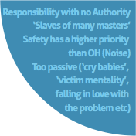
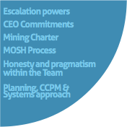
swot analysis
16
12

Slide 13

STRATEGIC OBJECTIVES
The strategic direction of the Noise Team is that of ending NIHL in the mining industry and have a plan in place for continued prevention of NIHL in the industry.
Conclude the adoption of HPD TAS Tool by October 2013
Source Elimination Initiatives
  Industry wide source elimination strategy – multi disciplinary approach and a
  5 year plans. The strategies to be driven from the CEOs
  Well managed and utilized ‘Source elimination repository’ for the industry
  Simplify and further educate the industry on Buy Quiet Policy
  Real cost of noise - simplify and educate
Identify & Facilitate a new leading practice by Dec 2013 – PW
2013 Strategic Objectives
Stakeholder Buy-in
  Right message at the right time to deciders
  Proactive - quick escalation
  Increased perception of value
13

Slide 14

STRATEGIC OBJECTIVES
2014 Strategic Objectives
Conclude the Drilling Model numerical model that will be able to evaluate the contributions of individual noise mechanisms on a drilling machine
Wide-spread adoption of the leading practice identified in 2013??????
Conscientise the industry the meaning of an industry-wide buy-in process
Increase the use of social media to fight NIHL
14

Slide 15


STRATEGIC OBJECTIVES -
Critical Strategic Objectives that beyond the current Team Mandate
Who is responsible for the Pre Cursors?
WHAT makes Noise Leading Practices to be products of SIMRAC researches ?
Integrated HCP is currently being applied but needs to be tested independently
Industry to be reporting on Hearing Loss Prevention– Including NIHL Leading indicators
NIHL prevention strategies (systems, measurements, awareness etc) are at par with those of developed countries.
15

Slide 16
Detailed Scoping of 2013 Strategic Objectives
Complete the HPD TAS Adoption by Ctober 2013
Obstacles | Intermediate Objectives | Responsibility
Current Mining Challenges – (Labour unrest, retrenchments) | Communicate the risk to Deciders (Learning Hub & industry) | All By 8 February 2013
Mines not honoring original commitments | Mine Adoption plans to be signed off by MOSH Taskforce members | All On going
Dealing with ‘late comers’ | Intensify HPD TAS perception of value up to June 2013 | All By June 2013
Continuity of Project Team members – resignations & redeployments | Pro activeness – quick escalation | All Ongoing
Capacity of the Noise Team and Learning Hub | POLC & standing agenda item on Noise Team weekly meetings | JDB Ongoing
16

Slide 17
Detailed Scoping of 2013 Strategic Objectives
Facilitate a New Leading Practice by End 2013
Obstacles | Intermediate Objectives | Responsibility
Current Mining Challenges – (Labour unrest, retrenchments) | Communicate the risk to Deciders (Learning Hub & industry) | Report and presentation to deciders By 21 March 2013
Capacity of the Noise Team and Learning Hub – Overwhelming response to the adoption of HPD TAS | Critical Chain Project Management (CCPM) principles | HG Ongoing
Improper Planning | CCPM principles and standing Agenda item on Noise Team Meetings | HG JDB
DC going on leave in April 2013 | Plan using ALP principles | HG Feb 2013
17

Slide 18
Detailed Scoping of 2013 Strategic Objectives
Source Elimination - Modeling of noise sources in a pneumatic rock drill by March 2014
Obstacles | Intermediate Objectives | Responsibility
SIMRAC funding | Communicate the risk to Deciders (Learning Hub & industry) | All By 8 February 2013
Research might take too long & general project management issues | CCPM principles and quick escalation | HG Ongoing
Expertise (facility, knowledge etc) | CCPM principles and quick escalation | HG Ongoing
Validity and verification | CCPM principles and quick escalation | HG Ongoing
Intellectual property issues | Clarify before project commencement | HG Ongoing
18

Slide 19
Detailed Scoping of 2013 Strategic Objectives
Source Elimination – (Repository, Cost of Noise, Buy Quiet Policy)
Obstacles | Intermediate Objectives | Responsibility
Industry feedback and information on practices on offer | Proactiveness & quick escalation Communicate the risk to Deciders (Learning Hub & industry) | HG By 8 February 2013
Un availability of source elimination initiatives – even when offered (power point practices) | CCPM principles and quick escalation | HG Ongoing
Capacity of the Noise Team and Learning Hub | POLC & standing agenda item on Noise Team weekly meetings | JDB Ongoing
Lack of a ‘wow’ source elimination practice | Communicate the risk to Deciders (Learning Hub & industry) Consider international leading practices | HG Ongoing
19

Slide 20
Detailed Scoping of 2013 Strategic Objectives
Stakeholder Management (Critical)
STAKEHOLDERS
Sponsor – (CEOs) Quarterly meetings – Reports and presentations Assist in penetrating the Coal Mines Increased Perception of Value (POV) – Quality, Scope & Time. | MOSH Taskforce Monthly updates Quick escalation
GEE/ HPC & Other relevant Keep updated Focus on the Involvement of Line Management (Senior Production People) | DMR Bi Annual Meetings Keep Updated OH Data & Future legislative initiatives
UNIONS Site specific Insist on their participation in all activities | LEARNING HUB Monthly Meeting Quick escalation Honesty
20

Slide 21
CONCLUSION
All mining equipment to be less than 82dBA
Technology to detect early NIHL
Prevention of NIHL to be part of everyone’s KPIs
Real leading Indicators for NIHL Prevention
All employees to be knowledgeable and appreciate NIHL hazard
NIHL systems that take individual differences into account & processes that manage NIHL prevention on an individual basis
21

Slide 22
Questions
22

