Slide 1




Noise Team Monthly Report
17 May 2012
CHAMBER OF MINES OF SOUTH AFRICA
Working together for a sustainable future since 1889

Slide 2

Table of Contents
Introduction
Activities
May/June Challenges
Highlights
Leading the change to zero harm

Slide 3
Introduction
Major activities
  Visits and Promoting the HPD_TAS_ Tool to potential industry adopters and implementers
  Sponsor Meeting
  Follow-up of noise initiatives presented on the Tripartite Forum
  Scoping and Planning Industry-Day of learning/workshop
Leading the change to zero harm

Slide 4
HPD_TAS Tool
Activities - Mine Visits (Training and demo-Industry members allocated)
  Petra Diamonds SHE Peer Review Presentation (Dust & Noise)
  Training 120 safety reps at Lonmin
  Khuthala Mine (1st contact)
Leading the change to zero harm

Slide 5
HPD_TAS Tool
Future Activities - Mine Visits (Training and demo)
  Lonmin - James Price (1st Contact COM)
  Exxarro - Busi Matolo (Await confirmation)
  Afrimat - Monty Coleman (ASPASA-Glen Douglas)
  Tranter - Bill Murray (OEM)
  Murray and Roberts - Johan Davel (1st Contact & Await confirmation)
  ARM - Tsietsi Lentana (Nkomati & Two Rivers)
  Sasol -Inus Labuschagne ( Assist with stakeholder requests)
  Continue with suppliers (Atlas Copco, Sandvik)
  Arnold Theron – Group Manager Coal (Kriel)
Leading the change to zero harm

Slide 6
Possible Simple Leading Practices
Activities
  Utilising information from NW tripartite forum;
    Contacting the presenters and write ups
Leading the change to zero harm

Slide 7
“Buy quiet policy”
Activities
  BECSA BHP Billiton
    Process not proven on the ground
  Contacted and planned visit to Kumba Iron Ore
    Still pending
  Sasol
    Procurement Process not proven yet
    Scrubber system failed as a possible LP
Future Activities
    Benchmarking with International Standards (NASA, Australia)
Leading the change to zero harm

Slide 8
May 2012/June - Challenges
Operational Challenges
  ‘Partners are economic with the truth
Leading the change to zero harm

Slide 9
Highlights
  Increased HPD_TAS_Tool participation
  Lonmin – Training of Safety Representatives
  Presentation an Medical Council Seminar
Sponsor meeting held 26 April 2012
  Understands his role
  Quantitative Targets for the next two years (e.g. reduce NIHL claims from 900 to 500
  Annual Plan
  Quarterly feedback
Increased visibility
    Petra Diamonds, Xstrata, Khutala
    Tranter Energy Mining supplies (OEM’s)
    BECSA, Shaft Sinkers, ARM, Lonmin
    Mine exhibition- Witbank
    Presentations and industry visits
    Attending Tripartite forums & AMMSA
    Rand Mutual Assurance interaction etc
Leading the change to zero harm

Slide 10
End
THANK YOU

Slide 11
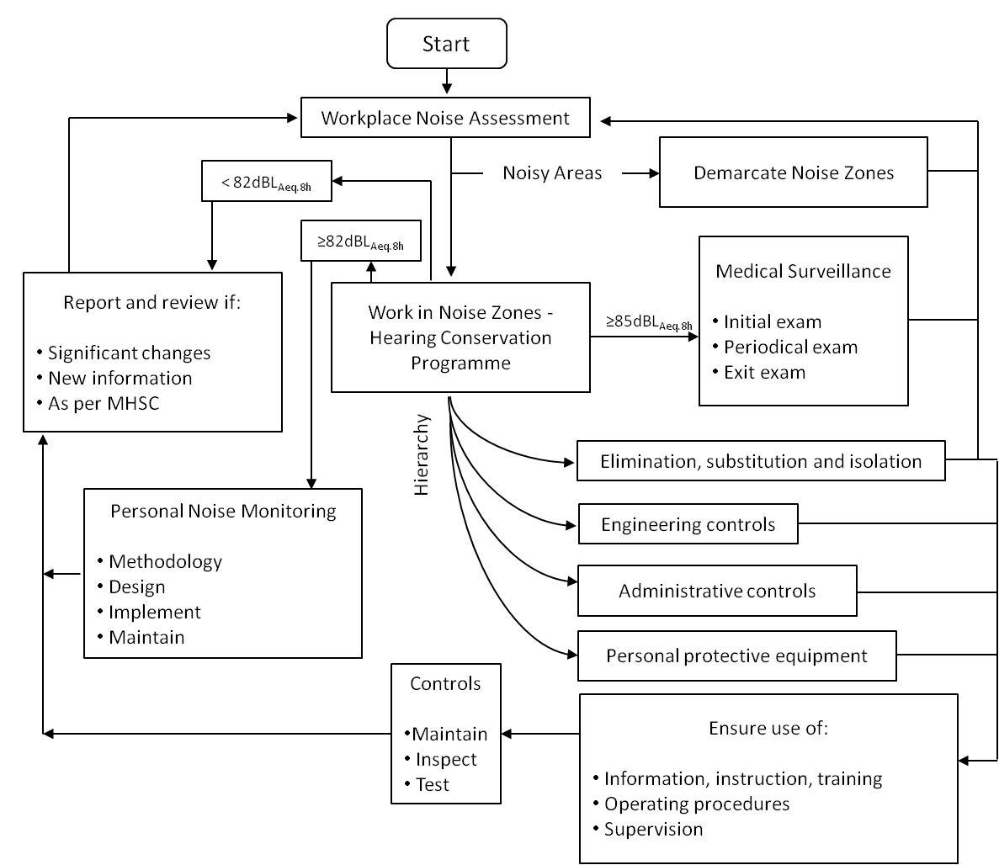
The Direction of the Solution
Leading the change to zero harm

Slide 12
The Direction of the Solution
Duty of Care & ALARP Zone
HCP | Current | Future
Elimination ,Isolation etc | 10%? | 60%
Engineering Controls | 10%? | 20 %
Administrative Controls | 10%? | 10%
Personal Protective Equip. (PPE) | 70%? | 10%
Leading the change to zero harm

