Slide 1


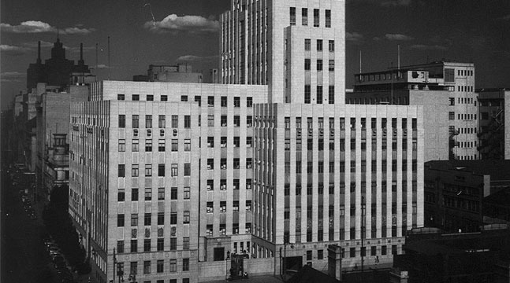

Aspects of the MOSH Leading Practice Adoption System
CHAMBER OF MINES OF SOUTH AFRICA
Working together for a sustainable future since 1889

Slide 2

Introduction
Approximately how many Leading Practices can be adopted from the Learning Hub per year by the industry?
  Alignment with Industry Expectation
Where should most energy (time, resources etc) of the Adoption Teams (or Learning Hub) be FOCUSED on
POSSIBLE Operational measurement strategy for the Teams and Hub
Leading Practice Adoption System MACRO DESIGN
Aligning to the Business world approach
Exploring the systems approach of the Leading Practice Adoption System
    How many weakest links in a chain?
    What determines the system’s Throughput?
Leading the change to zero harm

Slide 3
Systems Approach Background
Systems Approach Model
    System: A set of interdependent processes working together to achieve a common goal
    How many weakest links in a chain?
    What determines the system’s Throughput?
A
B
C
D
E
Leading the change to zero harm

Slide 4
Systems Approach Background
      Capacity Variations
      Murphy exists in reality
      Interdependencies
      Fluctuations
      Complexity
        Number of interdependent constraints managed (Physical and Non-physical)
10
20
5
15
25
Leading the change to zero harm

Slide 5
Systems Approach Background
      An hr lost at the bottleneck is an hr lost for the whole system
      Bottleneck determines the system throughput
      Bottleneck is the ‘drumbeat’ of the system
      Plans must be staggered around the bottleneck
10
20
5
15
25
Leading the change to zero harm

Slide 6
Systems Approach Background
    Physical Constraint
10
20
15
25
5
Starvation
BUFFER
BUFFER
Blockage
Identify the weakest link in the system
Exploit the weak link
Subordinate All to the Exploitation plan
Elevate the Constraint (Investment)
Go Back to 1.
Leading the change to zero harm

Slide 7
Systems Approach Background
    Non-Physical Constraint
Cough
Fever
Backache
Leg cramps
Chills
Leg cramps
Muscle
aches
Backache
Cough
Fever
Chills
Defence
Mechanism
Breakdown
Lungs
Compromised
In science, there is no
Complexity
PNEUMONIA
Leading the change to zero harm

Slide 8
Leading Practice Adoption System
MOSH Leading Practice Adoption System - identifies Leading Practices in health and safety and then helps with their widespread adoption across industry
Identification Phase – Identifying leading practices with greatest potential to address major risks
Documentation Phase – Documenting the leading practice at the source mine where it already applied
Demonstration Phase – Demonstrating the leading practice at another operating mine
Facilitation Phase – Facilitating the widespread adoption of the leading practice
CORE PROCESS
Leading the change to zero harm

Slide 9
Current Operating Philosophies
Identification
#1 Push LPs to the Bottleneck
Documentation
#3 Silo (Individual) Plans
Demonstration
#2 ‘Hands-off-approach’ with Support if requested by the Industry
Facilitation
Leading the change to zero harm

Slide 10
Future Operating Philosophies
Identification
#1 Pull according to the Bottleneck capacity
BOTTLECK SETS THE DRUM BEAT
Documentation
#3 Work according to the Integrated plan
Demonstration
#2 Marketing and Selling Mode of Operation during facilitation
Facilitation
Leading the change to zero harm

Slide 11
Future Operating Rules
Bottleneck Sets the Drum Beat
  Annual, Team, Leading Practices, targets & Plans are set from the constraint i.e. Pull from the facilitation stage)
  Facilitation phase has the first priority
  Progress reporting is based on;
    the impact to the facilitation stage e.g. delays to the facilitation phase
    Facilitation phase activities (70% of them should be planned)
  Stable & Rolling plans
Leading the change to zero harm

Slide 12
Future Operating Rules
Marketing and Selling Mode of Operation during facilitation
  Compelling Value Case (corn to spread)
  Follow comprehensive selling procedure
    Manage the facilitation phase like a sells funnel
Leading the change to zero harm

Slide 13
Future Operating Rules
Work according to the Integrated Plan
  Agree and signoff on Monthly, Quarterly and Annual plans
  Progress measurement should be based on the impact to the GOAL (critical path, chain, EV etc)
Leading the change to zero harm

Slide 14
Next Steps
Micro Design
  Work Cycles (at most 6 pages) – Inst. Memory
    Process Flows
    KPIs and KPAs
    Critical Interfaces
    Adds/destroys value
    Work designs per each phase (critical elements only)
    Technology & assets etc
  Non Physical Constraint
Leading the change to zero harm

