Slide 1
MOSH Adoption Team Training
January 2014

Slide 2
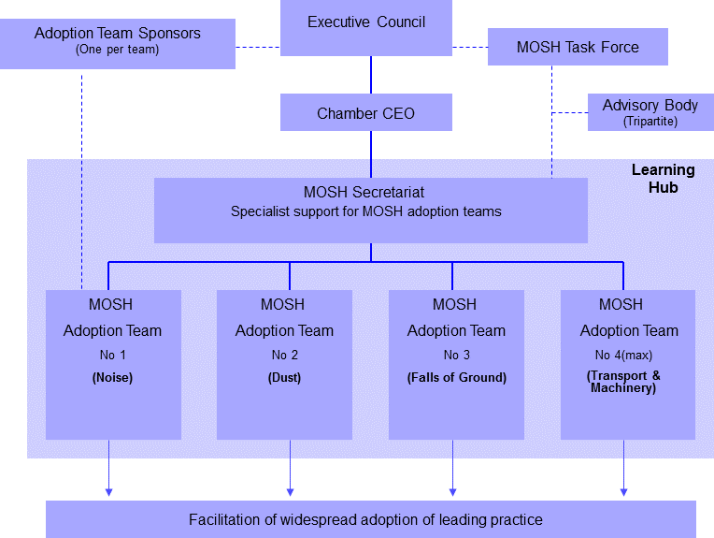

Slide 3
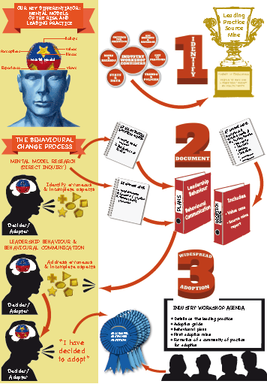

Slide 4
Differentiators
Behavioural communication
Leadership behaviour
Specialist secretariat
Communities of practice for adoption
Industry involvement

Slide 5
Leading Practice
Behavioural Comms
Practice
Leadership behaviour
A leading practice comprises three components:
What
How & Why

Slide 6
Behavioural Dimensions

Slide 7
MOSH Process: Key differentiators
Beliefs
Perceptions
Values
Mental Model
Experience
Biases
“All behaviour have a knowable set of causes”

Slide 8
Phase 1: Direct inquiry
“Unpack” the mental model to identify aids and barriers to adoption
Look for erroneous and incomplete elements
Beliefs
Biases
Views
Values
Perceptions
Knowledge
Adopter/
Decider/
Other stakeholder

Slide 9
Phase 2: LB & BC Plan
LB Plan
A
B
C
Enabling Environment
through BC Plan

Slide 10
Phase 3: Leadership behaviour and behavioural communication
Beliefs
Biases
Views
Values
Perceptions
Knowledge
Adopter/
Decider/
Other stakeholder

Slide 11
Desired outcome: Voluntary adoption
Beliefs
Biases
Views
Values
Perceptions
Knowledge
Adopter/
Decider/
Other stakeholder

Slide 12
Step 3: Adoption
“ I want to adopt the leading practice”
Adopter/
Decider/
Other stakeholder

Slide 13
Identify

Slide 14
Leading Practice Oxford: Practice: “the customary, habitual, or expected procedure or way of doing of something”
An existing practice
That is particularly effective in delivering good occupational health and safety performance
Has the potential for widespread adoption
Chosen after a rigorous selection procedure
Comprise technical aspects as well as practice specific behavioural aspects

Slide 15
Simple Leading Practice
An existing practice
That is particularly effective in delivering good occupational health and safety performance
Has the potential for widespread adoption
Classified after a rigorous selection procedure (doc #50; 51 & panel decision)
Comprise technical aspects as well as generic behavioural aspects

Slide 16
Difference between LP & SLP
No significant adjustment to other existing practices on the mine
Few people and levels of management
Few implementation steps
Little or no training
Little or no external assistance
No materially negative impact on people

Slide 17
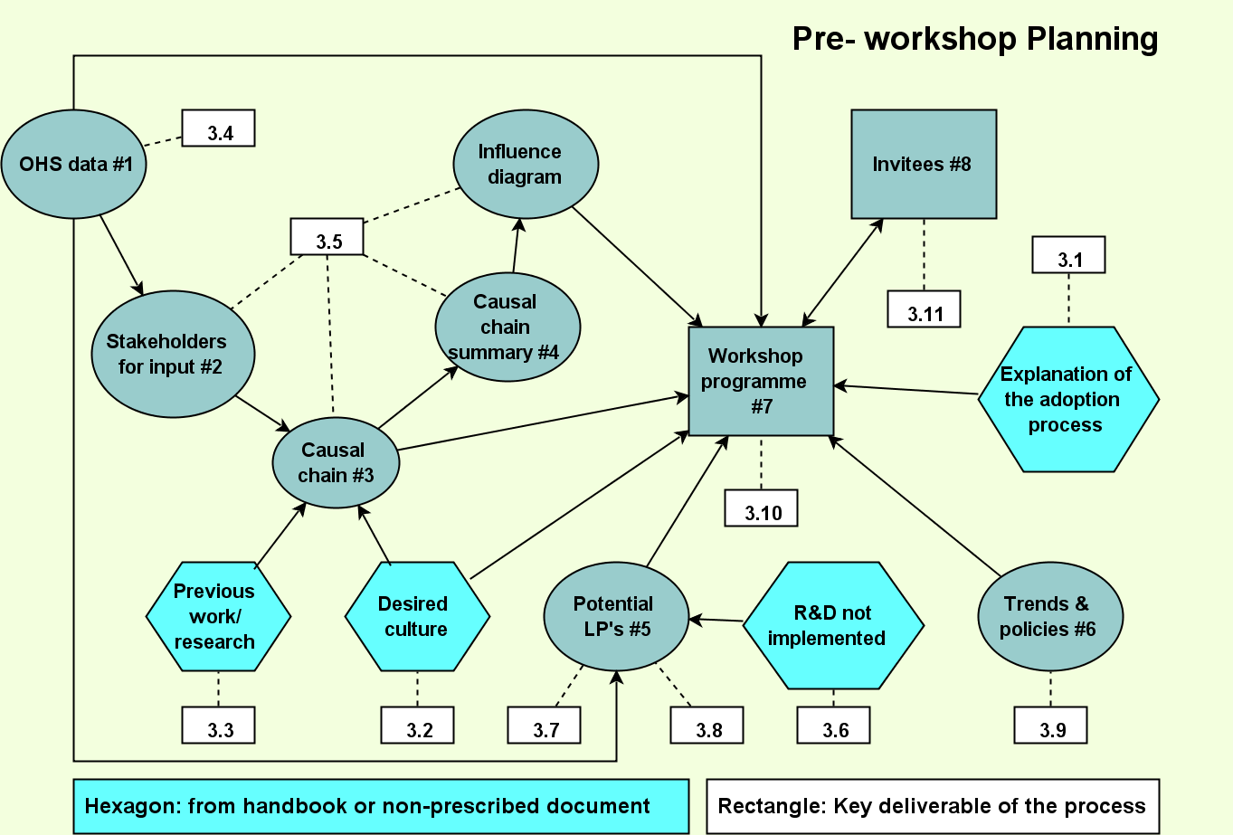
Identify

Slide 18
Influence diagram – The dust risk story
Ventilation planning
Ventilation control
Ventilation management
Ore Body
Source/ process
Mobility
Engineering: Predictive maintenance
Controls
Exposure
Mining:
Maintaining systems
Finance & commercial systems
HR systems
Biological outcomes
Health outcomes

Slide 19
The Planning Workshop
Explain desired culture
Consider:
Scope for improvement
Potential extent of adoption
Make or break issues
Key insights/ research
OHS data
Select LP
Shortlist potential LP’s
Trends & policies
Influence diagram
ID & prioritise potential adoption mines
List of practices
Develop master plan
Criteria for selection
CHAMBER OF MINES OF SOUTH AFRICA
Putting South Africa First

Slide 20
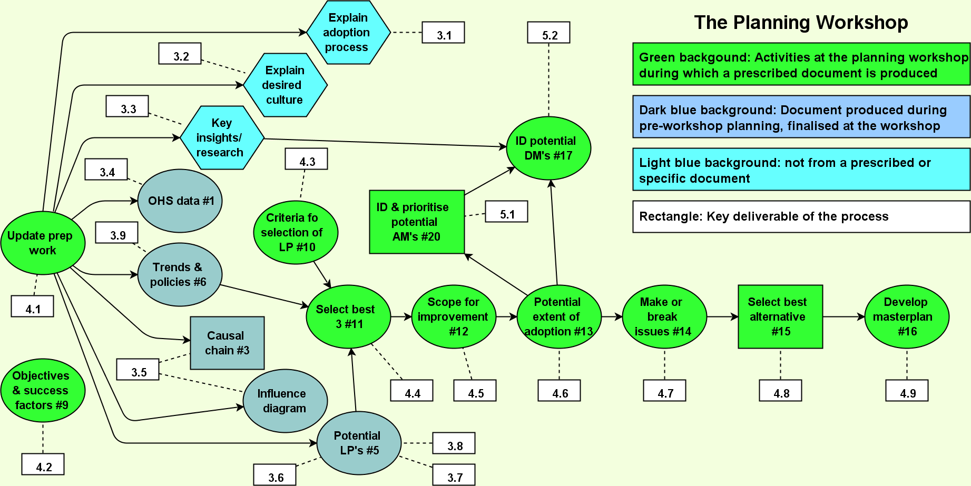

Slide 21
Document

Slide 22
Source Mine Investigation Report
Overview
Executive Summary
Introduction – The leading practice & risks addressed
Planning of necessary investigations
Development of the generic behavioural plans
Behavioural communication plan for deciders
Documenting the leading practice at the source mine
Development of generic value case
Summary of key lessons learned
Conclusion
Annexes
Development of behavioural plans (section 5.12)
Investigations at the source mine (section 5.11)
Development of the generic value case (section 5.13)

Slide 23
Leading Practice Adoption Guide
Part 1 – Strategic context
The problem addressed
Summary description of the practice
Summary of documented performance and impacts
The generic value case

Slide 24
Leading Practice Adoption Guide
Part 2 – Detailed adoption guidance
Facilitate adoption decision
Secure support for adoption
Establish an effective mine adoption team
Prepare initial plan for adoption
Initiate baseline monitoring programme
Establish effective relationship with COPA
Update key stakeholders on progress
Plan and conduct direct enquiries
Customise generic behavioural plans
Harmonise leading practice with mine standards
Assess risks and develop final adoption plan for approval
Develop training and communication materials
Brief and train key mine persons
Implement pilot adoption of the practice
Monitor, evaluate and report on performance
Finalise and implement mine-wide roll-out plan

Slide 25
Leading Practice Adoption Guide
Part 3 – Details of the leading practice
Technical elements
Behavioural communication
Leadership behaviour

Slide 26
Leading Practice Adoption Guide
Appendix A: Supporting work documents
A1 Framework of overall adoption plan
A2 Adoption process checklist
A3 Systematic leading practice review process
A4 MOSH Brochure outlining the Adoption Process
A5 Guidance document for the eight-step customisation process
A6 Expert causal chain risk summary – for customisation
A7 Likely key stakeholders and adopters
A8 Identification of adopters and stakeholders at the mine
A9 Guide to interviewers for direct enquiry interviews
A10 Questions for direct enquiry interviews at the mine
A11 Analysis worksheet for direct enquiry responses
A12 Generic mental models report
Appendix B: Supporting reference documents
B1 Example documents / communications / signage / etc
B2 Example training material

Slide 27
Facilitate widespread adoption

Slide 28
Widespread adoption
Industry Workshop
Introductory presentation
Outline of the adoption system
Outline of the leading practice
Presentation on Source Mine report
Presentation on Adoption Guide
Outline of envisaged COPA
Discussion –implementation difficulties, key issues for the COPA
Way forward
Signing up of COPA membership

Slide 29
Widespread adoption
COPA

