Slide 1
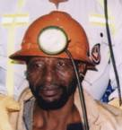
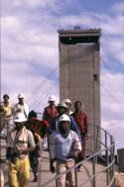
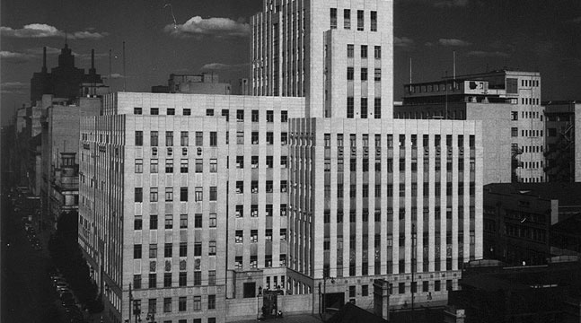
MOSH Leading Practice Adoption System - NOISE Team Initiatives
Noise Team
CHAMBER OF MINES OF SOUTH AFRICA
Working together for a sustainable future since 1889

Slide 2
Introduction
…all employees wear HPDs from bank to bank…
(is this a common practice/motto)?
…do we have OH challenges? YES
…do we have a Noise problem relative to other OHS challenges?
Is the Noise Team effectively contributing towards Zero Harm? NO
Dust Industry meeting (31/05/2012) We do not want a dust leading practice that does not add any value like the HPD TAS Tool from Noise
Leading the change to zero harm

Slide 3
The Problem
Nature of the Hazard
Prolonged exposure to high levels of noise can result in permanent & irreversible damage to hearing
Elimination
– Substitution -
-Isolation-
Engineering Controls
– Silencers-
- Noise filters-
Administrative Controls
– Removal of persons from the hazard –
- Reducing exposure times –
Personal Protective Equipment
– PPE - Last resort
Leading the change to zero harm

Slide 4
The Problem
Global profile of NIHL
NIHL has been recognized by World Health Organisation (WHO)
Program for Prevention of Deafness and Hearing Impairment (PDH)
NIHL prevalence of 120 Million
Member states to setup National Programs on Noise
WHO-PDH rates NIHL as the most prevalent irreversible industrial disease and most compensable occupational disease
Leading the change to zero harm

Slide 5
The Problem
State Intervention
Compensation for Occupational Injuries and Diseases Act 130/1993 (COID Act)
Instruction - 168, 171
Simplification & fairness the compensation mechanism
Punishes employers who allow the hearing ability of employees to deteriorate due to noise exposure at work places – Part of the National Program
Baseline Audiogram test
DMR’s Hearing Conservation Guidelines
Hearing Conservation Programs in Mines
Medical surveillance Programs
Leading the change to zero harm

Slide 6
The Problem
Industry Response
1988 - Concern through the establishment of HCP User Guide No. 11
Voluntary
Mining Occupational Health Advisory Committee (MOHAC) - Tripartite advisory body
Adopted the 2003 Industry milestones
Implemented the DMR/DME ‘s HCP Guidelines
Elimination,
Engineering Noise Control
Administrative Control measures
Personal Protection
Medical surveillance
Leading the change to zero harm

Slide 7
The Problem
Industry Response (cont.)
HPD to be used as an interim protective measure while permanent engineering solutions are being investigated and developed – world wide applicable standard
DMR approach
World wide applicable standard/approach
Leading the change to zero harm

Slide 8
The Problem
Prevalence of NIHL are derived primarily from compensation data
Only once workers are compensable (10% PLH shift from the baseline assessment) are they documented as having NIHL
Any degree of hearing loss that is not compensable is not reported in public data
70% of South African miners are exposed to noise levels exceeding the legislated Occupational Exposure Level (OEL) of 85 dBA
Leading the change to zero harm

Slide 9
The Problem
Impact of the Hazard
NIHL has cost the Industry R890 M – 1997 to 2007
R370 M – 2005 to 2009
Single biggest occupational disease in workforce
Total NIHL claims in 2011 – R 44M
Direct Cost – R37M
Subsequent cost – R5M
Days off - R 175K
Very good progress
Overwhelming Literature
Data : Scarce , unreliable not standardized (different criteria for different countries etc)
General absence of a ‘ helicopter view’
Leading the change to zero harm

Slide 10
The Problem
Leading the change to zero harm

Slide 11
The Problem Relative to OHS Challenges
NB: Numbers are used to inform direction (frequencies viz. sound)
Safety Challenges
121 lost lives
Estimated total cost to the Industry = R 1.5 Bn (R 12M x 121
OHS Challenges
Estimated total cost to the Industry =approx. 5 X 1.5Bn = R7.5bn
Total NIHL claims = R 44M
The Noise Problem viz Safety Challenges
Noise induced hearing loss was recognised as a major problem in the mining industry in 1994 by the Leo Commission
Safety Problem : Noise Problem = 33: 1
Dust Problems : Noise Problem = 170: 1
Approx. 2 Orders of Magnitude
Leading the change to zero harm

Slide 12
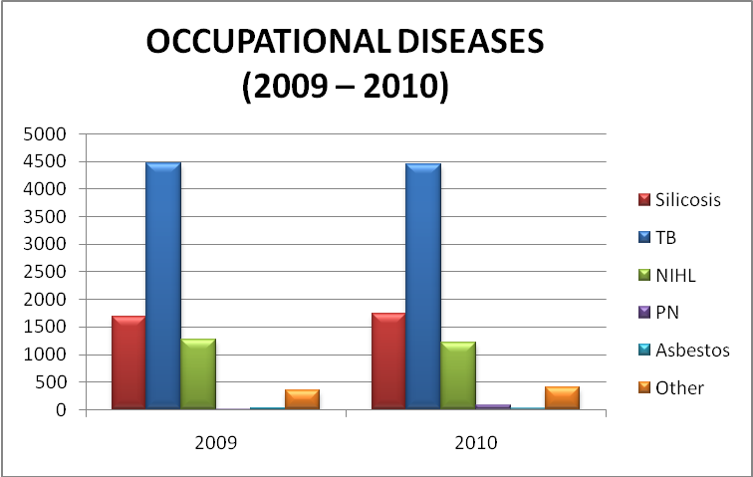
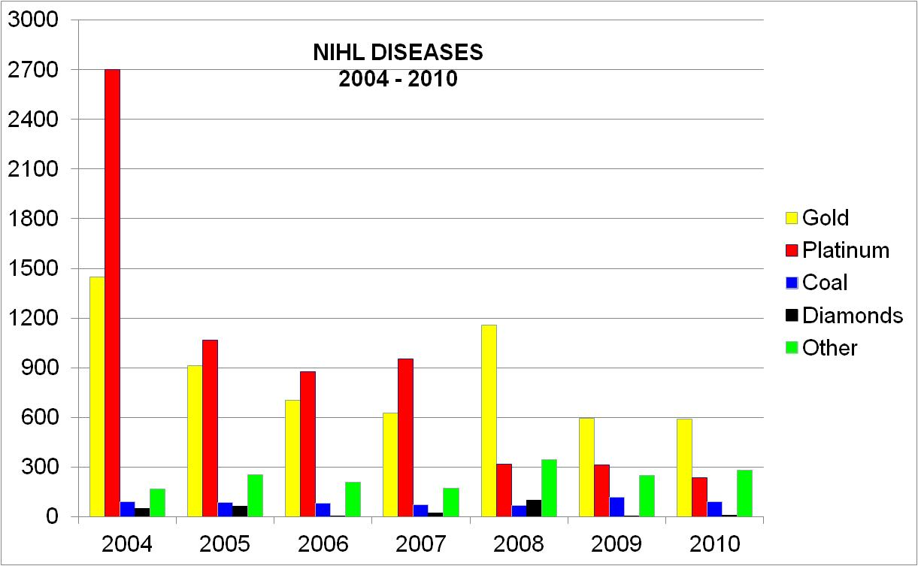
Health - Occupational Diseases
Same areas in the last few years
SILICOSIS
TB
NIHL
Notes:
12

Slide 13
CLINICAL CAUSES OF DEATH
2003 - 2010

Slide 14
(Group representation expressed as a percentage of the total number of clients with pathology, not of the gross overall number of clients)
Notes:
The prevalence of pathology in the sample group is skewed, mainly due the fact that most assessments are performed for placement purposes of new recruits according to their physical and functional work capacity. New recruits mostly present without pathology. This may possibly be attributed to the fact that underlying pathology has not been diagnosed during their initial assessment.
Diagnoses are captured by means of the ICD 10 coding system and grouped according to ICD10 groups. In case of using ICD 10 groups for viewing of the distribution of pathology;
identification of pathology linked to lifestyle (e.g. hypertension, diabetes etc.) is not possible. Primary and secondary diagnoses captured on the database combined were used to report on the prevalence of pathology.
It is however important to note that the presence of medical conditions and injuries cannot be disregarded when performing assessment of work fitness; the risk assessment tool must be sensitive enough to quantify the impact of pathology on actual work capacity.

Slide 15
Implications
Do we have a Noise Problem?? YES
Zero Harm Commitment
Do we have a Nose Problem RELATIVE to other OHS Challenges (Dust, TB, Fatigue and Safety)? NO
NOTE: International standards for Safety = 34 deaths per year (more than 70% of the mark!!!!!)
Noise = ???
Should the Noise Problem compete for space and time with other OHS challenges (Dust, TB and Safety)??
Should we have the have the same approach ??
Is there a need for a Paradigm shift in our approach? YES; WHY?
Hearing Conservation Programs in Mines: where do currently focus? & where should we focus?
Leading the change to zero harm

Slide 16
MOSH Noise Team Initiatives
1st Leading Practice - Noise Elimination (2008)
Electric Drilling Machine
World-wide accepted approach
Not successful
Right answer in a wrong paradigm – Galileo
Is it worth revisiting? YES
2nd Leading Practice - PPE and Administrative Control (2010 -2011)
Hearing Protection Device , Training ,Awareness and Selection Tool (HPD _ TAS)
Only segments of the Leading Practice implemented
Wrong answer in a right paradigm
Is it worth revisiting?
Prof. Cas Badenhorst ‘s MMPA presentation – “It is wrong to protect with PPE and then use medical surveillance to measure our success or failure . Occupational medicine and hygiene as disciplines are not the “silver bullet”
Leading the change to zero harm

Slide 17
MOSH Noise Team Initiatives (cont.)
Engineering Controls
Suite of Leading Practices
Need based approach
Collaboration with suppliers
Should they be the primary focus?
HCP | Leading Practice
Elimination ,Isolation etc | 1st Leading Practice - (Electric Drilling machines)
Engineering Controls | Ongoing - (Suite of Simple Leading Practices)
Administrative Controls | 2nd Leading Practice - (HPD_TAS Tool)
Personal Protective Equip. (PPE)
Leading the change to zero harm

Slide 18
The Direction of the Solution
Occupation | 1997 | 2007
Driller | 111.4 | 105.5
Winch Operator | 98.3 | 92.1
Loco Driver
Shiftboss | 104.9 | 89.7
Miner | 103.2 | 90.4
Stoper | 102.3 | 91.2
Team Leader | 104.9 | 93.2
Leading the change to zero harm

Slide 19
The Direction of the Solution
HCP | Current
Elimination ,Isolation etc | 10%?
Engineering Controls | 10%?
Administrative Controls | 10%?
Personal Protective Equip. (PPE) | 70%?
Leading the change to zero harm

Slide 20
The Direction of the Solution
Duty of Care & ALARP Zone
HCP | Current | Future
Elimination ,Isolation etc | 10%? | 60%
Engineering Controls | 10%? | 20 %
Administrative Controls | 10%? | 10%
Personal Protective Equip. (PPE) | 70%? | 10%
Leading the change to zero harm

Slide 21
The Direction of the Solution
Consensus with the Industry on the need for paradigm shift
Consensus on future management of the Noise Problem i.e. need a Paradigm shift (Strategy, ALARP - buy Quiet Policy)
Aligning HCPs and Noise Improvement programs to the suggested approach
Challenges of an employee profile of a Developed Country viz Developing Country – Understanding of quality of life
Do we REALLY NEED a MOSH Noise Team? Viz other pressing OHS Challenges
Implications ??
Manage variation viz IMPACT of variation? – employee profile
Leading Practice Approach?
Leading the change to zero harm

Slide 22
Conclusion
Noise challenge is at a different phase (importance, maturity, tipping point, development, etc) than other MOSH teams and other OH challenges (e.g. MMPA conference)
Need for a different approach
Maybe leading practices need conducive paradigm
Focus on Source Elimination - revisit the electric drilling machine concept
In-depth review
Not as a leading practice but part of Mining System
Longer timelines (>10 yrs)
Report on the new mines, expansion projects etc that are now designed for electric drills
Not as compliance to the Mining Charter
Continue with Engineering controls but not as a primary focus for the MOSH Noise Team
Leading the change to zero harm

Slide 23
Questions
Questions
Leading the change to zero harm

