Slide 1
INTERVENTIONS FOR TB CONTROL: MEASURING TB MORTALITY
Jill Murray
jill.murray@nioh.nhls.ac.za
MMPA Congress Valley Lodge May 2012

Slide 2
?

Slide 4
METHODS TO ASSESS TB MORTALITY
vital registration
verbal autopsies
TBCP register
Completeness of the data
Quality of the data

Slide 7
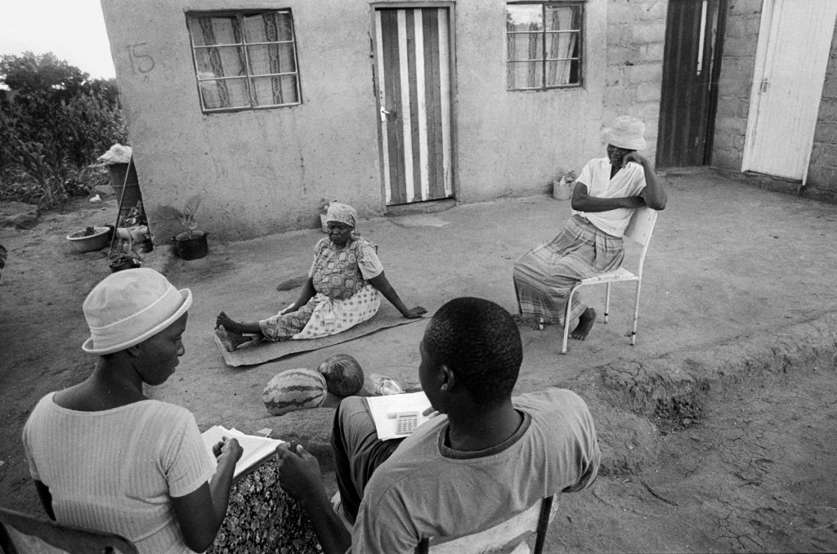
The Verbal Autopsy

Slide 9
THE TBCP REGISTER
Estimation:
Death while on treatment on the register X TB incidence
No of TB cases on the register
430 X 1866 = 205 (per 100,000)
4170
For many reasons this calculation may not include all TB deaths

Slide 11
TABLE 1: Number of cases, rates and outcomes in all cases registered on the TB programme, by year of start of treatment
Year | No. of TB cases n | Rate per 100,000 population |  | Outcomes n (%)
 |  |  | (95% CI) | Cured/ Completed treatment |  | Failed | Died | Default | Transfer | Unknown
1995 | 123 | 638.2 | (530-761) | 88 (72) | 1 (1) |  | 1 (1) | 0 (0) | 3 (2) | 30 (24)
1996 | 129 | 688.1 | (575-818) | 103 (80) | 1 (1) |  | 2 (2) | 0 (0) | 1 (1) | 22 (17)
1997 | 192 | 1037.2 | (896-1195) | 161 (84) | 3 (2) |  | 16 (8) | 0 (0) | 1 (1) | 11 (6)
1998 | 158 | 887.0 | (754-1037) | 117 (74) | 0 (0) |  | 18 (11) | 0 (0) | 2 (1) | 21 (13)
1999 | 208 | 1212.1 | (1053-1388) | 169 (81) | 3 (1) |  | 19 (9) | 0 (0) | 5 (2) | 12 (6)
2000 | 276 | 1670.9 | (1480-1880) | 214 (78) | 3 (1) |  | 37 (13) | 1 (0) | 10 (4) | 11 (4)
2001 | 257 | 1657.4 | (1461-1873) | 180 (70) | 11 (4) |  | 20 (8) | 1 (0) | 35 (14) | 10 (4)
2002 | 326 | 2135.0 | (1910-2380) | 212 (65) | 11 (3) |  | 31 (10) | 1 (0) | 67 (21) | 4 (1)
2003 | 346 | 2230.4 | (2002-2478) | 239 (69) | 12 (3) |  | 42 (12) | 5 (1) | 39 (11) | 9 (3)
2004 | 466 | 3118.3 | (2842-3415) | 293 (63) | 15 (3) |  | 62 (13) | 3 (1) | 90 (19) | 3 (1)
2005 | 431 | 3411.7 | (3097-3750) | 292 (68) | 19 (4) |  | 36 (8) | 4 (1) | 80 (19) | 0 (0)
2006 | 382 | 3242.2 | (2925-3584) | 277 (73) | 17 (4) |  | 37 (10) | 7 (2) | 42 (11) | 2 (0)
2007 | 364 | 2582.1 | (2324-2862) | 263 (72) | 7 (2) |  | 41 (11) | 7 (2) | 44 (12) | 2 (1)
2008 | 512 | 3261.1 | (2985-3556) | 346 (68) | 22 (4) |  | 85 (17) | 1 (0) | 46 (9) | 12 (2)
TOTAL | 4170 | 1866.0 | (1810-1924) | 2954 (71) | 125 (3) |  | 447 (11) | 30 (1) | 465 (11) | 149 (4)

Slide 12
Table 2: Summary of TB deaths occurring in the period 1995-2008
 | n | Combined n | Mortality rate / 100,000py | 95% CI
Deaths reported from TB register outcome data | 430 |  | 192.4 | 175.1-211.5
ADD Deaths in those Transferred or Defaulted | 65
 |  | 495 | 221.5 | 202.4-241.9

Slide 13
Table 2: Summary of TB deaths occurring in the period 1995-2008
 | n | Combined n | Mortality rate / 100,000py | 95% CI
Deaths reported from TB register outcome data | 430 |  | 192.4 | 175.1-211.5
ADD Deaths in those Transferred or Defaulted | 65
 |  | 495 | 221.5 | 202.4-241.9
LESS Deaths not due to TB (in programme) | -239
LESS Deaths not due to TB (in transfers/defaulters) | -42
TB-specific deaths on TB register |  | 214 | 95.8 | 83.4-109.5

Slide 14
Table 2: Summary of TB deaths occurring in the period 1995-2008
 | n | Combined n | Mortality rate / 100,000py | 95% CI
Deaths reported from TB register outcome data | 430 |  | 192.4 | 175.1-211.5
ADD Deaths in those Transferred or Defaulted | 65
 |  | 495 | 221.5 | 202.4-241.9
LESS Deaths not due to TB (in programme) | -239
LESS Deaths not due to TB (in transfers/defaulters) | -42
TB-specific deaths on TB register |  | 214 | 95.8 | 83.4-109.5
TB-specific deaths not recorded on the register:
Previously on TB register (i.e. died after treatment completion) | 153
Never on TB register | 307
TB-specific deaths not on TB register |  | 460 | 205.9 | 187.5-225.5

Slide 15
Table 2: Summary of TB deaths occurring in the period 1995-2008
 | n | Combined n | Mortality rate / 100,000py | 95% CI
Deaths reported from TB register outcome data | 430 |  | 192.4 | 175.1-211.5
ADD Deaths in those Transferred or Defaulted | 65
 |  | 495 | 221.5 | 202.4-241.9
LESS Deaths not due to TB (in programme) | -239
LESS Deaths not due to TB (in transfers/defaulters) | -42
TB-specific deaths on TB register |  | 214 | 95.8 | 83.4-109.5
TB-specific deaths not recorded on the register:
Previously on TB register (i.e. died after treatment completion) | 153
Never on TB register | 307
TB-specific deaths not on TB register |  | 460 | 205.9 | 187.5-225.5
TOTAL of TB-specific deaths |  | 674 | 301.6 | 279.9-325.3

Slide 16
SUMMARY OF RESULTS
Multiple types of errors
TBCP register:
Incomplete: counted only 28% of TB specific deaths
Poor quality: only 43% of register deaths were due to TB
Vital registration:
Complete: probably complete
Poor quality: 60% of TB found at autopsy was not diagnosed in life

Slide 17
Industry wide we have excellent data for fatalities due to mine accidents
If we can do it for accidents why can’t we do it for TB - the big killer of miners?

Slide 18
ACKNOWLEDGEMENTS
We thank Drs Lettie la Grange, Charles Mbekeni and Lesego Rametsi
(Anglo Platinum) for assisting with facilitation of the study and
Dr Andrew Copas (UCL) for statistical advice.
The study was funded by the Colt Foundation, UK

Slide 19
www.nioh.ac.za jill.murray@nioh.nhls.ac.za

Slide 20
Table 3: Comparison of TB mortality estimates in a population of platinum miners from 1995-2008, by year: indirect method (using data from the TB register) versus direct method (data from multiple sources)
Year | Estimated population mortality from TB programme |  |  |  | TB-specific mortality in total population (best estimates from multiple sources)
 | TB incidence | Case fatality | TB mortality (Incidence x case fatality)
 | rate/100,000py | % | n | rate/100,000py (95%CI) | n | rate/100,000py (95%CI)
1995 | 638.2 | 0.8 | 1 | 5.2 (0.7-36.8) | 5 | 25.6 (10.8-62.3)
1996 | 688.1 | 0.8 | 1 | 5.3 (0.7-37.9) | 3 | 16.0 (5.6-49.6)
1997 | 1037.2 | 8.3 | 16 | 86.4 (53.0-141.1) | 19 | 102.6 (65.4-160.9)
1998 | 887.0 | 8.9 | 14 | 78.6 (46.6-132.7) | 20 | 112.3 (72.4-174.0)
1999 | 1212.1 | 8.2 | 17 | 99.1 (61.6-159.4) | 25 | 145.7 (98.4-215.6)
2000 | 1670.9 | 10.1 | 28 | 169.5 (117.0-245.5) | 50 | 302.7 (229.4-399.4)
2001 | 1657.4 | 12.1 | 31 | 199.9 (140.6-284.3) | 42 | 270.9 (200.2-366.5)
2002 | 2135.0 | 9.8 | 32 | 209.6 (148.2-296.4) | 77 | 504.3 (403.4-630.5)
2003 | 2230.4 | 11.3 | 39 | 251.4 (183.7-344.1) | 103 | 663.9 (547.4-805.4)
2004 | 3118.3 | 11.8 | 55 | 368.0 (282.6-479.4) | 68 | 455.0 (359.8-577.1)
2005 | 3411.7 | 10.7 | 46 | 364.1 (272.8-486.1) | 64 | 506.6 (396.5-647.3)
2006 | 3242.2 | 8.6 | 33 | 280.1 (199.1-394.0) | 32 | 271.6 (192.1-384.1)
2007 | 2582.1 | 10.7 | 39 | 276.7 (202.1-378.7) | 76 | 539.1 (430.6-675.0)
2008 | 3261.1 | 15.2 | 78 | 496.8 (398.0-620.3) | 90 | 573.3 (466.3-704.8)
TOTAL | 1866.0 | 10.3 | 430 | 192.4 (175.1-211.5) | 674 | 301.6 (279.7-325.3)

Slide 22
Figure 1: Cause of death determined by autopsy in men who died in the TB programme (n=269)

