Slide 1
OCCUPATIONAL HEALTH (in the context of NHI)
MMPA Congress
19 May 2012

Slide 2
Overview
The proposed NHI
Funding & Delivery of Health Care in the context Workplace Programmes (focus on mining)
Macro - level
Meso - level
Micro - level
Conclusion

Slide 3
POLICY ISSUE ICREFORMS
PUBLIC
$$(4.2% of GDP)
R2,766.00 per capita
R103 billion
PRIVATE
$$$$$$$$$$$$$$ (4.1% of GDP)
R11,150.00 per capita
R113.1 billion (R90 billion + OOP)
Salaries; budget deficit; historical budgets
Fee for Service

Slide 4
CHALLENGES
SA health system is inequitable.............with the privileged few having disproportionate access to health services
Recognition that this system is neither rational nor fair
Current system of healthcare financing is two tiered
Source: 2012 - National Department of Health
Presentation to mining sector stakeholders’ workshop (02 February 2012)

Slide 5
PROPOSED HEALTH REFORMS
To address the fragmentation and inequity requires a healthcare financing mechanism that covers the whole population such as NHI
Furthermore, four interventions need to also happen simultaneously,
a complete transformation of healthcare service provision and delivery;
the total overhaul of the entire healthcare system;
the radical change of administration and management; and
the provision of a comprehensive package of care.

Slide 6
MACRO – LEVEL

Slide 7
FINANCING INTERMEDIARIES (IN 2005 Rand terms)
National Department of Health: 1 billion
Local Departments of Health: 1 billion
Provincial Departments of Health: R45.5 billion
Household out-of-pocket: R16.5 billion (~ underestimate)
Medical Schemes: R54.2 billion
Firms’ direct payments: ± R1 billion
Source: McIntyre D, Thiede M, Nkosi M, et al. A Critical Analysis of the Current South African Health System: SHIELD Work Package 1 report.(2007)

Slide 8
PAUCITY OF DATA ON WORKPLACE PROVISION OF CARE
“ Despite the active role of the private sector in health care provision in the workplace,
sourcing of data proved problematic as it was neither available nor accessible.
Consequently, most of the data were sourced from governments departments, policy
documents, company reports and through personal communication.”
Source: Adams S, Morar R, Kolbe-Alexander T, Jeebhay M. Health and Healthcare in the Workplace. In: Harrison S, Bhana R, Ntuli A, eds. South African Review 2007

Slide 9
THE MINING MODEL – extract from IMSA NHI Policy Brief 15
A 1997 Report:
66 mine hospitals with a total of 6, 088 beds
Extensive primary care facilities
29% reduction in the number of mine hospital beds between 1985 and 1997
Source: Söderlund N, Schierhout G, Van der Heever A. Technical Report to Chapter 13 of the 1998 SA Health Review. A report to Health Systems Trust by the Centre for Health Policy.
A 2006 Report
5 mine hospitals
1, 470 beds (5.3% of the total private beds)
Source: Matsebula T, Willie M. Private Hospitals. In: Harrison S, Bhana R, Ntuli A, eds. South African Health Review 2007. Durban: Health Systems Trust; 2007
IMSA Policy Brief: This reduction over ten years seems unrealistic and it is possible that some
hospitals classed as “independent” or belonging to one of the groups had previously been mine
hospitals

Slide 10
MEDICAL SCHEME MEMBERSHIP (2009)

Slide 11
MACRO-LEVEL – ???
Paucity of data
Under-estimation of funding & provision of health care in the private (not-for-profit) sector
Segmentation
“Not considered a major player in the
funding and provisions of health care”

Slide 12
Meso – level

Slide 13
POLICY DICHOTOMY FOR MINING
Comprehensive & integrated workplace programmes
Health Insurance Market (Private/Social Insurance)
Employee Wellness
(incl. OHC)
Policy shift towards NHI
Mining industry
commitments on health
Push for freedom of choice
(medical schemes)
Chronic Disease Screening, Monitoring
........“Management”

Slide 14
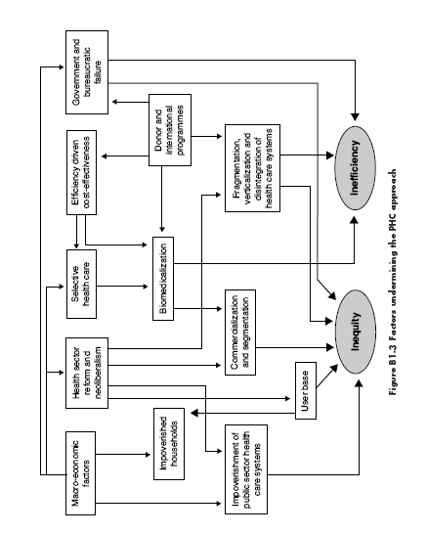
FRAMEWORK: FACTORS THE UNDERMINE THE PHC APPROACH

Slide 15
GEOGRAPHIC LOCATION & EXPANSION
What about the
Families Living
in labour sending
Areas
Loss in economies of scale

Slide 16
MESO-LEVEL – ???
Lack of explicit trade-offs
Employee benefits versus health-related commitments
Under-utilisation/closure of facilities
Segmentation

Slide 17
MICRO – LEVEL

Slide 18
FRAMEWORK ON PRIVATE - PUBLIC FINANCING & PROVISION
 | FINANCE
 | PUBLIC | PRIVATE
PROVISION | (public financing % public provision - traditional public sector role | (private financing & public provision) | PUBLIC
 | (public financing & private provision | (private financing & private provision) | PRIVATE

Slide 19
FRAMEWORK ON PRIVATE - PUBLIC FINANCING & PROVISION
 | FINANCE
 | PUBLIC | PRIVATE
PROVISION | _ | ↑ in Medical Inflation (no provisions) | PRIVATE
 | ↑ in Out-of-Network Provision (Mainly - PMB Driven) ↓ in Internal Global Budgets | ↑ in Medical Aid Contributions ↓ in Capitation Fees | PRIVATE

Slide 20
FRAMEWORK ON PRIVATE - PUBLIC FINANCING & PROVISION
Inputs
Process
Outputs
Facilities
Human Capital
Equipment
IT system
Consumables
Programmes
Clinical Pathways
Clinical
Operational
Ownership
Organisation
Contractual Arrangements

Slide 21
PROVISION OF HEALTH CARE
FUNDING OF HEALTH CARE
Capitation Fees
Statutory Occupational Health programmes
EAP
Emergency Care
Wellness components
Rehabilitation
Capitated Fees
Medical Scheme Contributions
Endogenous component
Closed Scheme
↑ exogenous
component of the budget
Open Scheme
Diminishing Budget/Revenue
Disease Management & Curative Care
HIV & TB Summit Commitments
Surrounding Communities
Differentiated Benefits (by option)

Slide 22
MICRO-LEVEL – ???
Implementation of programmes must take into account the health care setting & structure
Marginal changes in programme processes/outputs places additional burden on current resources
Huge changes in funding arrangements may inevitably lead to a need to review the entire organisation of health care
Trade-offs must be explicit

Slide 23
CONCLUSION: INTEGRATED MANAGEMENT & REPORTING – UTOPIA OR MINE FIELD
During changes in the funding and provision of health care – consideration must be given to macro, meso and micro – level implications
Noble macro objectives can have unintended consequences at a micro level
Different funding and delivery arrangement – affect location, ownership and record-keeping of data
Issues of confidentiality
Workforce Health
Employment Data
Morbidity & Mortality
Wellness/ Disease management
Occupational Health
Rehab
Separation
After Care

Slide 24
Thank you

