Slide 1
MOSH OHS LEADERSHIP…
…beyond ZERO HARM!
Mike Rossouw
June 2012

Slide 3
So What Changed?

Slide 4
As leaders we must see and promote future possibilities…
…even though we might not see how we can get there.

Slide 5
Defining Leadership…
Leadership has been defined by many…
“Leadership is the art of accomplishing more than the science of management says is possible.”
...and General (retired) Colin Powell gives it a pretty good shake.
Notes:
5

Slide 6
MOSH Is NOT a Chamber of Mines Thing!
THE PEOPLE DOING IT FOR THEMSELVES
For the people
By the people
MOSH Identified the biggest reason why people did not adopt is because they did not own the “practice”!
Executive
Industry Structures
Mangers
Supervisors
Team Leads
Team Members
ADOPT - To choose or take as one's own

Slide 7
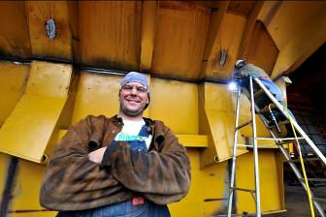
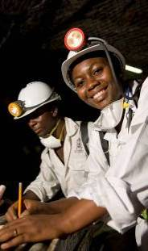
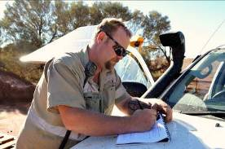
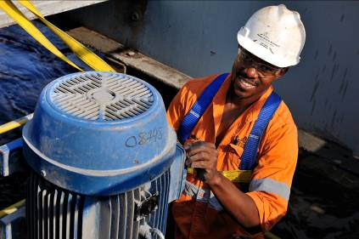
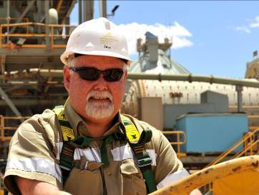
Defining Leadership…its about “PEOPLE”
Leadership is all about people…
“PEOPLE ARE THE BUSINESS”

Slide 8
Four Strategic Aspects of OHS Management

Slide 9
Four Strategic Aspects of OHS Management
Equipment

Slide 10
Four Strategic Aspects of OHS Management
Systems/
Processes
Equipment

Slide 11
Four Strategic Aspects of OHS Management
Systems/
Processes
Equipment
People

Slide 12
Four Strategic Aspects of OHS Management
VISIBLE FELT
LEADERSHIP
Systems/
Processes
Equipment
People

Slide 13
Its all about People Stupid
VISIBLE FELT
LEADERSHIP
Systems/
Processes
Equipment
People
+ 95%

Slide 14
If you are the Experts on People What are you doing About People and OHS?

Slide 15
Thank You

