Slide 1
MOSH NOISE TEAM Activities
6November 2012

Slide 2
Discussion Points
Background
Noise Team Activities
Future Activities

Slide 3
Background
1st Leading Practice - Noise Elimination (2008)
Electric Drilling Machine
Potential to reduce noise by 6 dBA
Source Mine : AngloGold Ashanti – Tau Tona
Demo Mine : Moab Khotsong
Adopters : None other than the Demo Mine
Not successful for various reasons
Readiness for adoption:
Required substantial R&D: only available for stope drilling
Cost constraints:
Required substantial refinement that proved to be expensive
Only Leasing Option available
Other:
“Climate” – “Energy crisis” paved the way for selection as leading practice.

Slide 4
Background
1st Leading Practice (cont.)
Concept worth revisiting
It is the ultimate Goal – part of zero harm
Long term view
Involving OEMs & Research institutions
Current Noise at source - ± 108 dBA
2013 Milestone : < 110 dBA & 2008 Milestone
Legal Requirement : Noise Exposure: 85 dBLAeq,8h
Shortfall: 25 dBA to be compensated for by HPDs

Slide 5
Background
2nd Leading Practice - PPE and Administrative Control (2010 -Current)
Hearing Protection Device, Training, Awareness and Selection Tool (HPD _ TAS)
Enables Occupational Hygienists to select the correct HPD per occupation based on noise exposures
Training and awareness material – an explanation on the effects of noise, hearing protection devices and the usage, care and maintenance
Only segments of the Leading Practice gets adopted & integrated into HCP programs
Few Mines have fully adopted

Slide 6
Background
Fundamental Challenges
Preventing Hearing loss versus Preventing Compensating for hearing loss
Paradigm shift
Improved but plateauing NHIL compensation figures (RMA)
Noise has a lower priority compared to other Safety challenges (FoG, fatigue, T&M etc) and OH ( TB, HIV, Dust)
Emphasis should be on Source Elimination

Slide 7
Discussion Points
Background
Noise Team Activities
Future Activities

Slide 8
MOSH Basics
Fully functioning Industry Team
Adopted Expert Model
Shared understanding of the hazard and risk being addressed
‘Actual’ cost of noise (R14K/employee/year Vs. R60K/employee/year)
Shared understanding of a comprehensive ‘Buy Quiet Policy’

Slide 9
HPD TAS Tool
Promotion of the Adoption of the Tool
5 Adopters
12 Implementers
27 Partial Adopters
Interest Group and future COPA
Creation of Mine Adoptions Teams (Xstrata & Impala)
Customization of Leadership Behaviour and Behavioural Communication Plans

Slide 10
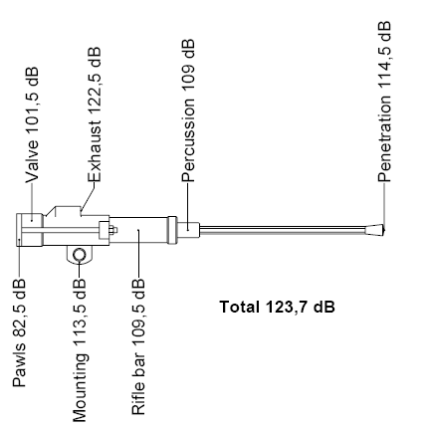
Source Elimination
Current Machines - Drilling
Noise sources are, Exhaust noise, Mechanical noise, Drill steel ringing, Steel on steel on rock, ambient noise, vibration and Echo
Current focus is on exhaust muffling initiatives
Five more noise sources that can be leveraged
Interaction with Research institutions, T&M Team, OEMs

Slide 11
Source Elimination
Current Machines – other Equipment
Assist the Industry with a source elimination Repository
Some initiatives will be candidates for the new leading practice
Source Elimination - Future mines and expansion projects
Not explicitly catered for by MOSH process
Forum where to influence the direction towards the usage of quieter rock breaking mechanisms such as hydraulic, electric drills
The decision to use quieter rock breaking mechanisms is part of mine design and feasibility studies hence the benefits will be longer-term side
Drilling Selection tool

Slide 12
Discussion Points
Background
Noise Team Activities
Future Activities

Slide 13
Future Activities
Source Elimination – Current Machines
Collaborate with T& M Team and CM& CCs , MHSC, University of Pretoria & other research institutions – OCT 2012
Regular progress reports at Industry Team Meetings
Source Elimination - Expansion projects and new mine
Discussion with the MOSH Taskforce - 19 Oct 2012
Obtain a list of design personnel from the MOSH Taskforce – 16 Nov 2012
Drilling Selection Tool - Nov 2012
Regular progress reports at Industry Team Meeting
HPD TAS Tool
Daft Assessment Tool –Sept 2012
Assist the adopter and Implementers – Jan 2013
Facilitate Interest group activities – Nov 2012
Regular progress reports at Industry Team Meetings

Slide 14
Future Activities
Source Elimination Repository
Compile summary of the practices and contact personnel - 14 Nov 2012
Source elimination repository on MOSH website - 14 Nov 2012
Industry Team Meetings & Workshops
1st Industry Team Meeting - 26 Sept 2012
2nd Industry Team Meeting - 14 Nov 2012
Industry Team Workshop - 13 February 2013
3rd Industry Team Meeting - 13 Mar 2013
4th Industry Team – 15 May 2013
5th Industry Team - 14 August 2013
Thanks Harmony - for Hosting & Presenting

Slide 15
Questions

